Slide 1
AMUL
AMUL LOGO REDESIGN
A Modern Visual Exploration of an Established Dairy Brand
LOGO REDESIGN
AMUL
Three concepts • One preferred direction
Aaina Anand | CodeAlpha Graphic Design Internship
Independent student concept redesign for educational purposes only • Not affiliated with or endorsed by Amul

Slide 2
Project Overview
CODEALPHA • 2/7
Understanding the brand before redesign
•
Amul is a well-known dairy brand with a recognisable red-and-white identity.
•
This student project explores alternative visual arrangements while keeping the brand name prominent.
•
The aim is to practise design thinking—not to present an official brand change.
Independent student concept redesign for educational purposes only • Not affiliated with or endorsed by Amul

Slide 3
Design Objectives
CODEALPHA • 3/7
What I wanted to achieve
•
Create clean and readable logo variations.
•
Explore different layouts and visual balance.
•
Use contrast and typography to keep the brand name clear.
•
Compare concepts before selecting a preferred direction.
Independent student concept redesign for educational purposes only • Not affiliated with or endorsed by Amul

Slide 4
Concept Exploration
CODEALPHA • 4/7
Three visual directions
•
Variation 1 — circular red badge with white wordmark.
•
Variation 2 — red rounded rectangle with white wordmark and a separate subtitle.
•
Variation 3 — light cream/yellow background with a circular icon and wordmark.
VARIATION 1
VARIATION 2
VARIATION 3
Independent student concept redesign for educational purposes only • Not affiliated with or endorsed by Amul

Slide 5
Selected Concept
CODEALPHA • 5/7
Preferred direction: Variation 2
•
The red rounded rectangle creates a clear focal point.
•
White lettering contrasts strongly with the red background.
AMUL
•
The subtitle sits separately below, making the layout easy to scan.
•
Selection is based on my design judgement for this student exercise.
Independent student concept redesign for educational purposes only • Not affiliated with or endorsed by Amul

Slide 6
Design Rationale
CODEALPHA • 6/7
Colour, type and composition
•
Red: strong visual emphasis and connection to the familiar brand palette.
•
White: clear contrast for the main wordmark.
•
Black/dark text: readable supporting label.
•
Rounded shape and centred alignment: a simple, balanced composition.
RED
WHITE
DARK TEXT
Independent student concept redesign for educational purposes only • Not affiliated with or endorsed by Amul

Slide 7
Learning & Conclusion
CODEALPHA • 7/7
What this project helped me practise
•
Logo composition and layout exploration.
•
Typography, alignment and colour contrast.
•
Comparing options and making a design decision.
•
Thank you for viewing my project!
Independent student concept redesign for educational purposes only • Not affiliated with or endorsed by Amul

Slide 8
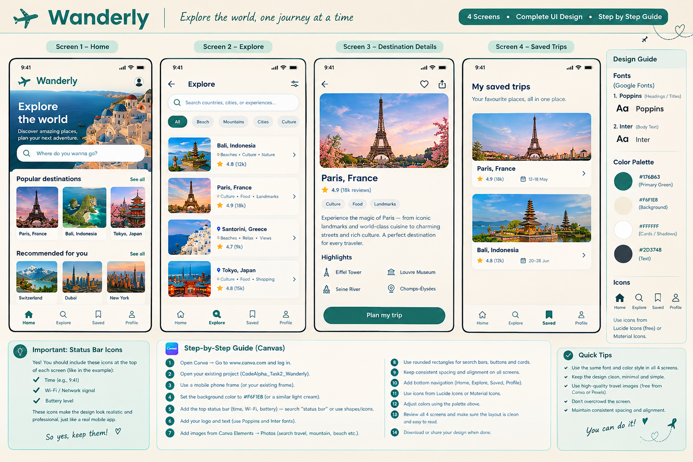
✈ WANDERLY
Travel App UI/UX Design
Discover, Save and Plan Your Next Adventure
4 mobile screens • Discover • Explore • Save
Aaina Anand | CodeAlpha Graphic Design Internship
Wanderly is a student UI/UX concept • CodeAlpha Graphic Design Internship

Slide 9
Project Objective
CODEALPHA • 2/7
A simple and welcoming travel experience
•
Help users discover travel destinations.
•
Make it easy to browse places and see destination information.
•
Let users keep favourite destinations together in Saved Trips.
•
Use a consistent, mobile-friendly interface.
Wanderly is a student UI/UX concept • CodeAlpha Graphic Design Internship

Slide 10
Four Main Screens
CODEALPHA • 3/7
A connected travel discovery flow
•
Home — travel inspiration and popular destinations.
•
Explore — search and browse destinations by category.
•
Destination Details — destination image, summary, highlights and plan action.
•
Saved Trips — revisit destinations saved for later.
HOME
EXPLORE
DESTINATION DETAILS
SAVED TRIPS
Discover
Browse
Learn & plan
Revisit favourites
Wanderly is a student UI/UX concept • CodeAlpha Graphic Design Internship

Slide 11
Visual Design System
CODEALPHA • 4/7
Consistency across the interface
•
Warm cream background (#F6F1E8) for a welcoming feel.
•
Teal accents (#176B63) for key actions and active navigation.
•
Dark text (#2D3748) for readable content; white cards for separation.
•
Poppins for headings and Inter for body text.
TEAL
CREAM
•
Consistent spacing, rounded cards and bottom navigation.
WHITE
CHARCOAL
Wanderly is a student UI/UX concept • CodeAlpha Graphic Design Internship

Slide 12
Screen Walkthrough
CODEALPHA • 5/7
How the screens support the user
•
Start on Home to find inspiration.
•
Use Explore to search and filter places.
•
Open a destination to review details and highlights.
•
Save favourites and return to them from Saved Trips.
Wanderly is a student UI/UX concept • CodeAlpha Graphic Design Internship

Slide 13
Design Decisions
CODEALPHA • 6/7
What I focused on
•
Clear visual hierarchy so key information is easy to scan.
•
Consistent typography, colours and navigation across screens.
•
Destination photos to make browsing more engaging.
•
Simple actions and card layouts to reduce visual clutter.
Wanderly is a student UI/UX concept • CodeAlpha Graphic Design Internship

Slide 14
Learning & Conclusion
CODEALPHA • 7/7
Skills practised through Wanderly
•
Mobile UI layout and screen organisation.
•
Typography, spacing, colour contrast and visual hierarchy.
•
Designing a consistent multi-screen experience.
•
Thank you for viewing my project!
Wanderly is a student UI/UX concept • CodeAlpha Graphic Design Internship

