Slide 1
WRIST WATCH
ME251A: ENGINEERING DESIGN AND GRAPHICS
Group 3
Aakarshika Singh
Akash Patel
Anuj Chaudhary
Chetan Kalyan
Donga Harika
Himanshu Pandey
Lakshita Mohanty
Parth Patil
Rahul Singh
Md Saif
Satyam Sourav
Savar Kaushik
Tanishka Agrawal
Vinoba Pandey
Dr. Nachiketa Tiwari
Dr. Bishakh Bhattacharya

Slide 2
Material Selection:
The following factors were kept in mind to select the material for the watch:
The Cost of the product.
Long Life of the Product.
Resistance to corrosion.
To avoid the interference of temperature changes to time of the watch.
The materials of the external cover can be changed based on budget.
The detailed report is here: MATERIAL SELECTION

Slide 3
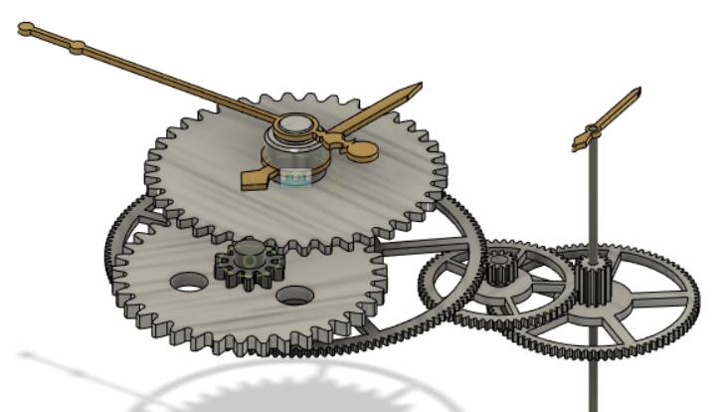
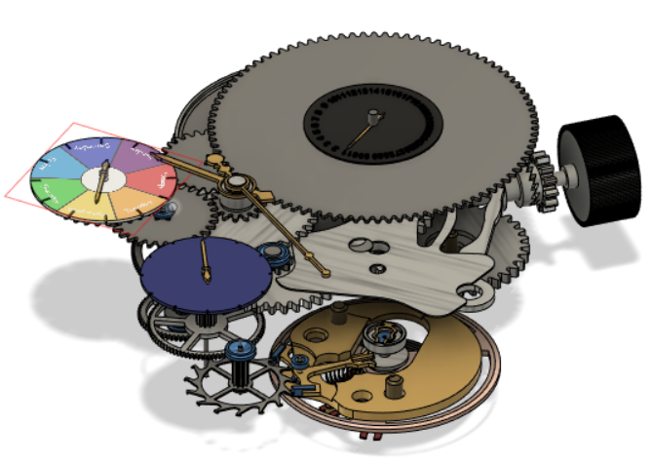
Gear Links:
MOTION WORKS:
Cannon Pinion (C7) drives the Minute Wheel (C11_upper).
It further drives a co-axial gear (C11_lower).
This in turn drives the hour wheel (C8).
WHEEL TRAIN:
MainSpring Barrel (C67) drives the co-axial gear (C18) of the center-wheel and hence the center-wheel (C19).
This now drives the Third Wheel (C26) and hence the one co-axial (C28) to it.
This drives the gear co-axial (C22) to the Fourth wheel and hence the Fourth Wheel (C23).

Slide 4
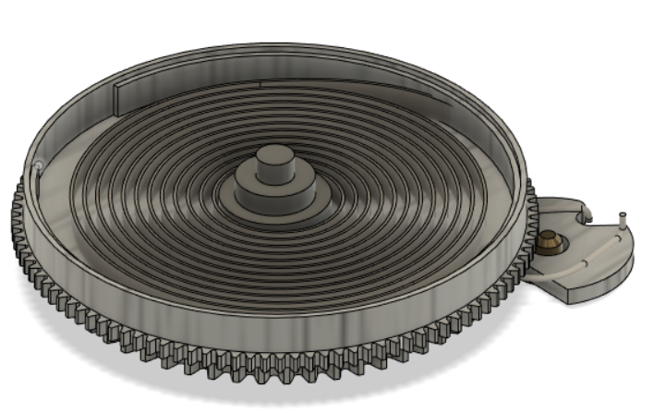
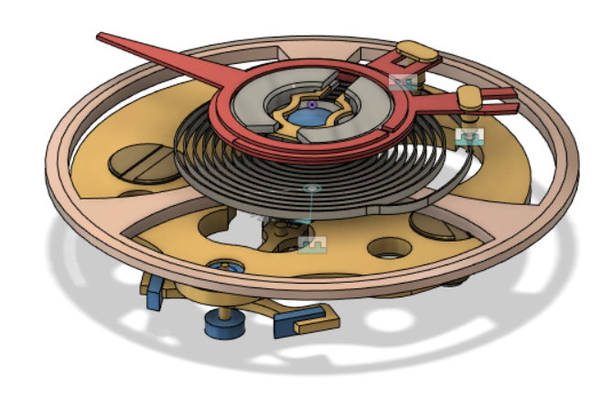
Gear Links:
MAINSPRING ASSEMBLY:
The sliding pinion (C31) drives the crown wheel ring (C78).
This further drives the MainSpring Barrel (C79).
Which compresses the spring and hence stores energy in the same.
This energy is released in increments manner through the coaxial gear (C67).
ESCAPE MECHANISM:
The balance wheel (C37) is supported by a shock-absorbing mounting system containing jewel bearing and capstone.
The regulator (C62, C63, C64) adjusts the active length of the hairspring which adjusts the speed of the balance wheel oscillation.
The escapement (escape wheel and pallet fork) and balance wheel work together to regulate the release of mainspring power in precisely timed increments.

Slide 5
Design Approach:
Research on watch parts.
Basic Analysis and designing of parts.
Calculations for gears & appropriate dimensioning to fit properly.
Divided part assemblies into sub-assemblies.
Completed the entire assembly by joining the sub-assemblies.
Animation on final work.

Slide 6
Calculations:
We have done the gear calculations for hour and minute gear trains as well as for the date and day display.
The report link: CALCULATIONS.
We have also done the calculations needed for the energy stored in the watch: ENERGY.
We have also done the calculation of the time period of the balance wheel: TIME PERIOD.
We have also done the tolerance analysis of the watch: TOLERANCE.
The detailed report of gears: GEARS.

Slide 7
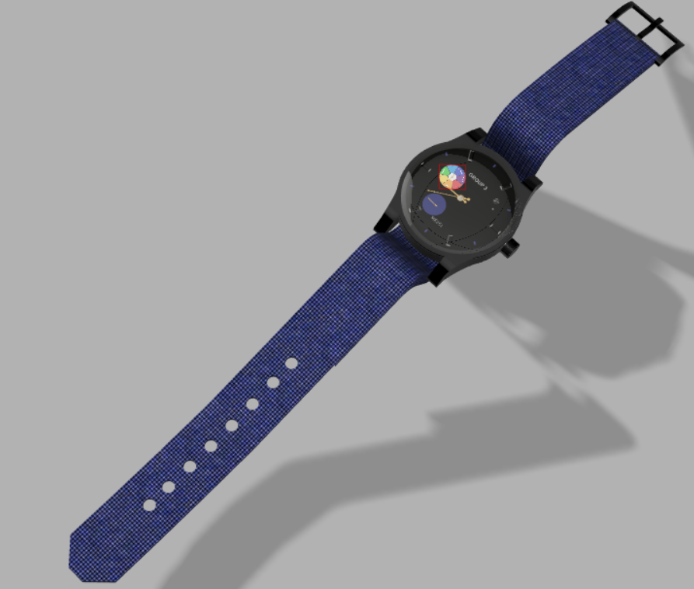
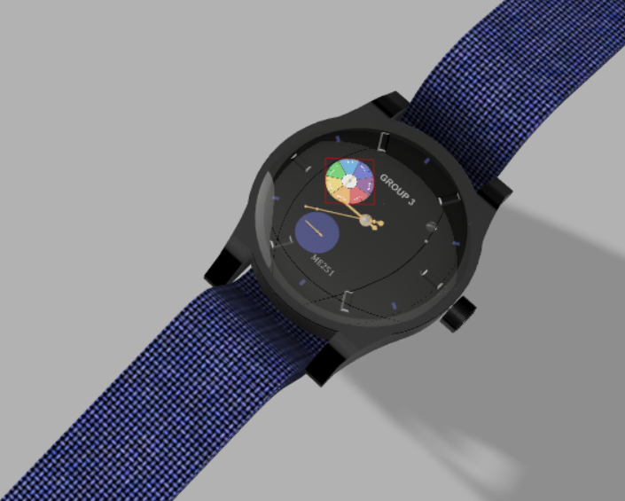
Our final Rendered Watch:
The animation link: ANIMATION.

Slide 8
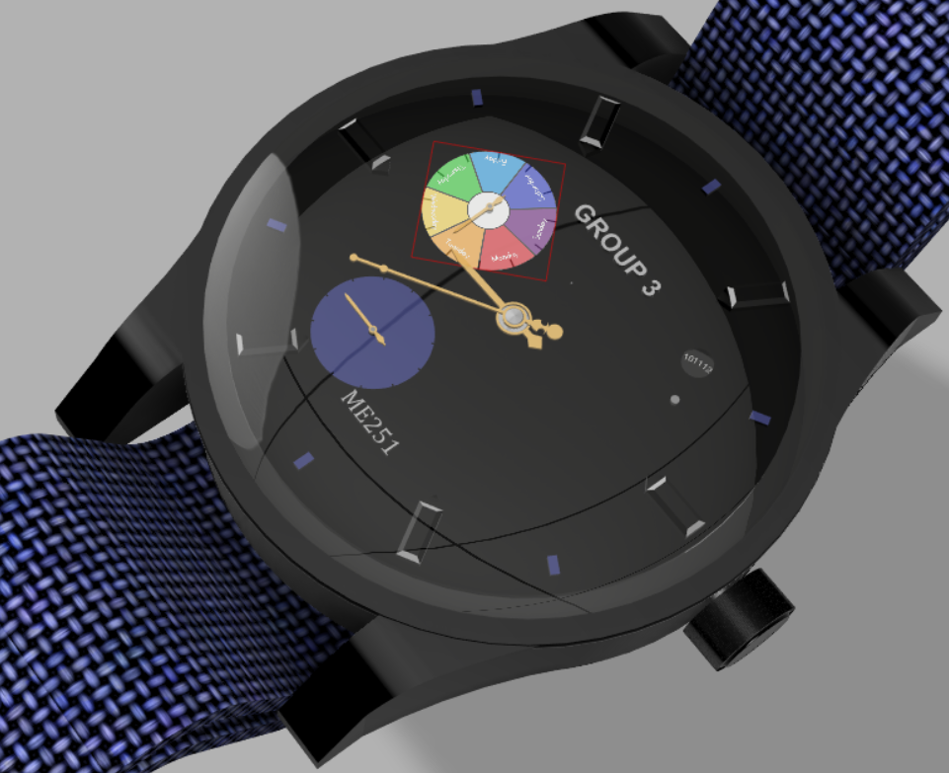
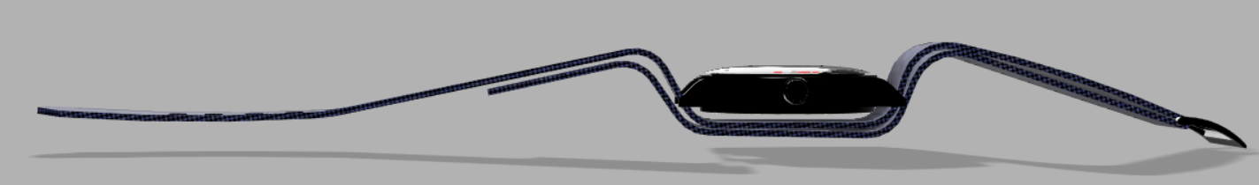
References:
Spur gear calculation tips – Blog CLR
How a Mechanical Watch Works - Animagraffs
How a Mechanical Watch Works - YouTube
HOW IT WORKS: Mechanical Watch - YouTube
Spur Gear Terminology & Formulas | Pitch Diameter, Pressure Angle, [...] (grobinc.com)
Measuring mechanical watches accuracy | by Xavier Noria | Medium
Accuracy of Mechanical watches | FAQs | Customer Service | Seiko Watch Corporation (seikowatches.com)

Slide 9
THANK YOU
In the end, we would also like to thank Professor Nachiketa Tiwari and Professor Bishakh Bhattacharya for giving us such an interesting project through which we have learnt so much.

