Slide 1

Flavors of Choice: Crafting an Intelligent Recipe Recommendation Framework
Team Members
Hari Prasath.C - 920421104025
Aakaash Kumar.M - 920421104001
Shiyam.A - 920421104094
2021-2025 Batch
Guided By,
Dr.A.Meenakshi HOD/CSE

Slide 2
CONTENTS
Problem Statement
Introduction
Objective
Literature Survey
Requirement Specification
Methodology
System Design
Module Implementation
Screenshots
Social Impact
References

Slide 3
Problem Statement
To Develop an intelligent recipe recommendation system using advanced machine learning techniques. Analyze user profiles, preferences, dietary requirements, and cooking skills to curate personalized recipe suggestions. Ensure user-friendliness, responsiveness, and adaptability across web and mobile platforms.

Slide 4
Base Paper
Title - RecipeBowl: A Cooking Recommender
Author name(s)-Mogan Gim, Donghyeon Park, Michael Spranger
Journal name- IEEE Access ( Volume: 9)
Year - 2021
Abstract – Create a user-friendly recipe recommendation system using advanced machine learning to analyze user profiles, preferences, and dietary needs. It curates personalized recipe lists based on individual cooking skill levels, adaptable for web and mobile platforms.

Slide 5
Introduction
In today's fast-paced world, individuals are often seeking convenient and diverse meal options that cater to their unique preferences, dietary restrictions, and culinary interests. A recipe recommendation system aims to leverage user preferences and available recipe data to provide personalized and engaging recipe suggestions, enhancing users' cooking experiences and promoting healthier eating habits.

Slide 6
Objective
Diverse Recommendation
Nutritional Considerations
Time-Efficient Recipes
Social Integration

Slide 7
Literature Survey
Title : Cooking Recommender
Methodology : Collect user data, employ collaborative and content-based filtering, and deploy on web and mobile for personalized recipe recommendations.
Limitation : Personalized recommendations improve user satisfaction

Slide 8
Requirement Specification
H/W requirements:
RAM: 1 GB
Processor: Single Core Processor
Operating system: Windows/Android/IOS

Slide 9
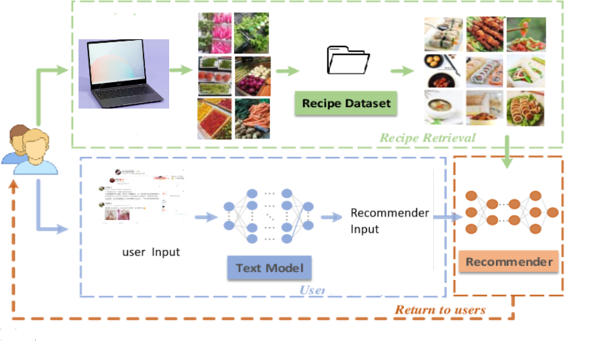
System Design
​

Slide 10
Module Implementation
Data Collection: Gather a large dataset of recipes with detailed ingredients and instructions.
Model Training: Fine-tune the selected NLP model on the recipe dataset to understand recipe structure and style.
User Input Handling: Accept user-specific inputs such as available ingredients, dietary restrictions, and desired cuisine.
Recipe Generation: Utilize the trained NLP model to generate recipes based on user inputs, ensuring they make sense and follow cooking logic. ​

Slide 11
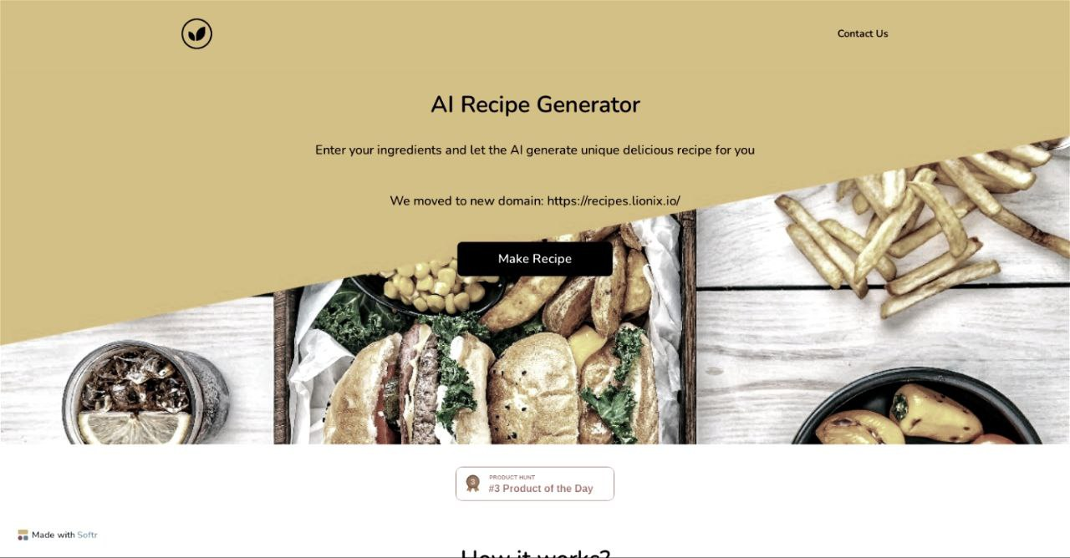
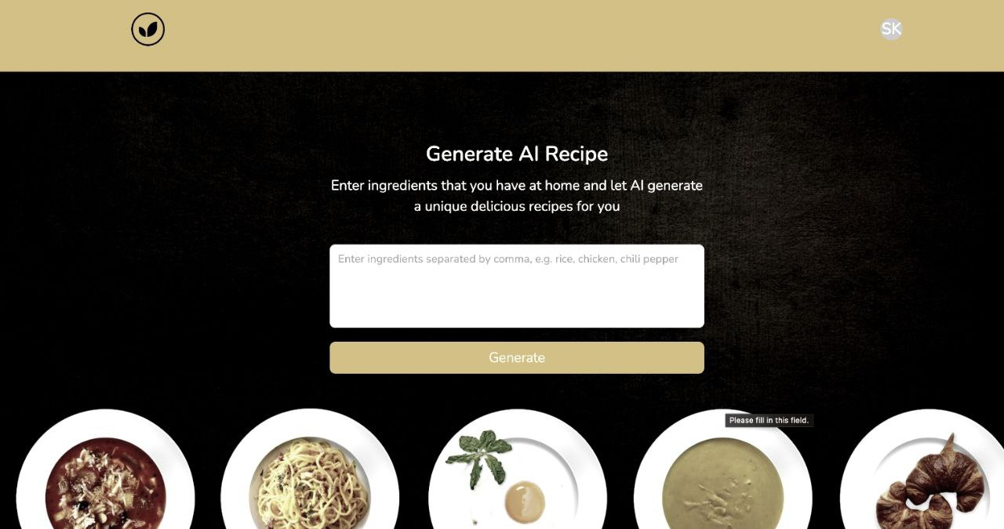
Screenshots/Results
Display the output of your project

Slide 12
Social Impact
Cooking Skill Enhancement
Healthier Lifestyles
Promoting Mindful Eating

Slide 13
References
Semantic-based Thai Recipe Recommendation
Nowadays, people are constantly affected by epidemics such as COVID-19. To reduce the risk of acquiring germs in the community, people's lifestyles have been changed, and they are more inclined to cook for themselves. Typically, people can usually quickly and easily find recipe information via websites and applications.
Publisher: IEEE.

Slide 14
Thank You

