Slide 1

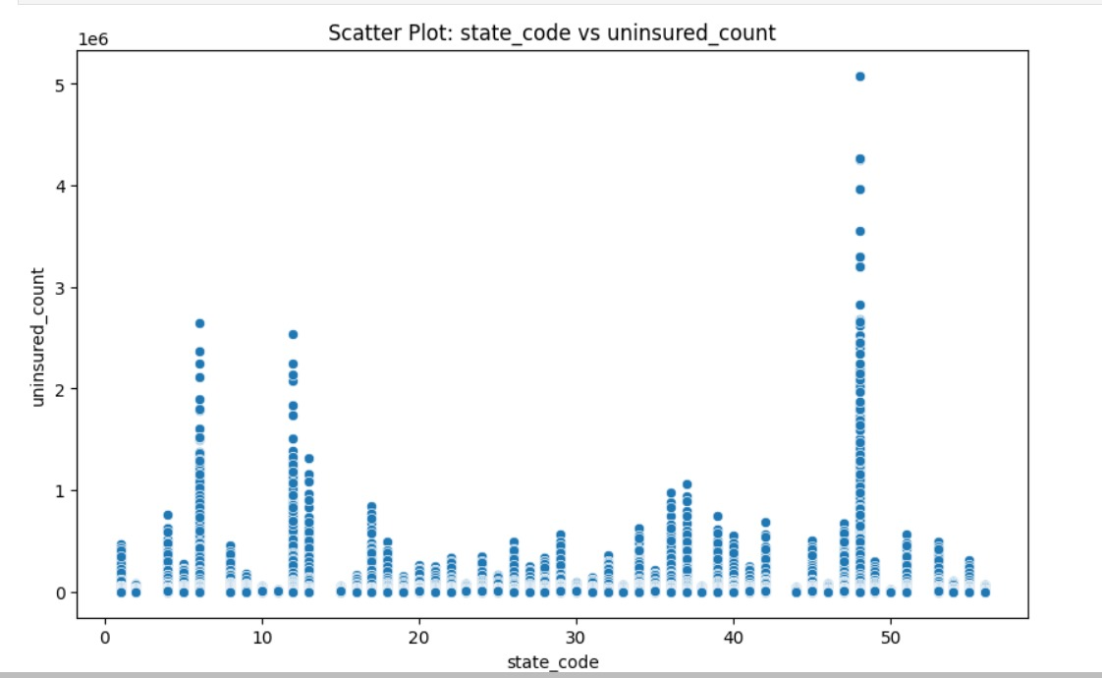
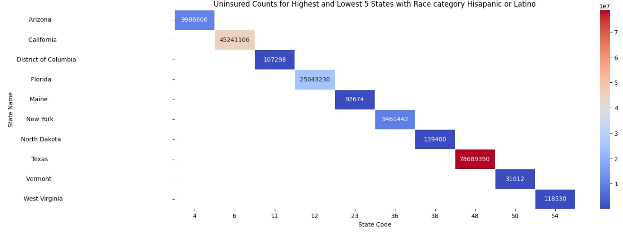
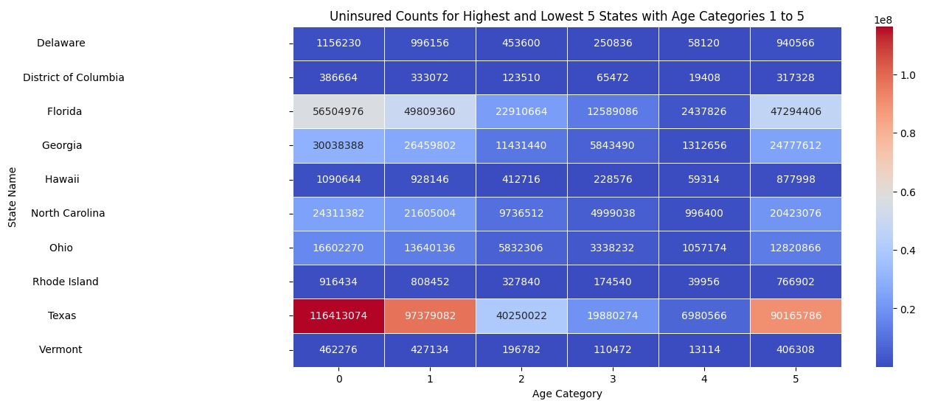
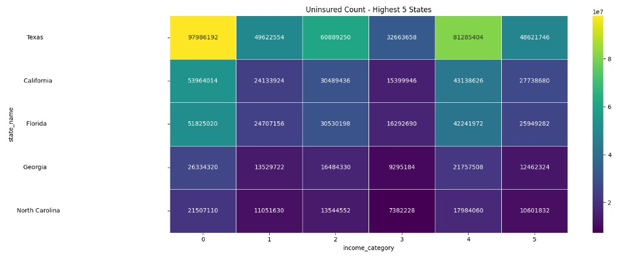
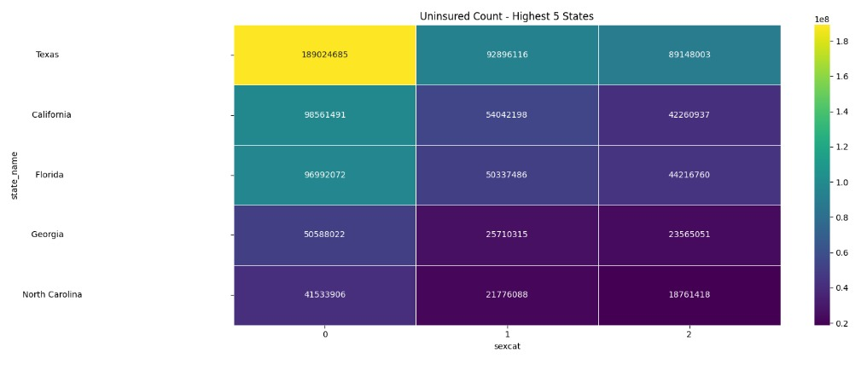
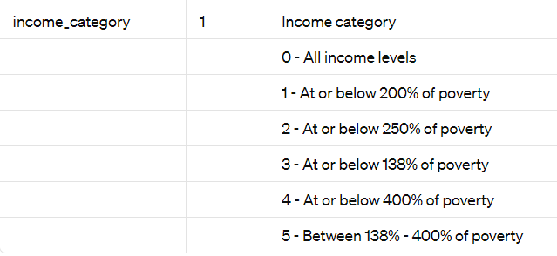
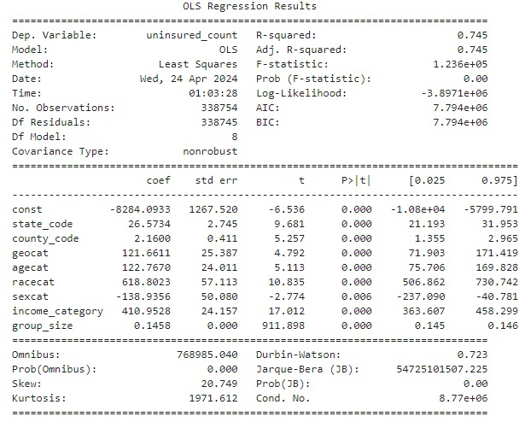
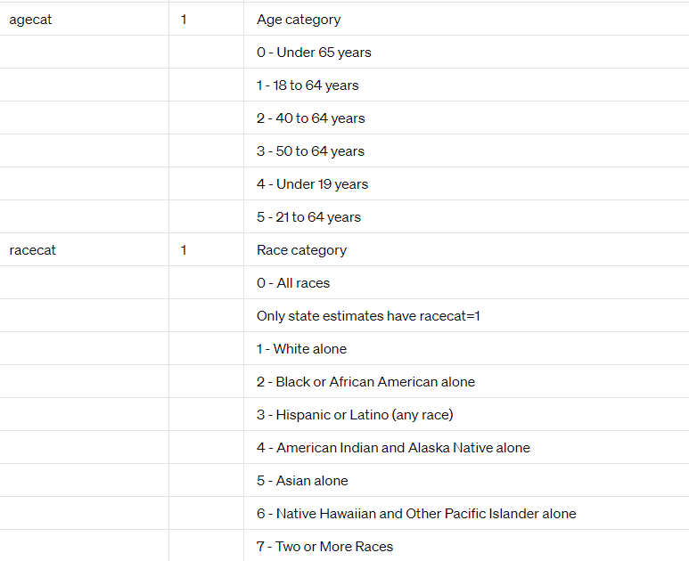
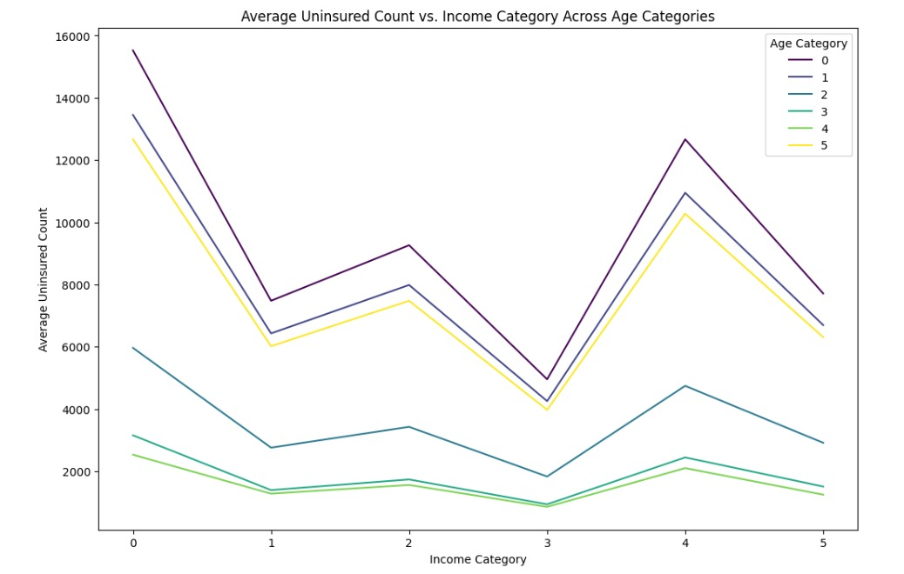
Exploring Health Insurance Coverage across US States IST 652 – Scripting for Data Analysis By: Aakanksha Maheshwari, Mansi Gopani, Het Trivedi
Problem Statement What are the reasons behind the disparity in health insurance coverage among demographic groups and geographic regions in the United States? Data Summary Source: 2021 SAHIE (Small Area Health Insurance Estimates) Program Reference: https://www.census.gov/data/datasets/time-series/demo/sahie/estimates-acs.html Rows: 33,000 Columns: 25 Preprocessing Handling missing values, correcting data types, and renaming columns for clarity.
How does uninsured counts vary across states? Inference: States with codes 6, 12, and 48, namely California, Florida, and Texas, respectively, exhibit the highest numbers of uninsured individuals. Notably, these states are coastal regions adjacent to oceans. The cost of insurance premiums can be notably high, particularly in areas susceptible to natural calamities such as wildfires, and floods. Research Q1: What are the key factors affecting uninsured counts using Regression Model? The model exhibits a 74% accuracy, indicating that a significant portion of the variation in uninsurance count can be explained by the other variables included in the model. Feature Importance: Race Category, Income Category, Gender and Age Category
Research Q2: How does the uninsured population vary among U.S. states, specifically focusing on the race , age, income and gender category?
Research Q3: How does the relationship between income and uninsured counts vary across different age categories?
Overall Analysis: The main reason behind the disparity in health insurance coverage, as explained by our analysis, is that Texas has the highest number of individuals not buying insurance in most demographic categories. Among racial categories, Hispanic or Latino individuals show lower rates of insurance coverage. Among age categories, individuals aged 21 to 64 years have the highest uninsured counts. In the income category, individuals at or below 400% of the poverty level have the highest uninsured counts. Male individuals have higher counts than females in not opting for insurance coverage. According to the research, Texas has a significant population of undocumented immigrants who might not buy insurance. Low wages and high living expenses could be reasons for this analysis. Moreover, limited availability of healthcare providers, particularly in rural regions, compounds the issue by making it difficult for individuals to access necessary care. At or below 400% of the poverty level, we interpret the highest uninsured counts in all age categories.

