Slide 1



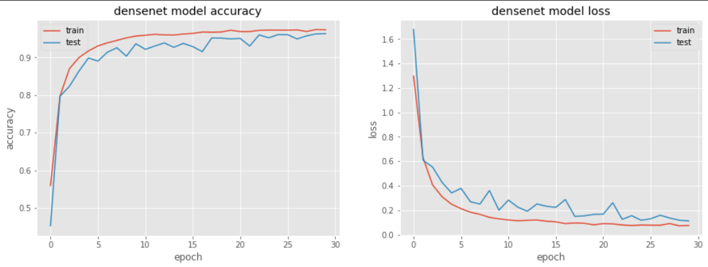

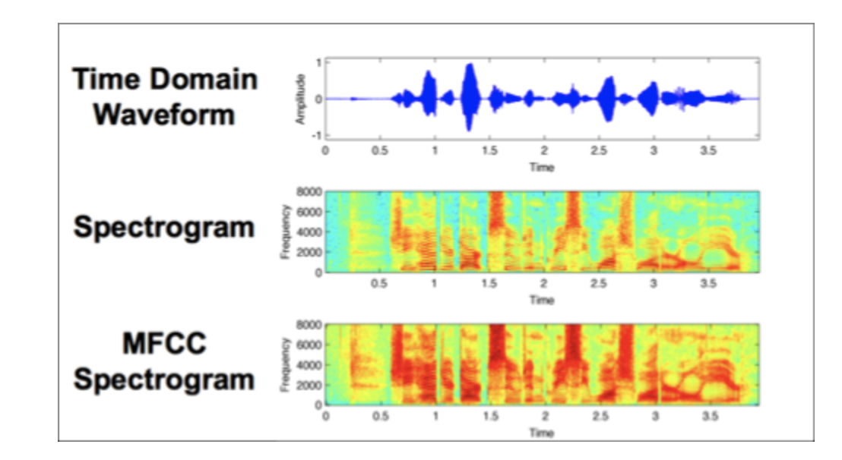
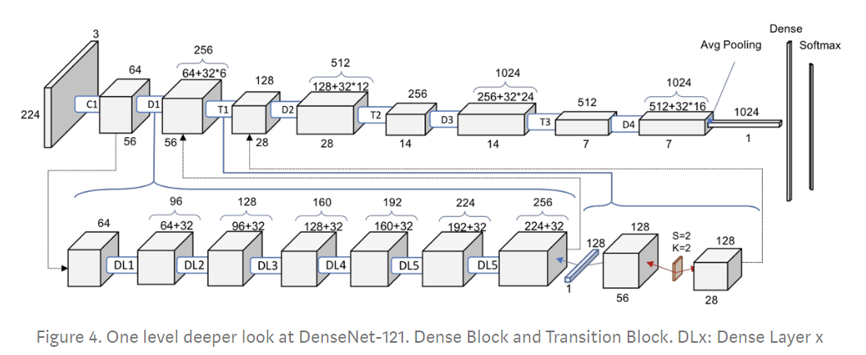
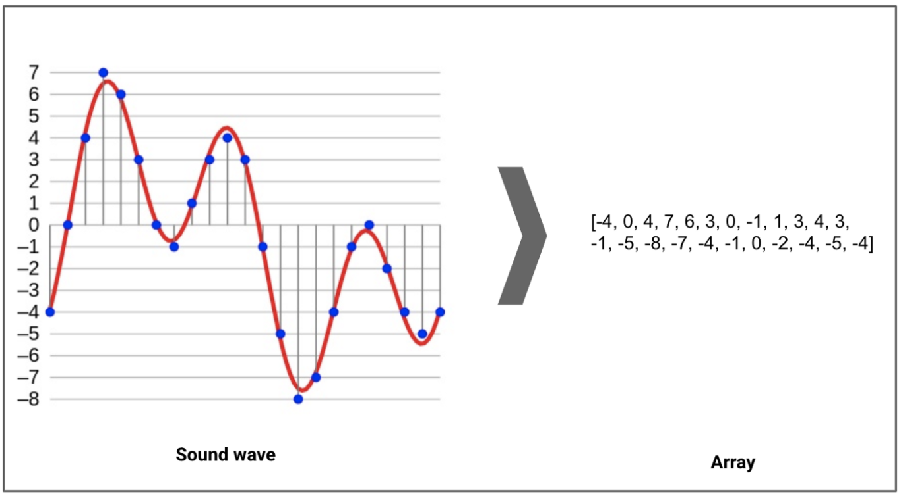
Urban Sound Classification
Srividaya, Bhavya, Aditya G., Aakanksha, Shreyashi, Aditya T., Manish | MSiA 432 Deep Learning | Spring 2020 | Northwestern University
Problem Statement
Technical Approach
Results
Classification of urban environmental sounds through Deep Learning.
Automated sound classification can have applications in,
Assistive devices for hearing impaired individuals
Smart home security systems
Predictive maintenance with airborne sound analysis
The problem is of audio classification and there are a lot of ways to extract information out of an audio clip. Spectrograms are one of the most popular techniques for visualizing the spectrum of frequencies of a sound and how they vary during a very short period. We used a similar technique known as Mel-Frequency Cepstral Coefficients (MFCC), which has recently become a highly recommended technique in the domain of audio analysis.
We propose to train a deep convolutional neural network classifier on carefully extracted visual representations of each of the audio samples to address the task of environmental sound classification.
Analyze the audio files and extract attributes like the number of audio channels, sample rate and bit-depth.
Preprocess the data and extract MFCC spectrograms.
Use cross validation to train the CNN and tune its hyperparameters.
Densenet121 achieved a test accuracy of 96.7% using 40 mfcc features with augmentation methods such as cropping, noise injection, pitch, speed and time shifting.
The model performed well in classifying most of the audio clips. It struggled in differentiating some audio clips of dog barking, gunshot and drilling as they have similar mel spectrograms and discrete cosine transforms. Our activation heatmaps showed that our model pays more attention to certain regions hence learning subtle frequencies and cepstrum features.
The baseline human accuracy is around 99%. Our model does not do that well, firstly mfccs to capture some part the frequency range that is audible to humans(20Hz to 20kHz)and time invariant features within which we humans can distinguish audio samples.
We tried extracting spectral, fourier and cosine transform features, but the model didn’t show much improvement. Constant Q-transform coefficients may improve the results.
The ability of deep convolutional neural networks (CNN) to learn discriminative spectro-temporal patterns makes them well suited to environmental sound classification compared to other approaches. CNNs by design do well in learning patterns inside images which turns out very helpful in this scenario as MFCC spectrograms are very efficient image representations of audio.
Best model:
Model architecture : Densenet121 with top layer removed, followed by a global average pooling,dropout layer, dense layer(256 nodes) with relu activation dropout layer and a 10 node dense layer with softmax was used.
Model hyperparameters: Batch size = 64(we tried 128 and 256), Number of epochs = 30(within 5 epochs the model had a validation accuracy of more than 90%)
Loss - Categorical cross entropy, Optimizer - Adam, Validation split was 33% on training.
Model performed better than VGG16, VGG19 and MobilenetV2 that also got close results.
Model accuracy: Training accuracy: 97.30 , Testing accuracy: 96.70
Model loss: Training loss: 0.0752 , Testing loss: 0.1071
Dataset
This project utilizes the UrbanSound8K dataset compiled from freesound.org.
It consists of 8732 labeled sound excerpts (=<4s) of urban sounds, from 10 classes.
We extracted attributes like the number of audio channels, sample rate and bit-depth and preprocessed the data using Librosa package.
The data size is not very large, which might lead to some loss in generalization of results. This is taken care of through network architecture and hyperparameter tuning
Conclusion
The best model (Densenet121 with augmented MFCC features) was able to achieve a test accuracy of 96.7%
Class imbalance correction using class weights and data augmentation significantly improved model performance
4 x 4 kernels were the best suited to this dataset
RNNs(Bidirectional LSTMs and LSTMs) did not perform as well as CNNs, , possibly since MFCCs are time invariant coefficients
References and Related Work
This dataset is available on https://urbansounddataset.weebly.com/urbansound8k.html
Many people have trained deep learning models such as CNNs, RNNs with LSTMS to classify sounds.
https://arxiv.org/pdf/1805.00237.pdf
http://noiselab.ucsd.edu/ECE228/Reports/Report15.pdf,https://www.preprints.org/manuscript/201811.0509/v1/download
https://arxiv.org/abs/1608.04363
https://www.ijrte.org/wpcontent/uploads/papers/v7i5s3/E11900275S19.pdf

