Slide 1
Project - 8
JOB MARKET ANALYSIS
& RECOMMENDATION SYSTEM
Prepared By:
Akanksha Mishra
Nexthikes IT Solutions

Slide 2
Project Objective and Scope
• Analyze relationships between job-title keywords and offered pay.
• Identify frequent and potentially emerging job categories from posting patterns.
• Examine posting volume over time and evaluate exploratory demand forecasting.
• Compare hourly rates by country while noting sample and currency limitations.
• Build a title-similarity recommendation engine for job seekers.
• Investigate monthly changes and remote-work signals.
• Deliver an interactive Streamlit dashboard packaged with Docker.
02

Slide 3
Dataset Overview
Item | Description
Rows after cleaning | 244,818
Available fields | Title, link, published date, hourly flag, hourly low/high, budget, country
Observed date range | 02 Nov 2023 – 24 Mar 2024
Pay fields | Hourly rates and fixed-price budgets are separate measures
Not provided | Job descriptions, skills, normalized currency, explicit remote field
• Categories are inferred from title keywords, not official labels.
• The short observation window limits durable trend and forecast claims.
03

Slide 4
Analytical Workflow
01 Load & clean
02 Explore
03 Analyze
Types, missing values, duplicate links
Contract types, countries, dates, pay
Categories, pay, remote signals
04 Model
05 Present
06 Deploy
Forecast evaluation and TF-IDF
Streamlit dashboard and exports
Docker image and runtime
04

Slide 5
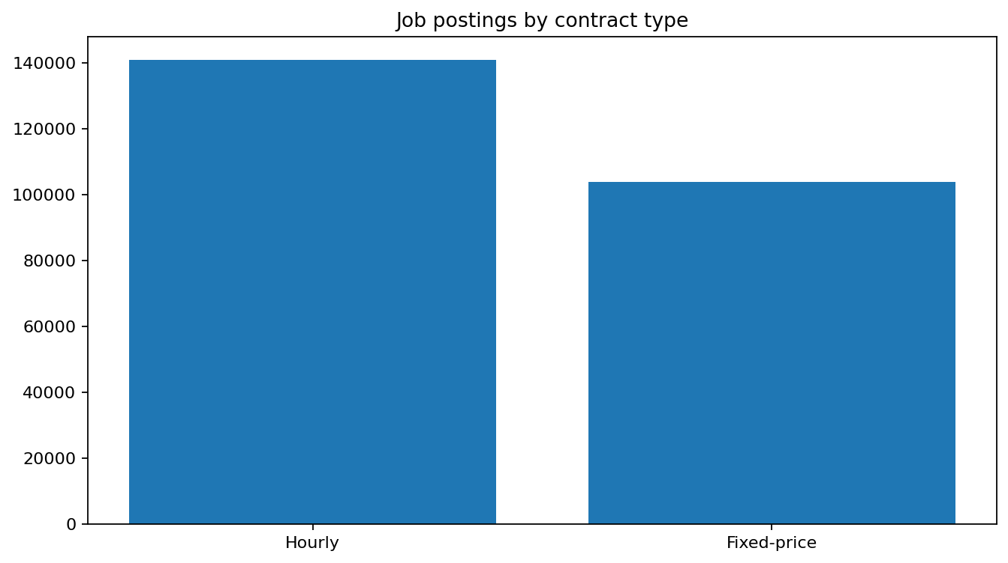
Job Postings by Contract Type
• Hourly postings: 140,935.
• Fixed-price postings: 103,883.
• Unclassified contract type: 0.
• Hourly rates and fixed-price budgets must be analyzed separately.
05

Slide 6
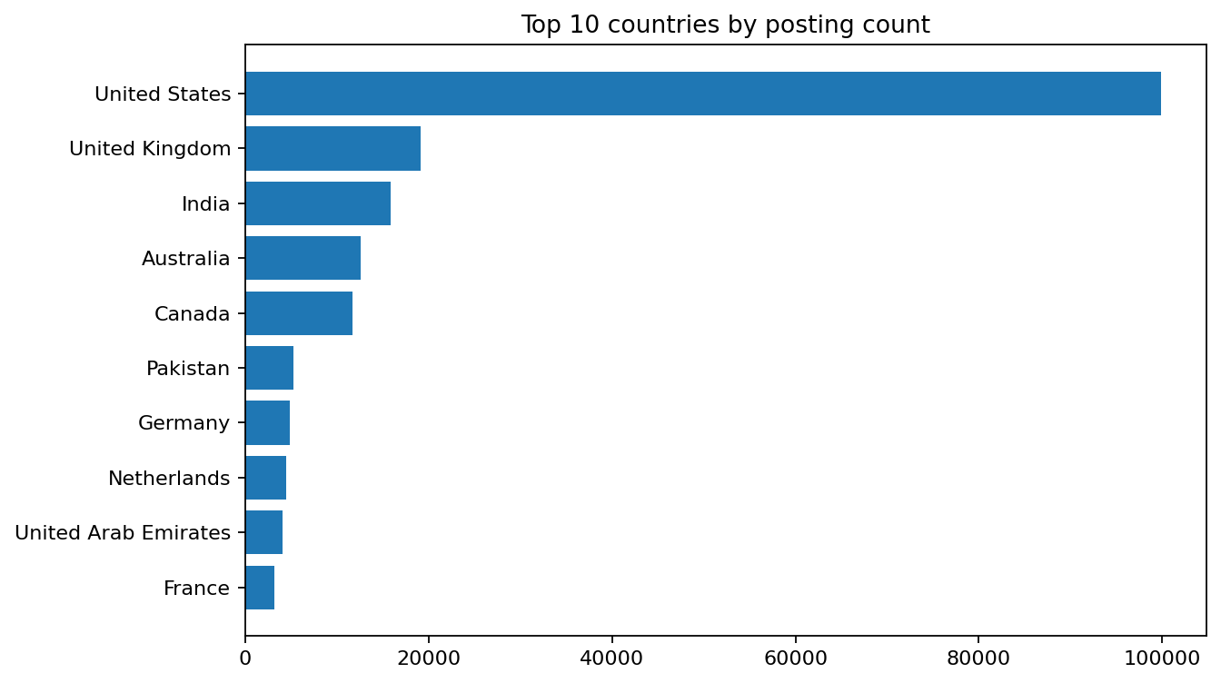
Where Are the Jobs Posted?
• United States: 99,827 postings
• United Kingdom: 19,148 postings
• India: 15,834 postings
• Australia: 12,618 postings
• Canada: 11,658 postings
• Country is the dataset's location field and may not mean employer headquarters.
06

Slide 7
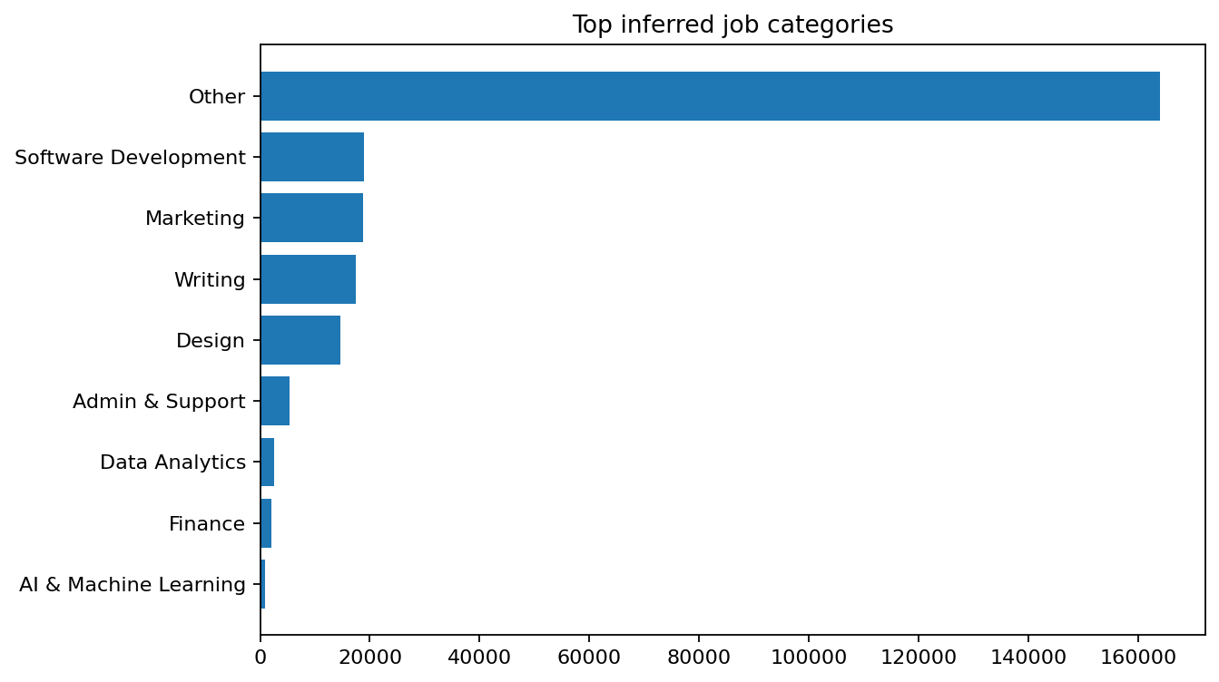
Most Frequent Job Categories
Categories inferred from title keywords
• Other: 164,067 postings
• Software Development: 19,011 postings
• Marketing: 18,825 postings
• Writing: 17,457 postings
• Design: 14,661 postings
• The first matching keyword group determines the category.
• ‘Other’ means no predefined group matched.
07

Slide 8
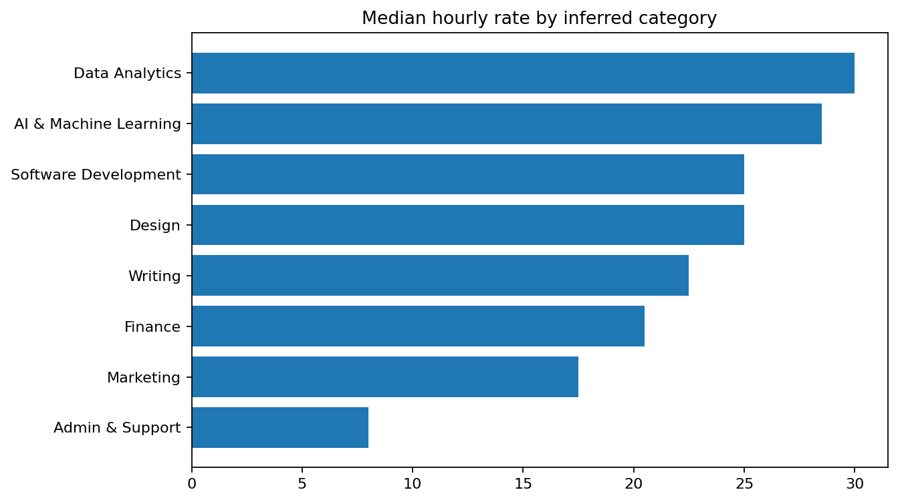
Job Category and Hourly Pay
• Data Analytics: median 30.00 across 1,293 jobs
• AI & Machine Learning: median 28.50 across 376 jobs
• Software Development: median 25.00 across 8,931 jobs
• Design: median 25.00 across 6,295 jobs
• Other: median 23.00 across 62,693 jobs
• Median is less sensitive to outliers than the mean.
• Currency is not normalized; interpret rates cautiously.
08

Slide 9
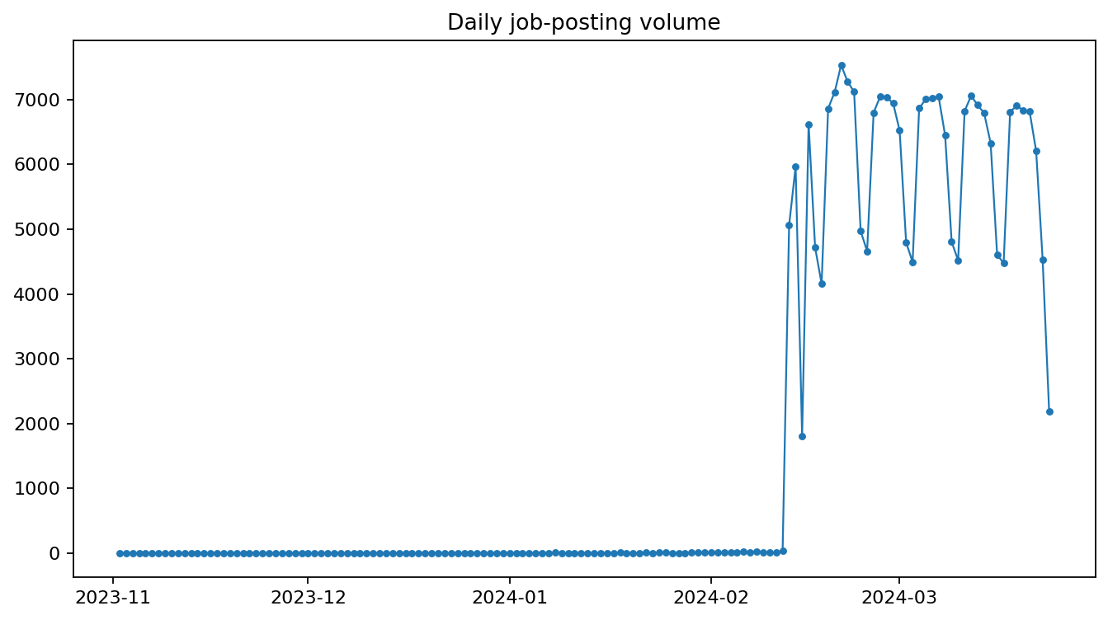
Job Posting Patterns Over Time
• Peak observed day: 21 Feb 2024
• Peak daily postings: 7,534.
• Daily counts can fluctuate with platform activity and collection.
• The short date range is insufficient for seasonal conclusions.
09

Slide 10
Emerging Categories: First Half vs Second Half
Category | First half | Second half | Change
Other | 15 | 164,052 | +164,037
Software Development | 2 | 19,009 | +19,007
Marketing | 1 | 18,824 | +18,823
Writing | 3 | 17,454 | +17,451
Design | 1 | 14,660 | +14,659
Admin & Support | 3 | 5,287 | +5,284
Data Analytics | 0 | 2,515 | +2,515
Finance | 1 | 2,068 | +2,067
AI & Machine Learning | 0 | 923 | +923
10

Slide 11
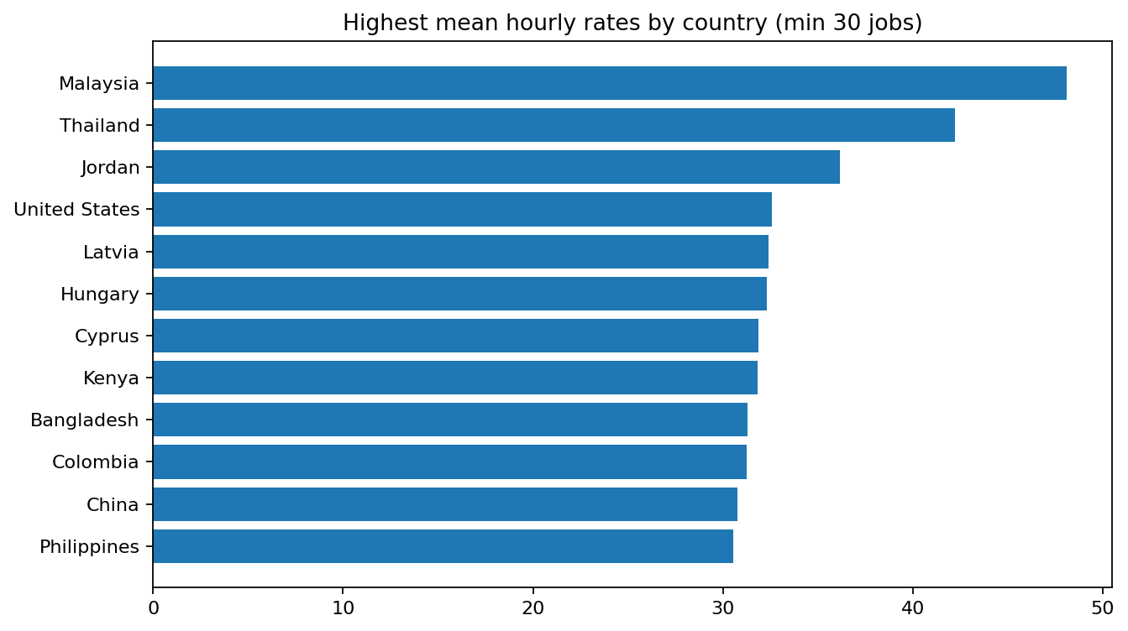
Hourly Rates by Country
Countries with at least 30 usable hourly observations
• Malaysia: mean 48.10 (n=325)
• Thailand: mean 42.21 (n=287)
• Jordan: mean 36.15 (n=55)
• United States: mean 32.58 (n=46,619)
• Latvia: mean 32.39 (n=106)
• Rates may not share a common currency.
• Results are descriptive and do not adjust for role mix or experience.
11

Slide 12
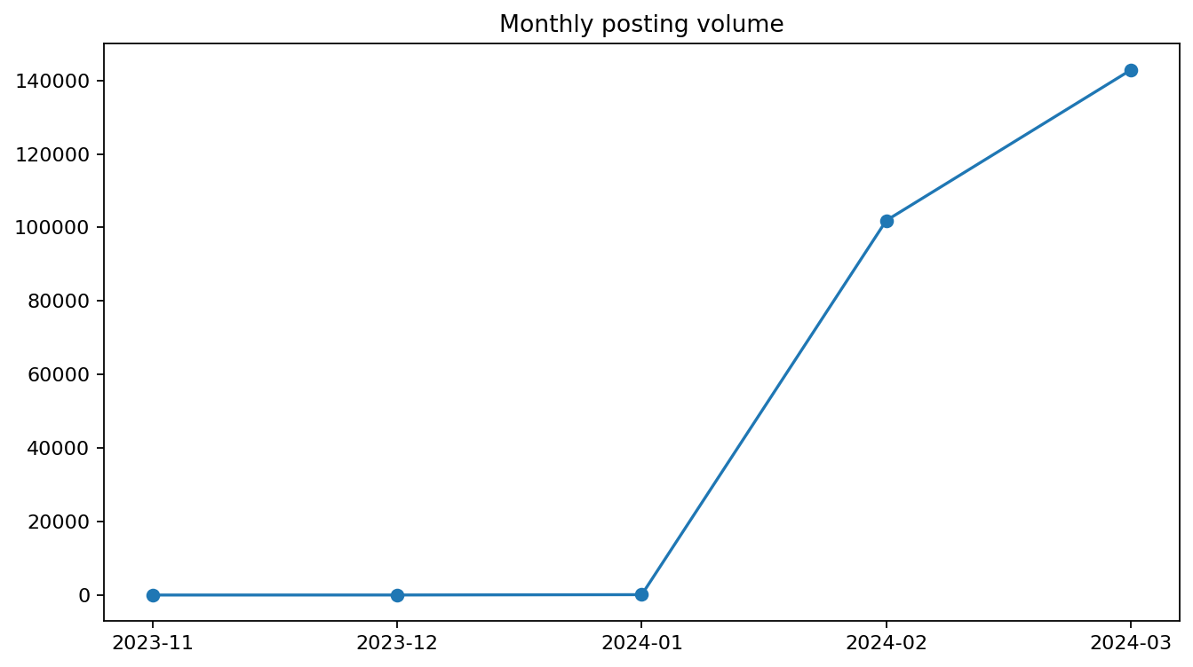
Monthly Job Market Dynamics
• 2023-11: 1 postings
• 2023-12: 10 postings
• 2024-01: 96 postings
• 2024-02: 101,886 postings
• 2024-03: 142,825 postings
• Only months represented in the file can be compared.
• Continued monthly data collection is needed for monitoring.
12

Slide 13
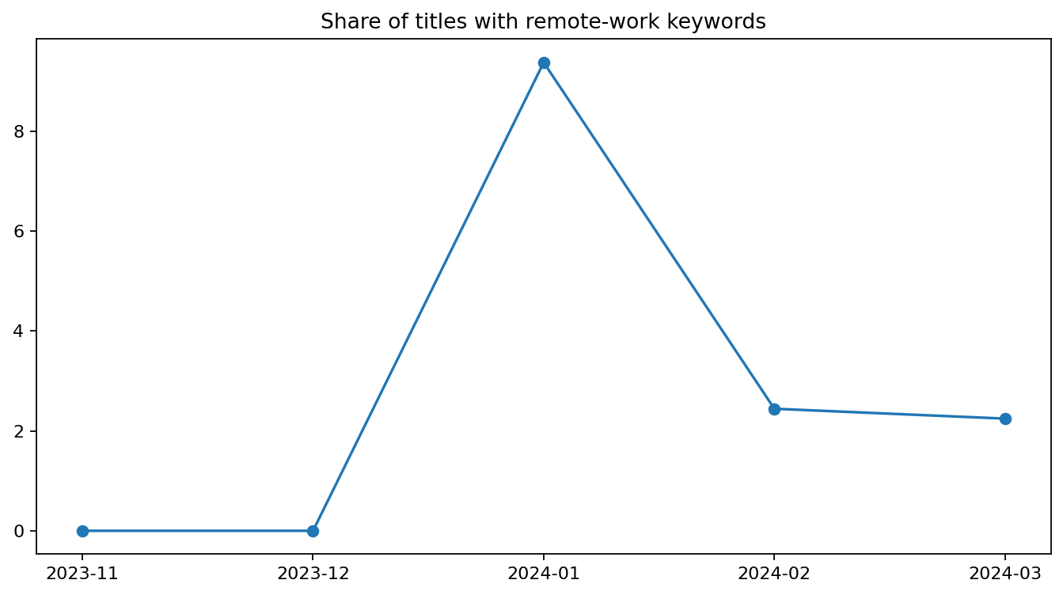
Remote-Work Landscape
• Titles with remote-related keywords: 5,705.
• Share of all postings: 2.33%.
• Keywords include remote, work from home, WFH, anywhere, distributed and virtual.
• Remote jobs may be missed if titles omit these terms.
13

Slide 14
Job Recommendation Engine
Content-based ranking using TF-IDF and cosine similarity
• Input: a job seeker's query, such as “Python data analyst SQL”.
• TF-IDF converts title text into weighted word and phrase features.
• Cosine similarity ranks postings by similarity to the query.
• Results can show title, country, rates, budget, and posting link.
• Title similarity is not a measure of candidate qualifications or hiring probability.
User query
TF-IDF
Similarity
Results
Role or skill terms
Vectorize title text
Rank matches
Show postings
14

Slide 15
Web Application: Streamlit
• KPI cards summarize postings, countries, categories, and median hourly rates.
• Sidebar filters allow country and inferred-category selection.
• Charts display posting frequency, pay comparisons, monthly activity, and remote-title signals.
• Search input returns postings ranked by title similarity.
• CSV download supports further analysis.
Launch command: streamlit run app.py
15

Slide 16
Containerization with Docker
Consistent runtime for local development and deployment
• Dockerfile defines the Python runtime, dependencies, application, and dataset.
• Build image: docker build -t job-market-analysis .
• Run container: docker run -p 8501:8501 job-market-analysis
• Open http://localhost:8501 in a browser.
• Keep the dataset filename consistent in app.py and the Dockerfile.
Project files: app.py • requirements.txt • Dockerfile • source Excel dataset
16

Slide 17
Limitations and Recommendations
• The dataset covers a short period; forecasts and trends are exploratory.
• Categories and remote-work signals are keyword-derived, not ground-truth labels.
• Country rates may use different currencies and are not normalized.
• Job descriptions, skills, experience levels, and candidate profiles are not provided.
• Collect more months of data, add richer fields, validate categories, and evaluate recommendations.
Conclusion:
• The analysis describes posting volume, inferred categories, observed hourly pay, and country patterns.
• The historical snapshot does not establish long-term market certainty.
• TF-IDF demonstrates a practical baseline for title-based recommendations.
• Streamlit makes the analysis interactive; Docker packages it for reproducible deployment.
• Future iterations should use richer data and longer time coverage
17

Slide 18
Thank you
18

