Slide 1
Project – 1 Creating a calculator using Python coding
Akanksha Mishra
Nexthikes IT Solutions

Slide 2
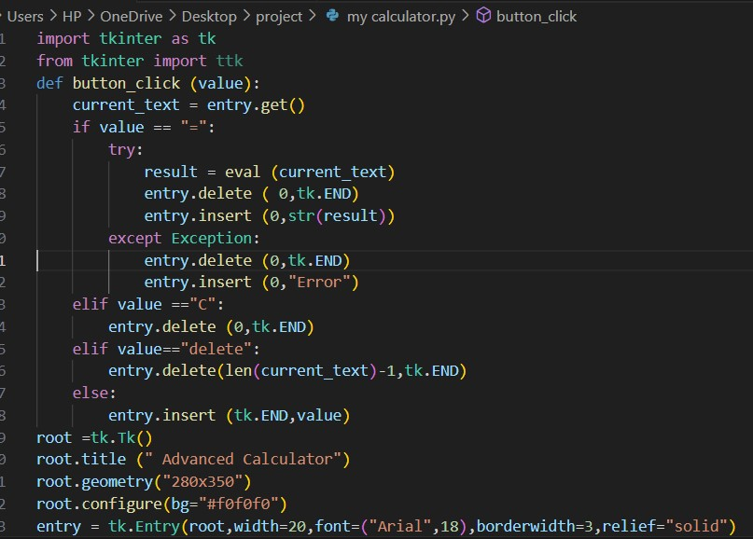
Calculator using python coding
Used python to create calculator because of its simple coding.
It is easy to use for the beginners .
This calculator can perform basic arithmetic operations such as addition, substraction, multiplication and division.
Its interface includes the buttons and screen for numeric presentation and operations .
Used hover code to apply style when user moves the mouse over an element .
Used try and except code to handle the invalid inputs

Slide 3
Overcoming the Hurdles encountered during coding
Faced Syntex and logical errors
Faced challenge in designing and preparing a user friendly interface which should be easy to work and also looks attractive .
Researched and implemented best practices for user interface designs
Implemented a stack based approach to handle the correct order of operations.

Slide 4
Output
Created a basic calculator successfully by using python coding with the help of tkinter which performs basic arithmetic operations.
Learned and gained good experience of using python coding and gui designs.
Will try to add more advanced features and scientific functions.
References
https://www.google.com/url?sa=t&source=web&rct=j&opi=89978449&url=https://www.codingal.com/coding-for-kids/blog/python-project-basic-calculator/&ved=2ahUKEwiJj9z9lsaLAxUnTmwGHZ4uLI0QFnoECB4QAQ&usg=AOvVaw1wSbBzQUMJVBGJohjiwCKb
https://youtu.be/6CZB6VTy3Hg?si=FBbRc10M4M9eAhX4
https://youtu.be/fbxsYcSccJE?si=cak1OFyVJd2-jHK8

Slide 5
Thank you

