Slide 1
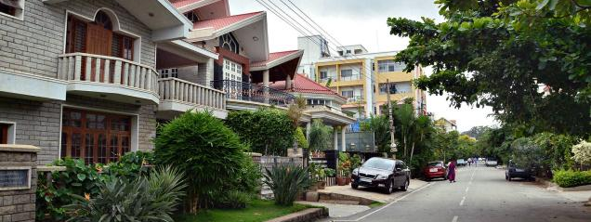
Eco You
Aakanksha Parameshwar
Promoting sustainability in neighborhoods through better waste management

Slide 2
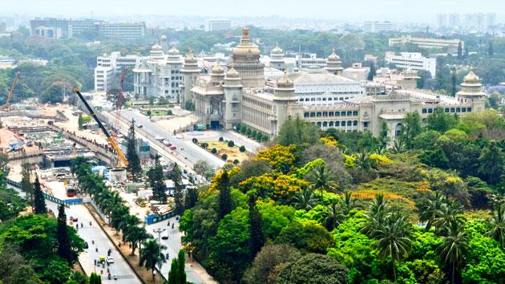
My City - Bangalore
BEFORE

Slide 3
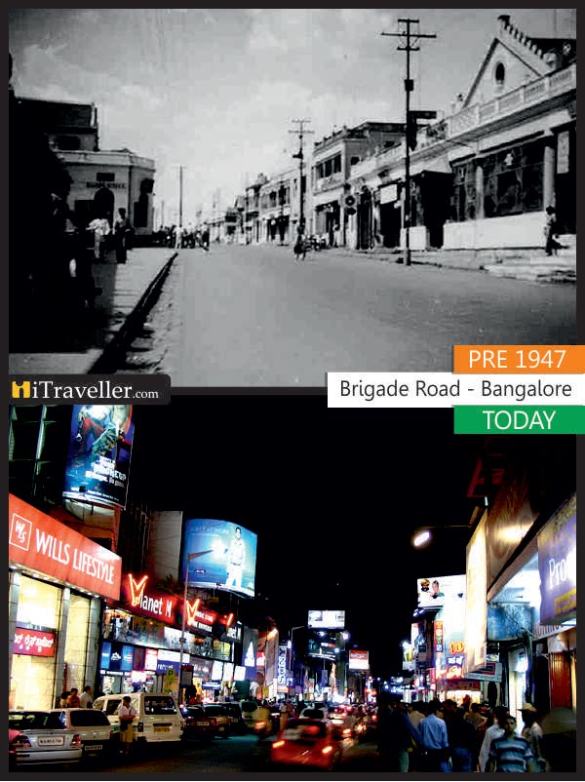
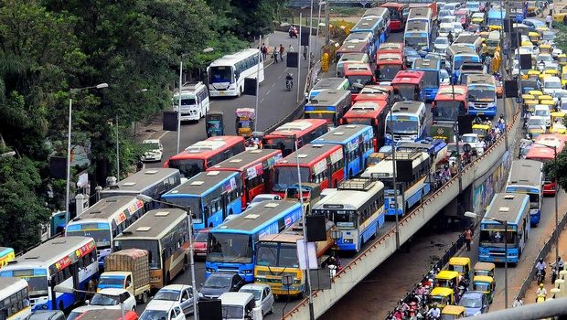
Cities are changing

Slide 4
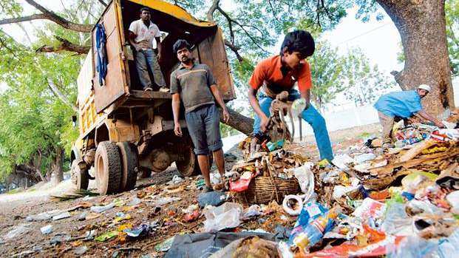
WITNESS MORE WASTE ON STREETS
NOW

Slide 5
IDEA
To promote sustainability among families in a neighborhood

Slide 6
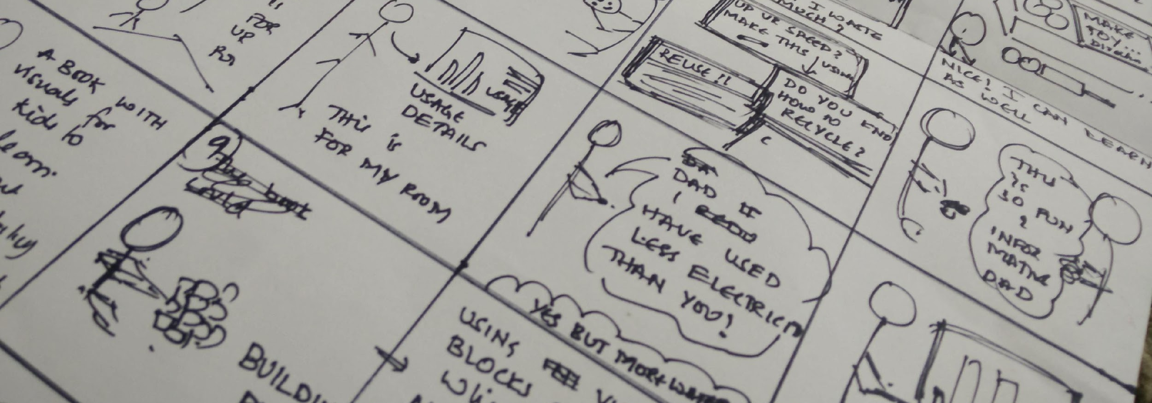
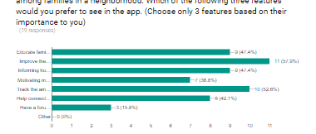
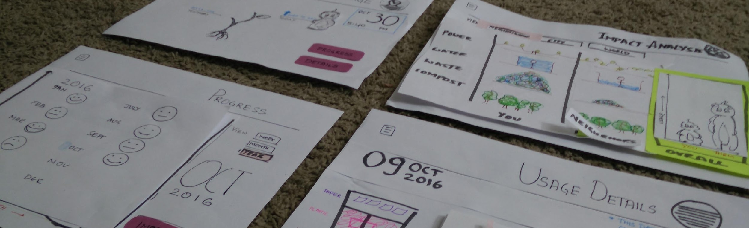
Design Process
Research
Brainstorming
Storyboarding
User interviews/surveys
Paper Prototypes
Digital Prototypes

Slide 7
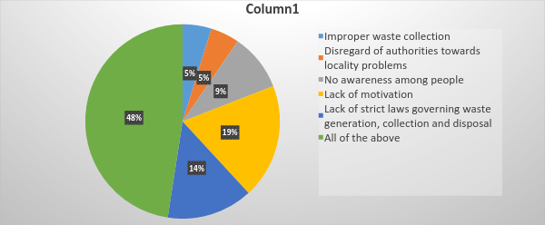
Bottlenecks in Waste Management

Slide 8
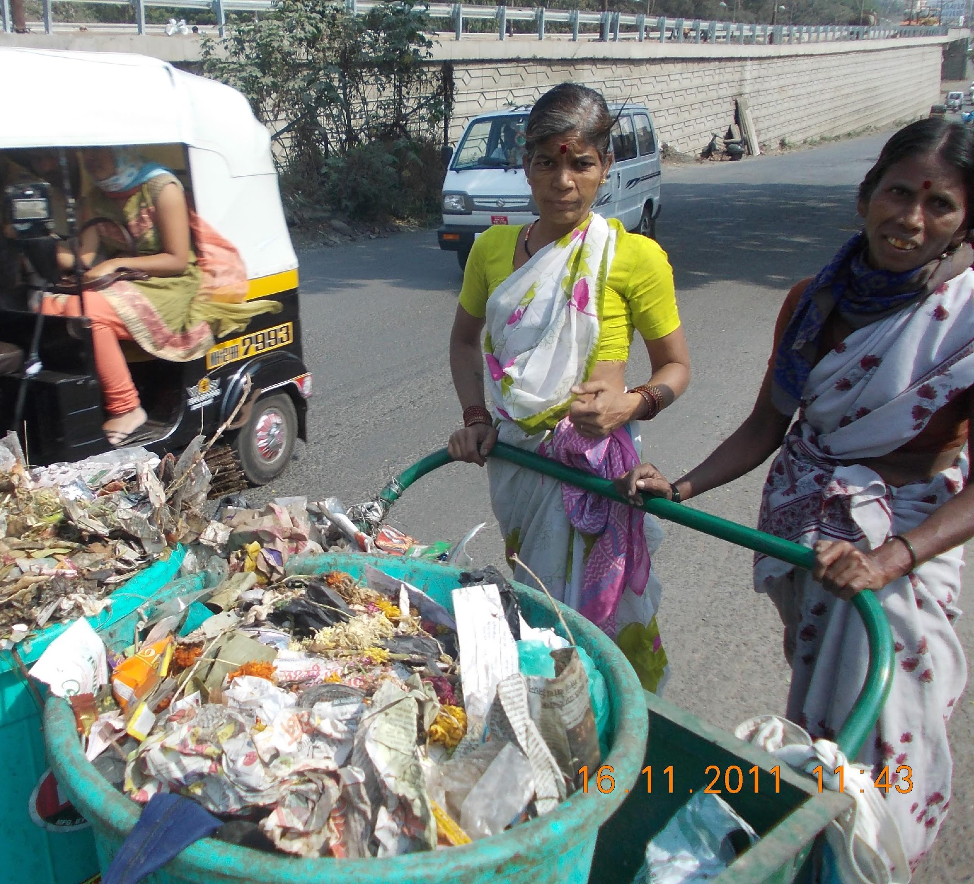
Existing waste collection methods
Door to door waste collection
Recycle stores which collect recycle-able waste

Slide 9

Persona - Jane
Mother of two kids
Working women
Finds it difficult to manage waste especially due to collection difficulties

Slide 10
“
Provide segregation/collection bins so the people can dispose waste without waiting for a truck to collect them. The waste disposal truck will only have to collect from the bin.
“

Slide 11
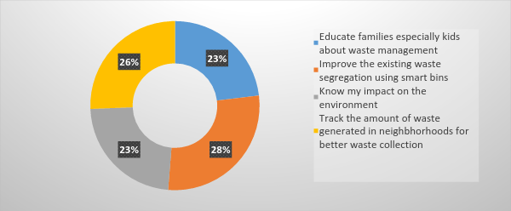
Upvotes for solutions

Slide 12
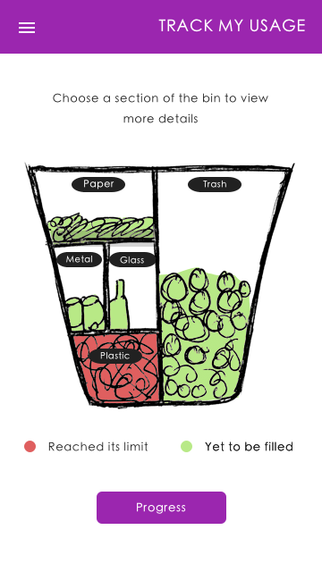
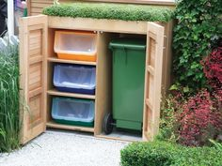
Smart Bin
Compartments for trash and recycleable waste

Slide 13
Smart Bin
Compartments for trash and recycleable waste
Wireless connectivity

Slide 14
Smart Bin
Compartments for trash and recycleable waste
Wireless connectivity
Fill sensors or Weight sensors

Slide 15
Smart Bin
Compartments for trash and recycleable waste
Wireless connectivity
Fill sensors or Weight sensors
Could be fixed fence or kept outside the house
Access to bin differs for house members and waste collectors

Slide 16
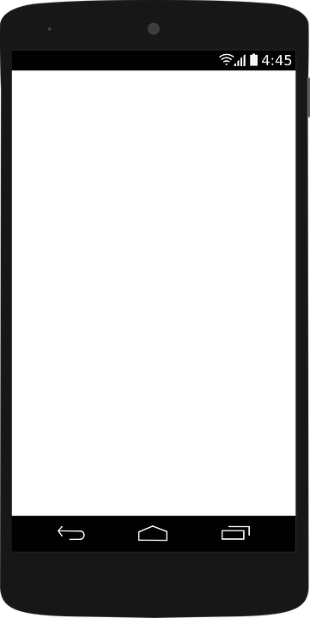
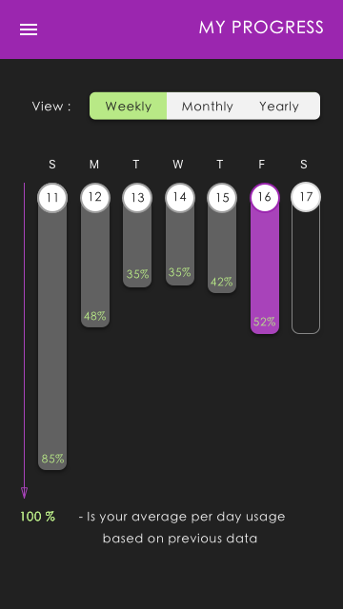
Digital Prototype
Track your Usage and Progress

Slide 17
Digital Prototype
Track your Usage and Progress

Slide 18
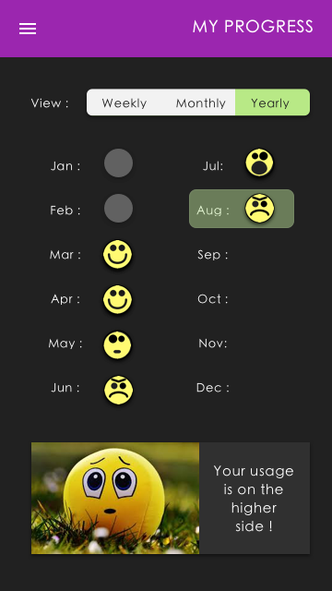
Digital Prototype
Track your Usage and Progress

Slide 19
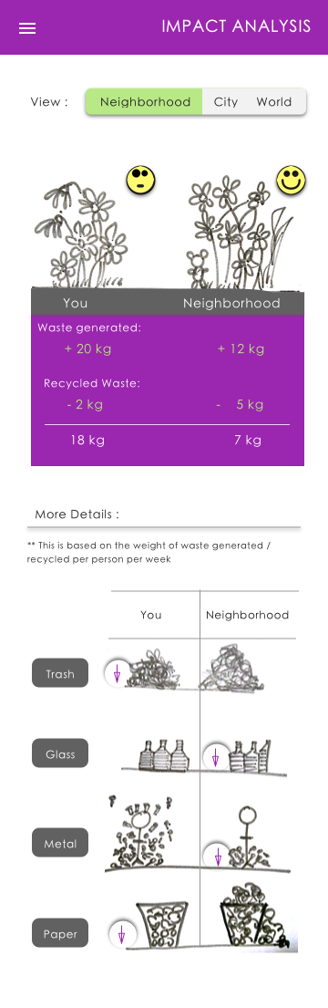
Digital Prototype
Impact Analysis

Slide 20
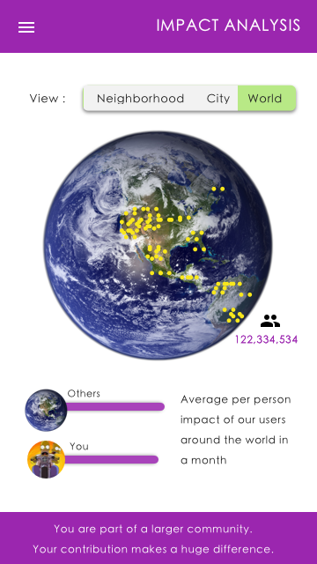
Digital Prototype
Impact Analysis

Slide 21
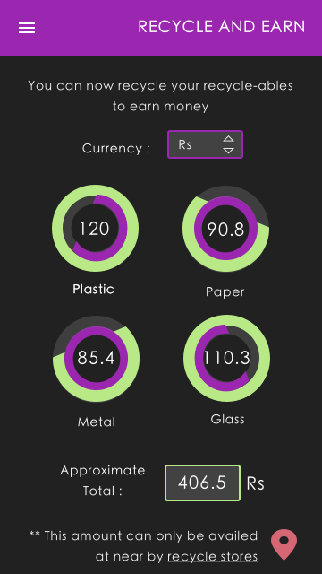
Digital Prototype
Recycle and Earn money

Slide 22
Questions?

