Slide 1
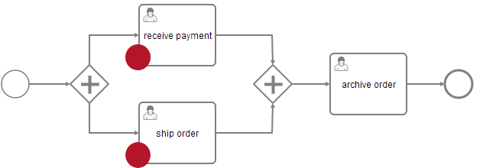
Execution 1
(= Process Instance)
Execution 2
Execution 3
Task 1
Task 2

Slide 2
Execution 1
(= Process Instance)
name: „customer“
value: „Kermit“
Execution 2
Execution 3
Task 1
Task 2
name: „worker“
name: „worker“
value: „Fozzie“
value: „Gonzo“

Slide 3
Execution 1
(= Process Instance)
name: „customer“
value: „Kermit“
Execution 2
Execution 3
Task 1
Task 2
name: „worker“
name: „worker“
value: „Fozzie“
value: „Gonzo“
name: „customer“
value: „Hugo“

Slide 4
Variable Scope
Variables
name: „isAFrog“
value: true
Process Instance
name: „customer“
id: „1“
value: „Kermit“
name: „order“
value: com.example.Order@1

Slide 5
Variables
Variable Types
name: „isAFrog“
boolean
value: true
bytes
short
name: „customer“
integer
value: „Kermit“
long
Primitive Types
double
name: „order“
date
value: com.example.Order@1
string
null
Custom Object Types
(exclusive)
serializable
spin-serialization

Slide 6
Variables
Variable Types
name: „isAFrog“
Serialized value: boolean
boolean
value: true
bytes
short
name: „customer“
integer
value: „Kermit“
long
Serialized value: String
double
name: „order“
date
value: com.example.Order@1
string
Serialized value: byte[]
null
serializable
spin-serialization

