Slide 1
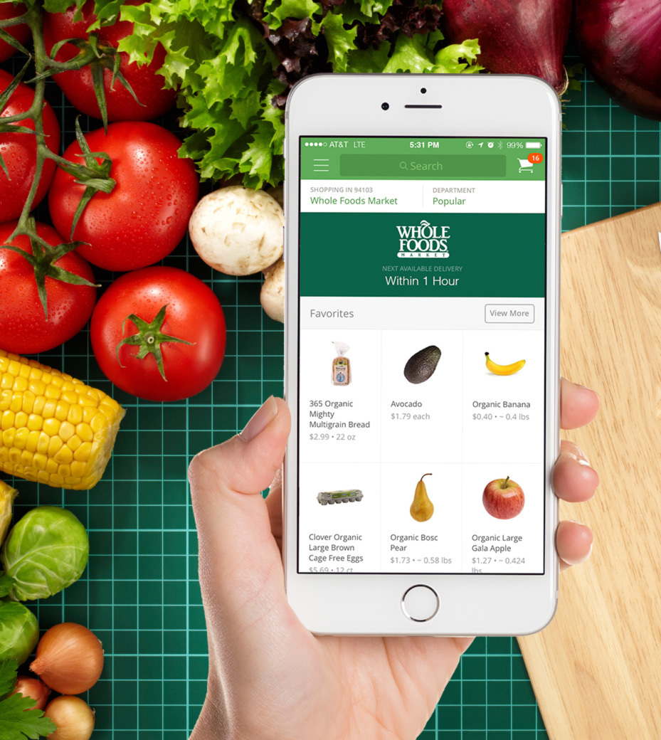
Customer Analytics on Instacart
Presented by Group 6
Aakanksha, Kamal ,Kiriti , Snigdha , Vibhuti

Slide 2

Contents
Objective & Approach
Exploratory Data Analysis
Market Basket Analysis
Recommendation Engine
Strategy & Recommendation

Slide 3

Objective
Deliver value to customers by introducing them to the products which they might wish to consume.
For the company, recommender systems drive significant engagement and revenue.
Providing insights to the company on product placement.
Analyzing the Association between different products, using which discount schemes and product grouping can be decided

Slide 4

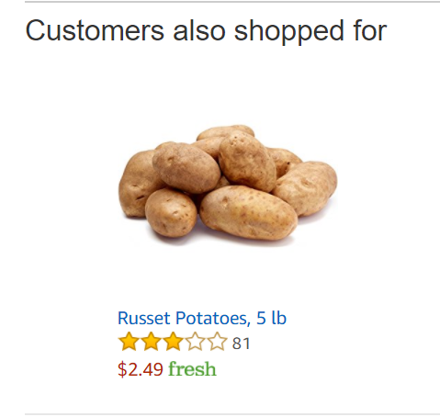




Approach
"3 million grocery orders from more than 200,000 Instacart users"
Strategy & Recommendation
“8000 Users and 1500 Products"
Step 1 :
Exploratory Data Analysis
Step 2 :
Market Basket Analysis
Step 3 :
Recommendation Engine

Slide 5

Exploratory Data Analysis
Key Observations
Most people order between 9:00 AM to 6:00 PM in the evening.
Sunday & Monday are the days when people order most
Two categories of customers : Order on day 7th & 30^{th.}
“Produce” ,”Dairy” and “snacks” are top 3 departments.
Always at least 3 prior orders.
Top ordered products – “Banana” & “ Bag of Organic Banana”
Aisle-”Candy Chocolate” & “Ice cream ice” offered maximum variety of products
Department- “Personal care” have maximum number of product offerings.
59% of items are reordered.
Step 1 : Exploratory Data Analysis

Slide 6
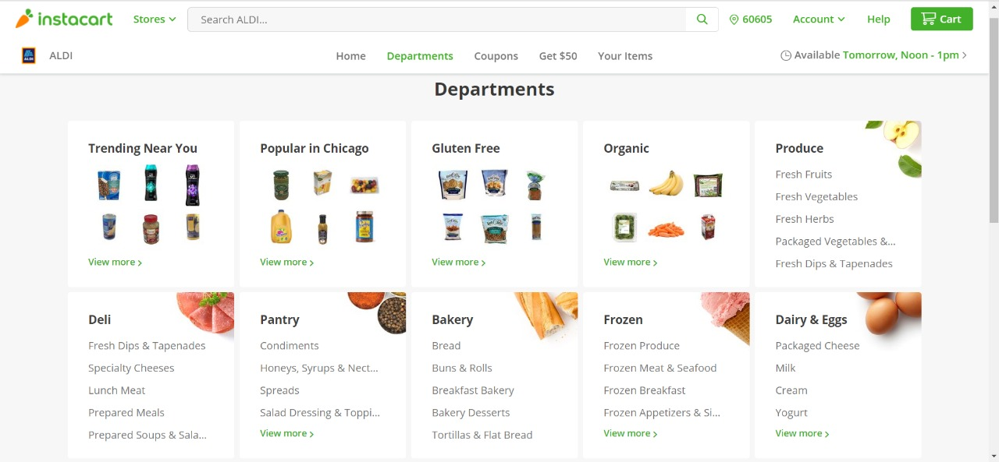
Strategy & Recommendation
Product Placement
Catalogue Arrangement

Slide 7

Market Basket Analysis
To find the association between frequent items and analyse the association rules between them
Opportunities
Products bought together frequently
Placement products & discounts on the bundles
Aisles associated with frequent patterns of buying
Revamping website : Accommodate the frequently bought products from different Aisles
Step 2 : Market Basket Analysis

Slide 8
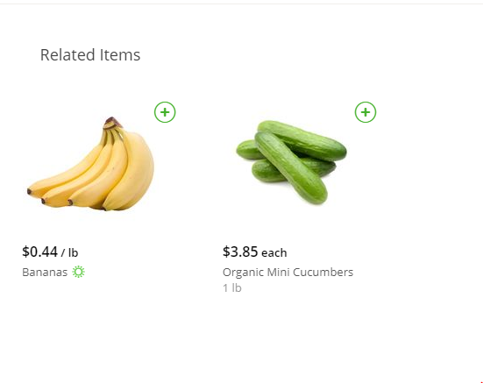
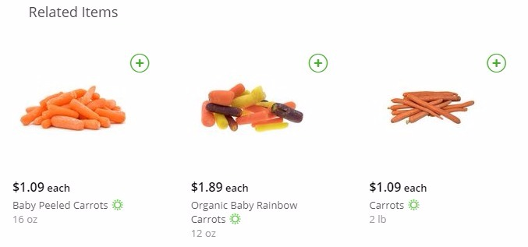
Strategy
Recommendation to Customers

Slide 9
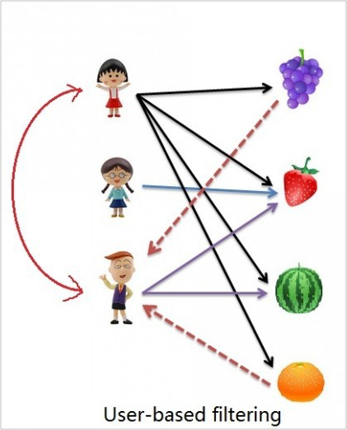

Recommendation Engine
User-User
The Utility Matrix is 99.87% sparse.
Sparsity
Large number of distinct items (approx. 50K). Thus, number of items a user has rated reduces to a tiny percentage making the correlation coefficient less reliable.
Dynamic User Profile-
User profiles change quickly and the entire system model had to be recomputed which is both time
and computationally expensive
Step 3 :Recommendation Engine

Slide 10
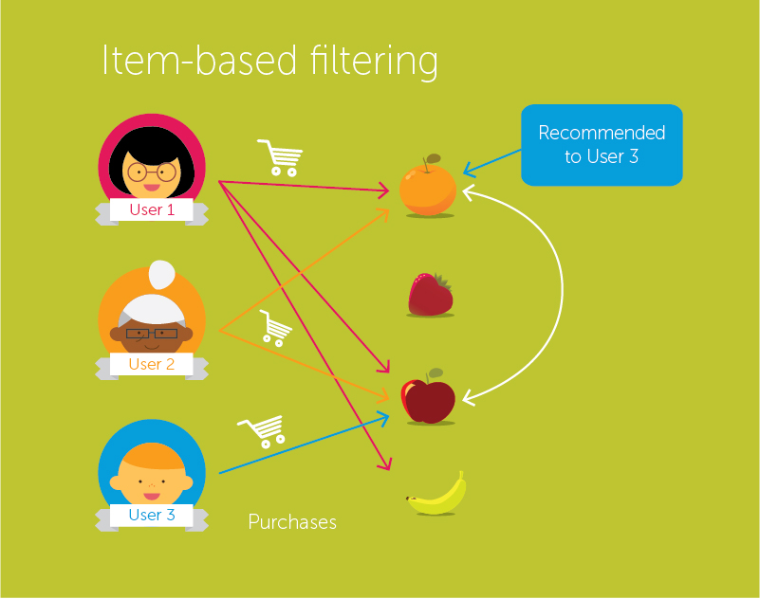
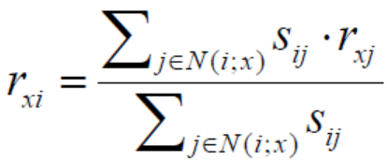

Recommendation Engine
Item-Item
Utility Matrix: r X s
where r-> Users, s-> Products
The cell r_{i}s_{j} represents the number of times User r_{i} has bought the item s_{j.}
Weight Matrix (W) – Cosine Similarity between each Product using the formula:
Lack of Bias Correction- All products are counted in isolation.
Model Evaluation:
RMSE => 0.43
Step 3 :Recommendation Engine

Slide 11
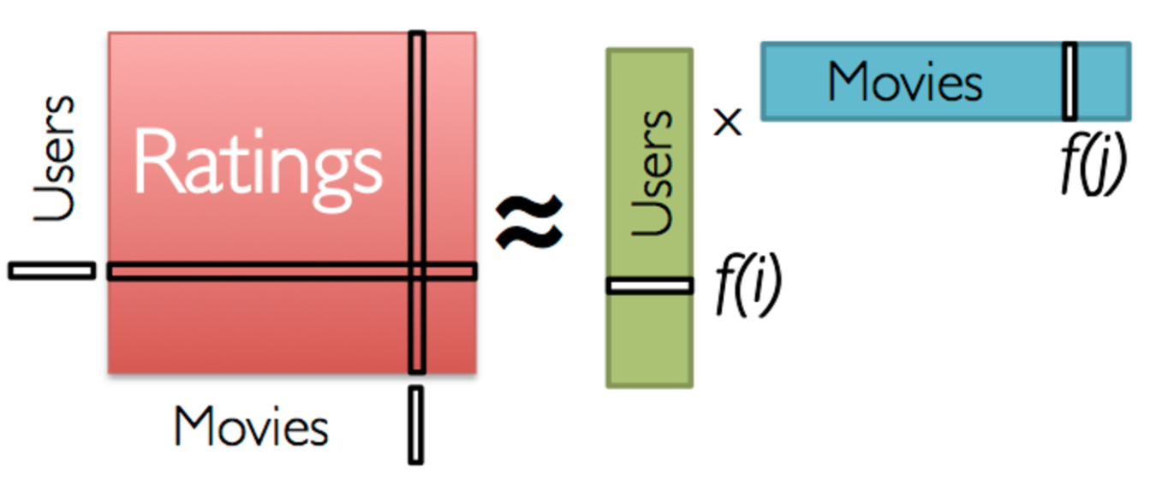
Recommendation Engine
Latent Factorisation -SVD
Model Evaluation:
RMSE with k= 30 => 0.16
RMSE with k=20 => 0.20
Therefore, k=30 was used: R ≈ P x QT = Ȓ
Products
Products
Drawbacks:
The Dataset comprises of Implicit Feedback- number of products bought by a User.

Slide 12

Recommendation Engine
Alternating Least square:
Preference matrix:
A binary matrix which is defined by below:
Confidence matrix: Contains probability that the user buys the product
0 specifies no product being used
1 specifies product being bought
Model Evaluation:
Recall:4.26 when α =11
Recall:4.01 when α =16
Step 3 :Recommendation Engine

Slide 13
Recommendations
User Id | Product Recommendation
1 | ‘Soda’, ‘0% Greek Strained Yogurt’, ‘Clementine’, ‘Bag of Organic Bananas’, ‘Organic Half & Half’, ‘Apples’, ‘Zero Calorie Cola’, “Crunchy Oats ’n Honey Granola Bars”, ‘Extra Fancy Unsalted Mixed Nuts’, ‘Reduced Fat 2% Milk’
38 | ‘Organic Hass Avocado’, ‘Sparkling Water Grapefruit’, ‘Half & Half’, ‘Lime Sparkling Water’, ‘Sparkling Lemon Water’, ‘2% Reduced Fat Milk’, ‘Organic Yellow Onion’, ‘Pure Sparkling Water’, ‘Organic Grape Tomatoes’, ‘Organic Garlic’
796 | ‘Half & Half’, ‘Organic Avocado’, ‘Organic Fuji Apple’, ‘Banana’, ‘Large Lemon’, ‘Organic Strawberries’, ‘Bag of Organic Bananas’, ‘Unsweetened Almond milk’, ‘Raspberries’, ‘Organic Large Brown Grade AA Cage Free Eggs’
421 | ‘Strawberries’, ‘Organic Yellow Onion’, ‘Organic Garlic’, ‘Large Alfresco Eggs’, ‘Raspberries’, ‘Organic Garnet Sweet Potato (Yam)’, ‘Organic Grape Tomatoes’, ‘Fat Free Milk’, ‘Icelandic Style Skyr Blueberry Non-fat Yogurt’, ‘Organic Small Bunch Celery’

Slide 14


Slide 15

References
http://citeseerx.ist.psu.edu/viewdoc/download;jsessionid=34AEEE06F0C2428083376C26C71D7CFF?doi=10.1.1.167.5120&rep=rep1&type=pdf
Role of Matrix Factorization Model in Collaborative Filtering Algorithm:A Survey by Dheeraj kumar Bokde1, Sheetal Girase2, Debajyoti Mukhopadhyay3

