Slide 1
Market Segmentation, Return
Predictability, and Portfolio
Optimisation of Indian InvITs & REITs
A Four-Phase Empirical Study using GJR-GARCH, DCC-GARCH, Diebold-Yilmaz Spillovers,
Bayesian Machine Learning, and Walk-Forward Portfolio Optimisation
MTP2 Dissertation | IIT Kharagpur — B.Tech Civil + MFE
Data: 27 Jul 2020 – 1 Mar 2026 | 29 Tickers, 5 Portfolios, 1,023 Daily Observations
1 / 28

Slide 2
Presentation Outline
01
Motivation & Research Gap
Why Indian InvITs and REITs?
02
Data & Portfolio Construction
29 tickers, 5 category portfolios
03
Phase 1 — Volatility & Spillovers
GJR-GARCH · DCC · Diebold-Yilmaz
04
Phase 2 — Factor Structure
OLS-HAC · Shapley · Panel Tests
05
Phase 3 — ML Prediction
BayesRidge with hierarchical priors
06
Phase 4B — Portfolio Results
MVO_Raw · GK ablation · Bootstrap
07
Implications & Conclusion
Managerial takeaways · Future work
2 / 28

Slide 3
Motivation — A Growing Asset Class Without a Research Baseline
India's first InvIT listed in 2017; first REIT in 2019
5 listed InvITs + 3 REITs as of 2026 — ₹1.5 lakh crore AUM
NSE's Nifty REITs & InvITs Index launched 2023
No published study on their volatility dynamics, segmentation, or predictability
International REIT literature covers US, Japan, Singapore, Australia — NOT India
₹1.5L Cr
Aggregate Listed AUM (2026)
0
Prior academic studies on India InvIT dynamics
1,023
Daily observations in sample window
Research Question: Are Indian InvITs and REITs segmented from global markets, and can returns be predicted and exploited?
3 / 28

Slide 4
Data & Portfolio Construction — 29 Tickers, 5 Category Portfolios
Portfolio | Constituents | Daily Mean% | Daily Vol% | Ann. Return
India_InvIT (N=3) | IRB InvIT, IndiGrid, PowerGrid InvIT | 0.028 | 0.828 | ~7.0%
India_REIT (N=3) | Embassy, Mindspace, Brookfield REIT | 0.060 | 0.757 | ~15.0%
India_Stock (N=5) | IRB, L&T, Adani Ports, NTPC, PowerGrid | 0.098 | 1.458 | ~24.5%
US_Infra (N=10) | AMT, CCI, EQIX, DLR, EPD, NEE… | 0.046 | 1.061 | ~11.5%
Europe_Infra (N=5) | Ferrovial, Nat. Grid, Engie, RWE, Cellnex | 0.069 | 1.036 | ~17.3%
All returns: daily log-returns r_t = ln(P_t / P_{t-1}) · Equal-weighted within category · Source: Yahoo Finance + Investing.com
4 / 28

Slide 5
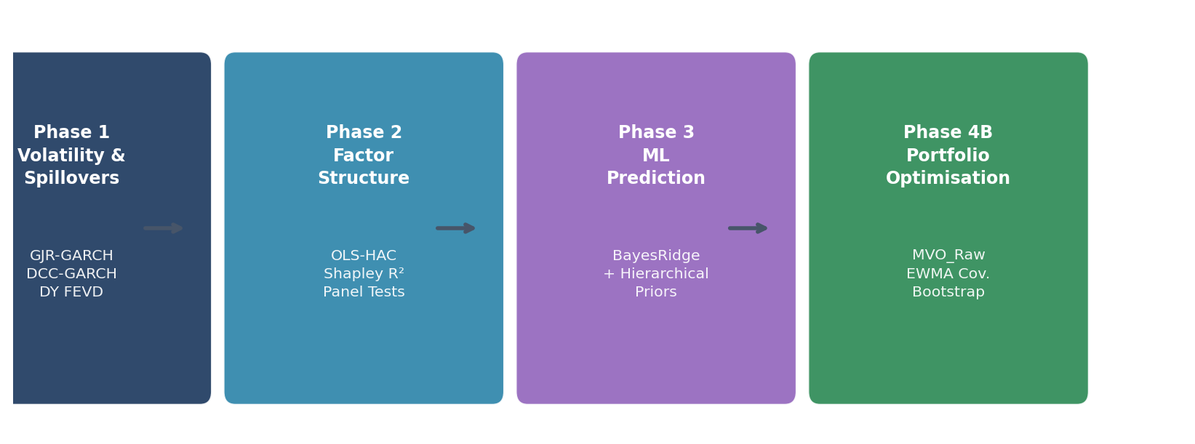
Four-Phase Empirical Framework — Each Phase Feeds the Next
Phase 1 Output:
Phase 2 Output:
Phase 3 Output:
Phase 4B Output:
Segmentation confirmed → global model will NOT work → motivates Phase 2
Domestic factor coefficients → become hierarchical Bayesian priors in Phase 3
Panel IC = 0.254, GKX R² = 12% → raw predictions feed Phase 4B optimiser
MVO_Raw Sharpe 1.87 → GK ablation confirms priors add value
5 / 28

Slide 6
01
Phase 1 — Volatility Dynamics & Global Spillovers
GJR-GARCH(1,1) · DCC-GARCH · Diebold-Yilmaz Generalised FEVD
6 / 28

Slide 7
Phase 1 — GJR-GARCH(1,1): Leverage Effects & Persistence
Portfolio | α (ARCH) | β (GARCH) | γ (Leverage) | p(γ) | α + β | Half-Life
India_InvIT | 0.966 | 0.496** | −0.924 | 0.045 | 1.46 ⚠ | >100 d (non-stat)
India_REIT | 0.076 | 0.272 | 0.186* | 0.069 | 0.35 | 0.66 d
India_Stock | 0.176 | 0.403** | 0.277** | 0.037 | 0.58 | 1.27 d
US_Infra | 0.017 | 0.924** | 0.069** | 0.037 | 0.94 | 11.3 d
Europe_Infra | 0.128 | 0.564** | 0.181** | 0.030 | 0.69 | 1.89 d
No Leverage Effect
Leverage Present
InvIT Non-Stationary
InvIT & REIT: γ not significant at 5% — pass-through structure insulates from classical equity leverage
Stock, US_Infra, Europe_Infra: γ significant at 5% — negative shocks raise variance more
α+β = 1.46 violates stationarity → refit GARCH(1,1) → EWMA(20) fallback for DCC inputs
7 / 28

Slide 8
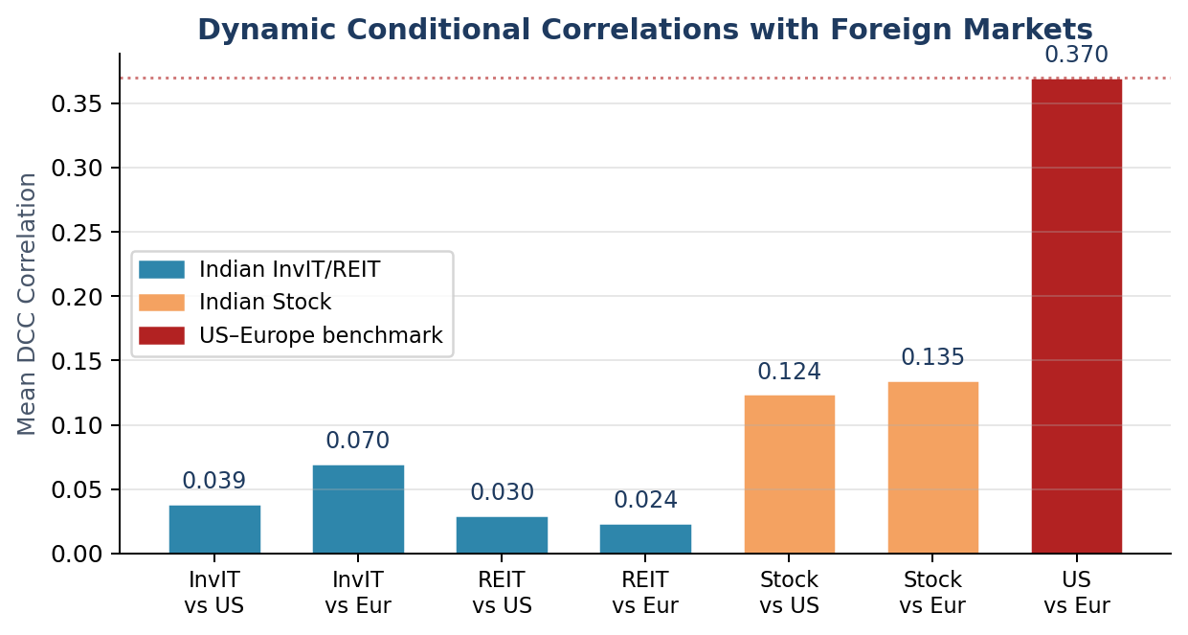
Phase 1 — Dynamic Conditional Correlations with Foreign Markets
0.039
InvIT–US mean DCC
(lowest in system)
0.370
US–Europe mean DCC
(10× higher)
0.124
Stock–US mean DCC
(3× InvIT)
⟶ Low and stable correlations confirm descriptive segmentation — formal FEVD test follows
8 / 28

Slide 9
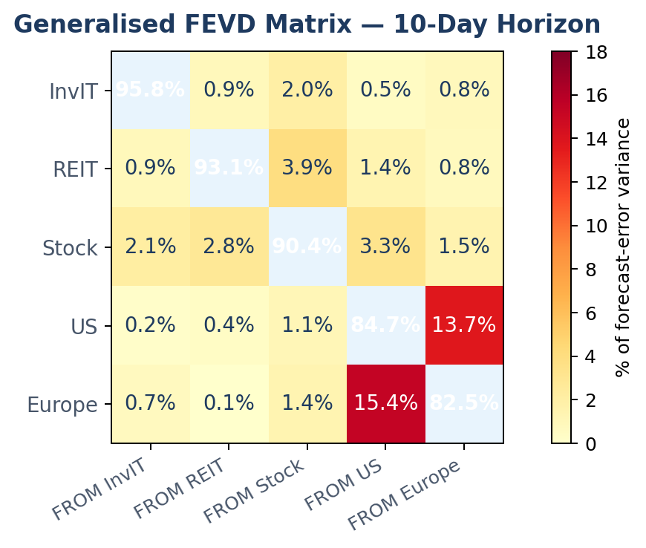
Phase 1 — Generalised FEVD Matrix (10-Day Horizon, VAR(1))
95.85%
InvIT own-variance
93.06%
REIT own-variance
90.39%
Stock own-variance
84.65%
US own-variance
10.71%
Total spillover index
9 / 28

Slide 10
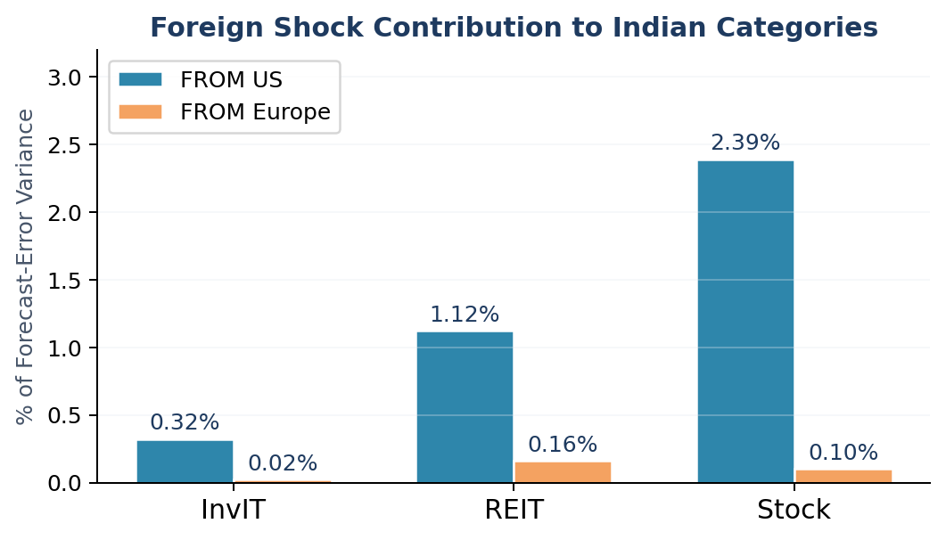
Phase 1 — Key Finding: Indian InvITs Receive < 0.35% from Foreign Shocks
0.34%
Foreign spillover
to InvIT
1.28%
Foreign spillover
to REIT
2.49%
Foreign spillover
to Stock
58–65%
Developed-market
REIT average (DY 2021)
Interpretation: Indian InvITs and REITs are more than 97% domestically driven — an order of magnitude more segmented than developed-market REIT cohorts.
10 / 28

Slide 11
02
Phase 2 — Domestic Factor Structure
OLS-HAC · Shapley R² Decomposition · Pooled Panel · Monthly Lagged Priors
11 / 28

Slide 12
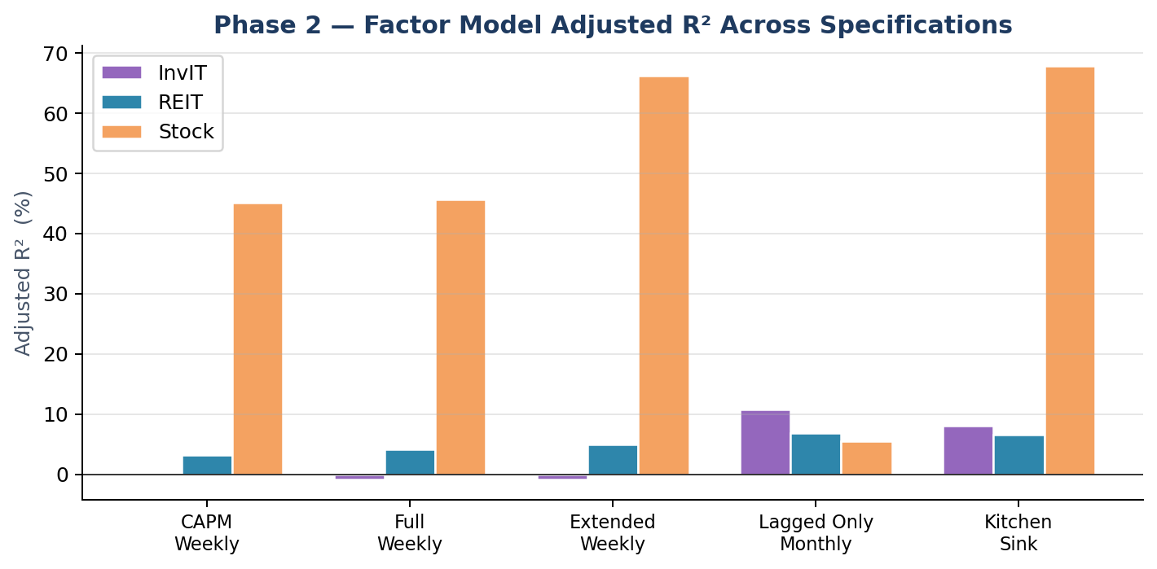
Phase 2 — Three-Tier Factor Intensity
Tier 1 — Stock
Kitchen-sink adj. R² = 67.8%
NiftyInfra dominates (Shapley: 42.9pp)
Tier 2 — REIT
Kitchen-sink adj. R² = 6.5%
Nifty50 & INR/USD significant
Tier 3 — InvIT
Kitchen-sink adj. R² = 8.1%
Only Amihud adds meaningful fit
Monthly lagged factors reveal delayed price discovery: InvIT lagged-only R² = 10.8% — this motivates the Phase 3 monthly panel design.
12 / 28

Slide 13
Phase 2 — Factor Loadings & Cross-Category Interaction Tests
Factor | InvIT β (t) | REIT β (t) | Stock β (t)
Nifty50 | 0.040 (0.49) | 0.146 (2.34)** | 1.228 (13.37)***
Yield_10Y | −0.016 (−0.87) | 0.022 (1.51) | 0.059 (2.16)**
INR_USD | −0.056 (−0.51) | −0.376 (−2.02)** | −0.259 (−0.98)
Oil | −0.000 (−0.01) | −0.005 (−0.25) | −0.016 (−0.47)
Adj R² | −0.8% | 4.2% | 45.7%
Cross-Category Interaction Tests
(Stock = base, pooled panel, clustered SEs)
Nifty50 × InvIT −1.198***
InvIT beta 1.2 units BELOW Stock
Nifty50 × REIT −1.082***
REIT beta 1.1 units below Stock
Yield × InvIT −0.075**
InvIT more rate-sensitive
Competing-Asset Channel: de-meaned yield level significantly negative for InvIT (β=−0.007, p=0.026) and REIT (β=−0.005, p=0.016) — when yield > long-run mean, investors switch from yield vehicles to bonds.
13 / 28

Slide 14
Phase 2 → Phase 3 Bridge — Monthly Lagged Coefficients Become Priors
Phase 2 monthly lagged-only regression identifies the Bayesian priors for Phase 3 BayesRidge:
Feature | InvIT Prior β | REIT Prior β | Stock Prior β | Why it matters
Nifty50_lag1 | +0.234** | +0.263** | +0.441** | Momentum channel; significant all categories
INR_USD_lag1 | +0.563* | −0.223 | −0.603 | Sign flip: InvIT and Stock react oppositely to FX
Yield_10Y_lag1 | −0.106 | +0.089** | +0.102 | Rate sensitivity differs by category
Amihud | −0.484 | 0.000 | 0.000 | Only InvIT exhibits illiquidity premium
Adj R² | 10.8% | 6.8% | 5.5% | Monthly > weekly — delayed price discovery
These coefficients are verbatim Phase 3 CATEGORY_PRIORS — blend weight λ selected by LOOCV at each OOS step.
14 / 28

Slide 15
03
Phase 3 — Bayesian ML Return Prediction
BayesRidge + Hierarchical Phase 2 Priors · LOOCV Blend Weight · 27-Month Walk-Forward OOS
15 / 28

Slide 16
Phase 3 — Hierarchical BayesRidge Design
1
Panel Construction
7 Models Compared:
3 cats × 57 months = 171 obs | 9 features incl. category dummies
HistMean
2
Walk-Forward OOS
OLS_HAC
Train = 30 months expanding · OOS = 27 months (Dec 2023 – Feb 2026)
Ridge
3
Prior Blending
LASSO
β̃_c = (1 – λ) · β̂_BR + λ · β̃^prior_c per category c
ENet
4
LOOCV λ Selection
Grid {0.0, 0.1, 0.2, 0.3, 0.5, 0.7} · mean selected = 0.207
★ BayesRidge (PRIMARY)
5
Evaluation
TL_ENet (transfer)
GKX R², Campbell-Thompson R², IC, PT directional test, SHAP
16 / 28

Slide 17
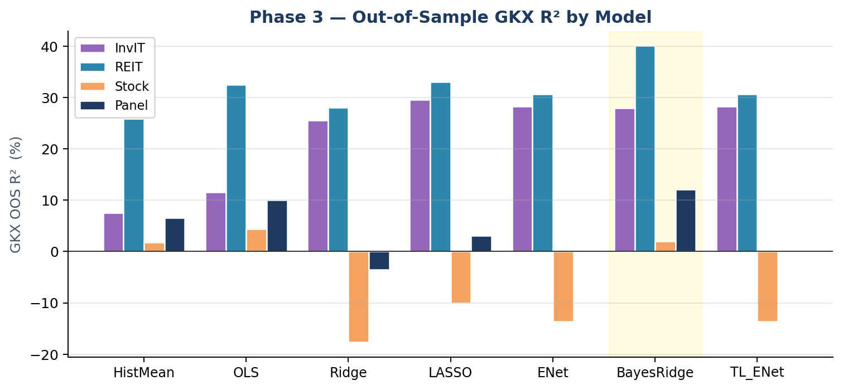
Phase 3 — Out-of-Sample Results: BayesRidge Dominates
+12.09%
BayesRidge Panel GKX R²
(highest among all models)
+0.91%
Panel Campbell-Thompson R²
(only model beating hist. mean)
+40.05%
REIT GKX R²
(vs +5.01% Leow & Lindenthal 2025)
Note: LASSO/ENet strong for InvIT/REIT but negative R² for Stock → BayesRidge alone achieves positive panel R² across all three categories.
17 / 28

Slide 18
Phase 3 — IC and Directional Accuracy Diagnostics
Model | InvIT IC | REIT IC | Stock IC | Panel IC
HistMean | −0.145 | −0.192 | −0.034 | −0.026
OLS_HAC | −0.359 | −0.017 | −0.223 | −0.202
LASSO | +0.361 | +0.234 | −0.176 | +0.052
BayesRidge | +0.385 | +0.360 | +0.119 | +0.254
Directional Accuracy Warning:
REIT DA = 85% → Looks impressive
Naive DA = 81% → 22/27 months were UP
PT test p > 0.24 → No genuine skill
Up/Down split: 100% up, 0% down
Correct metric = IC, not DA
Panel IC = +0.254 ⟶ 2.5× the Grinold-Kahn useful-skill threshold of 0.10 | BayesRidge LOOCV blend weight mean = 0.207 (always > 0 — priors always help)
18 / 28

Slide 19
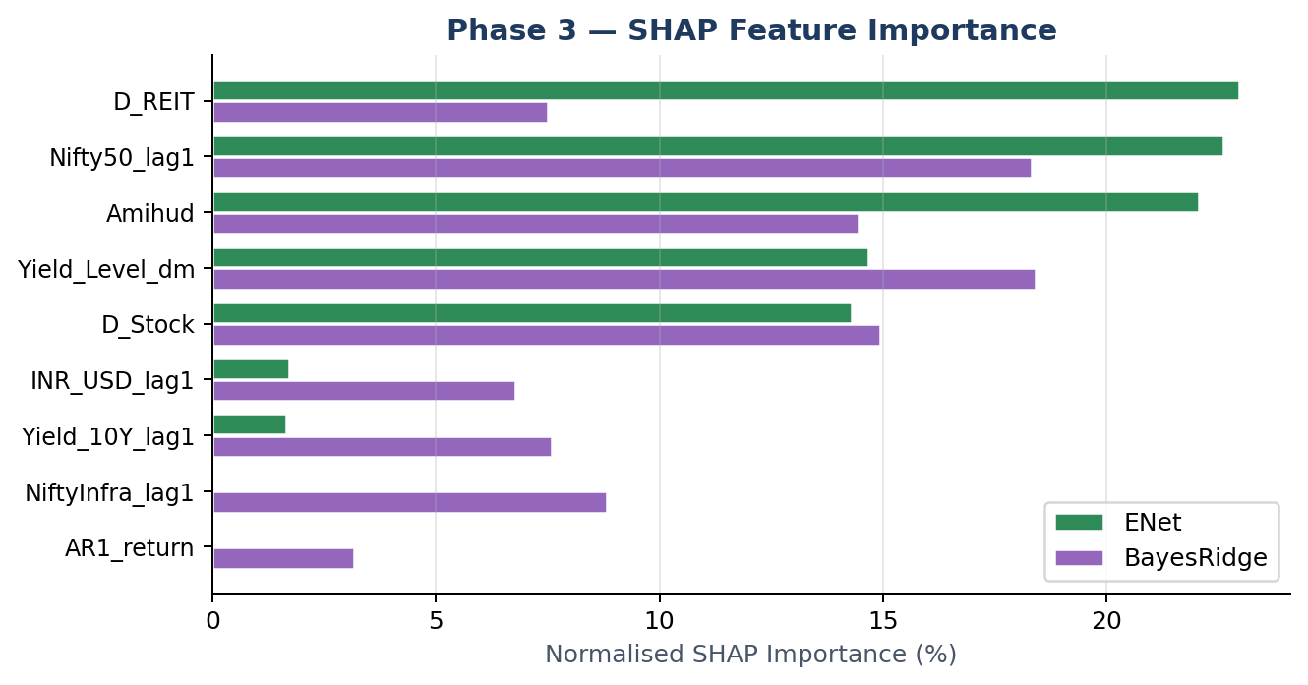
Phase 3 — SHAP Feature Importance (Full-Sample Refit)
Nifty50_lag1 (22.6%)
Delayed market momentum — consistent with Phase 2 significance across all categories
Amihud (22.1%)
Illiquidity premium — dominant for InvIT; prior = −0.484 (only non-zero for InvIT)
Yield_Level_dm (14.7%)
Competing-asset channel — rates above mean suppress yield-vehicle returns
SHAP top-4 features agree with Phase 2 significance indicators → Cross-phase consistency confirmed.
19 / 28

Slide 20
04
Phase 4B — Portfolio Optimisation
8 Strategies · EWMA Covariance · MVO_Raw vs GK Ablation · Paired Bootstrap
20 / 28

Slide 21
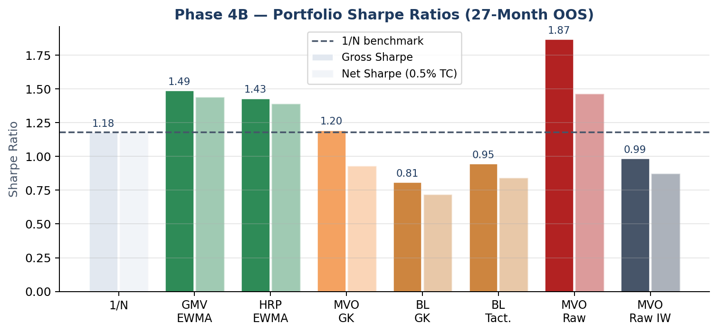
Phase 4B — Master Performance Comparison (27-Month OOS)
Top Strategies:
MVO_Raw
SR 1.868 | Return 23.21% | Net SR 1.466
GMV_EWMA
SR 1.488 | Return 17.88% | Net SR 1.442
HRP_EWMA
SR 1.431 | Return 17.39% | Net SR 1.391
1/N (benchmark)
p(MVO_Raw) = 0.010 (t-test) | Bootstrap P(beat 1/N) = 97.7% | Bonferroni: suggestive
SR 1.180 | Return 17.50% | Net SR 1.180
21 / 28

Slide 22
Phase 4B — The Grinold-Kahn Ablation: A Methodological Finding
What differs between MVO_Raw and MVO_GK?
1.868
MVO_Raw
Raw ensemble prediction × 12 → optimiser
MVO_Raw Gross Sharpe
MVO_GK
GK rescaling: μ_GK = RF + IC · σ · z → optimiser
1.196
MVO_GK Gross Sharpe
Difference
Same covariance · Same constraints · Same optimiser
−0.672
Gross Sharpe destroyed by GK rescaling
(at N=3, ensemble IC≈0.27)
Principle: GK regularises noisy signals toward RF — appropriate at large N / low IC. At small N + high IC, GK discards the level information the optimiser needs. Always run a no-GK baseline.
22 / 28

Slide 23
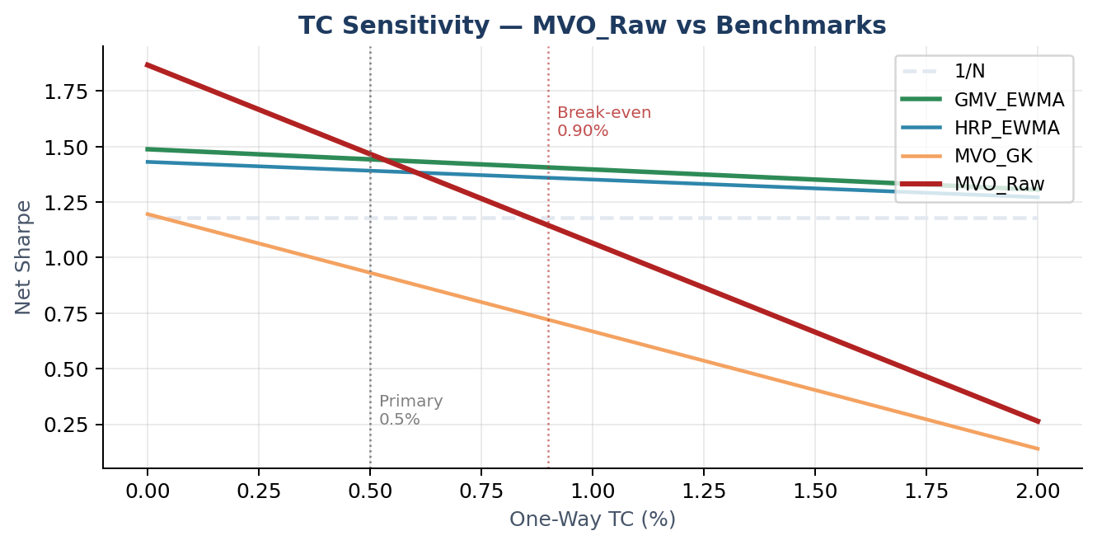
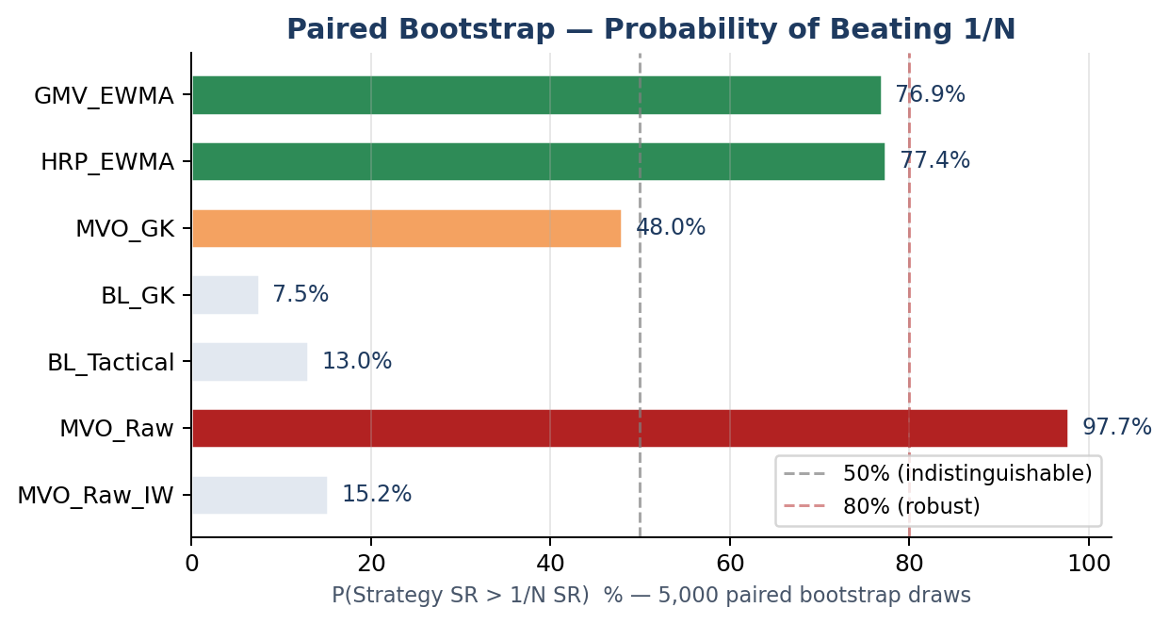
Phase 4B — Transaction Cost Sensitivity & Bootstrap Robustness
Primary TC = 0.5% one-way → MVO_Raw net SR = 1.47
Break-even vs 1/N: TC = 0.90%
GMV/HRP: low turnover (<6%) → robust to higher TC
MVO_GK: 44% monthly turnover → net SR = 0.93
23 / 28

Slide 24
05
Managerial Implications & Conclusion
Stakeholder Recommendations · Contributions · Limitations · Future Research
24 / 28

Slide 25
Managerial Implications — Four Stakeholder Groups
🏦 Indian Institutional Managers
🏢 InvIT / REIT Sponsors
Adopt MVO_Raw over 1/N for InvIT/REIT sleeve (Sharpe +0.69)
Audit GK preprocessing — destroys 0.67 Sharpe at high-IC settings
Reduce InvIT position when Amihud in top quintile
Time equity raises away from top-quartile yield regimes
Use <0.34% spillover evidence in foreign IR materials
Yield spread management between distribution yield and 10Y bond
🌐 International Portfolio Managers
⚖ SEBI / Policy-Makers
Size India sleeve 3–8% of infra allocation (foreign corr. < 0.04)
Apply 3-month NDF hedge for USD accounts (INR_USD β = −0.376)
Monitor FPI limit changes as integration signal
Stagger FPI liberalisation: Stock first → InvIT last
Embed rolling Diebold-Yilmaz index in systemic-risk dashboards
Mandate daily liquidity disclosures (spread, Amihud)
25 / 28

Slide 26
Three Contributions to the Literature
I
Substantive Empirical Baseline
First systematic econometric study of Indian InvIT and REIT market dynamics. Establishes: segmentation (< 3% foreign spillover), three-tier factor structure, and monthly predictability — against which all future work can be calibrated.
II
Hierarchical Bayesian Prior Design for Small-T Panels
Encoding per-category Phase 2 OLS coefficients as hierarchical priors in a BayesRidge panel model with LOOCV-selected blend weight. Template transferable to any nascent asset class with a related longer-history prior source (Thai REITs, Mexican energy infrastructure, Indonesian infrastructure bonds).
III
No-GK Ablation — Internally Controlled Counterfactual
First published comparison of Grinold-Kahn rescaling against a raw-signal baseline in a real portfolio backtest at small N, high IC. −0.67 gross Sharpe attributable entirely to GK. General principle: GK harms at small N + high IC.
26 / 28

Slide 27
Limitations & Avenues for Future Research
Key Limitations
Future Research
27-month OOS window — bootstrap 95% CI ≈ [0.44, 3.48]
N = 3 assets — findings specific to small-N regime
India 10Y yield is I(1) — near-unit-root caveat
DCC parameters fixed (a=0.01, b=0.95) — not QMLE-estimated
0.5% TC assumption — break-even at 0.90%
Extend OOS to 60 months (through 2028) for tighter inference
Two-step QMLE for DCC parameter estimation
TVP-VAR connectedness (Antonakakis et al. 2021 framework)
Intra-daily HAR-RV on the three most liquid InvITs
Event-study: SEBI FPI liberalisation impact on spillover index
Cross-sectional InvIT pricing (ticker-level, not category)
Bayesian neural network priors vs BayesRidge
27 / 28

Slide 28
Five Principal Findings
①
Strong Segmentation
InvIT 0.34% · REIT 1.28% · Stock 2.49% foreign spillover — 10× below developed-market REITs
②
Three-Tier Factor Structure
Stock R²=67.8% REIT R²=6.5% InvIT R²=8.1% | Nifty β gap InvIT vs Stock = −1.20***
③
BayesRidge Predictability
Panel IC = +0.254 (2.5× GK threshold) | GKX R² = +12.09% | LOOCV λ = 0.207
④
MVO_Raw Portfolio Value
Gross SR = 1.87 (p=0.010) | Net SR = 1.47 at 0.5% TC | Bootstrap P = 97.7%
⑤
GK Ablation
−0.67 gross Sharpe attributable to GK rescaling at N=3, IC>0.25 — GK is detrimental in this regime
Indian InvITs and REITs — a ₹1.5 lakh crore asset class — now has its first systematic empirical baseline.
28 / 28

