Slide 1
Kate Wang & Shobeir Mazinani Member Analytics Workshop 2020
Program Evaluation Workshop
Notes:
Q1

Slide 2
Table of contents
Scope and concepts:
Evaluation overview
Selected concepts:
Causal Inference
Evaluation Design
Random Sampling
Balance
Evaluation methods by example:
Hypothesis testing
Multiple Regression
Propensity matching and adjusting (hands on exercise)
Simpson’s paradox and back door adjustment using GLMM
Open Discussion (optional)
Cases
Other methods
The information presented here is for training purposes and reflects the views of the presenter. It doesn’t necessarily represent the official propositions of the Member Analytics, Aetna or CVS

Slide 3

Program Evaluation Overview
Evaluation process you were told
Evaluation process you’ve been going through
Randomized (?) Experiment
Simple Hypothesis Testing
It is significant! (or maybe not)
New Hypothesis
Quasi Experiment Design
Multiple regression
Loss of Balance
Simpson’s paradox
Anything else?
Maybe a sub population worked
Matching
Adjusting
Contamination
Econometrics Models
Heckman's Two-Stage Model
Interrupted Time Series
Regression Discontinuity
Instrumental Variables
Insoluble
Randomize
Execute
Check P-value
Program evaluation became a well-established area of research starting around the 1960s when the United States’ federal government began investing large sums of money into public works projects. The mathematics associated with program evaluation represents extensions of some of the more classical methods of predictive modeling. The recent methodological advances in the program evaluation have permeated across fields and have become increasingly commonplace for research efforts. Recent advances in quantitative program evaluation such as the development of two-stage models and propensity score adjustments reflect an emphasis on the importance of selection bias that was an area of research by a number of leading economists including James Heckman, winner of the 2000 Nobel Memorial Prize in Economics. - Paul Thurman &. Howard S. Friedman, School of Public Health, Columbia University, 2016

Slide 4

Selected Concepts
Causal Inference
Evaluation Design
Random Sampling
Balance
Outcomes Research in Healthcare
A diverse and growing number of organizations – employers, health care delivery organizations, insurers, pharmaceutical companies, and governments – rely on health outcomes research for actionable data that will help them make better decisions about the value of different treatments and interventions. By improving the decision-making process, outcomes research increases the value of each dollar spent on health care¹
Measurement, Design, and Analysis Methods for Health Outcomes Research, Harvard T.H. Chan School of Public Health

Slide 5
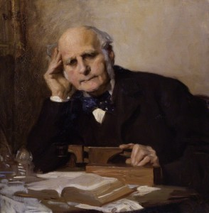
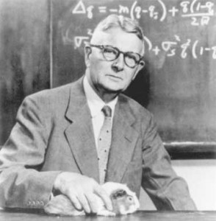
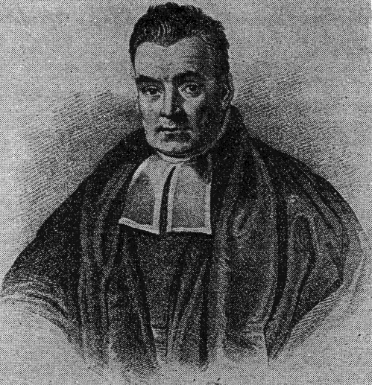

Causation / Causal Inference Introduction
Sir Francis Galton:
When the probability is 100%...
Prof. Sewall Wright:
There is a dependency …
Rev. Thomas Bayes:
The probabilistic conditional dependency…
Prof. Judea Pearl:
Causal Revolution…
What conditions are necessary in order to say “A caused B” ? In the context of intervention or program evaluation, most will be convinced:
Sequence – cause preceded effect
Association – cause related to effect
Counterfactual – had A did not exist, there is no B. (There is no other explanation other than the cause, or everything else holds equal)
- Paul Thurman & Howard S. Friedman, School of Public Health, Columbia University, 2016

Slide 6
Evaluation Designs & Validity Check
Pre
Post
Single arm design:
Cross-sectional studies
Retrospective studies
Comparisons with Control Group
Control Group with Pre-post (diff-in-diff)
Test
Control
The best study has both internal and external validity, examples may impact generalization:
Aptitude-Treatment-Interaction – The sample might have certain features that can interact with the independent variable, limiting generalizability
Situation – time, place, any constraints that can limit the generalizability
Reactivity – John Henry and Hawthorne Effects
Rosenthal effect – Pygmalion effect
Notes:
Launch Q2

Slide 7


Three myths about computerized Randomization
Mersenne Twister:
The Mersenne Twister is a pseudorandom number generator (PRNG). It is by far the most widely used general-purpose PRNG that is commonly used in Python, R, and most commercial statistical and machine learning software
Common Randomization Methods:
Simple Randomization
Stratified Randomization
Covariate adaptive randomization
Randomization gives us an unpredictable sample that truly represents the population of interests
RCT is the golden standard. As long as a randomized control group has set aside, everything has been taken care of
There is no way a computer can generate a truly random number.
Simple randomization using Python and R (Mersenne Twister)
random.seed(x)
random.sample(df, k)
alternatively:
df.sample(n= frac= random_state=)
set.seed(x)
sample_n(df, k)
sample_frac(df, k)
sample_index()
The sampling functions will sample k rows/cols from data frame df.
Preceded with seed numbers or pass an integer for the random_state can initialize the pseudorandom number generator
When different seed numbers yield different results – what does that mean?
https://en.wikipedia.org/wiki/Mersenne_Twister
https://docs.python.org/3/library/random.html
https://engineering.mit.edu/engage/ask-an-engineer/can-a-computer-generate-a-truly-random-number/
https://www.ncbi.nlm.nih.gov/pmc/articles/PMC3136079/
https://www.ncbi.nlm.nih.gov/pmc/articles/PMC5856359/

Slide 8
The pursuit of balance – check, check and check again
Check balance after randomized design and before evaluation
Where there is imbalance,
there is a bias
Carefully designed randomization may not be successful
Contamination
Attrition
Missing information
Randomize what?
Randomization may not be possible or practical (quasi-experimental design)
Design Experiment
Execute
Test Hypothesis
Check balance
Check balance

Slide 9

Evaluation by example
Simple Hypothesis Testing
Multiple Regression
Propensity matching and adjusting (hands on exercise)
Simpson’s paradox and back door adjustment using GLMM
Mixed Methods Evaluation:
Mixed methodology is a design for collecting, analyzing, and mixing both quantitative and qualitative data in a single study or series of studies to understand an evaluation problem.
https://www.cdc.gov/dhdsp/pubs/docs/cb_july_2012.pdf
Evaluation and Program Effectiveness Team, CDC
Notes:
Launch Q3

Slide 10
Case Study: First Randomized experiment within AB&C- the Innovation Health Pilot (2016 – 2017)
 | Individual
Groups | Pre | Post | % dis-enrolled
Intervention | 1,042 | 773 | 26%
Control | 1,127 | 852 | 24%
Targeted Members: IH members just started taking prescriptions for selected conditions
Campaign runs daily to randomize, communicate with members and reward them based on their behavior
The measuring objective is to evaluate if the program worked
We lost more members from the test group than from the control group
Check covariates
Check baseline
 | Groups | Average Age | % Female | %Permit Email | Average Prospective Risk Score | Days covered pre Intervention | Days covered post Intervention
Before Exclusion | Intervention | 49.1 | 40.9% | 36.1% | 2.1 | 50.0 | 108.5
 | Control | 48.7 | 46.4% | 35.4% | 2.1 | 47.7 | 99.8
 | Test Equality (P-value) | 0.51 | 0.01 | 0.75 | 0.91 | 0.11 | 0.00
Post Exclusion | Intervention | 49.6 | 40.1% | 35.7% | 2.0 | 47.02 | 114.8
 | Control | 49.2 | 45.1% | 35.4% | 2.0 | 45.46 | 106.5
 | Test Equality (P-value) | 0.13 | 0.04 | 0.91 | 0.57 | 0.51 | 0.01
Using T-test, we validated there is a significant difference between test and control
We did not lose balance after removing the dis-enrolled members

Slide 11
Sample Hypothesis Testing Methods
T-Test - two sample means for normal distributions
from SciPy.Stats
import ttest_ind,
t_statistic,
p_value=ttest_ind(var1, var2)
t.test(var1~var2, data = df)
Chi-square test for two proportions
from SciPy.stats import chi2_contingency
chi2_contingency(var1, var2)
chisq <- chisq.test(contingencytable)
chisq
Non-parametric tests for non-normal distributions
from SciPy.Stats import mannwhitneyu
u,
p_value=mannwhitneyu(var1, var2)
library(MASS)
wilcox.test(df$var1,df$var2, paired=TRUE)
These hypothesis testing explicitly assumes that the randomization was successful and that subjects in the test and control groups are well balanced with respect to all critical characteristics.

Slide 12
Multiple Regression – when to use it and key assumptions
Multiple linear regression modeling is used to measure the impact of a program while controlling for the influence of covariates. If there are no issues of selection bias and the critical assumptions of multiple linear regression are valid, then it can be used to obtain an unbiased estimate of the program impact.
Some key considerations associated with multiple regression analysis (OLS), especially in the context of measurement:
Variable selection: Which variables have statistically significant linear relationships with the outcome variable? Nonlinear relationships? Are there any interactions that we should consider?
Collinearity: Which variables exhibit collinearity issues?
Model structure: The distribution of the residuals should match the assumed distribution in the model structure. For example, multiple linear regression assumes normally distributed residuals. Is this true? Alternatives would include developing general linear models with other error distributions (such as Poisson, Gamma, etc).
Heteroscedasticity: Will the variability of a measured variable is unequal across the range of values of independent variables? How should we resolve these issues? Variance weighting and White’s correction are both options.
Cost Gap Analysis for Flu shots:
2018 Cost = β0 + β1 * 2017 Cost + β2 * Gender + β3 * Age + β4 * Charleson Index + β5 * Flu Shot 2018 + ε
Causal Effect of interests:
Flu Shot Medical Cost

Slide 13
Propensity Score Matching & Adjustment Intro
When comparing treated and untreated, the groups often do not have similar distributions of characteristics.
By simply introducing the unbalanced variable into the regression model, we are assuming that the relationship between the unbalanced input variable and the outcome are the same throughout the entire range of the unbalanced input variable.
In real-world studies, there is almost always going to be imbalances in key variables. We can adjust for this through a number of techniques, including propensity score matching and adjustment.
1
Matching
2
Inverse Weighing (self-study)
3
Adjustment

Slide 14
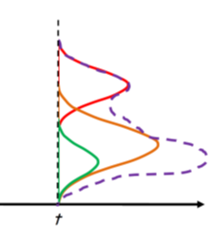
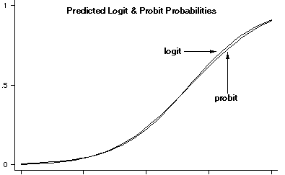
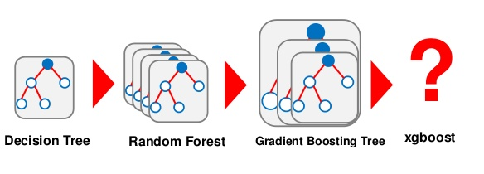
First step: Modeling with binary outcomes
Regression models
Probit model
Logistic regression
SL regression (Lasso)
Tree based models
Decision tree
Random Forest
Boosting
Other models
Neural networks
Ensemble models
Practical Tips:
Run model on entire population. No need to split the data into training/validation/test samples
Use caution with regularization methods or ensemble models.
Accuracy may not be as important as interpretability
Be diligent in variable selection - in lack of consensus in the applied literature, there are theoretical arguments in favor of the inclusion of only those variables that affect treatment assignment - Peter C. Austin 2011
Logistic Regression is the most popular method for develop the propensity score of treatment assignment

Slide 15
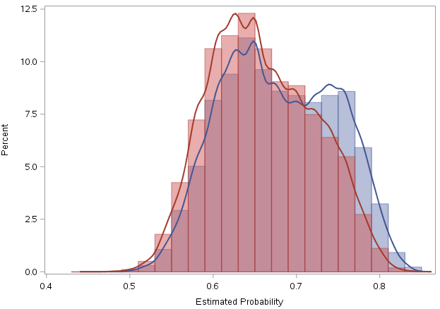
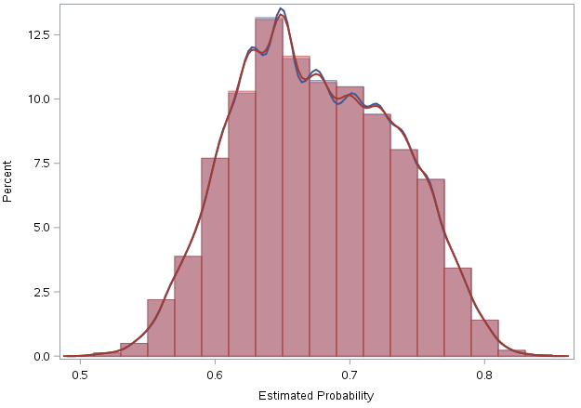
Practical Steps for matching
Estimate the probability of treatment given observables using binary estimation procedures (for example, probit or logit).
Rank treated and untreated individuals by estimated probability of treatment.
Choose untreated individuals that are “close” to treated individuals for comparison based on propensity score. There is a wealth of algorithms that can be used for this matching, including minimum distance, nearest neighbor and simply matching on digits.
Go back and check that the sample is balanced and % that’s retained
Essentially, directly compare the distributions of matched treated and untreated individuals along observable characteristics.
Review what percent of test and control are discarded in the matching process.
If too much population need to be dropped to achieve balance, causal inference may be compromised
For estimating the treatment effect, many data scientists build multiple linear regression models even though they are using matched populations. Why?
Prior to matching
After matching
Examples in MA:
Propensity match on reached and not reached population in Rx adherence outreach that were used for:
Evaluating outreach efficacy
Develop a net lift model to identify members who are more likely to be impacted by outreach programs
Reached
Unreached

Slide 16
Sample matching techniques
N → 1 Digit Greedy Match
In this specific greedy algorithm, a set of cases is matched to a set of controls. After a match is made, the match is not reconsidered. The algo start by matching at n^{th} digit and proceeds to eventually match on one digit, which works out to about 1 standard deviation of the propensity scores.
Matching options in Python and R
Differs from the greedy match in that previous matches are reconsidered before making a new match. In comparisons of the two options, the optimal match will generally outperform the greedy match but can be more computationally intensive. Packages from Python and R offers a few choices of matching algorithms and options
To be developed
import causalml
install.packages("Matching")
install.packages("MatchIt")
To be developed
Reducing Bias in a Propensity Score Matched-Pair Sample Using Greedy Matching Techniques
https://support.sas.com/resources/papers/proceedings/proceedings/sugi26/p214-26.pdf
Propensity Scores, Practical methods Using R http://journals.sfu.ca/jmde/index.php/jmde_1/article/download/431/414
Assumptions:
Strong Ignorability: The assumption that the set of observable characteristics is sufficient to explain why some individuals choose treatment and others do not. In reality, we do not usually formally test this assumption but rather state that, we are limited to matching on the available information. We control the bandwidth of the match, report the percent matched and compare .
Common support region: there needs to be a strong overlap of the distributions of propensity scores between the two groups

Slide 17
Evaluate the match/balance using pre period covariates after matching/balancing
 | Groups | Average Age | % Female | %Permit Email | Average Prospective Risk Score | Days covered pre Intervention
Before Exclusion | Intervention | 49.1 | 40.9% | 36.1% | 2.1 | 50
 | Control | 48.7 | 46.4% | 35.4% | 2.1 | 47.7
 | P-value | 0.51 | 0.01 | 0.75 | 0.91 | 0.11
 | SMD | 0.03 |  |  | 0.04 | 0.09
Post Exclusion | Intervention | 49.6 | 40.1% | 35.7% | 2.0 | 47.02
 | Control | 49.2 | 45.1% | 35.4% | 2.0 | 45.46
 | P-value | 0.13 | 0.04 | 0.91 | 0.57 | 0.51
 | SMD | 0.03 |  |  | 0.04 | 0.06
SMD can be used when studies report efficacy in terms of a continuous measurement like age, risk score and days covered
Check p-values and standardized mean difference (SMD)
A good match:
P-value > 0.05
|SMD| < 0.10
Significance testing has been frequently used to compare the distribution of measured baseline covariates between treated and untreated subjects in the propensity-score matched sample. Imai et al. have argued that the use of significance testing to assess baseline balance in the matched sample is inappropriate for two reasons. First, the sample size of the matched sample is less than that of the original unmatched sample. Thus, there is reduced statistical power to detect imbalance in the matched sample compared with in the original unmatched sample; apparent improvement in balance may be due to the reduced sample size. Second, Imai et al. suggest that balance is a property of a sample and makes no reference to a super-population. Imai et al.'s proscription against the use of significance testing has been echoed elsewhere. SMD is not influenced by sample size and is not based upon statistical hypothesis testing. - Prof. Peter C. Austin, University of Toronto 2009
Controversy in significant testing

Slide 18
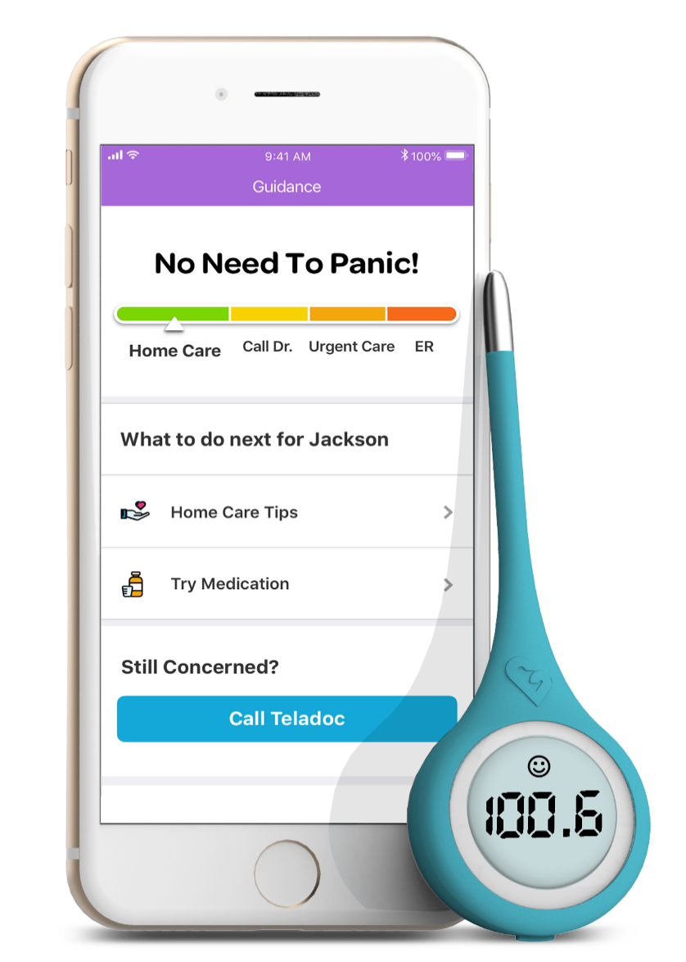
Kinsa v1 campaign was launched in October 2018 on families at risk of unnecessary ER
Hypothesis: For members at high risk of visiting ER for unnecessary reasons, Kinsa thermometer and in-app messages could effectively steer them to recommended site of care and reduce UER visits
Key proponents of propensity score matching argue that it does a reasonably good job at replicating a randomized experiment and it is reasonably easy to communicate to a non-expert audience that is accustomed to randomized experiments.
Key opponents of propensity score matching call out that – it matches only on available variables – you often need to drop large number of patients so generalizability is limited. If you cannot build a good predictive model of cohort assignment, what does that mean?
Numerous studies have shown that the method of matching is not critical, but the window of match is. Also, some researchers use a combination of propensity and exact match based on research need.
Test Group
(31.2K families)
Families with highest risk of UER visit in Commercial, Fully-insured
At least one child <= 15 years old in the family
Subscriber is Teladoc eligible and not yet registered with Teladoc
No disability in the family (e.g. hear and vision impairment)
Control Group
(3.5K families)
Same inclusion criteria as the test group
Randomly selected
Intervention
Timing: Oct 2018 to Dec (customer representative on alert in early 2019)
Channel: Multiple DM, Emails and call center (early 2019)
Call for action: “Register with Teladoc”
Incentive: “Receive a free thermometer if you register to Teladoc”
Test Group
(31.2K)
Control Group
(3.5K)
Matched control² (1.2K)
Kinsa has low adoption rate (4%, 1.3K out of 31.2K), thus making comparison between test and control less relevant
Kinsa users have different profiles (e.g., children UER risk) from control group, thus requires matching for meaningful comparison
We use propensity score matching and top predictors of Kinsa user to identify a matched control group
Kinsa user¹ 1.3K
4% adoption of Kinsa
Top predictor of Kinsa user (p<.05) | Test | Kinsa Users | Matched control | Control
% Female Subscribers | 38.2% | 45.7% | 43.7% | 37.5%
Children UER Risk | 61.9% | 63.8% | 63.4% | 61.9%
Age youngest child | 3.24 | 2.73 | 2.59 | 3.36
AH app download | 2.20% | 5.71% | 4.93% | 1.91%
Web login | 4.80% | 7.99% | 7.56% | 4.92%
Sms permission | 35.7% | 46.2% | 41.1% | 35.7%
Email permission | 60.6% | 90.2% | 90.0% | 61.1%
2 channels at launch | 52.0% | 87.5% | 87.9% | 51.5%
Visits 2 Mo Prior³ | 1.79 | 2.06 | 2.16 | 1.78
Notes:
1 Used Kinsa at least once after the shipment date
2 Matches are searched in the Holdout and Test groups (after excluding those who received Kinsa but the did not use it)
3 Total visits in 5 the POS in the 2 month prior to the campaign launch

Slide 19
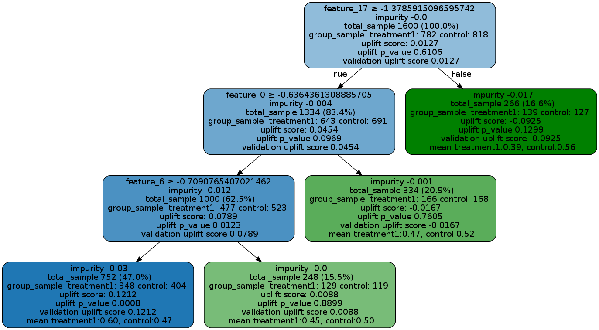
Python Package CausalML Intro
More Causal Inference Python Packages:
EconML: implements heterogeneous treatment effect estimators from
econometrics (such as instrumental variables)
DoWhy: structuring the causal inference problem through graphical models
based on Judea Pearl’s do-calculus and the potential outcomes framework.
CausalML is actively maintained and developed by the Uber development team. It is a Python package that provides a suite of uplift modeling and causal inference methods using machine learning algorithms based on recent research. 8 models in total, it provides a standard interface that allows user to estimate the Conditional Average Treatment Effect (CATE) or Individual Treatment Effect (ITE) from experimental or observational data. Essentially, it estimates the causal impact of intervention T, on outcome Y for users with observed features X, without strong assumptions on the model form.

Slide 20
Propensity Score Adjustment
Propensity score adjustment involves developing a propensity score and then inserting this score into the outcome model
Practical steps:
In propensity score matching, we repeat the statistical tests using the matched population. In propensity score adjustment, we need to take a slightly different approach so as to add the adjustment in while still measuring cohort differences.
When we run the post-adjustment models for age, baseline cost, Charlson index and gender, we should see the output where the coefficients for the indicators taking flu shots in 2018 are not significant
If, after propensity score adjustment, differences remain in the baseline characteristics, then you should adjust the propensity score model.
Cost Gap Analysis for Flu shots:
2018 Cost = β0 + β1 * 2017 Cost + β2 * Gender + β3 * Age + β4 * Charleson Index + β5 * Flu Shot 2018 + β_{6 *}P(Flushot) + ε
Causal Effect of interests:
Flu Shot Cost Savings
Age = β0 + β5 * Flu Shot 2018 + β_{6 *}P(Flushot) + ε
2017 Cost = β0 + β5 * Flu Shot 2018 + β_{6 *}P(Flushot) + ε
f(Charleson Index) = β0 + β5 * Flu Shot 2018 + β_{6 *}P(Flushot) + ε
f(Gender) = β0 + β5 * Flu Shot 2018 + β_{6 *}P(Flushot) + ε
Although some data scientists like to also explore baseline characteristics, but this must be done
with extreme caution due to the risk of collinearity. In
theory, the influence on these variables should already be captured in the propensity score.

Slide 21
Propensity Score Adjustment Example
Before Adjustment:
 | # Members | Flu Shot Taken 2018 |  | Age |  | Gender |  | Charleson Index |  | 2017 Medical Cost
Location |  | Coefficient | P-Value | Coefficient | P-Value | Coefficient | P-Value | Coefficient | P-Value | Coefficient | P-Value
Community Wellness | 5,384 | 38.71 | 0.319 | -0.12 | 0.924 | -10.30 | 0.787 | 57.04 | 0.000 | 0.50 | 0.000
After Adjustment:
 | # Members | Flu Shot Taken 2018 |  | Propensity Score
Location |  | Coefficient | P-Value | Coefficient | P-Value
Community Wellness | 5,384 | 64. 20 | 0.000 | -43.11 | 0.702
The unadjusted results show no significant differences in members who took flu shots, but the adjusted results suggested that members who took flu shots have increased medical cost than members who did not
Notes:
Launch Q4

Slide 22
Simpson’s paradox in Member Analytics Campaign
Simpson's paradox is a phenomenon in probability and statistics, in which a trend appears in several different groups of data but disappears or reverses when these groups are combined.
A fictious example of a drug that lowers blood pressure¹
 | Test Group |  | Control Group |  | Overall
 | DM | EM | DM | EM | Test | Control
Members Contacted | 358,074 | 177,067 | 18,845 | 44,265 | 535,141 | 63,110
Members Converted | 3,501 | 2,310 | 176 | 549 | 5,811 | 725
Conversion % | 0.98% | 1.30% | 0.93% | 1.24% | 1.09% | 1.15%
 | Treatment Group |  | Control Group |  | Overall
 | Low BP | High BP | Low BP | High BP | Treatment | Control
Heart Attack | 3 | 8 | 1 | 12 | 11 | 13
No heart Attack | 37 | 12 | 19 | 28 | 49 | 47
% Hear Attack | 8% | 40% | 5% | 30% | 18% | 22%
Retail to Mail Campaign results showing favorable results by communication channel, but unfavorable results when combined
This is an example from “The Book of Why”. The new science of cause and effect – by Judea Pearl and Dana Mackenzie

Slide 23
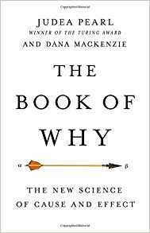
What is the truth and how to tell the truth using a causal diagram¹
Blood Pressure
Have Email
Promotion
Conversion
Drug
Heart Attack
Members having email or not is unaffected by the promotion and in addition, having email or not is co-related to the conversion rate – members with emails are more likely to convert. Having email also affects how the promotion is conveyed. Here, having emails or not is a confounder that we must adjust for:
Test group conversion = 1.14% (average of 0.98% and 1.30%)
Control group conversion = 1.09% (average of 0.93% and 1.24%)
* Marginal means, LS-means, adjusted means
Here, blood pressure is a mediator, lowered blood pressure is the result of the drug. Stratifying the data is unnecessary. The aggregated data is the “Truth” .
Causal Diagram was discussed in Judea Pearl’s several books. He is a professor of computer science at UCLA and winner of the 2011 Turing Award and the author of three classic technical books on causality. He lives in Los Angeles, California.

Slide 24
Evaluation using generalized linear mixed model (GLMM)
> install.packages("lme4")
> library(lme4)
> r2m_sum <- data.frame(
"Group"=c(1,2,1,2),
"Channel"=c(1,1,2,2),
"N"=c(358074,18845,177067,44265),
"Y"=c(3501, 176, 2310,549))
> df.glmm1 <- glmer(y/n ~ group + (1|Channel),
data = r2m_sum,
family="binomial",
Weights=n,
control = glmerContro(optimizer= “bobyqa”), nAGQ=0))
> print(df.glmm1, corr=F)
Under research …
Model calculates the least square mean
group | Estimate | Standard Error | DF | t Value | LS Mean | Standard Error of Mean
Test | (4) | 0 | 1 | -332.31 | 0.01129 | 0.00015
Control | (5) | 0 | 1 | -119.18 | 0.01075 | 0.000404
Model compares the least square mean of the test and control and concludes it is not statistically significant
group | group | Estimate | Standard Error | DF | t Value | Pr > |t| | Adj P
Test | Control | 0 | 0.04069 | 1 | 1.23 | 0.4358 | 0.4358
https://stats.idre.ucla.edu/other/mult-pkg/introduction-to-generalized-linear-mixed-models/
https://cran.r-project.org/web/packages/lme4/lme4.pdf

Slide 25
Revisit concepts covered in this workshop
Causal Inference (sequence, association and counterfactual)
Evaluation design ( pre-post, design with control , diff-in-diff)
Random sampling ( it does not take care of everything)
Balance (check, check and check again)
Hypothesis testing (pay attention to distribution)
Multiple regression (pay attention to assumptions)
Propensity matching and adjustment (are you interested in the subsegment or causal inference?)
De-confounding using causal diagram and back door criterion
Design of Experiment
Execute
Design Evaluation
Test hypothesis
Check balance
Check balance
Check balance
Notes:
Launch Q5

Slide 26


References
Online resources:
An overview of randomization techniques: An unbiased assessment of outcome in clinical research
KP Suresh
https://www.ncbi.nlm.nih.gov/pmc/articles/PMC3136079/
Balance diagnostics for comparing the distribution of baseline covariates between treatment groups in propensity-score matched samples
Peter C. Austin
https://www.ncbi.nlm.nih.gov/pmc/articles/PMC3472075/
An Introduction to Propensity Score Methods for Reducing the Effects of Confounding in Observational Studies
Peter C. Austin
https://www.ncbi.nlm.nih.gov/pmc/articles/PMC3144483/#s11title
Why Propensity Scores Should Not Be Used for Matching
Gary King etl
https://gking.harvard.edu/files/gking/files/psnot.pdf
Introduction to Generalized Linear Models
https://stats.idre.ucla.edu/other/mult-pkg/introduction-to-generalized-linear-mixed-models/
Packages used in this presentation:
SciPy.Stats: https://docs.scipy.org/doc/scipy/reference/stats.html
Causalml: https://pypi.org/project/causalml/
Lme4: https://cran.r-project.org/web/packages/lme4/lme4.pdf
Howard Friedman & Paul Thurman
Mailman School of Public Health
Columbia University
Propensity Score Matching, Adjustment and Randomized Experiment © 2016
Judea Pearl & Dana Mackenzie
Samueli School of Engineering
University of California, Los Angeles
The Book of Why © 2018

Slide 27
Let's discuss: your cases your methods

