Slide 1
Join Terminology: Cartesian Product
Characteristics of a Cartesian product
Combine all possible combinations of two sets
In SQL queries, usually undesired
Special case: table of numbers
Name | Product
Davis | Alice Mutton
Davis | Crab Meat
Davis | Ipoh Coffee
Funk | Alice Mutton
Funk | Crab Meat
Funk | Ipoh Coffee
King | Alice Mutton
King | Crab Meat
King | Ipoh Coffee
Name
Davis
Funk
King
Product
Alice Mutton
Crab Meat
Ipoh Coffee
Notes:
20461C
4: Querying Multiple Tables

Slide 2
Overview of Join Types
Join types in FROM clauses specify the operations performed on the virtual table:
Join Type | Description
Cross | Combines all rows in both tables (creates Cartesian product)
Inner | Starts with Cartesian product; applies filter to match rows between tables based on predicate
Outer | Starts with Cartesian product; all rows from designated table preserved, matching rows from other table retrieved. Additional NULLs inserted as placeholders
Notes:
20461C
4: Querying Multiple Tables

Slide 3
Inner Join Syntax
List tables in FROM Clause separated by JOIN operator
Table aliases preferred
Table order does not matter
FROM t1 JOIN t2
ON t1.column = t2.column
SELECT o.orderid,
o.orderdate,
od.productid,
od.unitprice,
od.qty
FROM Orders AS o
INNER JOIN OrderDetails AS od
ON o.orderid = od.orderid;
Notes:
20461C
4: Querying Multiple Tables

Slide 4
Outer Join Syntax
Return all rows from first table, only matches from second:
Return all rows from second table, only matches from first:
Return only rows from first table with no match in second:
FROM t1 LEFT OUTER JOIN t2 ON
t1.col = t2.col
FROM t1 RIGHT OUTER JOIN t2 ON
t1.col = t2.col
FROM t1 LEFT OUTER JOIN t2 ON
t1.col = t2.col
WHERE t2.col IS NULL
Notes:
20461C
4: Querying Multiple Tables

Slide 5
Outer Join Examples
All customers with order details if present:
Customers that did not place orders:
SELECT c.custid, c.contactname, o.orderid, o.orderdate
FROM Customers AS C
LEFT OUTER JOIN Orders AS O
ON c.custid = o.custid;
SELECT c.custid, c.contactname, o.orderid, o.orderdate
FROM Customers AS C LEFT OUTER JOIN Orders AS O
ON c.custid = o.custid
WHERE o.orderid IS NULL;
Notes:
20461C
4: Querying Multiple Tables

Slide 6
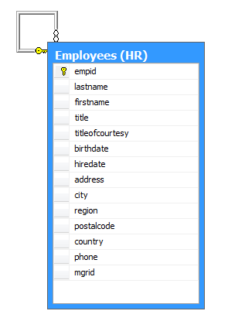
Understanding Self Joins
Why use self joins?
Compare rows in same table to each other
Create two instances of same table in FROM clause
At least one alias required
Example: Return all employees and the name of the employee’s manager
Notes:
20461C
4: Querying Multiple Tables

Slide 7
Self Join Examples
Return all employees with ID of employee’s manager when a manager exists (inner join):
SELECT e.empid, e.lastname,
e.title, e.mgrid, m.lastname
FROM Employees AS e
LEFT OUTER JOIN Employees AS m
ON e.mgrid=m.empid ;
Notes:
20461C
4: Querying Multiple Tables

