Slide 1
Optimizing OList: Inventory Management and Market Basket Analysis for Cost Reduction

Slide 2
Agenda
Objective
Background
Key findings
Recommendations
Appendix:
Data methodology

Slide 3
Objective
Identify top products that contribute to the revenue.
Identify top products by order quantity.
Use market basket analysis to analyze the purchase behavior of individual customers.
Having specific categories in hand that will be beneficial to the company.
To reduce the number of items in a particular category to increase profit.

Slide 4
Background
OList is an e-commerce company that has faced some losses recently.
They want to manage their inventory very well so as to reduce any unnecessary costs that they might be bearing.
OList wants to identify the product categories which they can get rid of without significantly impacting business.

Slide 5
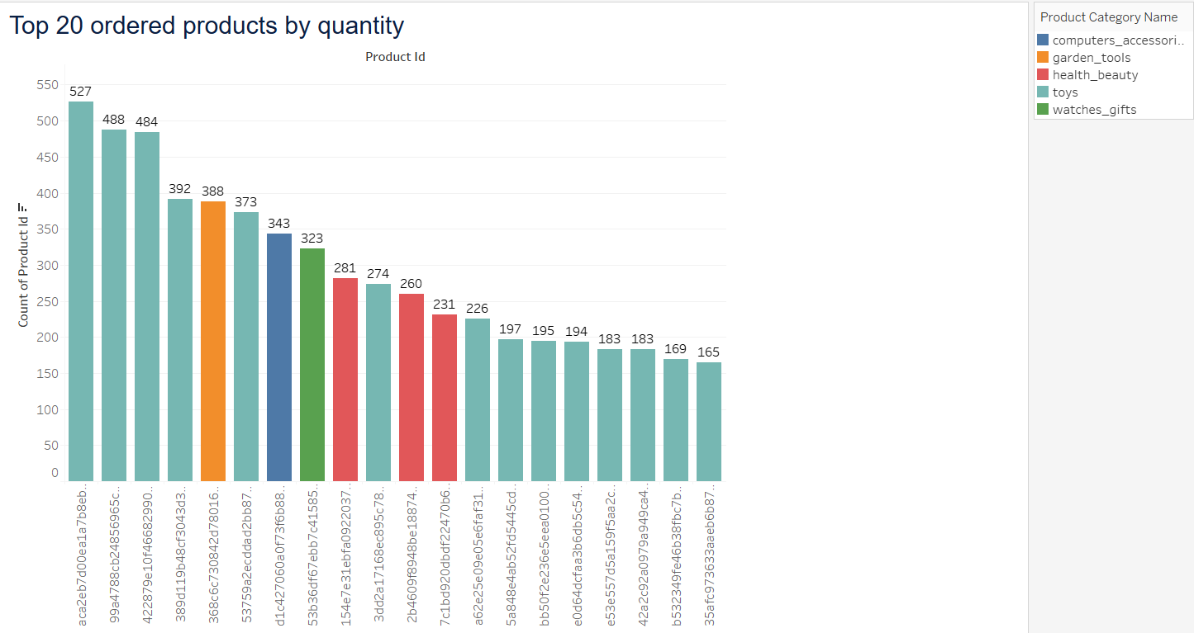
Key Findings
Top 20 Ordered Products By Quantity:
The most ordered product by quantity has been ordered 527 times and it belongs to the category “toys”.
14 out of 20 top ordered products by quantity belong to the category “toys”.

Slide 6
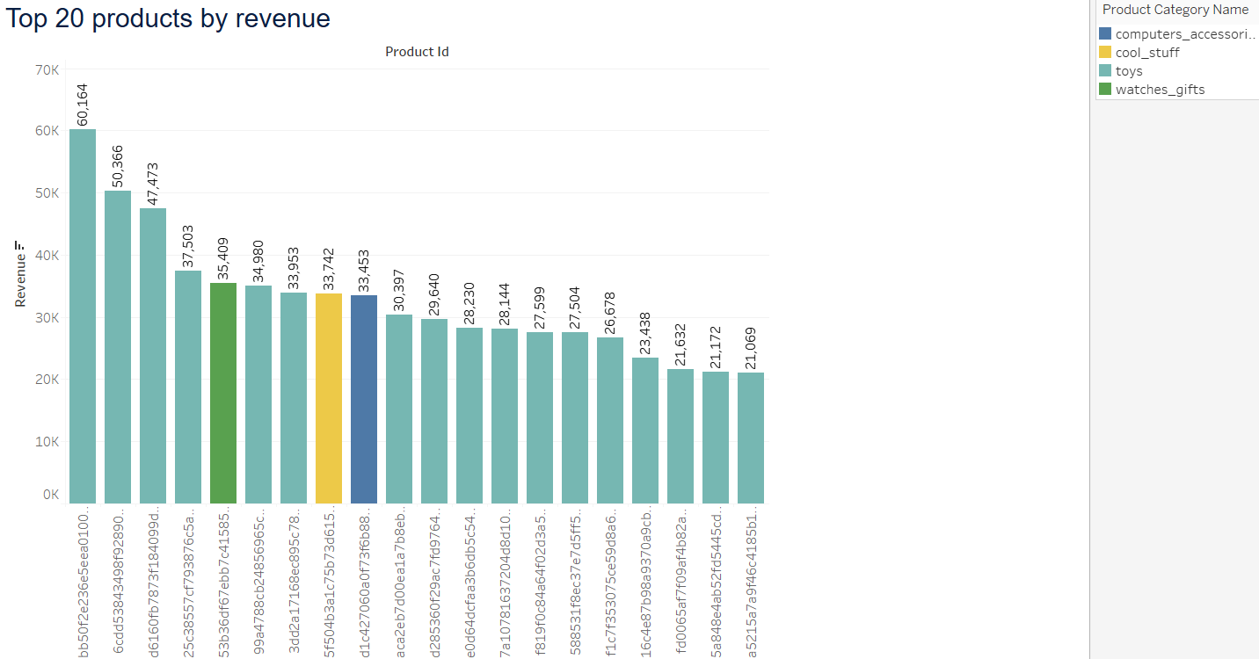
Key Findings
Top 20 Products By Revenue:
The product having the highest revenue of $60,164 belongs to the category “toys”.
17 out of 20 top products by Revenue belong to the category “toys”.

Slide 7
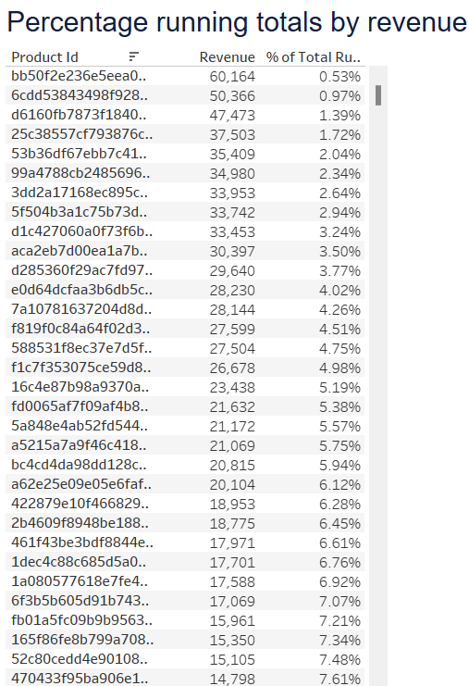
Key Findings
Percentage running total by revenue:
Top revenue generating products along with their running total percentage of revenue can be discerned with the help of this table.
A revenue percentage can be capped and business can focus more on those products that are contributing to that revenue percentage.

Slide 8
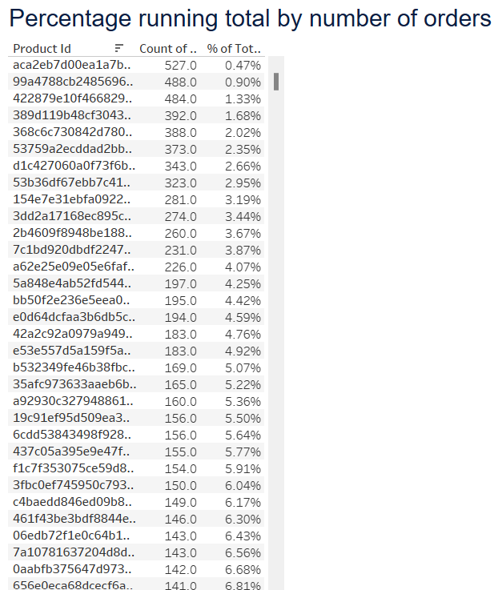
Key Findings
Percentage running total by number of orders:
Top most ordered products along with their running total percentage of number of orders can be discerned with the help of this table.
An order quantity percentage can be capped and business can focus more on those products that are contributing to that order quantity percentage.

Slide 9
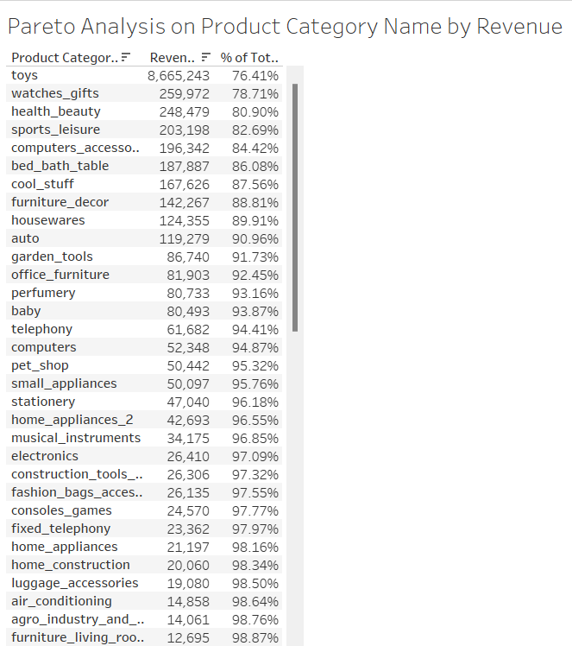
Key Findings
Pareto Analysis on Product Category Name by Revenue:
The top 3 categories by revenue are “toys”, ”watches_gifts” and “health_beauty”.
The top 3 categories by revenue account for 80.90% of the total revenue generated by the business.

Slide 10
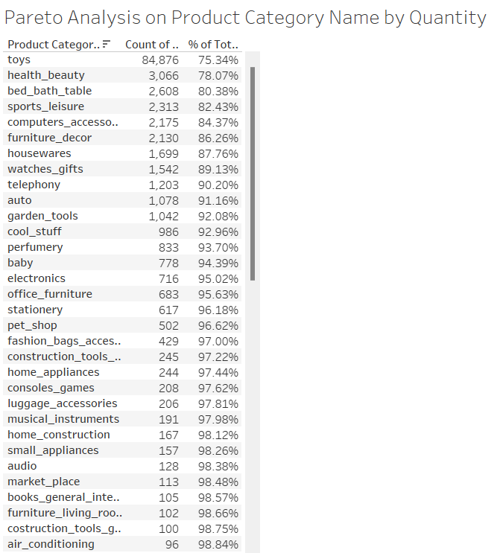
Key Findings
Pareto Analysis on Product Category Name by Order Quantity:
The top 3 categories by order quantity are “toys”, ”health_beauty” and “bed_bath_table”.
The top 3 categories by order quantity account for 80.38% of the total order quantity delivered by the business.

Slide 11
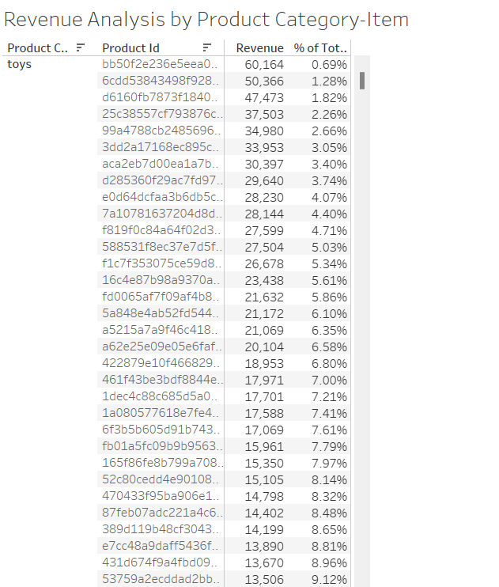
Key Findings
Revenue Analysis by Product Category-Item:
In this table, the top 3 categories by revenue have been further investigated on the revenue contribution of each product to the business.
The business can reduce the number of items per category based on their revenue contribution.

Slide 12
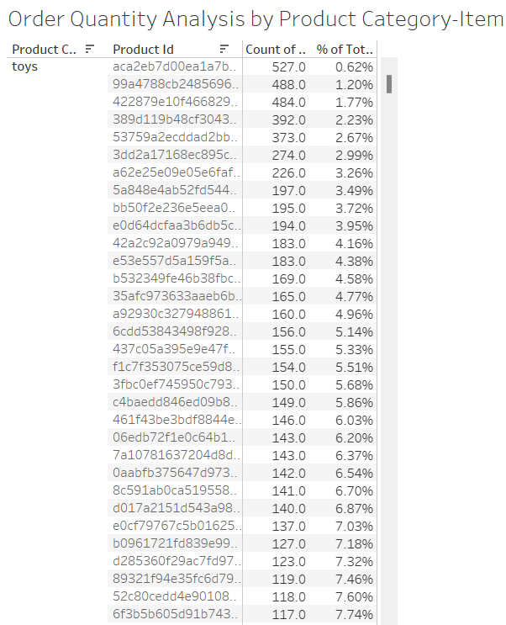
Key Findings
Order Quantity Analysis by Product Category-Item:
In this table, the top 3 categories by order quantity have been further investigated on the order quantity contribution of each product to the business.
The business can reduce the number of items per category based on their order quantity contribution.

Slide 13
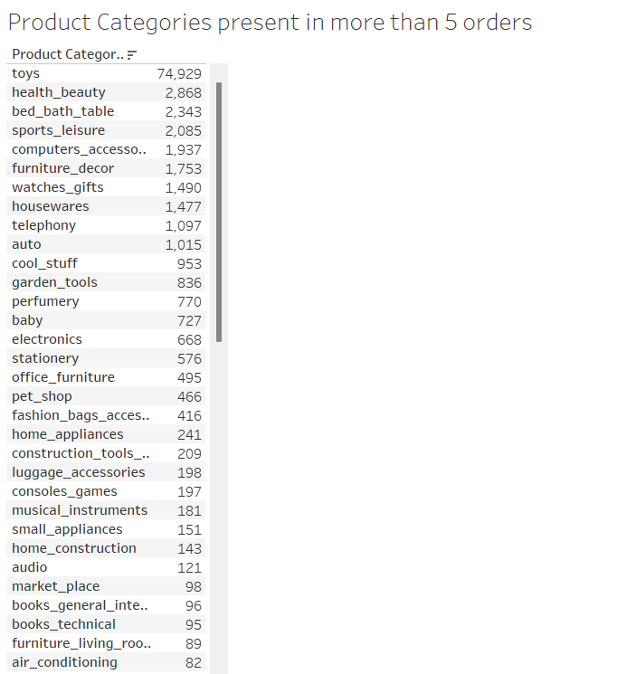
Key Findings
Product Categories present in more than 5 orders(Market Basket Analysis):
In this table, the categories which have been ordered at least once in any order have been listed .
The business can put a number of minimum order cap and focus on those shortlisted product categories.

Slide 14
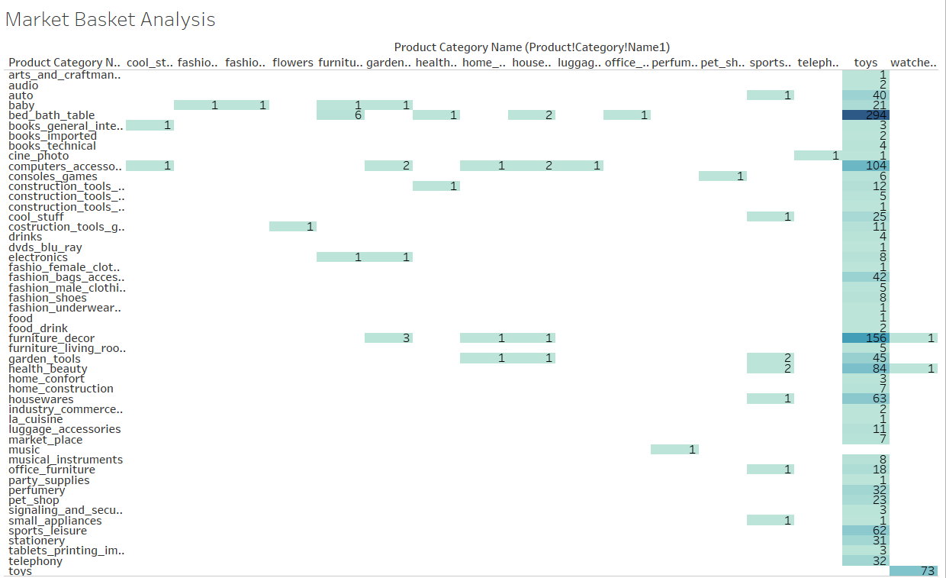
Key Findings
Combination of Product Categories(Market Basket Analysis):
In this table, the combination of categories which have been ordered at least once in any order have been listed.
It can be seen that “toys”&”bed_bath_table” is the best combination followed by “toys”&”furniture_decor” and “toys”&”computers_accessories”.

Slide 15
Recommendations
The business should focus on top products by order quantity and make sure to have them in their inventory as well.
The business should also focus on top products by revenue and make sure to have them in their inventory as well.
A revenue percentage can be capped and business can focus more on those products that are contributing to that revenue percentage.
An order quantity percentage can be capped and business can focus more on those products that are contributing to that order quantity percentage.
Since, “toys”, ”watches_gifts” and “health_beauty” account for 80.90% of the total revenue generated by the business. These categories should be their go to categories.
Since, “toys”, ”health_beauty” and “bed_bath_table” account for 80.38% of the total order quantity delivered by the business. These categories should also be a part of their go to categories.
In the combination of strongly associated categories which have been ordered at least once in any order, “toys”&”bed_bath_table” is the best combination followed by “toys”&”furniture_decor” and “toys”&”computers_accessories”. The business should come up with strategies to manage the inventory accordingly.

Slide 16
Appendix
Data Methodology:
Data cleaning & transformation: Python
Data visualisation: Tableau

Slide 17
Thank you

