Slide 1
Empowering Farmers Through PASHU VIGYAN KENDRA: Enhancing Livelihoods and Animal Productivity

Slide 2
Agenda
Problem Statement
Objectives
Approach
Key Findings
Recommendations
Appendix
Data methodology

Slide 3
Problem Statement
Pashu Vigyan Kendras are initiatives focused on sustaining and enhancing animal productivity to improve the livelihoods of farmers. These centers play a crucial role in providing agricultural support and information to farmers.
The primary goal of PVKs is to increase animal productivity, thereby improving the economic condition of farmers by enhancing the quantity and quality of animal products like milk.
Currently, PVKs operate with a hierarchical structure, where the Gram Sakhis serve as a vital link between the PVKs and the end-users, i.e., the farmers. Gram Sakhis are responsible for selling food for cattle and interacting directly with farmers.
One of the significant challenges faced by PVKs is the absence of a formal process for collecting detailed purchase-level data. This includes information such as order dates, quantities of food bags sold, sales figures, and demographic data of farmers.
To address these challenges and improve the effectiveness of PVK operations, a structured approach to data collection and analysis is required. This approach will enable PVKs to gather essential insights into farmer behavior, purchase patterns, and demographics, which can be used to tailor offerings and enhance animal productivity and farmer livelihoods. Additionally, our approach can address the challenge faced by Gram Sakhis, who struggle to maximize sales and earnings due to the absence of detailed purchase-level data.

Slide 4
Objectives
Creating a data architecture and then developing and implementing a structured data collection process to gather purchase-level data, including order dates, quantities of food bags sold, and sales figures, at each PVK.
Gather demographic data of farmers, including information on income, number of cattle, and other relevant factors, to understand their preferences and buying patterns.
Analyze purchase behavior to identify trends, such as preferred brands and pricing, frequency of purchases, and seasonal variations, to inform decision-making.
Use the collected data to personalize food offerings for farmers based on their demographics and buying patterns, aiming to increase adoption of nutritious food for cattle.
Promote the exclusive use of nutritious cattle food sourced from Gram Sakhis, discouraging farmers from using their own produce or purchasing non-nutritious brands. By emphasizing the benefits of these products for animal health and productivity, aim to establish a preference among farmers for nutritious cattle food from Gram Sakhis. This initiative will not only enhance farmer livelihoods but also increase sales for Gram Sakhis, benefiting both parties.
By enhancing animal productivity through personalized food offerings, aim to improve the economic condition of farmers and contribute to their overall livelihood improvement.
Improve the efficiency of PVK operations by enabling informed decision-making based on data-driven insights, leading to better resource allocation and service delivery.
Empower stakeholders with a comprehensive dashboard that serves to assist Gram Sakhis among others. This dashboard will provide valuable insights, such as preferred brands and pricing, frequency of purchases, and seasonal variations, enhancing their sales strategies and earnings.
Establish a data-driven approach that can be sustained over the long term, ensuring continued improvement in animal productivity and farmer livelihoods.

Slide 5
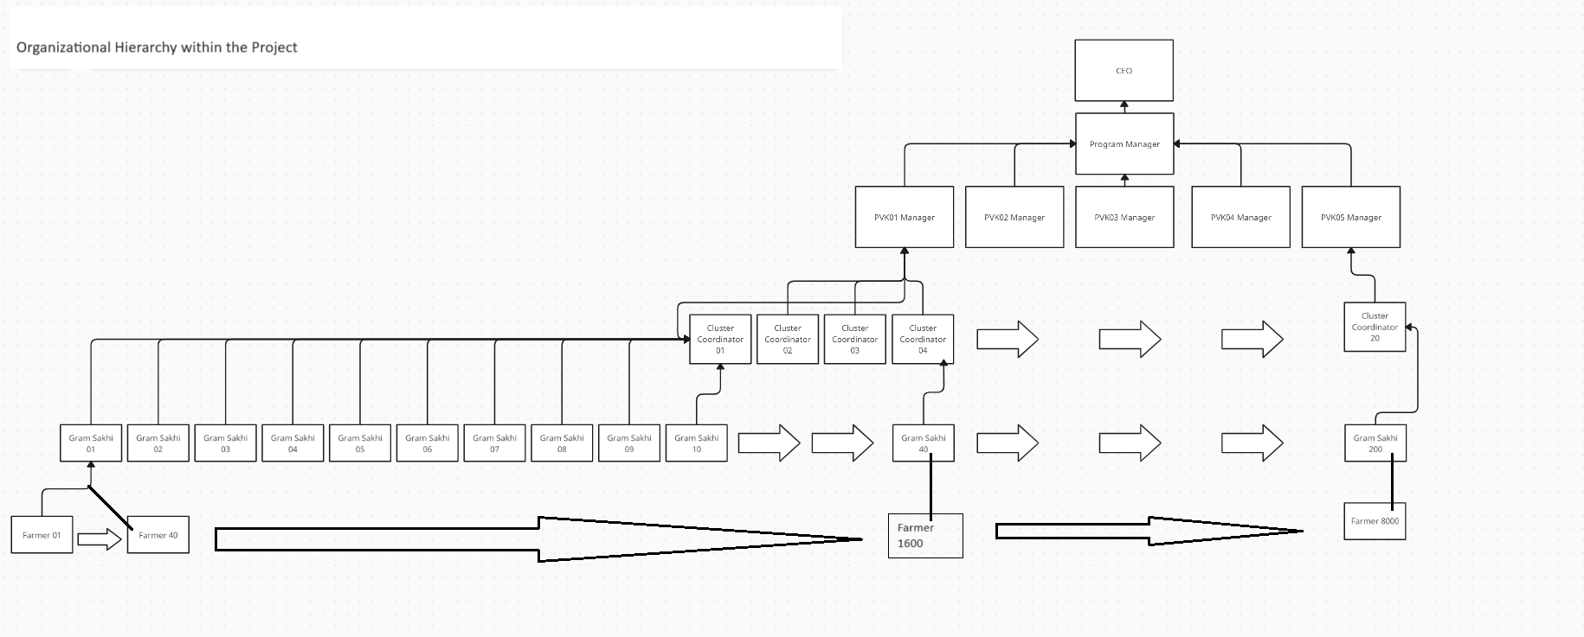
Approach Organizational Hierarchy within the Project

Slide 6
Approach Zooming In: Focus Area for Project Demonstration
For the project demonstration, we will focus solely on the first PVK.
This process will be replicated for the others when the project goes live.

Slide 7
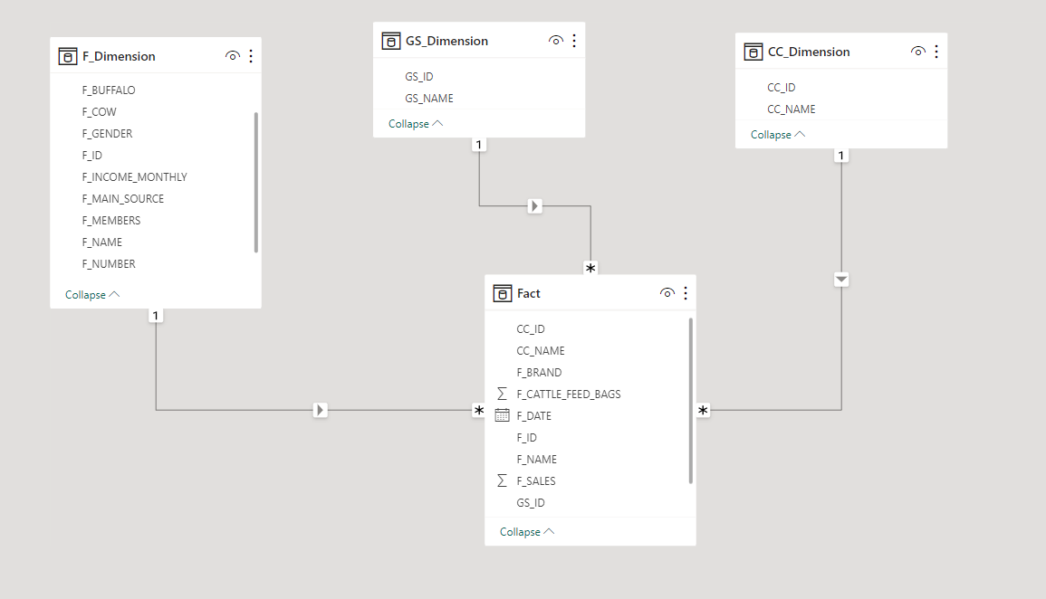
Approach
Creating a Data Architecture
Adopted a star schema model
Fact table: Purchase order data
Dimension tables: Cluster coordinators, Gram Sakhis, and farmers
Ensures efficiency and scalability

Slide 8
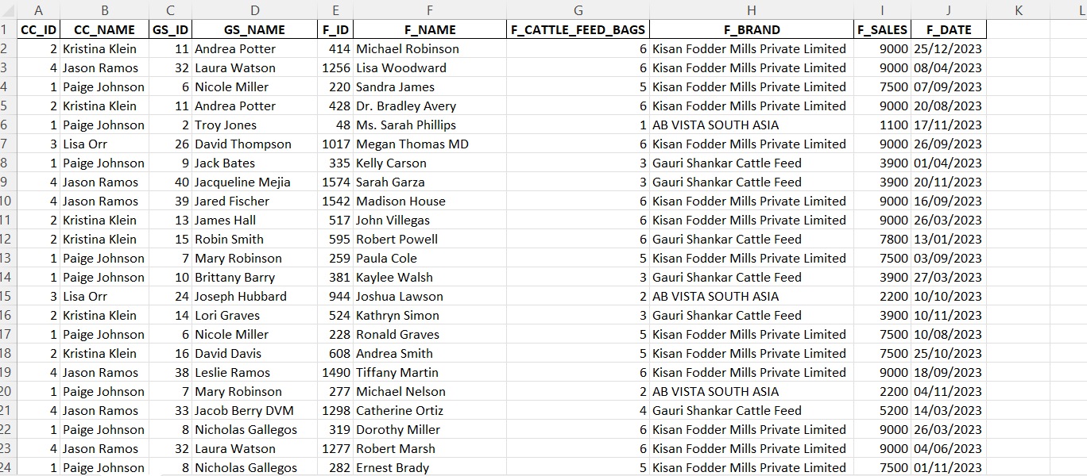
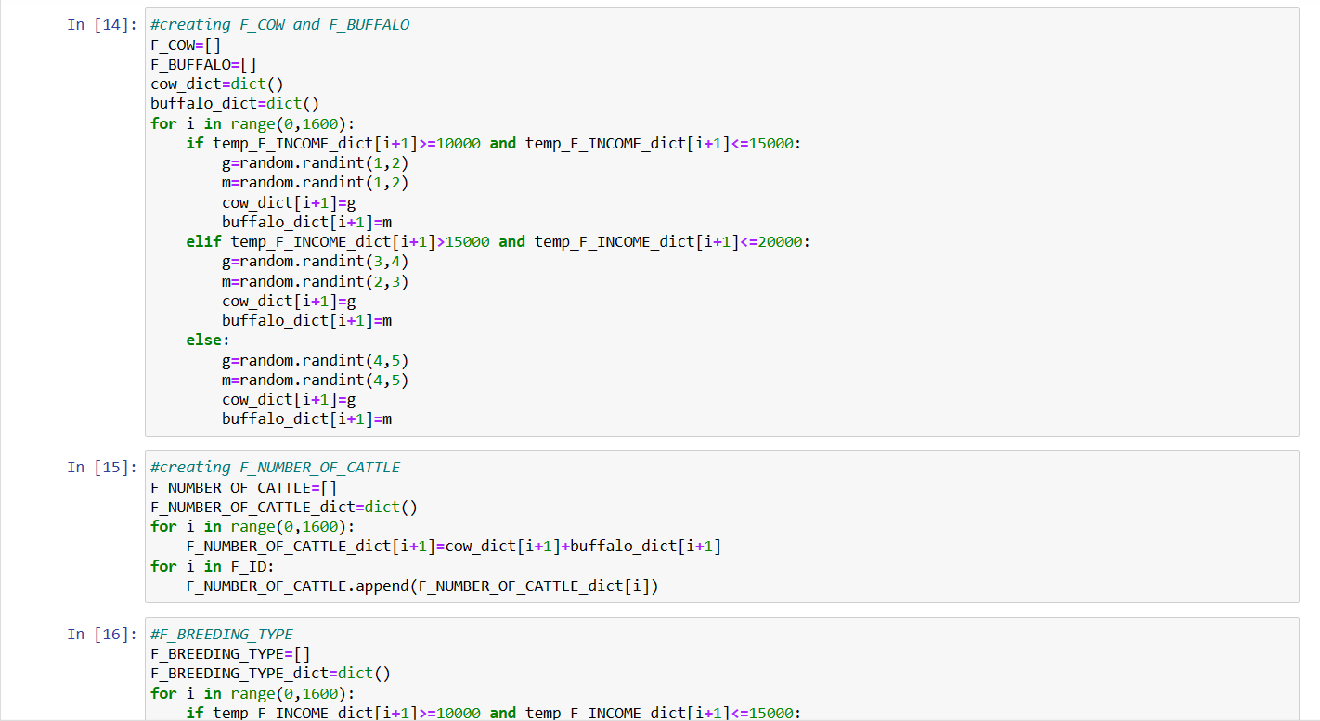
Approach
Data Generation Using Python
Since this project is adopting a data-driven approach for the first time, it is crucial to generate data to proceed with our proposed process and demonstrate its potential impact.
Developed complex Python functions to generate data which mimics real-life scenarios in PVKs, including purchase orders and farmer demographics.

Slide 9
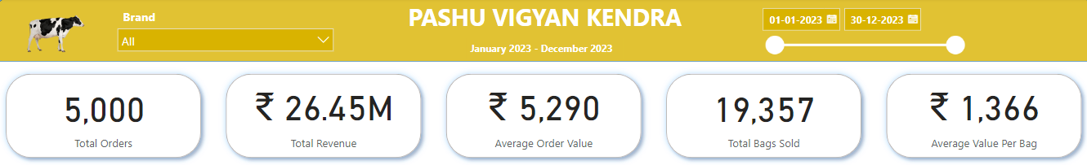
Key Findings
Key Performance Indicators
In 2023, a total of 5,000 orders were processed.
19,357 bags were sold during the year.
The average value per bag was Rs. 1,366.
The total revenue generated was approximately Rs. 26.45 million.
The average order value was Rs. 5,290.

Slide 10
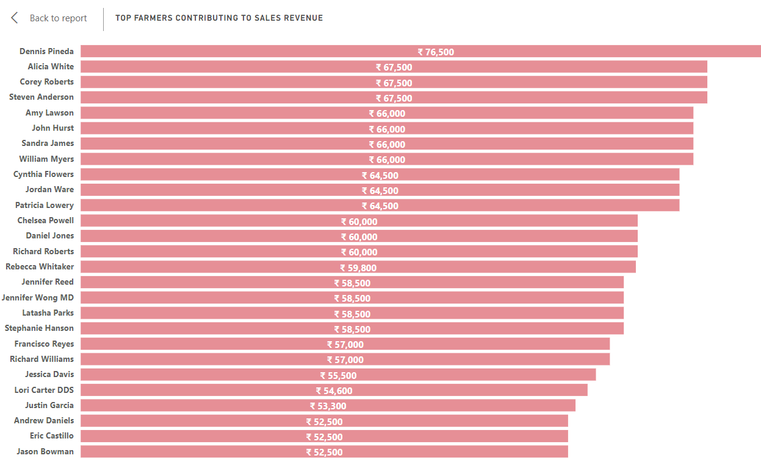
Key Findings
Top Farmers Contributing to Sales Revenue
This graph illustrates the top farmers who generate a sales revenue of greater than equal to 50,000 rupees.

Slide 11
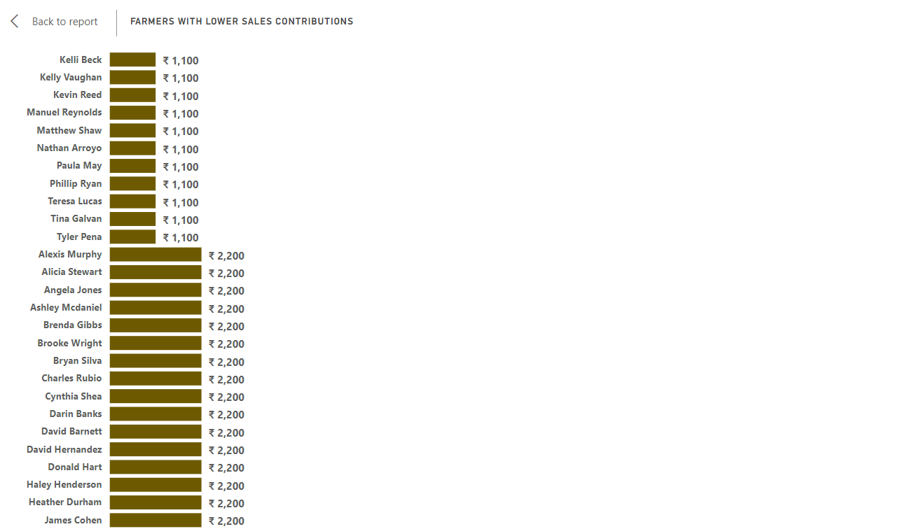
Key Findings
Farmers with Lower Sales Contribution
This graph displays the distribution of sales contributions from farmers, generating a sales revenue of less than 50,000 rupees.

Slide 12
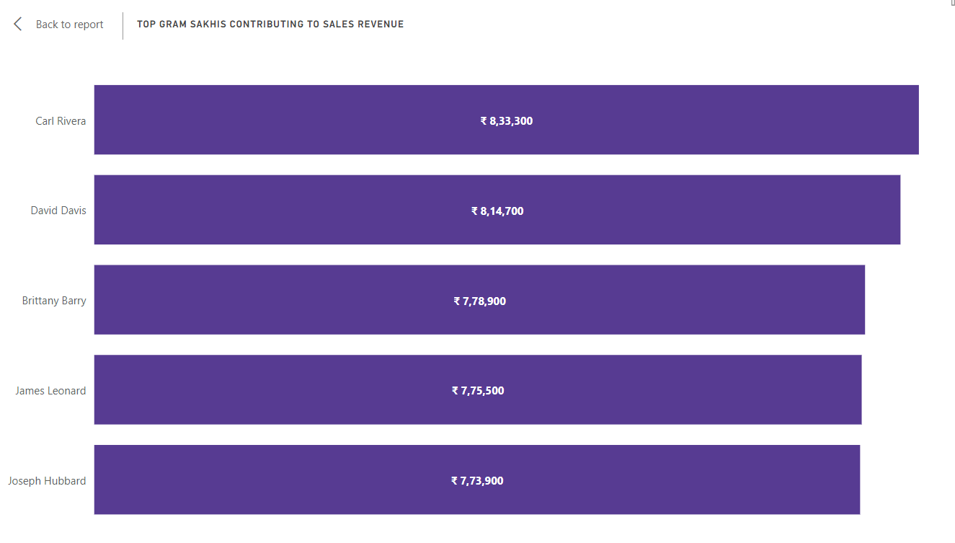
Key Findings
Top Gram Sakhis Contributing to Sales Revenue
This graph illustrates the top Gram Sakhis whose contributions significantly impact sales.

Slide 13
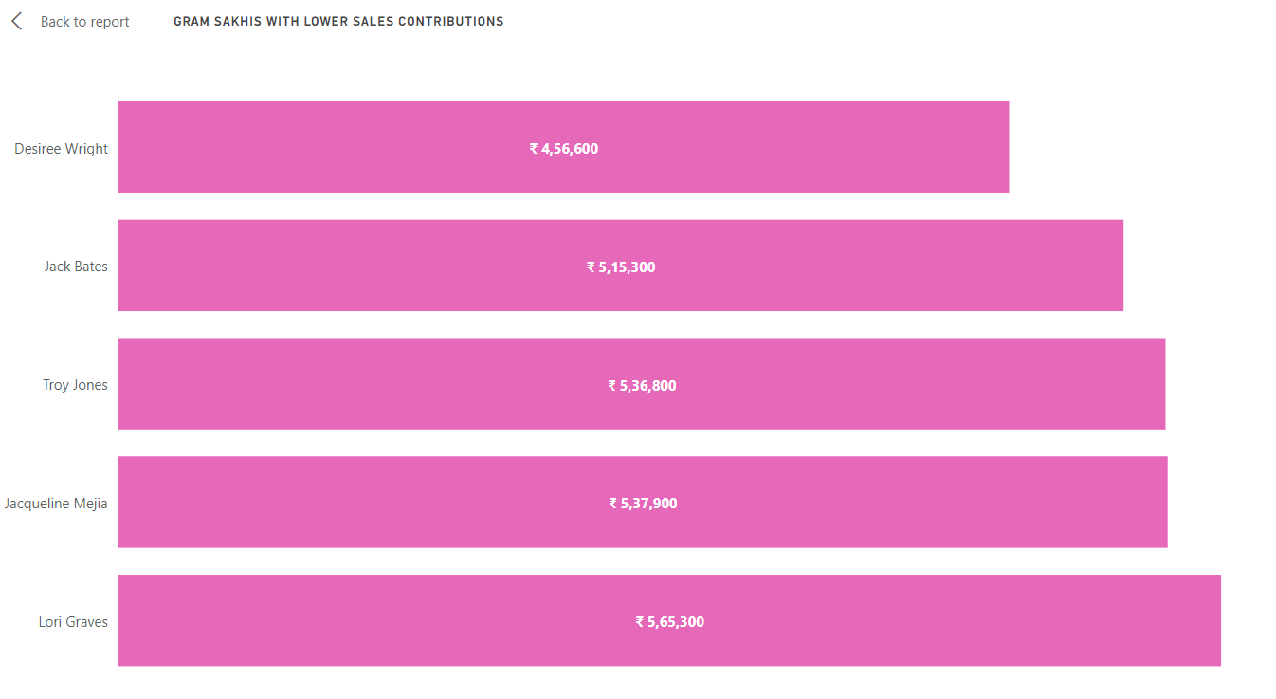
Key Findings
Gram Sakhis with Lower Sales Contribution
This graph displays the distribution of sales contributions from Gram Sakhis, emphasizing the diversity in their participation levels and highlighting opportunities for engagement and growth.

Slide 14
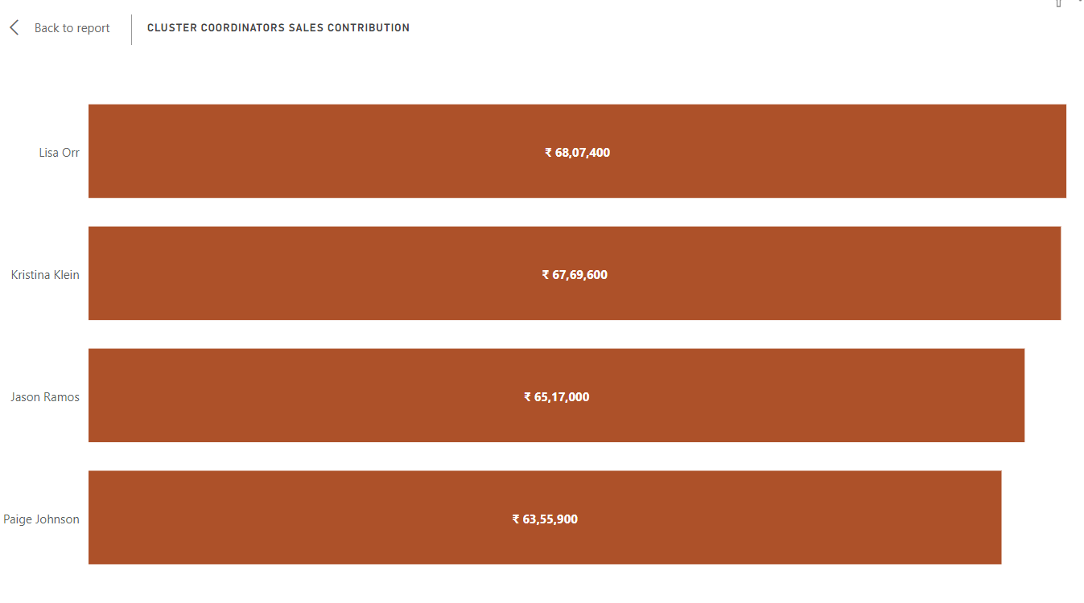
Key Findings
Cluster Coordinators Sales Contribution
This graph illustrates the sales contributions of cluster coordinators, showcasing their impact on overall sales performance.

Slide 15
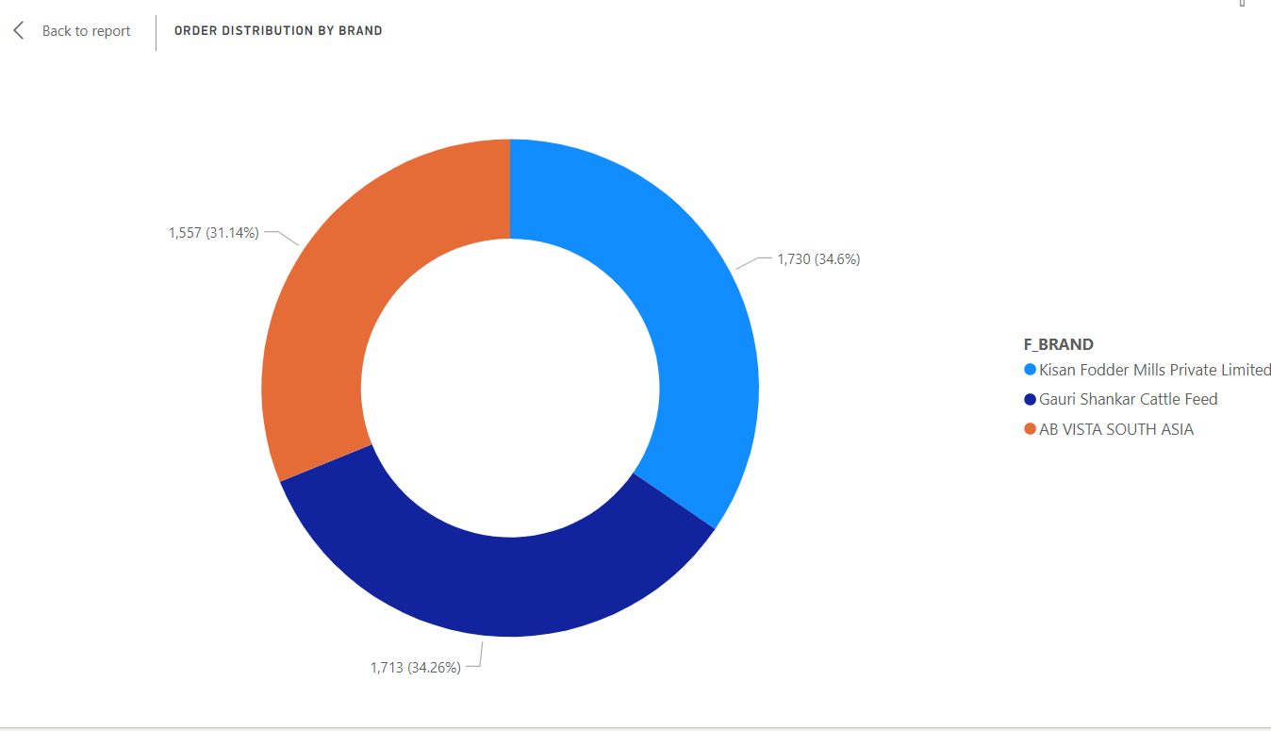
Key Findings
Order Distribution by Brand
Kisan Fodder Mills Private Limited has been ordered the most number of times followed by Gauri Shankar Cattle Feed and AB VISTA SOUTH ASIA

Slide 16
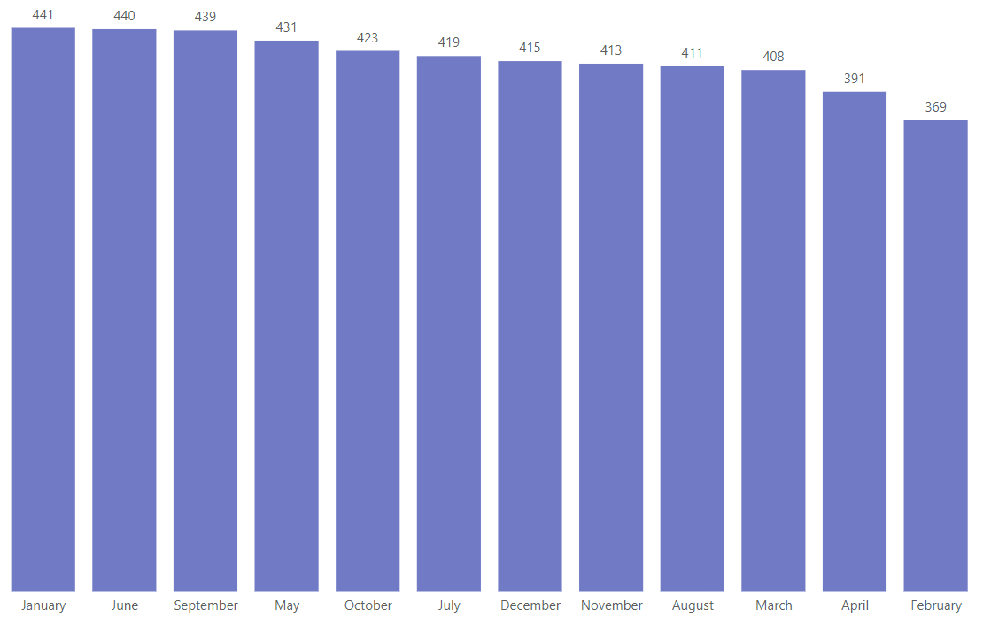
Key Findings
Top 5 Months by Orders
The month of January, June and September observed almost an equal number of orders which was the maximum amongst all the months.
February observed the least number of orders.

Slide 17
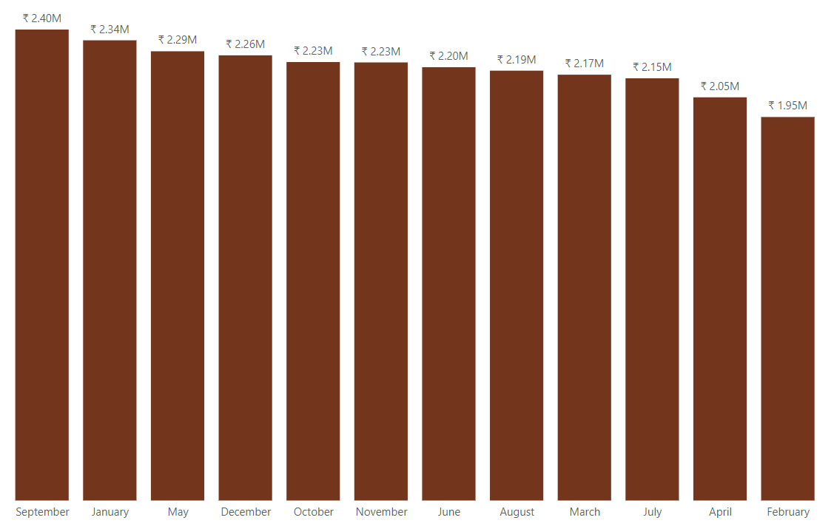
Key Findings
Top 5 Months by Sales Revenue
The month of September observed a revenue generation of about 2.40 million rupees which was the maximum amongst all the months.
February observed the least sales revenue generation.

Slide 18
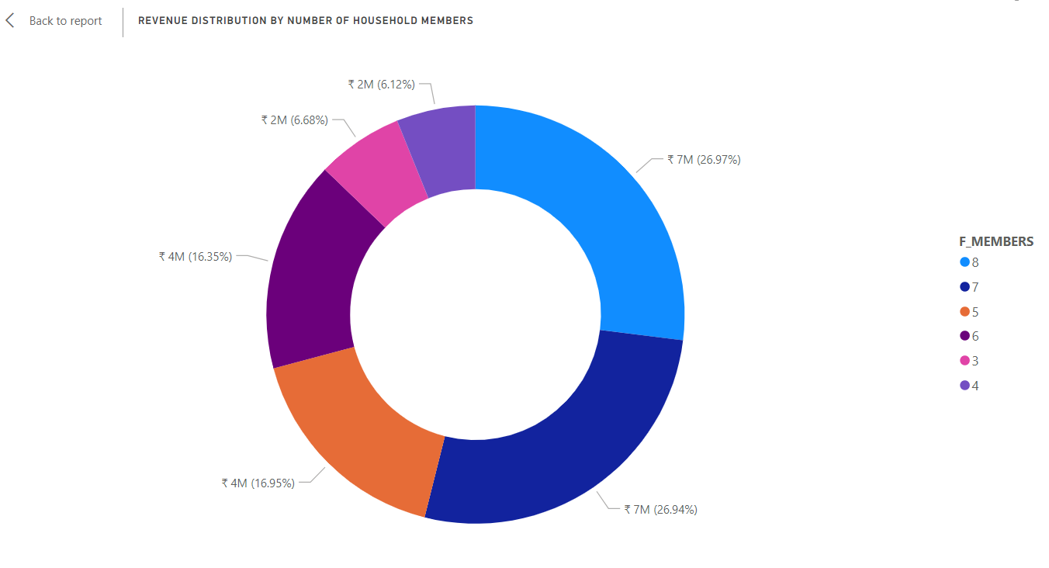
Key Findings
Revenue Distribution by Number of Household Members
The pie chart illustrates that households with 8 and 7 members have the highest revenue share, followed by households with 6 and 5 members, and then by households with 4 and 3 members. This pattern indicates a correlation between household size and purchasing power, with larger households contributing more to sales revenue.

Slide 19
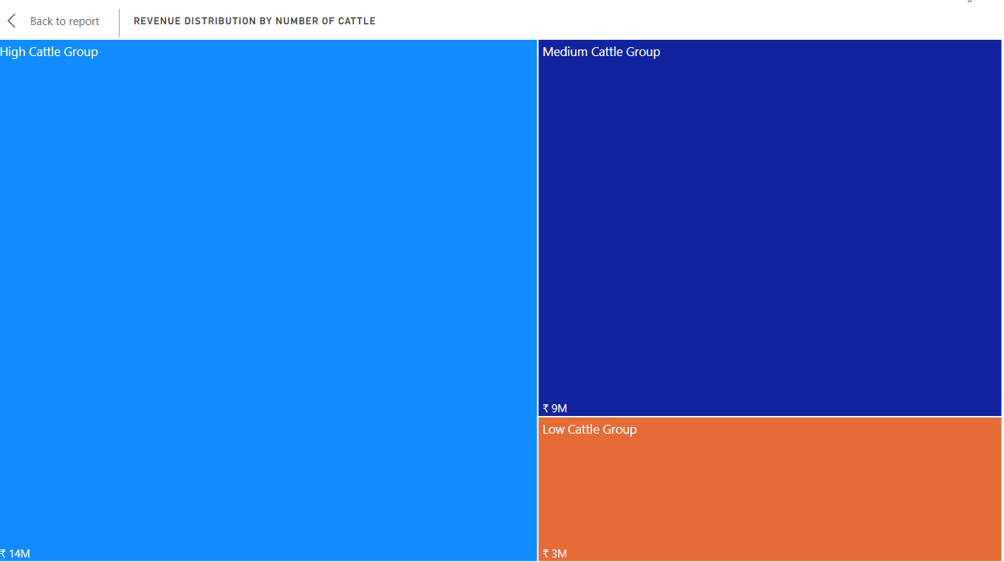
Key Findings
Revenue Distribution by Number of Cattle
The tree map shows that the high cattle group, comprising households with 8, 9, or 10 cattle, has the highest sales revenue. This is followed by the medium cattle group 5, 6, or 7 cattle and then the low cattle group 2, 3, or 4 cattle.
The visualization highlights the impact of cattle ownership on sales revenue, with households owning more cattle contributing significantly more to sales compared to those with fewer cattle.

Slide 20
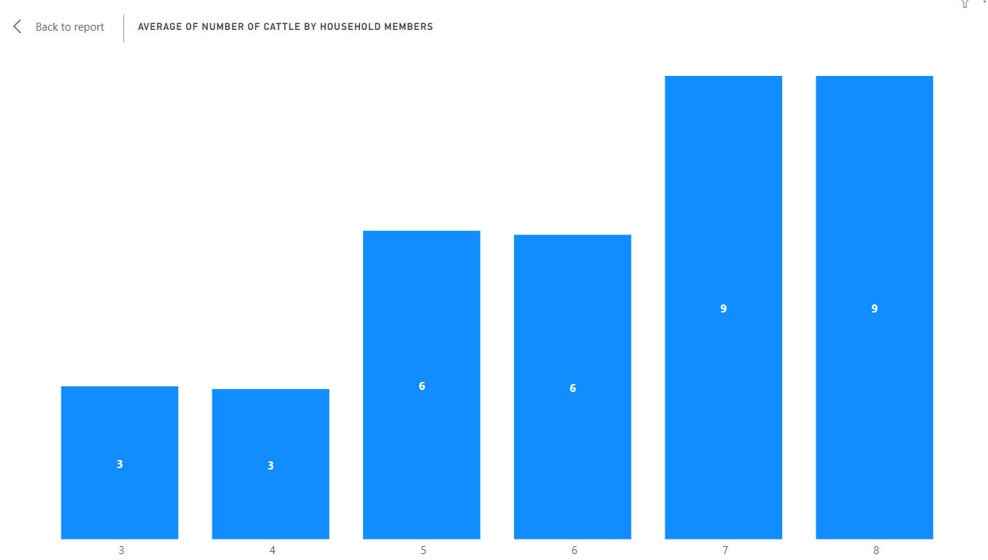
Key Findings
Average of Number of Cattle by Household Members
The graph reveals distinct patterns in cattle ownership based on the number of household members. Families with 3 or 4 members have an average of 3 cattle, while families with 5 or 6 members have an average of 6 cattle. The trend continues with families of 7 or 8 members having an average of 9 cattle.
The data suggests a correlation between household size and cattle ownership, with larger families tending to own more cattle on average.

Slide 21
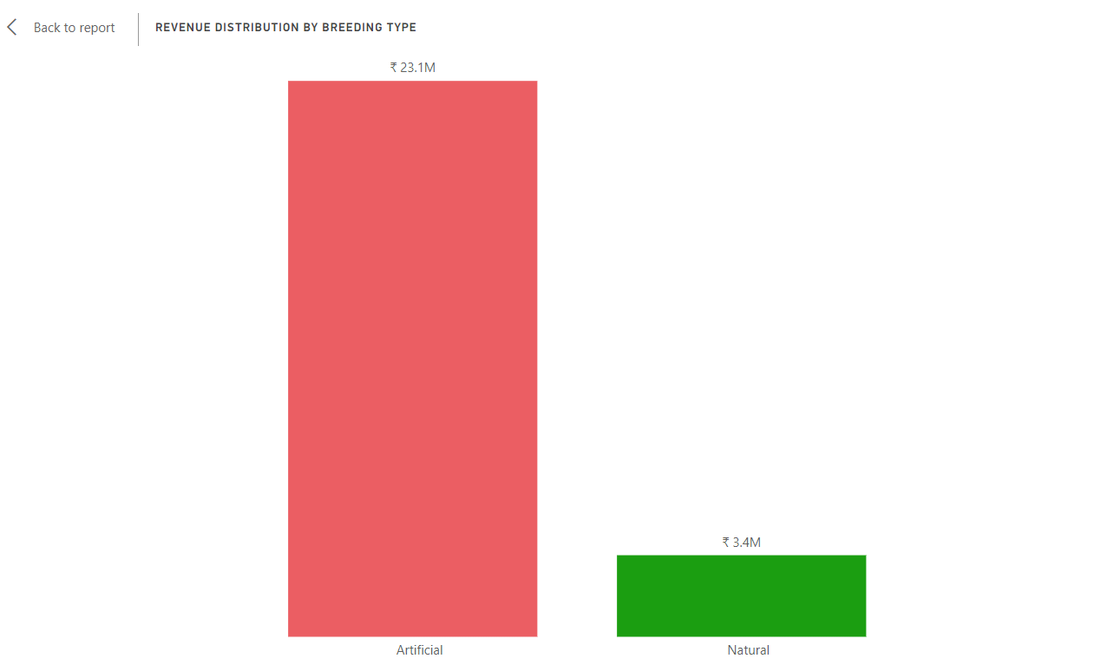
Key Findings
Revenue Distribution by Breeding Type
The graph depicts that the Artificial Breeding type has a higher sales revenue compared to the Natural Breeding type. This indicates a stronger preference or higher adoption rate of Artificial Breeding among customers, resulting in greater revenue generation.

Slide 22
Recommendations For Nutritious Food Production
Analyzing farmers' preferences for specific brands and their price sensitivity can help tailor offerings. This analysis can guide the selection of high-quality, nutritious products at competitive prices that are likely to be popular among farmers.
Understanding how often farmers purchase food for their cattle can help in determining the quantity of stock to maintain and in planning promotions or discounts to encourage more frequent purchases.
The data has revealed that farmers with smaller household sizes tend to have fewer cattle and generate less sales revenue. To cater to this segment, consider producing nutritious food in smaller quantity bags or packaging sizes. This approach can make the products more affordable and manageable for these farmers, potentially increasing sales volume and revenue.
Recognizing seasonal trends in purchase behavior can inform the availability and promotion of seasonal or weather-appropriate products. For example, during the summer, offering more hydration-focused products might be beneficial.
Information on farmers' income levels, the number of cattle they own, and other relevant factors can help in recommending appropriate and affordable products. For instance, farmers with lower incomes might benefit from cost-effective yet nutritious options.

Slide 23
Recommendations For Business Growth at Gram Sakhi Level and for enhancing farmer livelihood
Increasing the average order value can directly impact the total revenue generated, potentially leading to higher profitability. This could be achieved through strategies such as bundling products, offering discounts for higher quantities, or introducing premium products to encourage customers to spend more per order.
Implement targeted engagement strategies to incentivize and support the top-performing farmers, gram sakhis, and cluster coordinators such as offering exclusive benefits, personalized support, and additional training, ensuring their continued high sales contributions.
Implement targeted support and training programs for farmers, gram sakhis, and cluster coordinators with lower sales contributions to help them increase their sales revenue, thereby balancing the distribution and overall sales performance.
Implement targeted promotional campaigns or incentives during the months of February to boost order volumes, while leveraging the consistent high-order months (January, June, September) for strategic inventory planning and marketing efforts.
Leverage the high revenue-generating month of September for targeted marketing campaigns or promotions to maximize sales, while implementing strategies to boost sales revenue during February, such as special offers or new product launches, to balance revenue distribution throughout the year.
Develop targeted promotions or product offerings tailored to households with high cattle numbers (8, 9, or 10 cattle) to capitalize on their higher contribution to sales revenue. Consider offering bulk discounts or specialized products for cattle management to appeal to this segment and drive additional sales. For households with low cattle numbers, focus on convenience and affordability, offering smaller package sizes or single-serve options. This approach can help you cater to a wider range of customers and increase overall market penetration.
Leverage the higher revenue generated from Artificial Breeding by focusing marketing efforts and promotional campaigns on its benefits, such as improved breeding outcomes or higher-quality offspring. Consider offering incentives or discounts for customers adopting Artificial Breeding to further encourage its adoption and drive sales.

Slide 24
Appendix
Data Methodology
Data Generation and Cleaning: Python
Data Transformation and Visualization: Power BI

Slide 25
Thank you

