Slide 1
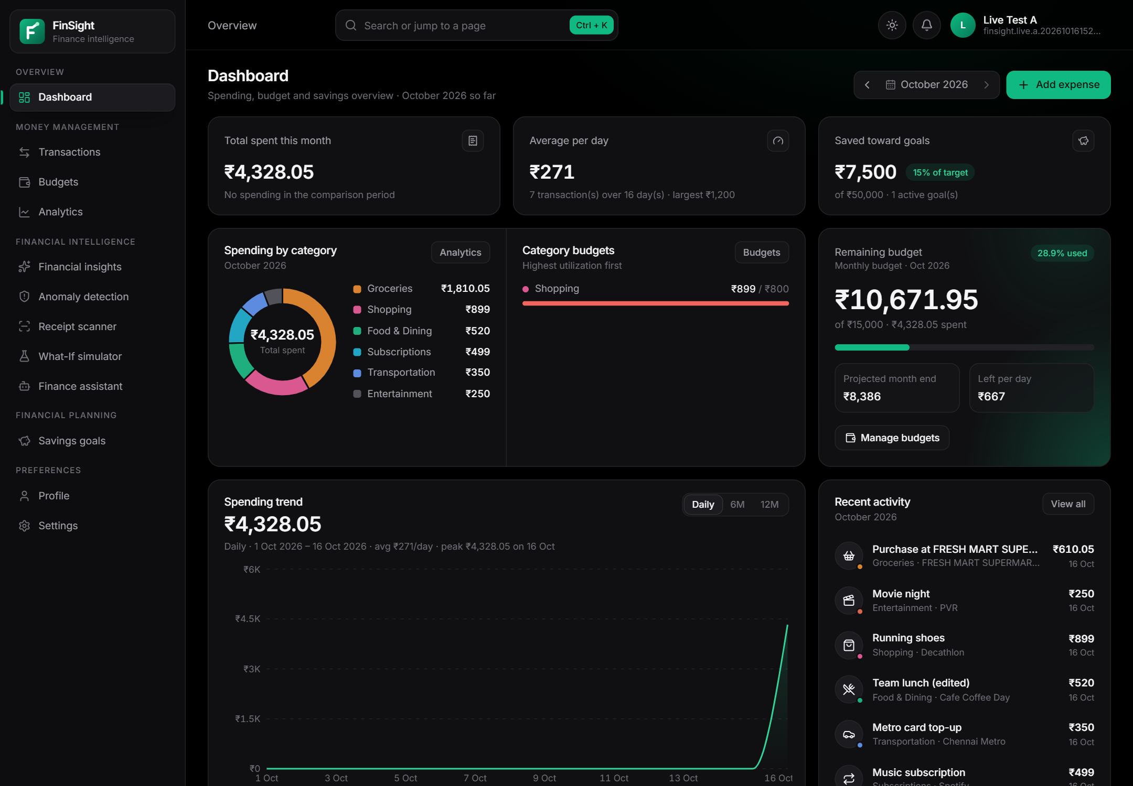
FINSIGHT
Cloud-Based Personal Finance Intelligence & Expense Analytics Platform
UNDERSTAND YOUR SPENDING. MAKE SMARTER FINANCIAL DECISIONS.
Aakar Gupta
Registration No. 24BRS1321
Vellore Institute of Technology, Chennai
LIVE ON AWS · AP-SOUTH-1 (MUMBAI)
zkht2b4ib3.execute-api.ap-south-1.amazonaws.com
API Gateway · Lambda · DynamoDB · S3 · Cognito
Notes:
FinSight is a personal finance intelligence platform built by Aakar Gupta at VIT Chennai and deployed on AWS serverless services in Mumbai. The screenshot is the live dashboard of a synthetic test user, served from the deployed stack.

Slide 2
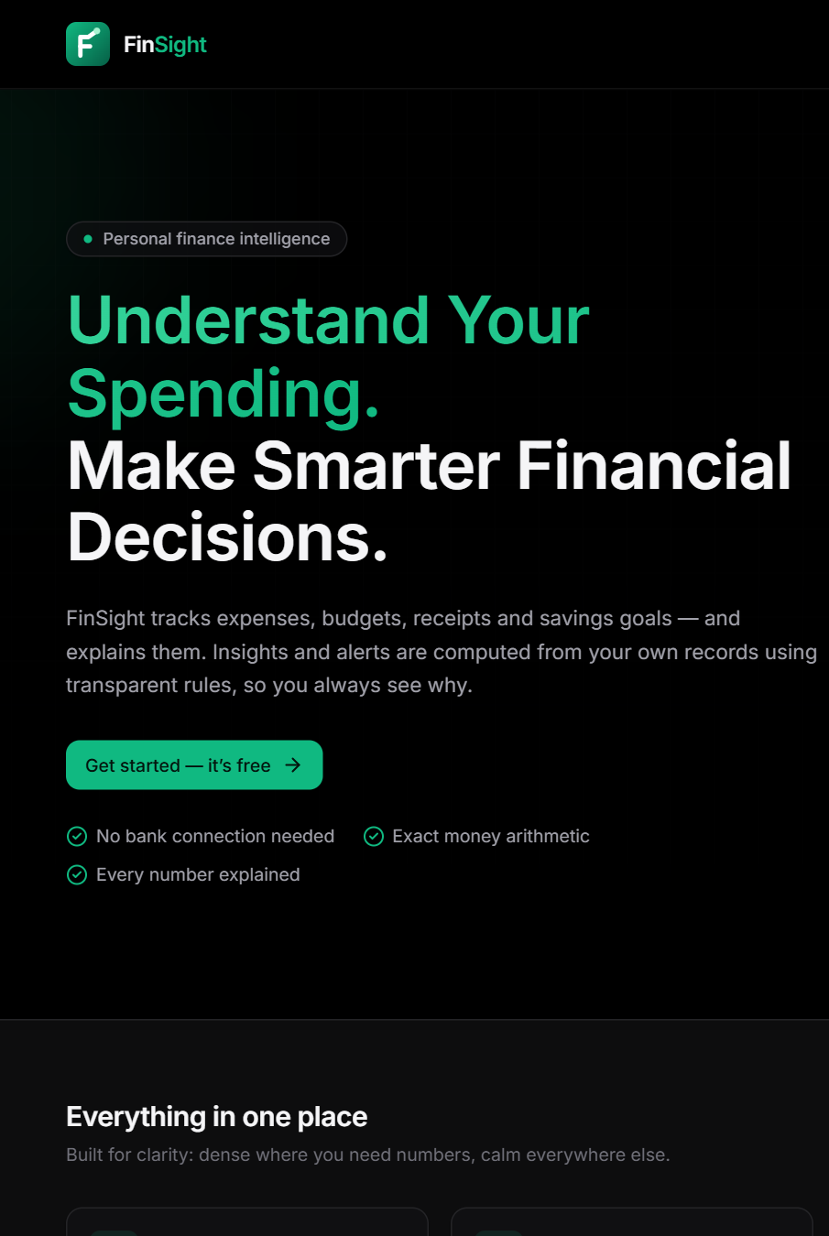




PROBLEM AND MOTIVATION
WHY PEOPLE LOSE TRACK OF THEIR MONEY
Low visibility
Spending is split across UPI, cards and cash, so totals and trends are hidden.
Manual entry
Paper receipts must be typed in by hand, so many purchases are never recorded.
Unexplained numbers
Charts show amounts, not the calculation or transactions behind them.
Late discovery
Overspending and duplicate charges are noticed only at month end.
Goal: every number FinSight shows can be traced to the user’s own records.
Notes:
Four everyday problems shaped the design. The motivation is explainability: every insight shows its calculation and evidence, and nothing depends on bank connections or paid AI.

Slide 3








OBJECTIVES AND KEY FEATURES
ELEVEN OBJECTIVES · ALL IMPLEMENTED AND VERIFIED
Expenses
Budgets
Analytics
Insights
Add, edit, search, filter, sort and export, in exact paise
Overall and category budgets, one alert per threshold
Trends, categories, payment methods, merchants
Labelled fact, estimate or projection, with evidence
Anomalies
Receipt OCR
What-If
Goals & assistant
Robust statistics flag charges for review only
Tesseract reads the receipt; the user confirms
Up to four saving scenarios, no side effects
Savings goals plus a rule-based assistant
Notes:
Each objective maps to an implemented module. Money is stored as integer paise. The assistant and insights are deterministic rules, not a paid AI service. Income tracking and bank connections are deliberately out of scope.

Slide 4
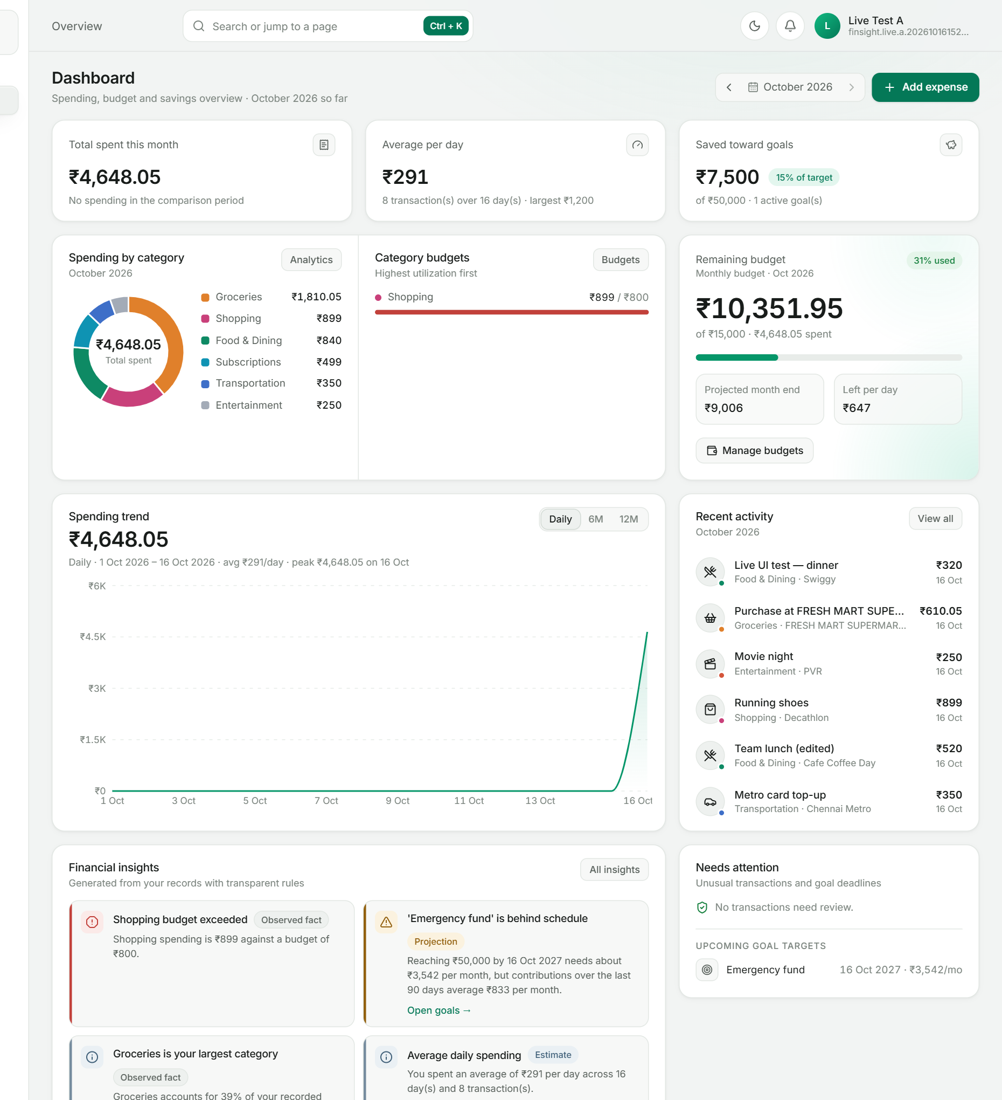
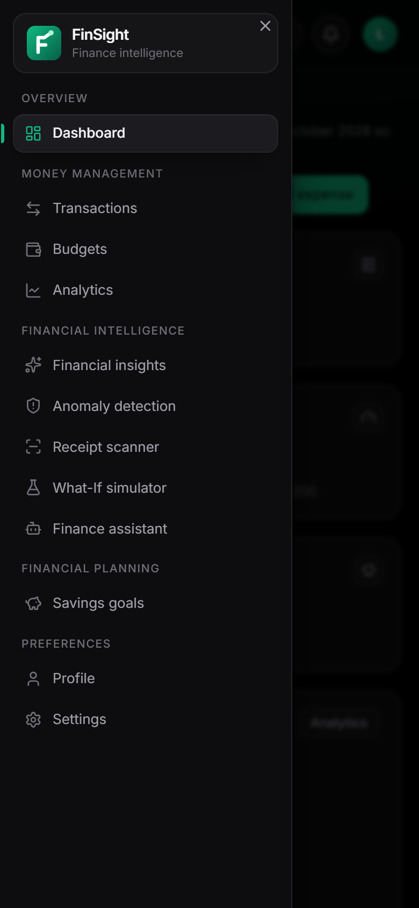
APPLICATION OVERVIEW
LIVE SCREENS · SYNTHETIC TEST USER
16 routes: dashboard, transactions, budgets, analytics, insights, anomalies, receipts, What-If, assistant, goals
Cognito sign-in; every record scoped to the signed-in user in DynamoDB
Dark (default) and light themes; mobile drawer below 1024 px
Animations that respect reduced motion
“Created by Aakar Gupta” credit and an About-the-author dialog
Notes:
Genuine screenshots from the live deployment: the light-theme dashboard and the mobile navigation drawer at 390 px. All pages call the same versioned API on the same origin.

Slide 5







ACTUAL SYSTEM ARCHITECTURE
AS DEPLOYED · STACK FINANCE-INTELLIGENCE-PROD · AP-SOUTH-1
WebFunction
serves the built SPA
Cognito
user pool (Lite)
CloudWatch
9 log groups · 5xx alarm
API Gateway
HTTP API · JWT authorizer · 25 rps
Browser
React SPA
7 API functions
Python 3.13 · FastAPI
DynamoDB
single table + GSI1
CloudFront + web bucket
planned · not deployed
Receipts function
container · Tesseract 5.5
S3 receipts
private · presigned
ECR
OCR image
One origin for the SPA and /api/v1 (no CORS) · browser uploads receipts straight to S3 with presigned URLs · one IAM role per function · no VPC, NAT, EC2 or RDS
Notes:
This is the deployed architecture, not the original plan. CloudFront and the web bucket are in the template behind FrontendHosting=cloudfront but were refused because the new account needs AWS verification, so WebFunction serves the SPA on the same HTTP API. Dashed arrows: token verification against Cognito and the OCR image pulled from ECR.

Slide 6
CORE MODULES AND WORKFLOW
ONE USER JOURNEY · ONE LAYERED CODEBASE
1
2
3
4
5
6
Sign in
Record
Check
Understand
Plan
Ask
Cognito tokens
form or receipt
budget alerts, anomaly scan
dashboard, analytics, insights
goals, What-If
rule-based assistant
API routes
Services
Repository
9 route groups · token → user id · strict validation
all business logic, independent of HTTP and storage
SQLite locally · DynamoDB on AWS · same tests
Modules
Expenses
Budgets
Analytics
Insights
Anomalies
Receipts
Simulator
Goals
Assistant
Each Lambda builds only its own route group, so it receives only the IAM permissions that group needs.
Notes:
After every expense change the server runs the budget threshold check and the anomaly re-scan, so dashboards, alerts and insights stay consistent. The same services run locally and in Lambda; only the repository and auth mode change by configuration.

Slide 7
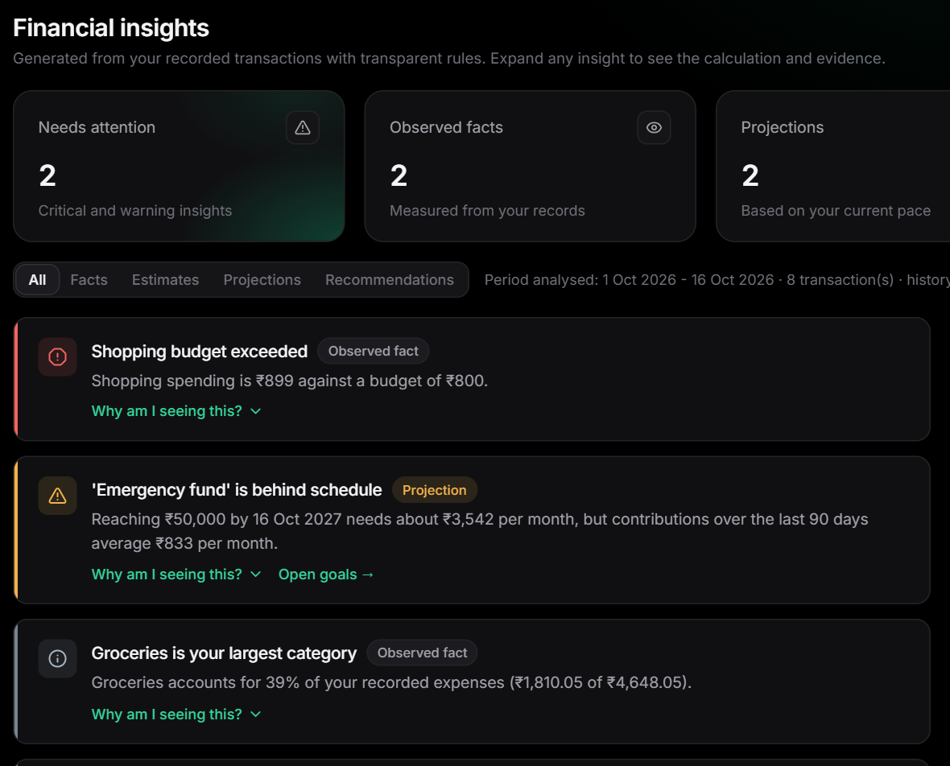
ANALYTICS AND INTELLIGENCE
EVERY NUMBER IS EXPLAINED
+
INSIGHT ENGINE
Each insight is labelled fact, estimate, projection, recommendation or data gap, with its period, formula, values and transactions.
+
ANOMALY DETECTION
Modified z-score 0.6745 · (x − median) / MAD ≥ 3.5 and amount ≥ 2.5 × the category median. Flags are reviewed; data is never changed.
+
BUDGET PROJECTION
Month-end spend = spent ÷ days elapsed × days in month. Each threshold (75 / 90 / 100 %) alerts once per month.
Notes:
The insights page on the live stack: each card shows its kind and an evidence panel. Anomaly rules use the median and MAD because they are robust to outliers; identical subscriptions are not flagged. Recurring payments are detected by similar amounts at weekly or monthly intervals.

Slide 8
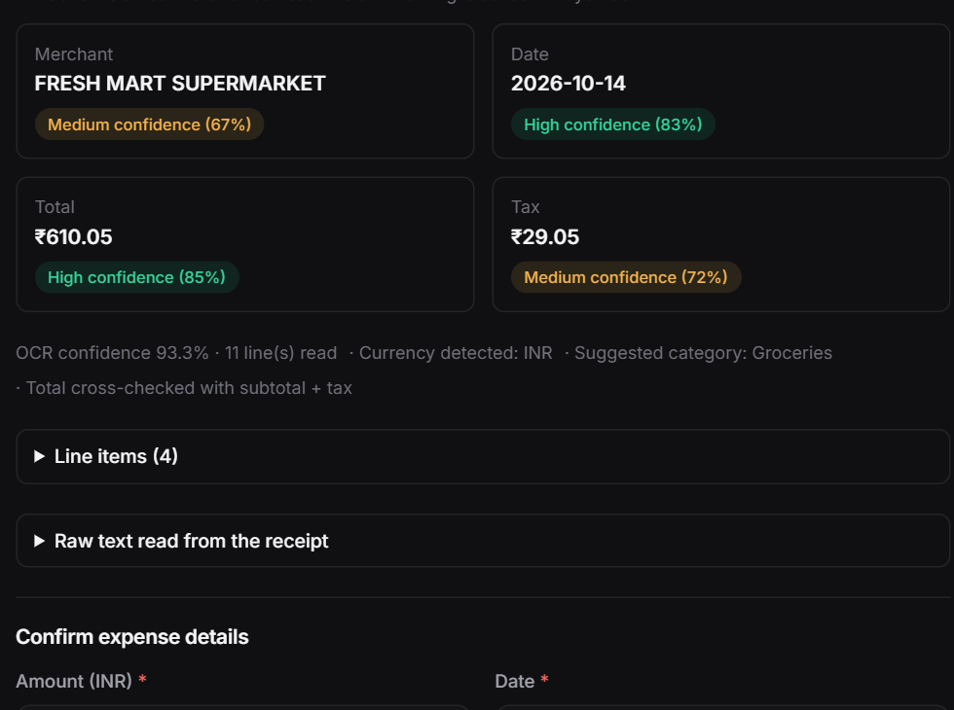
RECEIPT OCR WORKFLOW
PRESIGNED UPLOAD · OCR IN LAMBDA · REVIEW
1
Request upload URL
5-minute presigned POST fixes key, type, encryption and 1 B–5 MB size
2
Upload to private S3
the browser posts the image straight to the bucket
3
OCR in Lambda
validation, Pillow preprocessing, Tesseract --psm 4
4
Parse with confidence
merchant, date, total, tax, currency, line items
5
Review and confirm
93.3 %
₹610.05
3.2 s
the user corrects fields; a linked expense is created
OCR confidence
total extracted
processed in Lambda
Notes:
Live test RCT-06 on the deployed stack: a synthetic receipt uploaded to the private bucket was read by the container function with 93.3 percent OCR confidence and a total of 610.05 rupees in 3.2 seconds. Unsigned access to the object returned 403, and nothing is saved until the user confirms.

Slide 9
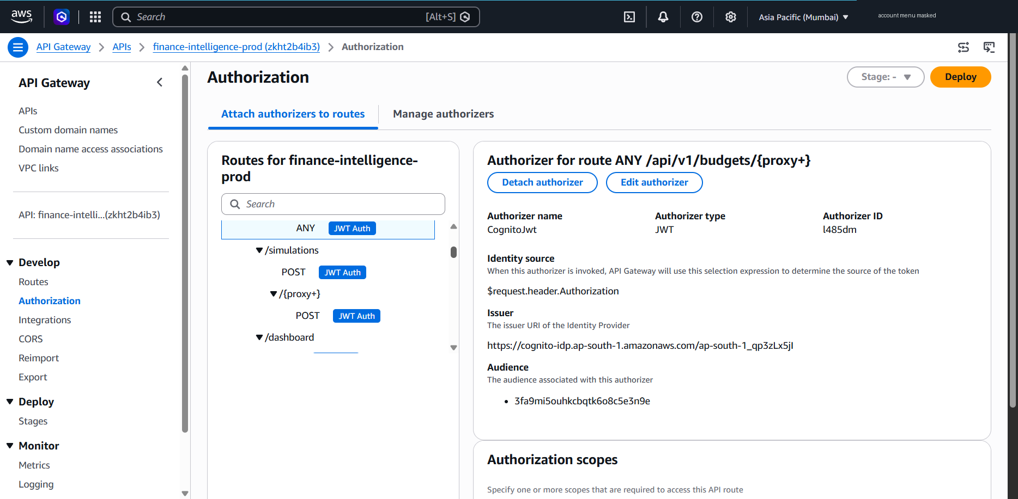
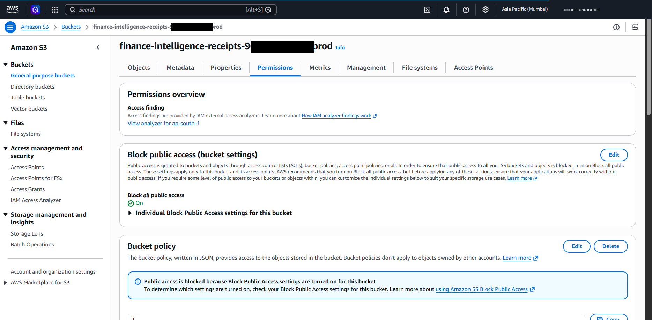


AWS DEPLOYMENT AND SECURITY
LIVE SINCE 16 OCTOBER 2026 · AWS SAM
STACK
finance-intelligence-prod · 63 resources
HOSTING
API Gateway + WebFunction (CloudFront blocked)
RELEASES
change-set review · 3 code-only updates
Two token checks JWT authorizer, then JWKS and Cognito GetUser (sign-out revokes within 15 s)
Per-user isolation user id only from the token; other users’ ids return 404
Private receipts Block Public Access, SSE-S3, TLS-only, presigned URLs
Least privilege one IAM role per function; no Scan, no wildcards
AWS Management Console screenshots · account ID masked
Notes:
Genuine AWS Console captures with the account ID masked: the Cognito JWT authorizer attached to the routes, and the private receipts bucket with Block Public Access on. Live tests confirmed 401 without or with a forged token, 404 for other users’ data, 403 for unsigned S3 access and 401 token_revoked after sign-out.

Slide 10
TESTING, EVALUATION AND COST
FINAL RUNS · 16 OCTOBER 2026
64/64
27/27
131
20
live API, Cognito, S3, OCR checks
live browser checks · 0 errors
backend tests passed
frontend tests passed
ESTIMATED COST
≈ US$0.05–0.10 / month
Free plan, US$159.91 credits; US$0.09 used
Largest idle cost: ECR images (~0.38 GB)
No EC2, RDS, NAT or load balancer
An estimate for demo use, not a guarantee
Notes:
All numbers come from the final runs (docs/AWS_LIVE_TEST_RESULTS.md and the billing console). No load test or OCR accuracy study was performed, and no coverage percentage is claimed. The cost estimate assumes at most 5,000 requests and 50 OCR runs a month.

Slide 11
CONCLUSION AND FUTURE WORK
WHAT WAS DELIVERED · WHAT REMAINS
+
CONTRIBUTIONS
+
LIMITATIONS
+
FUTURE WORK
Full finance platform: expenses, budgets, analytics, insights, anomalies, OCR, What-If, goals, assistant
Explainable by design: every insight shows its evidence
Serverless on AWS with two-layer auth, revocation and per-user isolation
CloudFront blocked until AWS verifies the account
Revocation within 15 s; fail-open if Cognito is down
Cold starts ~3 s; no load test or OCR accuracy study
CloudFront + WAF, then a Content-Security-Policy
IAM Identity Center for deployments; SNS alarms; DynamoDB PITR
Statement import and better OCR preprocessing
LIVE https://zkht2b4ib3.execute-api.ap-south-1.amazonaws.com
Notes:
Close on what is verified (64 of 64 live checks, 27 of 27 browser checks), what is new (explainable insights and robust anomaly review on a secure serverless design) and the honest next steps.

