Slide 1
ARTIFICIAL INTELLIGENCE (BCSE306L) · COURSE PROJECT
KRISHIMITRA
Explainable, Multi-Source Agricultural Decision Support System
Aakar Gupta · Prathamesh Avinash Burange
School of Computer Science and Engineering (SCOPE)
Vellore Institute of Technology, Chennai, India
Notes:
OPEN: Introduce the project and both authors. KrishiMitra is an explainable decision-support system for farmers: it combines live weather, climatology, soil and market data and turns them into a crop recommendation, a yield estimate, an irrigation schedule and risk alerts. Say upfront that it is a working web application, evaluated on benchmark data and with software tests, not yet validated in the field. Likely question: 'Is this deployed with farmers?' Answer: No. It is a prototype; limitations are on slide 8.

Slide 2
The Problem and Our Solution
One evidence-labelled advisory instead of scattered, unexplained information
THE PROBLEM
OUR SOLUTION
1 Fragmented information weather, soil, prices live apart
KrishiMitra one canonical farm summary
2 Incomplete soil data most farms lack a recent test
Weather intelligence
Open-Meteo 7-day forecast
Soil information
HWSD v2.0 + optional soil test
3 Unpredictable weather heat, frost, heavy rain, dry spells
4 Uncertain crop suitability which crop fits this place and season?
Crop recommendation
KM-Rules 2.1, 12 crops
ML insight
XGBoost second opinion
5 Irrigation inefficiency when and how much to irrigate?
Yield estimate
with reliability label
Irrigation schedule
daily root-zone balance
6 Price fluctuation mandi prices change daily
Risk monitoring
seven risk categories
Market information
Agmarknet observed prices
7 Unexplainable ML answers a score with no reasons
Every value is labelled: measured · modelled · fallback · unavailable
KrishiMitra · VIT Chennai · Artificial Intelligence (BCSE306L)
2
Notes:
Problem (left): a farmer must combine weather, soil, crop calendars and market prices from different sources, each with gaps; many ML tools then give an answer with no reasons. Seven pain points: fragmented information, incomplete soil data, unpredictable weather, uncertain crop suitability, irrigation inefficiency, price fluctuation, unexplainable ML answers. Solution (right): KrishiMitra is a web application (React front end, FastAPI back end) that builds one canonical farm summary from eight capability areas: weather, soil, crop recommendation, ML insight, yield, irrigation, risk and market. Every page reads the same summary, so pages cannot disagree, and every value carries a source label: measured, modelled, fallback or unavailable. Input: latitude/longitude, area, irrigation system, current crop, optional soil test (N, P, K, pH). Evaluator question: 'Where is the evidence for these problems?' Answer: they are the motivating gaps from the decision-support literature (e.g. Zhai et al. 2020, Rose et al. 2016) in our paper; we do not claim measured farmer outcomes.

Slide 3
System Architecture
Rules decide; the ML classifier only offers a second opinion
REACT 19 FRONTEND
Farm profile and map
Dashboard · Crop · Yield · Irrigation · Weather · Soil · Insights · Reports
Alerts and PDF report (jsPDF)
FASTAPI BACKEND
Validation and routing
build_summary(): concurrent fetch
Canonical farm-summary JSON
DATA INTEGRATION AND STATE
DECISION LAYER (DETERMINISTIC)
INDEPENDENT ML OPINION
Open-Meteo
forecast, ET₀
NASA POWER
climatology
HWSD v2.0
soil, optional
KM-Rules 2.1
authoritative crop ranking
XGBoost classifier
22 benchmark classes
Agmarknet
mandi prices
Nominatim
geocoding
SQLite + TTL cache
status, prices, geocodes
Yield service
Irrigation (FAO-56)
Top-5 classes + agreement status. Never changes the rule ranking.
Missing soil data is reported "unavailable", never invented
Soil interpretation
Risk and economics
Outputs: ranked and explained crops · yield with reliability · 7-day irrigation plan (m³) · soil and risk indicators · prices · source provenance
KrishiMitra · VIT Chennai · Artificial Intelligence (BCSE306L)
3
Notes:
Walk top to bottom. (1) The React 19 front end sends the farm profile. (2) FastAPI validates it and one function, build_summary(), fetches data concurrently and assembles a single JSON document that every page and the PDF report read. (3) Data layer: Open-Meteo forecast, NASA POWER climatology, HWSD v2.0 soil (optional local raster), Agmarknet prices, Nominatim/Open-Meteo geocoding; an asynchronous client with timeouts, retries, TTL cache and a SQLite state database for source status, price history and geocode cache. (4) Decision layer: KM-Rules 2.1 is AUTHORITATIVE for the crop ranking; yield, irrigation, soil and risk services sit beside it. (5) The XGBoost classifier is drawn dashed and purple: it only compares its top class with the rules pick and reports agree / differ / not comparable. It never changes the ranking. If HWSD is not installed, soil is reported 'unavailable', never invented. Evaluator question: 'Why not feed XGBoost into the ranking?' Answer: it is trained on a benchmark with no location, so we show it as a labelled second opinion only.

Slide 4
Data Engineering and Technology Stack
Seven sources, each cached, labelled and degraded gracefully
LIVE SERVICES
LOCAL DATASETS AND KNOWLEDGE
Open-Meteo forecast, ET₀, soil moisture cache 15 min
HWSD v2.0 30″ soil raster, optional; nearest cell ≤ 5 km
NASA POWER 5-year monthly climatology cache 7 days
Kaggle crop benchmark 2,200 rows, 22 crops: trains classifier
Agmarknet observed mandi modal prices cache 6 h
FAOSTAT-style yield sample 20 hand-made rows: trains yield model
Nominatim reverse geocoding cache ≤ 30 days
KM-Rules knowledge base 12 crops: ranges, calendars, Kc
Validate request
Fetch: timeout, retry, back-off
TTL + negative cache
SQLite status log
Label: ok · fallback · stale · unavailable
Frontend
Backend
Machine learning
Storage
React 19 · Vite · Tailwind 4
Zustand · Recharts · Leaflet · jsPDF
Python · FastAPI
async httpx · request coalescing
XGBoost · SHAP
scikit-learn · pandas · NumPy
SQLite state · memory-mapped HWSD
trained models + metadata
Tests: 23 passed · 1 skipped (28 Oct 2026) · Soil-grid values are modelled estimates, not laboratory measurements
KrishiMitra · VIT Chennai · Artificial Intelligence (BCSE306L)
4
Notes:
Top left: four LIVE services. Open-Meteo: 7-day forecast, ET0, soil moisture (cached 15 min). NASA POWER: five-year monthly climatology (7 days). Agmarknet via data.gov.in: observed modal mandi prices (6 h; public key returns at most ten records). Nominatim: reverse geocoding (up to 30 days, 1.1 s spacing). Top right: LOCAL data. HWSD v2.0 is an optional 30-arc-second soil raster; the Kaggle crop dataset (2,200 rows, 22 crops) trains the classifier; the 20-row FAOSTAT-style yield sample is described in the repository as hand-made, which is why the yield model is low reliability. Middle: every fetch is validated, retried with back-off, negative-cached and logged to SQLite; each value reaches the UI labelled ok, fallback, stale or unavailable. Soil-grid values are modelled estimates, not lab measurements. Bottom: React 19, Vite, Tailwind 4, Zustand, Recharts, Leaflet, jsPDF; Python, FastAPI, async httpx; XGBoost, SHAP, scikit-learn; SQLite and a memory-mapped HWSD raster. 24 pytest functions: 23 passed, 1 skipped (needs real HWSD data) when run on 28 Oct 2026. No automated UI tests. Open CORS is a development setting.

Slide 5
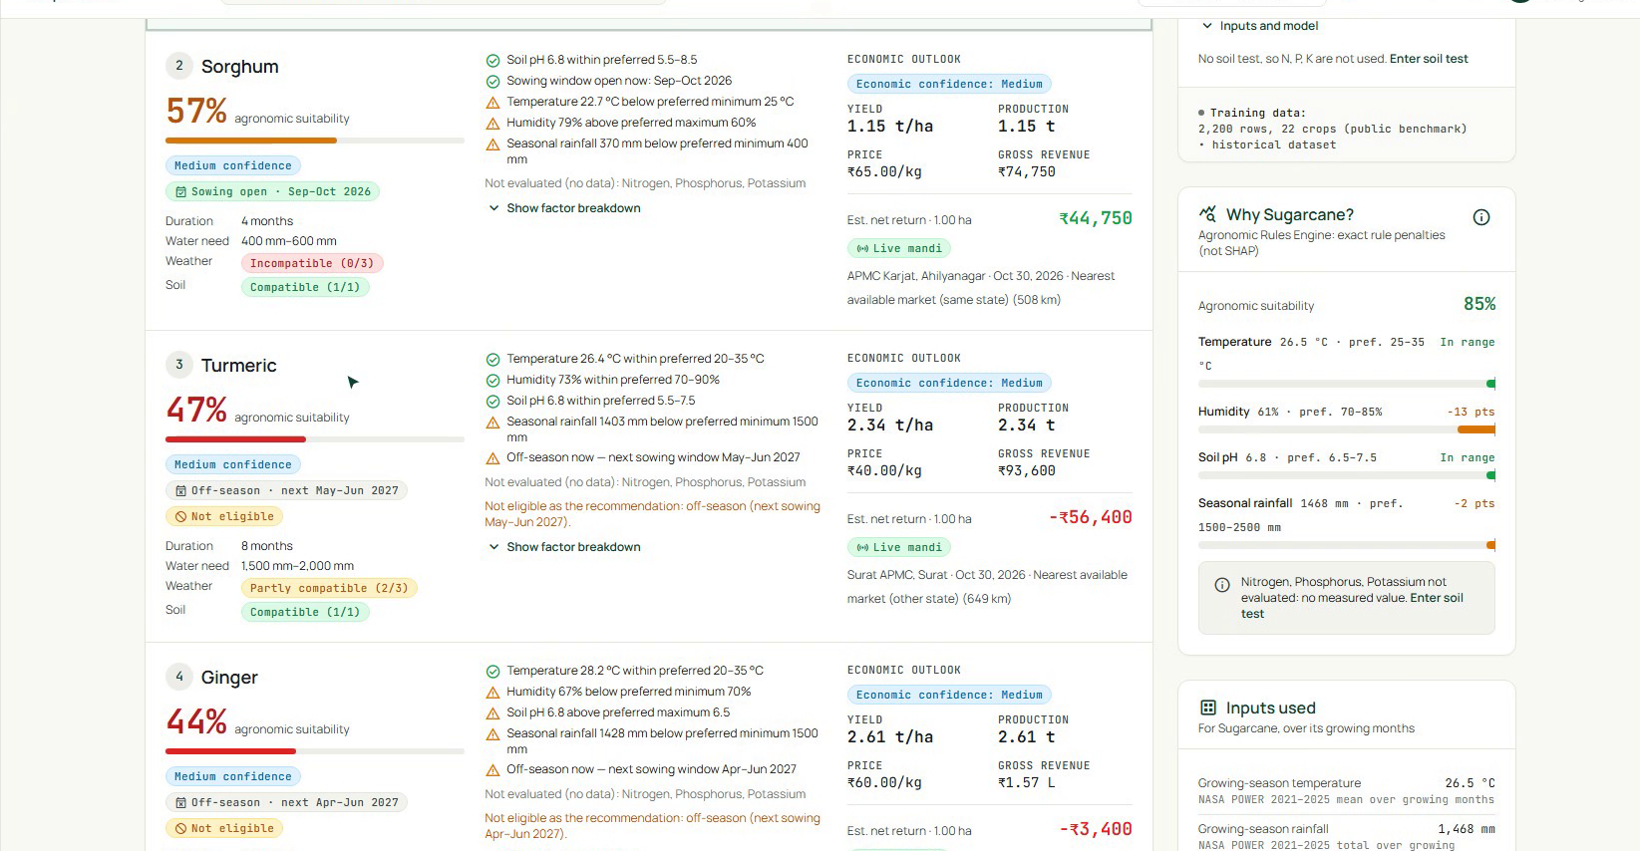
Crop Recommendation: Rules and ML
KM-Rules 2.1 is authoritative; the classifier is an independent second opinion
KM-RULES 2.1 (AUTHORITATIVE)
XGBOOST CLASSIFIER (INDEPENDENT SECOND OPINION)
Full variant
Climate + pH variant
used with a soil test
N · P · K · temp · humidity · pH · rain
default without a soil test
temp · humidity · pH · rain
Holdout accuracy
98.86%
Holdout accuracy
94.09%
Macro F1
98.85%
Macro F1
94.01%
5-fold CV
99.27%
5-fold CV
95.82%
Real crop-advisor screen: per-factor reasons and eligibility
Score S = product of factor multipliers (1 in range, floor 0.2)
200 trees · depth 4 · learning rate 0.1 · 22 classes. Top-5 with agree / differ / not-comparable status. Never overrides the rules ranking.
Season window opens > 60 days away: S × 0.5
Benchmark hold-out results, not field accuracy: no location or date in the data; probabilities are uncalibrated.
Eligible ≥ 2 factors · in season · S ≥ 0.40; then rank by S, net return
KrishiMitra · VIT Chennai · Artificial Intelligence (BCSE306L)
5
Notes:
Left: KM-Rules 2.1 scores 12 crops (wheat, sorghum, pearl millet, barley, green gram, black gram, sugarcane, tomato, potato, onion, turmeric, ginger) on seven factors: N, P, K, temperature, humidity, pH, seasonal rainfall. A factor multiplier is 1 inside the preferred interval and falls linearly with relative distance to a floor of 0.2; the score is the product. If the sowing window opens in more than 60 days the score is halved. Eligible means at least two factors assessed, in season, score at least 0.40. Ranking: eligibility, score, then net return from observed price. Missing values are excluded and reported, not imputed. The screenshot is real: sugarcane 85%, sorghum 57%, turmeric 47% (off-season, not eligible). Ranges are hand-compiled and national, not field-calibrated. Right: XGBoost, an ensemble of boosted trees (not a neural network): 200 trees, depth 4, learning rate 0.1, 22 classes, Kaggle benchmark of 2,200 rows, stratified 80/20 split (seed 42) plus 5-fold CV. Full variant (N, P, K, T, RH, pH, rain) is used only with a soil test; otherwise the climate+pH variant. Full: accuracy 98.86, macro F1 98.85, CV 99.27. Climate: 94.09, 94.01, 95.82. These are benchmark results; the data has no location or date, so they are not field accuracy. At runtime the top-5 is compared with the rules' top crop: agree, differ, not comparable. Probabilities are uncalibrated. Evaluator question: 'Why not let XGBoost decide?' Answer: no regional labelled data; rules are transparent and testable.

Slide 6
Yield Estimation and Smart Irrigation
A low-reliability yield model, reported honestly, and a stated-assumption water balance
YIELD ESTIMATION
IRRIGATION: SIMPLIFIED FAO-56 DAILY WATER BALANCE
Wheat: XGBoost regressor
year + crop; SHAP explanation
Reliability label
shown with every estimate
ET₀
Open-Meteo forecast
ETc = Kc · ET₀
mid-season Kc, default 1.0
Peff = 0.8 · P
if P ≥ 5 mm
Other rule crops
reference yield × suitability
Dr = Dr + ETc − Peff
daily depletion
Dr > RAW ?
trigger irrigation
Gross = net / η
V = 10 · A · mm
R²
−5.33
4 hold-out rows, all rice
worse than predicting the mean
Why
20 hand-made rows
MAE 0.031 t/ha hides the failure
Marked LOW reliability
Implemented parameters
Zr = 0.5 m · p = 0.5 · TAW = 1000 (θFC − θWP) · Zr · RAW = p · TAW
Efficiency η: drip 0.90 · sprinkler 0.75 · flood 0.60
Stated assumptions
Not Penman–Monteith; ET₀ comes from the forecast
One mid-season Kc; fixed root depth; texture-table water limits
Not calibrated with soil-moisture sensors; HWSD soil is modelled
Not field-validated. Treat estimates as indicative.
KrishiMitra · VIT Chennai · Artificial Intelligence (BCSE306L)
6
Notes:
Left, yield: wheat is the only rule crop estimated by the XGBoost regressor (100 trees; features year and crop one-hot); all other rule crops use a reference yield multiplied by the suitability score. Every estimate carries a method and reliability label. The regressor was trained on a 20-row hand-made FAOSTAT-style sample (rice 18, wheat 2; 15 rows repeat 27,000 hg/ha). With a 16/4 split all four test rows are rice: MAE 0.031 t/ha but R squared minus 5.33, i.e. worse than predicting the hold-out mean. It is marked LOW reliability and is not field-validated. TreeSHAP exists for this model only and shows year and crop identity, not agronomy. Right, irrigation: ETc = Kc x ET0 with ET0 from Open-Meteo and a stored mid-season Kc (1.0 if no crop); effective rain 0.8 x P when P is at least 5 mm; TAW = 1000 (FC - WP) x root depth with a texture table from HWSD (loam if unknown), root depth 0.5 m, p = 0.5, RAW = p x TAW. Depletion starts from modelled soil moisture at 9-27 cm, is updated daily, and when it exceeds RAW we irrigate the depletion divided by efficiency (drip 0.90, sprinkler 0.75, flood 0.60; rainfed shows net). Volume = 10 x area (ha) x gross mm. A unit test (loam, drip) gives TAW 65, RAW 32.5, first trigger day 5. Assumptions: not Penman-Monteith, one Kc, fixed root depth, heuristic effective rain, no sensor calibration; HWSD soil is modelled.

Slide 7
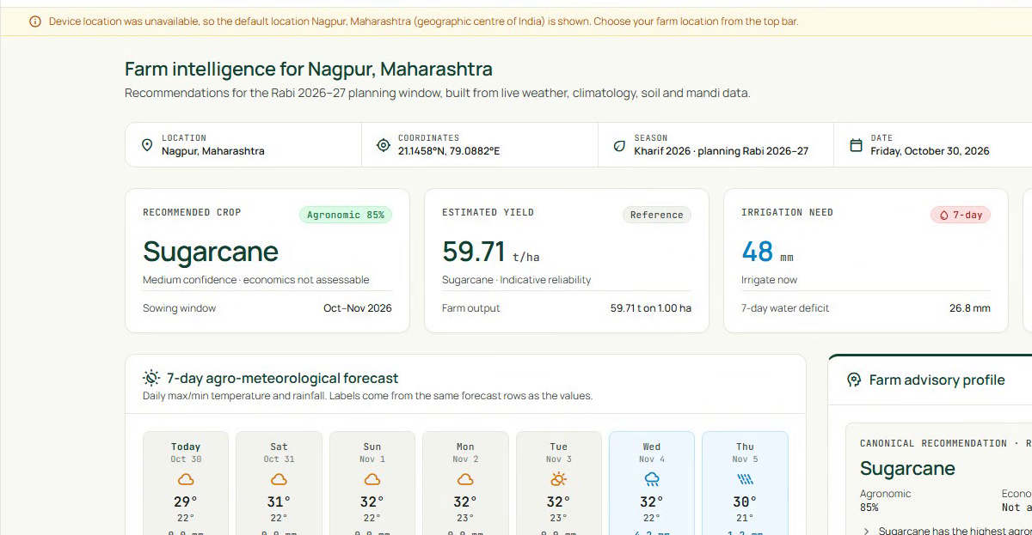
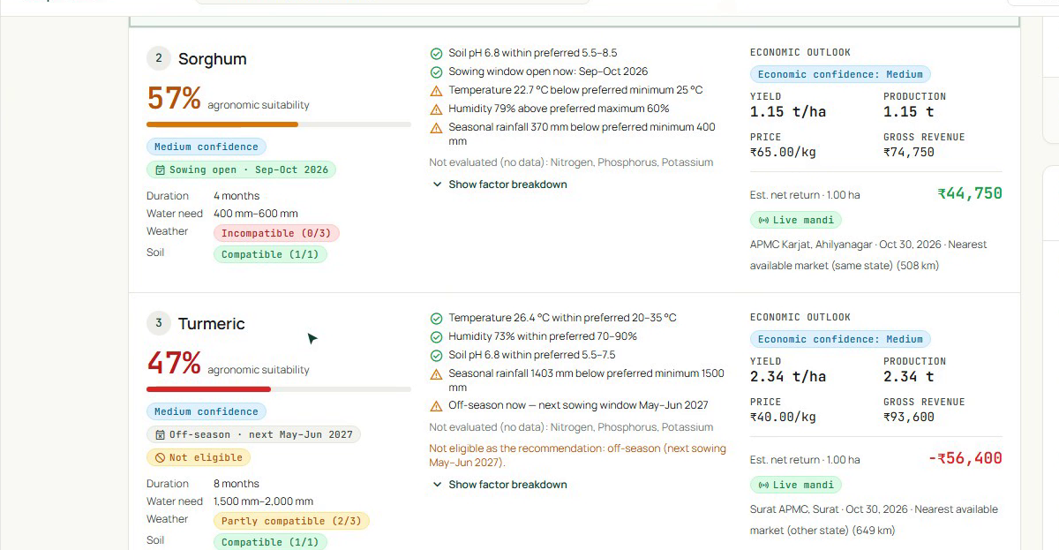
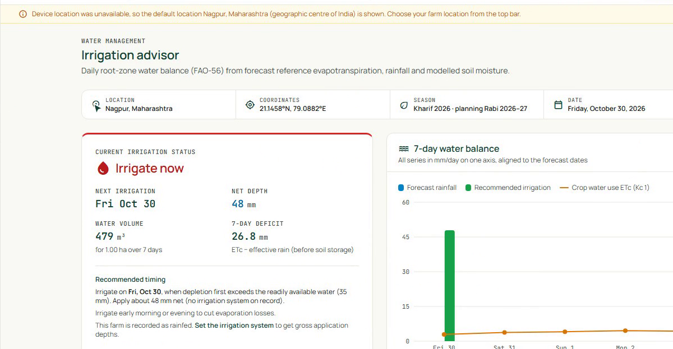
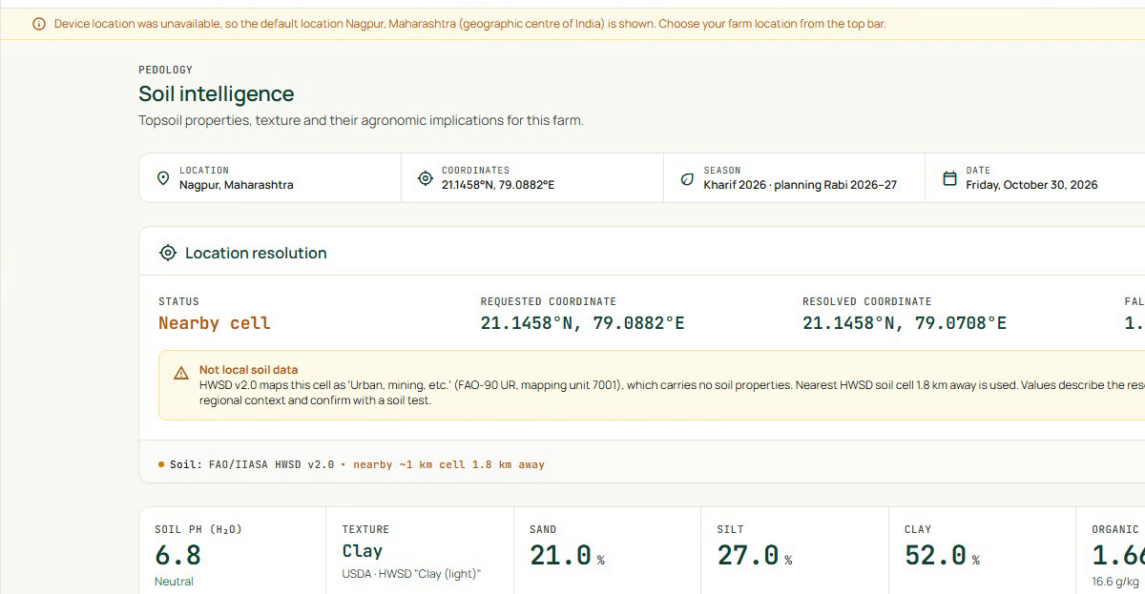
The Working Application and Its Results
Real screens from the walkthrough; benchmark metrics and software tests are different evidence
Dashboard
Crop advisor
Axis starts at 90 %. Measures benchmark separability, not field accuracy.
Functional tests
23 passed · 1 skipped
24 pytest functions, 28 Oct 2026
Yield regressor
R² = −5.33
low reliability, 4 test rows
Irrigation advisor
Soil intelligence
Also: yield, AI insights and risk, weather, farm profile, PDF reports, source provenance
KrishiMitra · VIT Chennai · Artificial Intelligence (BCSE306L)
7
Notes:
Left: four real screens from our walkthrough video (cropped only): dashboard for a preset farm near Nagpur, crop advisor with factor-level reasons, irrigation advisor with the 7-day water balance, and soil intelligence showing the resolved HWSD cell and a nearby-cell fallback label. Also in the app but not shown: yield page, AI insights and risk matrix, weather, farm profile with map and soil-test entry, reports page that builds the PDF, and a settings page with data-source provenance. Offer a live demo. Right: classifier metrics reproduced by retraining on 28 Oct 2026: full 98.86 / 98.85 / 99.27, climate 94.09 / 94.01 / 95.82 (accuracy, macro F1, CV). Dropping N, P, K costs about 4.8 points, which matters because most users have no soil test. These measure benchmark separability, not field accuracy. Functional evidence: 24 pytest functions, 23 passed, 1 skipped (needs real HWSD data); tests cover irrigation, soil lookup and fallback, market fallbacks, caching, summary resilience to outages, model-card consistency. Yield R squared minus 5.33, low reliability. We do NOT claim water savings, yield gains, farmer adoption or field accuracy.

Slide 8

Limitations, Future Scope and Conclusion
What we have not done, what comes next, and the contribution
CURRENT LIMITATIONS
FUTURE WORK (PROPOSED, NOT IMPLEMENTED)
1 Benchmark-to-field domain mismatch
→ Larger regional agricultural datasets
2 Limited, partly placeholder yield dataset
→ Field trials with farmers
→ Soil-sensor integration
3 No comprehensive farm-level field validation
→ Satellite crop-health monitoring
4 Dependence on external data-source availability
→ Multilingual farmer interaction
5 Modelled soil-property uncertainty (≈ 1 km cells)
→ Improved regional yield modelling
6 Uncalibrated irrigation parameters
→ Expanded agronomic recommendations
KrishiMitra: Making Agricultural Intelligence More Accessible, Explainable, and Actionable.
Aakar Gupta · Prathamesh Avinash Burange
School of Computer Science and Engineering (SCOPE) · Vellore Institute of Technology, Chennai, India
KrishiMitra · VIT Chennai · Artificial Intelligence (BCSE306L)
8
Notes:
Be direct about limitations: the classifier has only seen benchmark data; the yield sample is tiny and partly placeholder; there is no field validation of recommendations, irrigation or risk; the system depends on free external services with rate limits; soil values are modelled with about 1 km uncertainty; irrigation parameters are uncalibrated defaults. Future work (proposed, NOT done): regional datasets and a better yield model, field trials, soil sensors, satellite crop-health monitoring, multilingual interaction, expanded agronomic recommendations. First thing we would do: build a labelled regional dataset and calibrate the rule intervals. Conclusion: an integrated, explainable decision-support prototype that separates a transparent rule engine from an independent ML opinion, labels provenance and reliability of every value, and reports weaknesses openly. What is novel is the evidence-labelled integration and explicit reliability reporting, not a new algorithm. The QR code links to the public repository. Thank the evaluators and invite questions.

