Slide 1
IoMT: Internet of Medical Things
Team AJAS (39)
Aakarsh Mishra
Joshua Koilpillai
Aayush Khatanhar
Saharsh Kallu

Slide 2
Project Objective
Nurses/doctors cannot observe every patient 24×7.
This can lead to delayed detection of critical health issues.
We aim to create an edge device with relevant sensors and a multimodal AI dashboard, to detect abnormalities and instantly alert medical staff
AIG Hospital:
yearly review showed 72 post-surgery patients’ conditions deteriorated due to insufficient monitoring
This system can reduce preventable complications and even save lives.
of which 6 cases resulted in fatalities

Slide 3
Broad Project Overview
ECG
ESP32-CAM
accelerometer
Sensors:
project DB
Arrhythmia model
Gesture model
EHR-based model
AI models:
online DB

Slide 4
SENSORS
AD8232 ECG
Purpose: Measures electrical activity to analyze heart rhythm and detect arrhythmias.
Specs: Low-power, compact, and wearable design.
Output: Uses 3 electrodes to output high frequency analog ECG waveform
ESP32CAM
Purpose: Captures real-time video to classify hand gestures for patient communication.
Specs: Integrated Camera + Wi-Fi module for edge inference; easily mountable.
Output: gesture ‘class’ labels for monitoring & alerting
MPU6050
Purpose: Monitors orientation and acceleration to detect falls or sudden posture changes.
Specs: 6-axis motion tracking (Accelerometer + Gyroscope) in a single chip.
Output: uses parameters to detect falls

Slide 5
DATA FLOW
Sensors
MQTT server
AI model
Broker
InfluxDB
Subscriber Node
MQTT Server:
We use an mqtt server to collect and publish data from our sensors running on Arduino code. The data is published to a single topic in a format similar to JSON.
Telegraf (Subscriber Node):
Telegraf is a subscriber application that collects the data from our mqtt server by subscribing to the topic given to it, formats it, and writes the data into our InfluxDB database.
InfluxDB:
InfluxDB is our database for storing data in an easily processible and viewable manner, and makes the data available to our dashboard and training/processing for our AI models.

Slide 6
Arrhythmia modality
Specs:
The model is a 3D-CNN with conv1D layers (32->64->128) filters with batch normalization and dropout.
140k+ parameters.
Training:
Model was trained on online data + our samples.
Simulated arrhythmia with strenuous exercise: jumping jacks, high knees
Class-balanced weighting for imbalanced data and early stopping if validation AUC does not improve for 3 epochs in a row.
70/15/15 train/val/test split.
At epoch 1: ~70% val_auc, final epoch: ~90%val_auc and the testing data gave auc of 93%

Slide 7
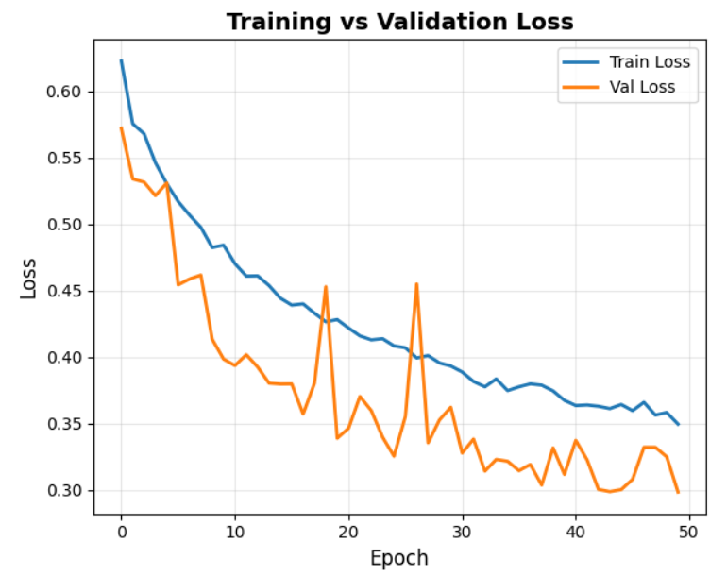
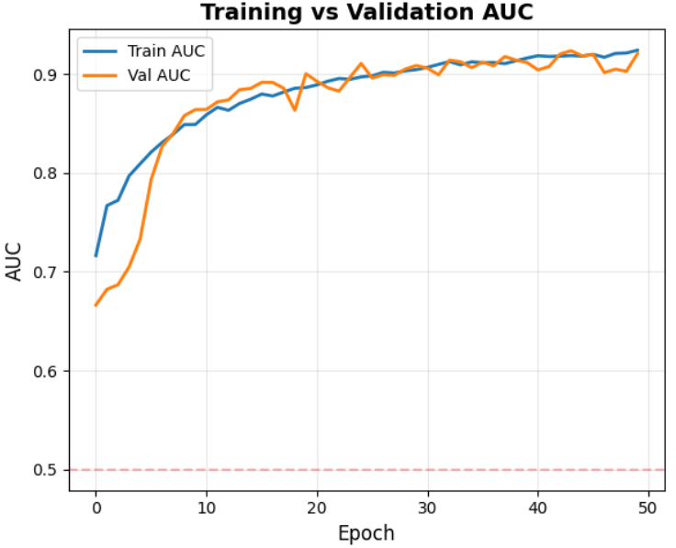

Slide 8
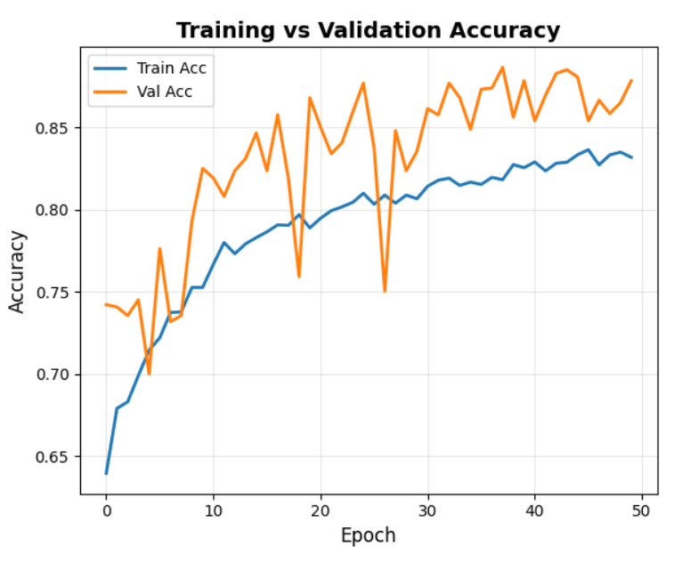
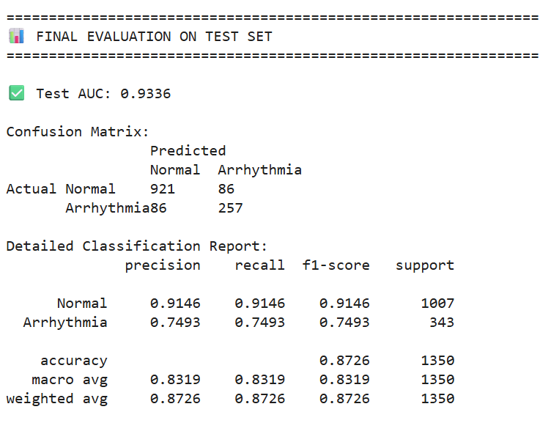

Slide 9
EHR modality
We built a multi-task neural network that analyzes over 130 patient features (vitals, labs, and history) to predict 51 different conditions across 3 timeframes (6h, 24h, 48h), for a total of 153 risk scores.
Data Source: We processed 10 million+ individual records from raw patient files (FHIR JSONs), which included demographics, lab results, medications, and diagnoses.
Training:
      Parse & Clean: We used parallel processing to read millions of raw JSON files, extract the 130+ key features, and save them as clean, efficient Parquet files.
  Engineer Features: We read the clean data in chunks and engineered new features, such as 3-hour rolling averages, delta_ values (changes over time), and the 153 "risk" labels and we fed this final data into our neural network to train it.
Our model is a Multi-Task Network.
The Shared Body: This is a set of deep layers (Dense(64) -> Dense(32)) that learns the complex, general patterns of "sickness" from all 131 inputs.
The Output Heads: We have 153 tiny, separate output layers (one for each risk). Each head looks at the shared body's analysis and makes a simple "yes/no" decision for its one specific condition.

Slide 10
Gesture Recog Modality
Problems in patients room:
Bed Alarms go off when patient shifts weight (False Positives).
Fall Detectors trigger when items dropped on the floor (False Positives).
Cameras require constant monitoring from nurses.
Solution: An Autonomous Triage Agent that lives in the patient's room. It doesn't just "sense" motion; it validates it before bothering the nurse.

Slide 11
Gesture Recog: Architecture
L1: Accelerometer
Role: The Trigger. Instantly detects high-energy events (Impacts, Seizures, CPR).
L2: Camera
Role: The Validator. Checks patient posture to confirm the sensor's story.
Reliability: 98% detection rate for physical forces.
Classes: SAFE (Vertical), DOWN (Horizontal), DISTRESS (Hunched).
Model: 1D-CNN (Motion Pattern Recognition).
Model: MobileNetV3 (Vision).
The system makes decisions based on a Weighted Fusion Score
Final Score = Medical Risk + Physical Event + Visual Confirmation

Slide 12
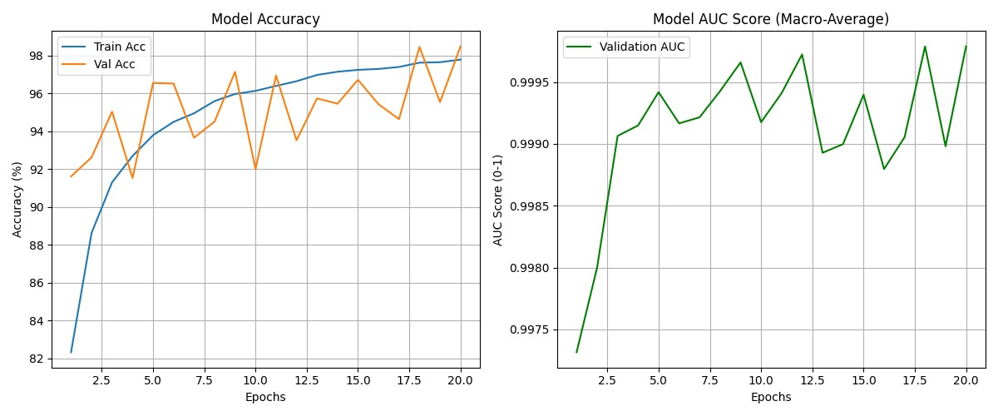
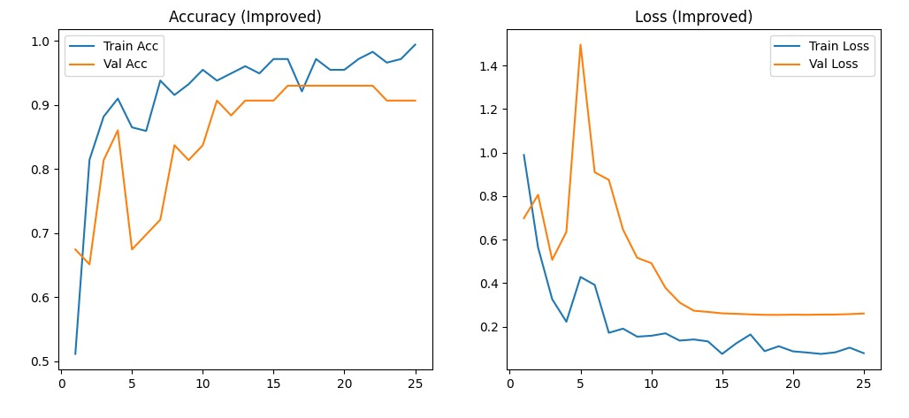
Gesture Recog: Training + Testing

Slide 13
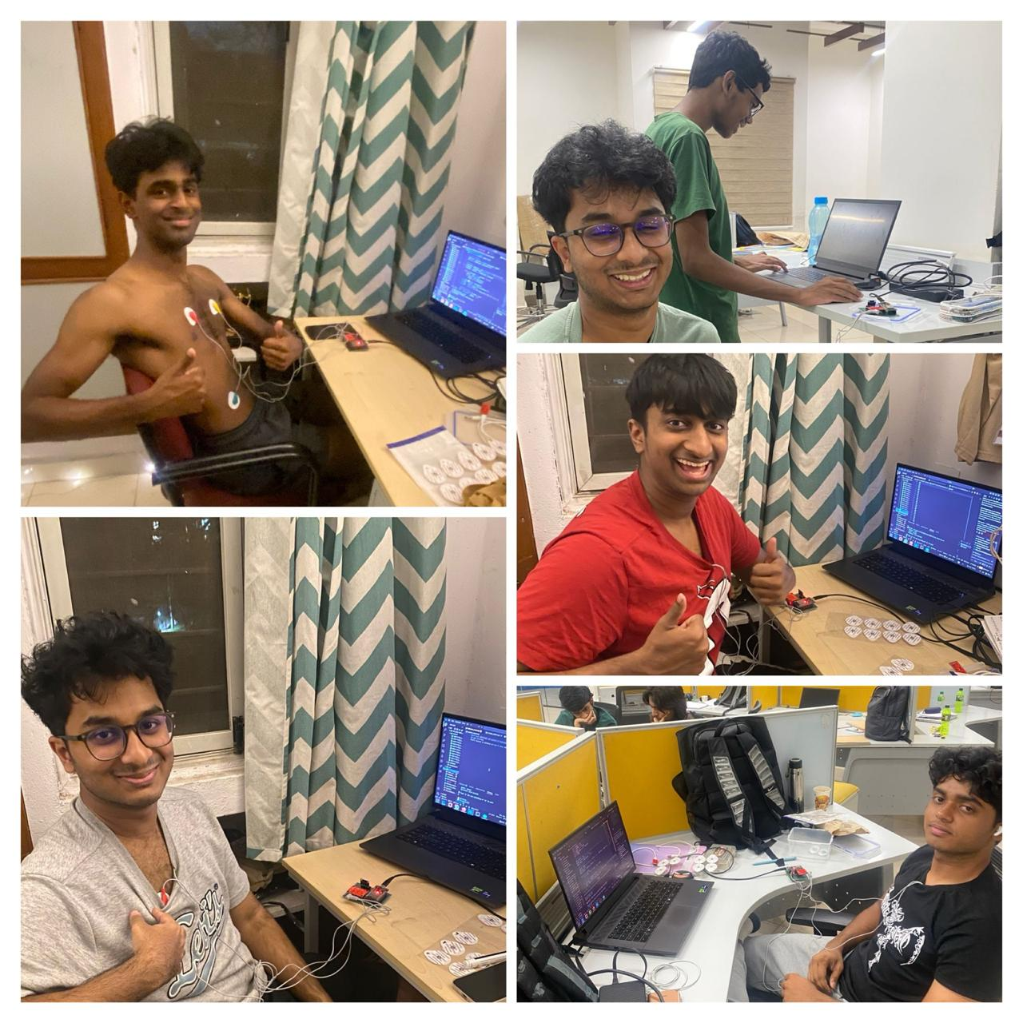
Data Collection

Slide 14
Challenges Faced
Initially, we faced the issue that the AI models were not learning but simply overfitting or making random guesses. We fixed this by balancing class weights and using auc as a metric.
Also faced the issue that sensor readings were extremely inconsistent and inaccurate. Fixed by reading sensor documentation and rigorous calibration.
The 10M+ row dataset was for the EHR modality was too big to fit in RAM. We fixed this by using a streaming data_generator and tf.data Dataset. This feeds the model small batches (like BATCH_SIZE=8) directly from the hard drive without ever loading the whole dataset.
Training models on our samples was difficult due to the comparative low accuracy and precision of our sensors in comparison to medical grade ones.

