Slide 1
Varithms (An E-learning platform)

Slide 2
INTRODUCTION
In this new era of globalization, digitalization is playing a pivotal role. E-learning is more of, out-of-classroom and in-room educational experiences.
Our E-learning platform will impart knowledge related to Algorithms, how they are implemented .
Aim of this platform is to make Algorithms learning more interesting, effective and efficient.
These E-learning platforms are rising exponentially , these platforms are even helping professionals who cannot afford the time for in-classroom teaching due to busy schedules.

Slide 3
For developing countries like India who are progressing towards E-Governance and education , concept of e-Learning platforms are working as a boon.
Our main aim is to provide you all the algorithms to study but also to make things a lot simpler for the students. Minimizing your struggle while understanding them. We’re here to provide you with simpler techniques to understand a particular algorithm and to implement it.

Slide 4

Problem Statement:
The E-learning platforms are more empowering , efficient, and economical.
During pandemic all educational institutes were shut down, and all the content was delivered through online-mode.
So it became the necessity to impart knowledge through platform like ours.

Slide 5
Motivation and Overview
1
E-learning platforms are more empowering , effective.

Slide 6
As far as we believe , smart learning is the demand of the hour . We are dedicated to providing you the best of our knowledge...

Slide 7

Want big impact?
Need for new system.
To make the e-learning process faster
Reduce the time for the E-learning
To move towards digitalization and reduce paper use
To make learning more interesting
Most importantly, saves time as you can learn at the comfort of your home.

Slide 8
Technology Used
HTML
Provides structure to the webpage, assisted by the technologies such as CSS, JS
CSS
Provides styling ti the webpage

Slide 9
Continued…
Firebase
It is cloud platform that provides Backend as a service.Gives functionality to register and authenticate your users and save their datain JSON format.
Also provides feature to upload data into database and retrieve it as per your requirement.
Visual Studio Code
Editor made by Microsoft.
Supports debugging , syntax highlighting, intelligent code completion, snippets.
Dart
Programming language for apps on multiple platforms , developed by Google.
Used to build mobile, desktop, server and web applications.

Slide 10
Modules
Login Module
Learning Module
Searching Module
Will allow users to login to access their profile.
Users can learn various algorithms by reading out the concept.
Efficiently searches across hundreds of algorithms. Categorical Searching.

Slide 11

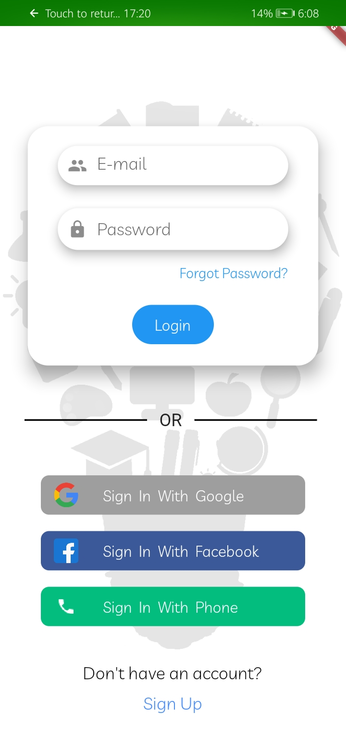

Slide 12
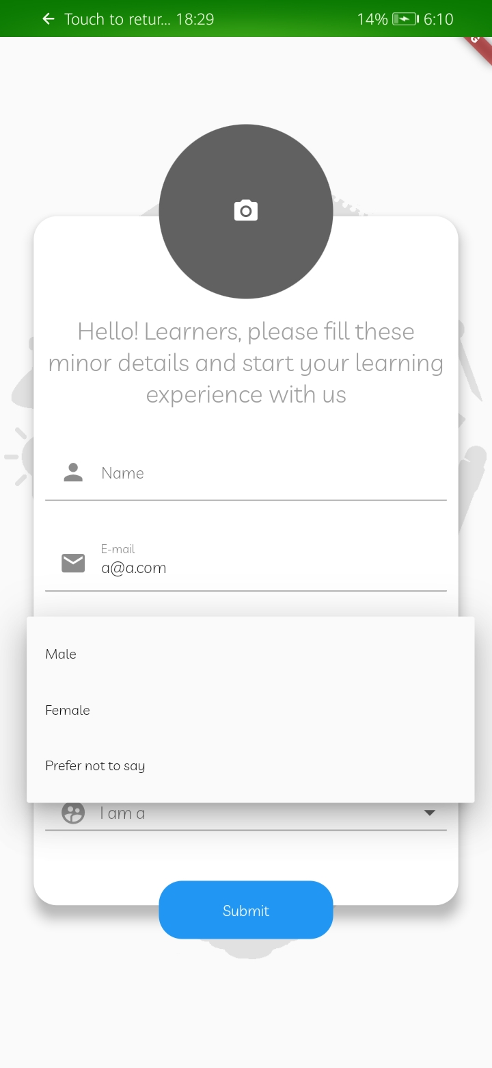
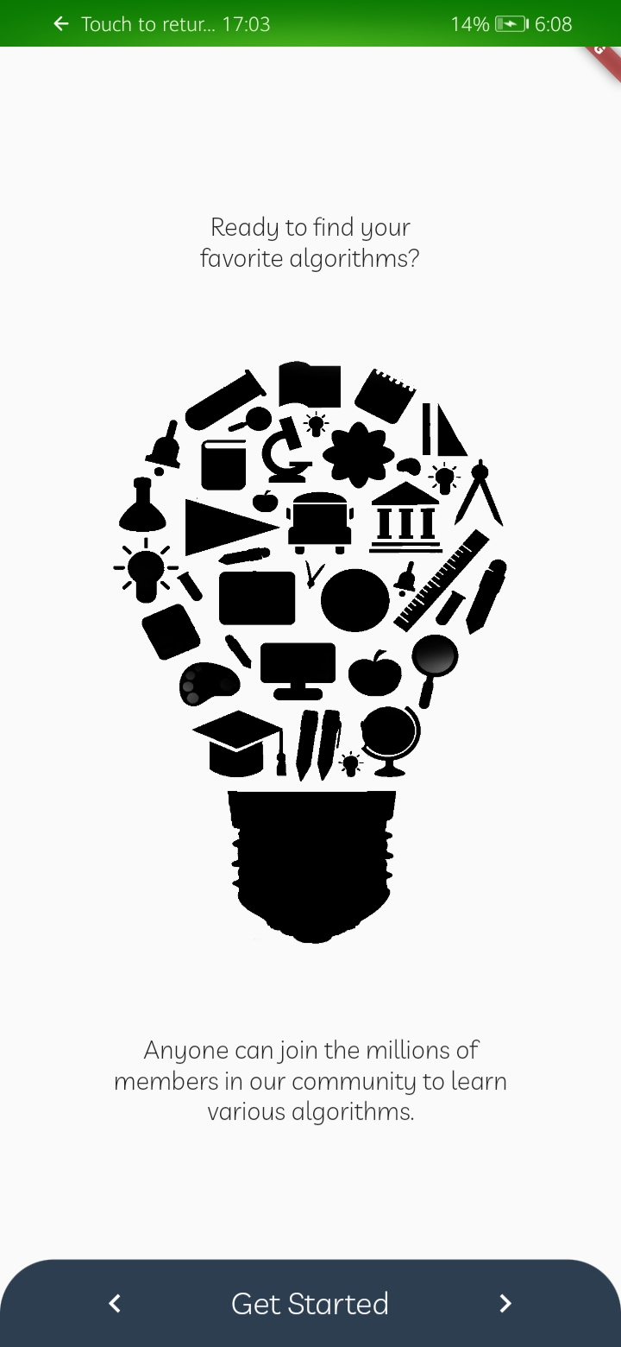
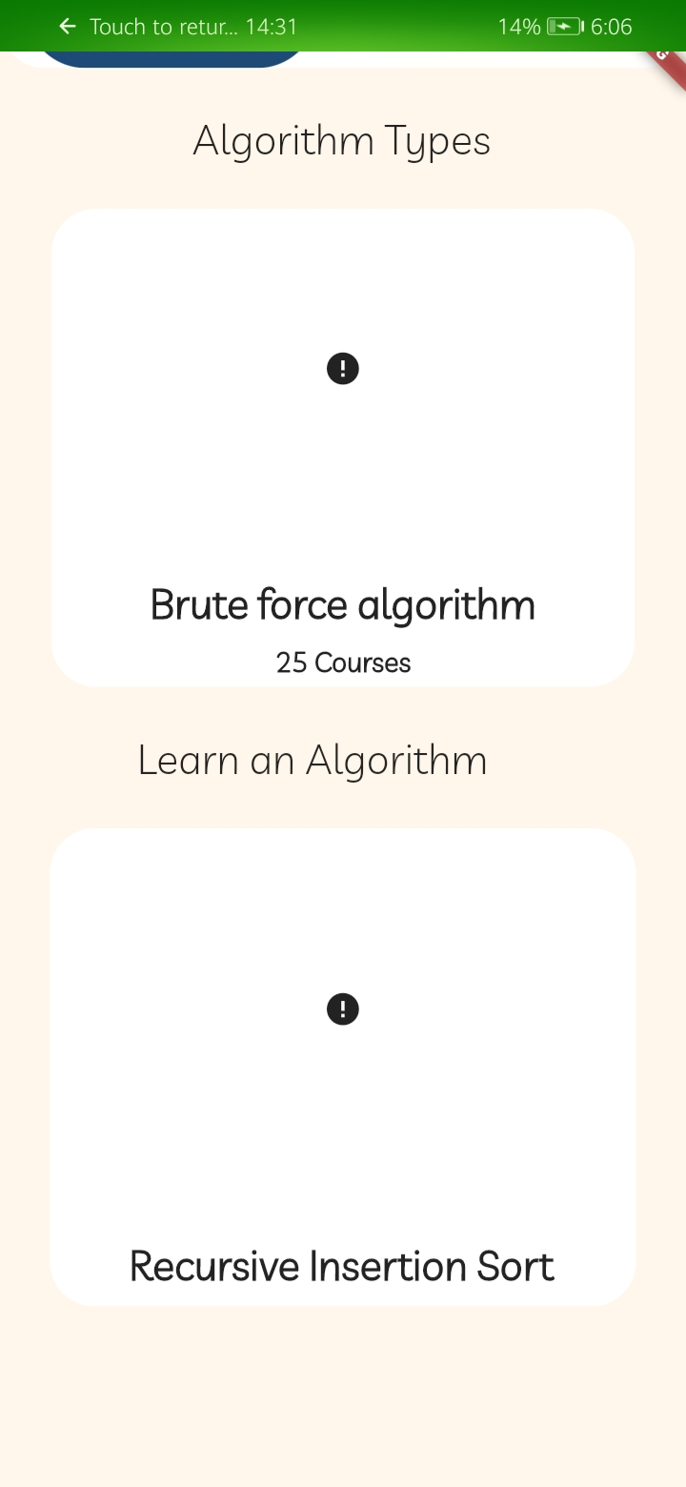

Slide 13
eLearning market
Knowing these eLearning stats can make you realize how you can leverage it to boost your organizational processes.
Online learning can be great alternative to saving time , money, and effort insetting up corporate training and delivering the curriculum to the learners. However many companies are still hesitant to join the wave of creating a digital learning environment.
To prove that eLearning is becoming new trend in learning & development, we have gathered some up-to-date stats...

Slide 14
The global corporate e-learning market size will be worth $ 50 billion by 2026.
72% of the organizations interviewed believe that e-Learning will help them increase their competitive edge.
E-learning takes 40% to 60% less employee time than traditional education.

Slide 15
Use of the Project
Designed specifically to keep all the requirements of a Computer Science student in mind.
It opens the door for almost everyone to see the subject matter in depth.
Saves time.
Doubt clearance becomes much easier.

Slide 16
Future Scope
We will be updating the content based on the feedback of the students.
For now the content is in notes format which is precise enough.
Mentors will be provided for one to one doubts clearance.
In the coming future , we are also planning to provide the multimedia learning content that is comprehensive and practical using video
Complete learning track will be given to choose from at the time of registration.
If we will get positive feedback then we will introduce a discussion forum.

Slide 17
THANKS!
Any questions?

