Slide 1

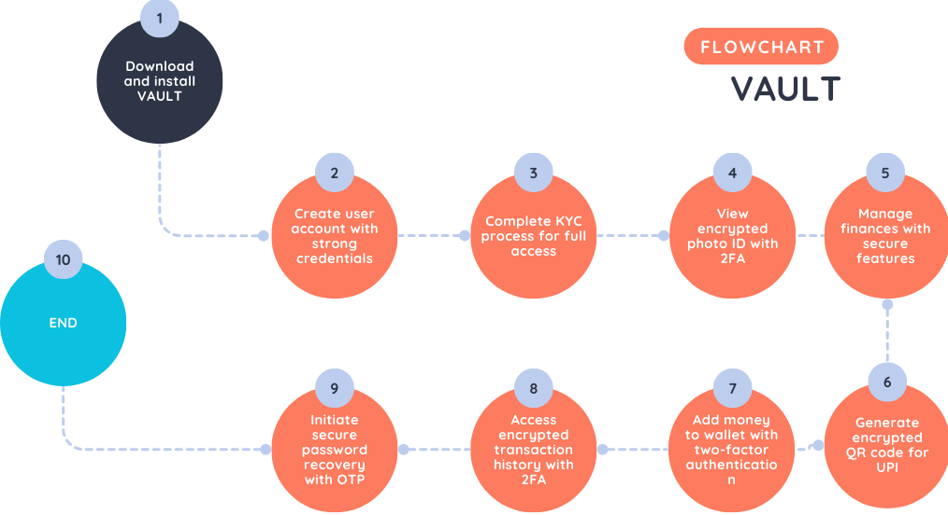
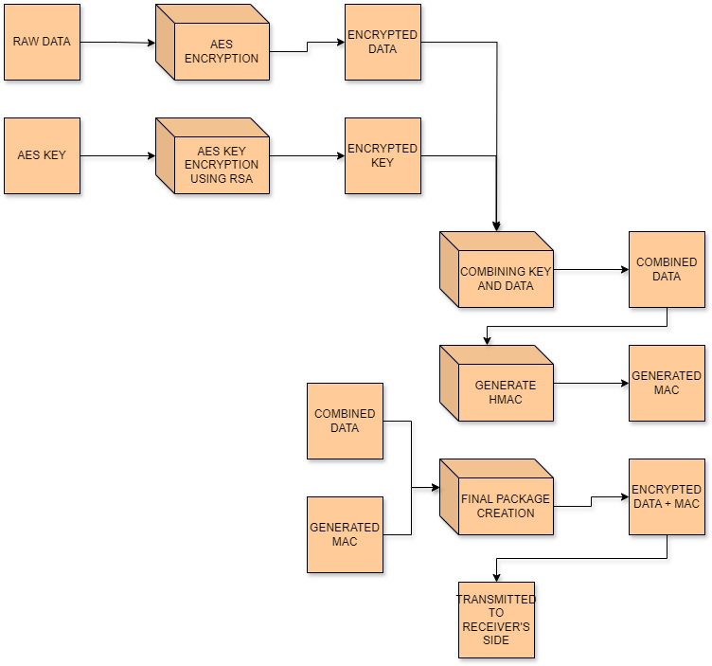
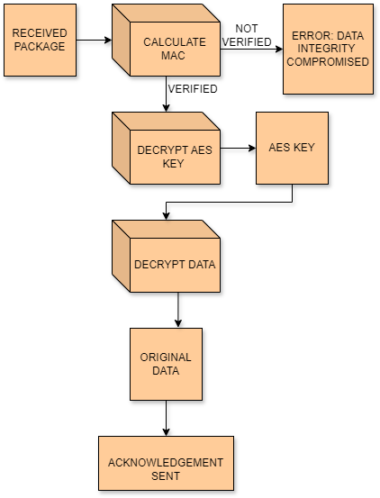
VAULT - A FULLY SECURE TRANSACTION APPLICATION
Nancy Saxena(21MIS1024), Aakarsh Mishra(21MIS1025) Department Name : SCOPE, VIT Chennai
Under the Guidance of Dr. MALATHI D., (53036), VIT Chennai
Abstract
Methodology
Result
VAULT, a revolutionary payment gateway, tackles growing cybersecurity concerns in financial transactions. Its robust security architecture prioritizes user data protection.
VAULT utilizes a three-factor login to significantly reduce unauthorized access. Sensitive KYC data is secured with TriSecurEncrypt, a novel algorithm leveraging a combination of established encryption techniques: AES for confidentiality, RSA for secure key exchange, and HMAC for data integrity. Additionally, steganography further safeguards user information by concealing it within images.
For financial transactions, VAULT employs specialized encryption protocols, ensuring the confidentiality of credit card details, debit card information, and bills. Even password recovery prioritizes security with two-factor authentication via one-time passwords (OTPs).
By offering a comprehensive suite of security features, VAULT aims to establish itself as the new standard for secure and user-friendly digital transactions.
VAULT redefines secure financial transactions with a multi-layered approach. User authentication utilizes biometrics, username/password, and OTPs for a strong first line of defense. KYC data is encrypted with TriSecurEncrypt (explained previously) and further hidden within uploaded photo IDs using steganography, creating a double layer of protection.
Secure data access requires two-factor authentication, ensuring only authorized users can view their KYC information. Similarly, banking details are encrypted with industry standards and TriSecurEncrypt. Transactions leverage secure protocols and a two-factor authentication process protects top-up and password recovery actions.
The Image Vault application distinguishes itself through its innovative approach to securing user data. By combining advanced encryption techniques such as AES256 with biometric verification and user-specific data like date of birth, the application offers a unique and highly secure method for storing and accessing images. This multi-layered approach provides a robust defence against unauthorized access, ensuring only the authorized user can decrypt and view their encrypted images. Additionally, the user-friendly interface and seamless integration of security measures create an efficient and reliable solution for managing sensitive images. The application sets itself apart as a cutting-edge tool for safeguarding user data in an increasingly digital world.
Secure communication is achieved through HTTPS and certificate validation, safeguarding data transmission. User privacy is paramount: minimal data collection, anonymization where possible, and user control over their information are prioritized. Backups ensure data recovery in emergencies.
Robust access controls restrict access to user data and critical functions. The principle of least privilege and role-based access control ensure only authorized personnel can access sensitive information. Multi-factor authentication further secures administrative access.
VAULT's commitment is reflected in continuous security monitoring. Regular security audits identify vulnerabilities, while a SIEM system monitors security events. A well-defined incident response plan ensures swift action against potential threats.
By combining these methodologies, VAULT offers a secure and trustworthy platform for managing finances.
Introduction
In today's digital age, convenience often clashes with security, especially when managing finances online. Every click can feel like a gamble, leaving you wondering if your hard-earned money is truly safe. But what if there was a payment app built from the ground up to prioritize your financial well-being? Introducing VAULT, the revolutionary app that redefines secure transactions and empowers you to take control of your financial life.
VAULT transcends conventional security measures, creating an impenetrable fortress for your financial data. Our groundbreaking TriSecurEncrypt algorithm, a multi-layered encryption system, acts as your digital vault, safeguarding your sensitive information like a virtual Fort Knox. This unparalleled security extends beyond basic protection, offering a holistic approach that tackles vulnerabilities at every stage of the financial transaction.
Imagine a world where weak passwords become relics of the past. VAULT's robust three-factor authentication system utilizes facial recognition, fingerprint scanning, and your traditional login credentials, ensuring ultimate access control. Every transaction you make is meticulously encrypted, guaranteeing complete confidentiality. Even if memory fails you, our secure two-factor authentication process for password recovery ensures only you regain access, eliminating unauthorized intrusions.
VAULT doesn't stop at guarding your data; it empowers you. VAULT simplifies your financial life. It's the perfect marriage of convenience and security, finally allowing you to experience the peace of mind you deserve when managing your finances online.
Novelty
VAULT sets itself apart from conventional transaction apps through its groundbreaking TriSecurEncrypt algorithm and a user-centric design philosophy.
Enhanced Security: This multi-layered approach offers significant advantages. AES ensures data confidentiality, while RSA enables secure key exchange, preventing unauthorized access to the decryption key. Additionally, HMAC (Hash-based Message Authentication Code) is employed for data integrity. HMAC detects any tampering during transmission, safeguarding against message alterations.
TriSecurEncrypt: A Paradigm Shift: VAULT boasts a novel encryption algorithm, TriSecurEncrypt, that surpasses traditional methods like AES. It leverages the strengths of both symmetric and asymmetric encryption, offering superior security. Imagine a layered security blanket:
Sender Side:
User's data is first encrypted using AES (Advanced Encryption Standard), a widely trusted symmetric algorithm. This scrambles the data with a secret key, rendering it unreadable without the key.
The AES key itself is then encrypted using RSA (Rivest–Shamir–Adleman), an asymmetric algorithm. RSA utilizes a public and private key pair. The user's device securely stores the private key, while the public key can be shared for secure key exchange.
Receiver Side:
The receiver possesses the corresponding private key for the RSA algorithm. They use this private key to decrypt the AES key received from the sender.
The decrypted AES key is then used to decrypt the actual data, unlocking the confidential information.
.
Conclusion
Sender’s side
VAULT redefines secure financial transactions. Three-factor authentication and cutting-edge encryption, including TriSecurEncrypt, safeguard user data. This robust system is built with Android Studio, Java, XML, and Firebase's suite of security-focused services. Additionally, VAULT adheres to industry-standard practices for ongoing protection.
Security doesn't hinder usability. VAULT boasts a user-friendly interface with clear instructions and intuitive features, ensuring a seamless experience. Real-time feedback empowers users to manage finances confidently.
VAULT's potential extends far beyond its core functionalities. The secure architecture can integrate with various financial institutions, creating a versatile platform. With continuous updates and rigorous security assessments, VAULT is poised to be a leader in secure and user-friendly financial transactions for the digital age.
Receiver’s side
J component – SWE3002 – Information and System Security (Winter Semester 2023–24)

