Slide 1
Courier Management System
Presented by
AAKARSH SINHA
Roll No.:- B210001CS

Slide 2
CONTENT
About The Project
Relational Schema
Cardinalities
ER Diagram
Implementation
Future Work
Conclusion
Reference

Slide 3
ABOUT THE PROJECT
A courier management system (CMS) is like a smart tool for delivery companies. It helps them organize everything - from taking orders to tracking packages and planning the best delivery routes. This system also looks after the delivery vehicles and keeps customers updated about their packages. By using this tool, delivery companies work better, make fewer mistakes, keep customers happier, and earn more money.

Slide 4
SIGNIFICANCE OF THE PROJECT
The use of courier management software helps the business in many ways:-
1. Time Efficiency
2. Minimum Paperwork
3. Real-Time Tracking
4. Minimum Cost
5. Enhanced Security
6. Improved User Experience & Customer Service

Slide 5
RELATIONAL SCHEMA
Admin:
(Email, Name, Phone Number, A.Id)
Customer:
(Email, Name, Phone Number, C.Id)
Employee:
(Email, Name, Phone Number, E.Id)
Courier:
(Courier Id, Courier Name,Courier Status, Type, Quantity, Price, Expected Delivery date, Dimensions)
Address:
(Name, Phone Number, House Number & Landmark, City, State, Country)

Slide 6
CARDINALITIES
One admin can manage many parts of the system (one-to-many).
Each customer can place multiple orders (one-to-many).
An employee can manage multiple aspects or orders (one-to-many).
Each courier package is managed by one courier service (one-to-many).
An address can be associated with multiple entities but usually, each entity has one address (one-to-many).

Slide 7
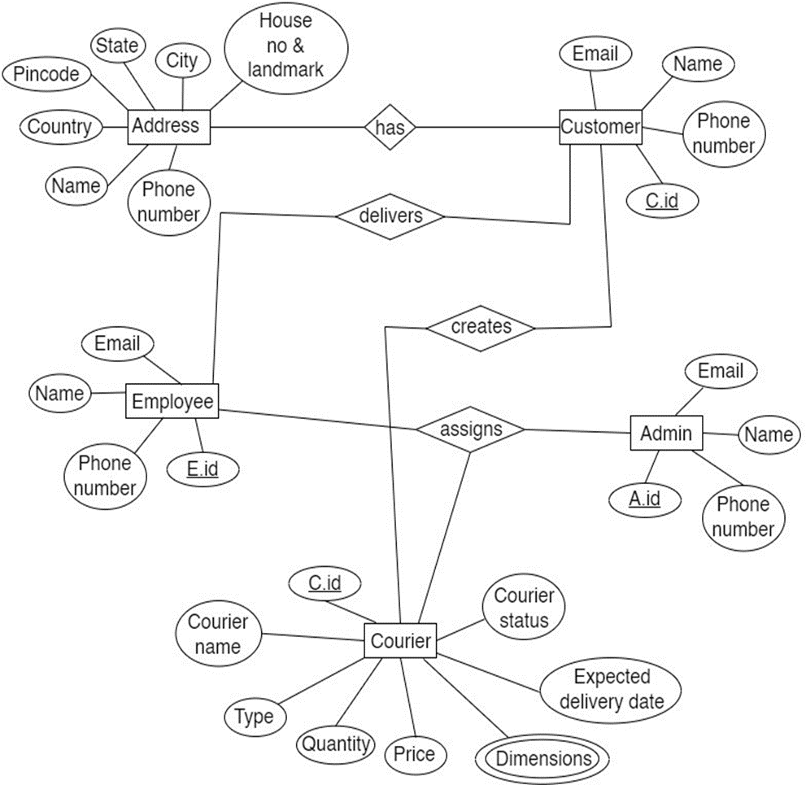
ER DIAGRAM

Slide 8
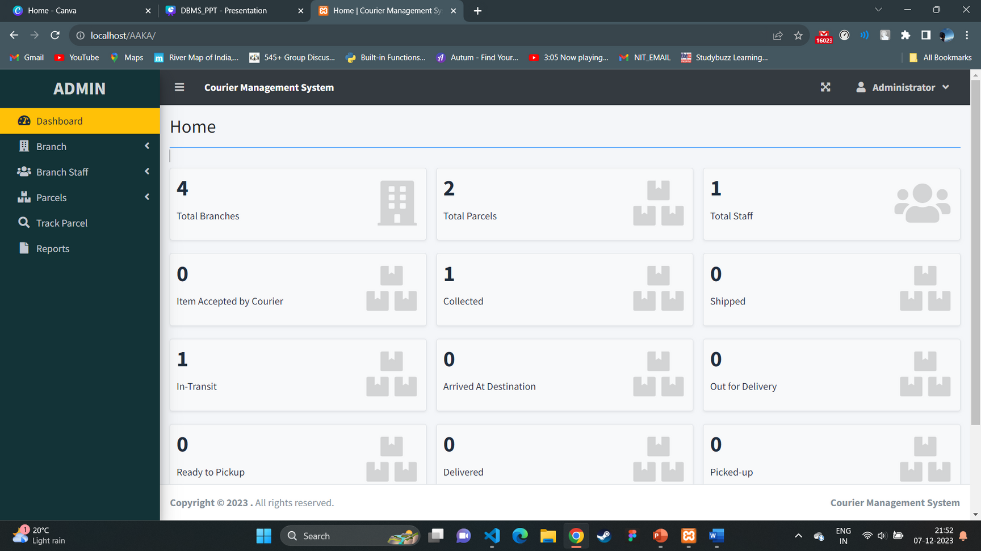
IMPLEMENTATION

Slide 9
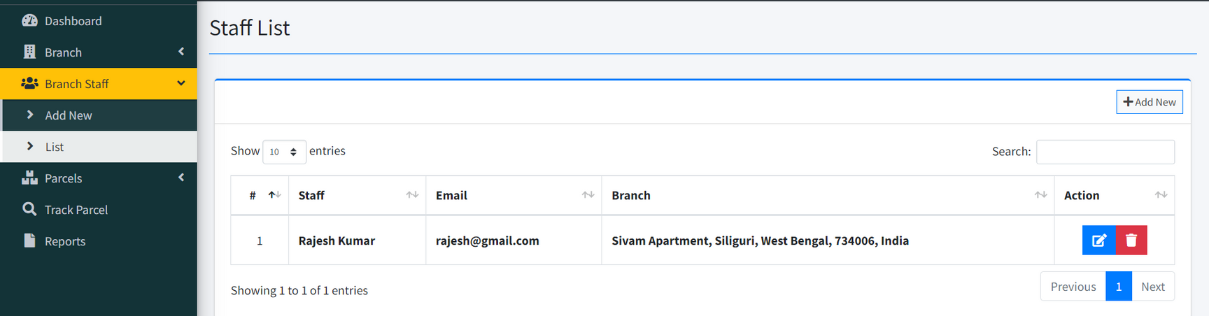
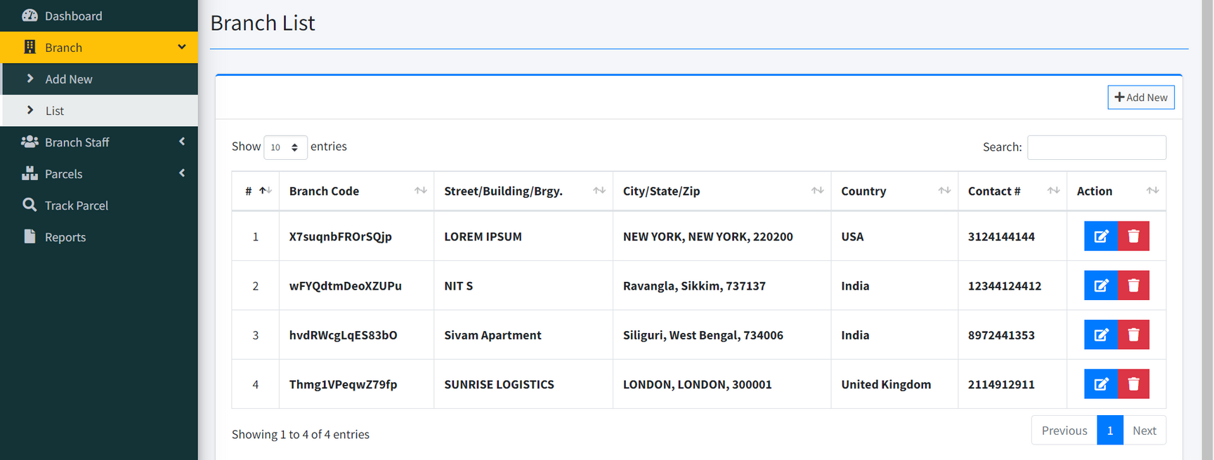

Slide 10
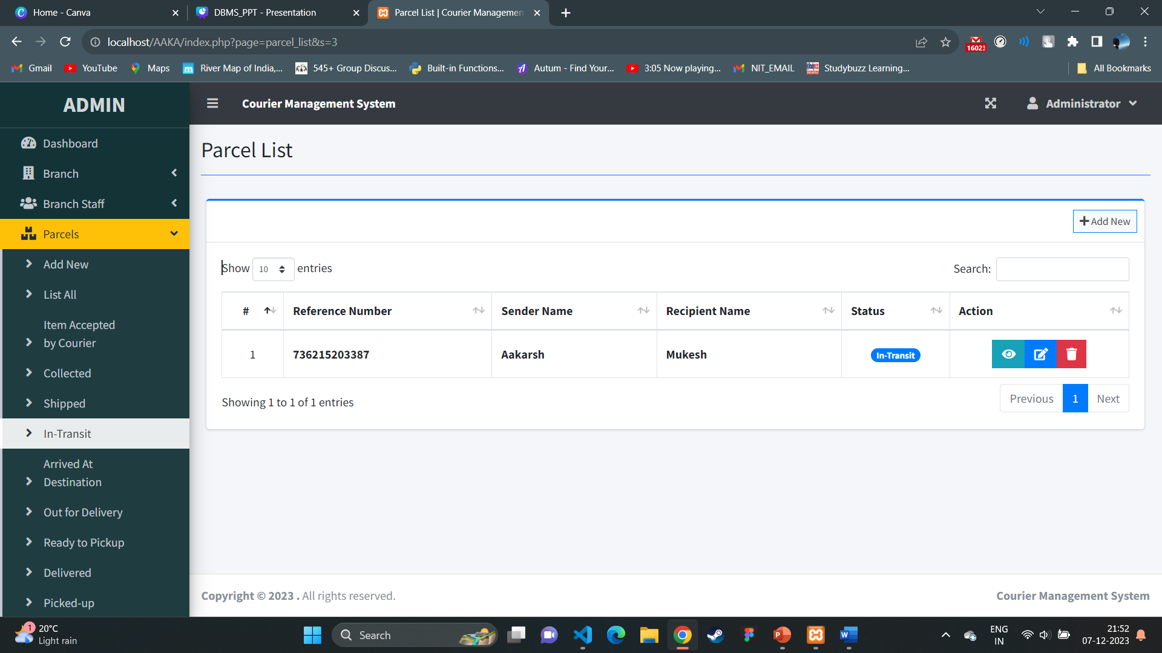

Slide 11
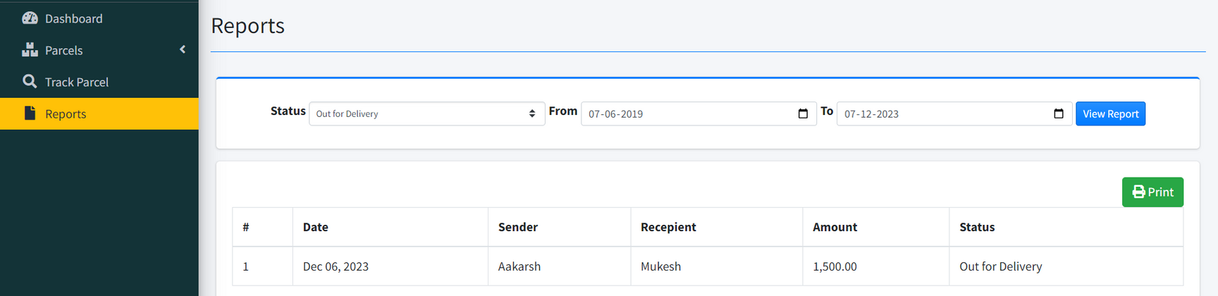
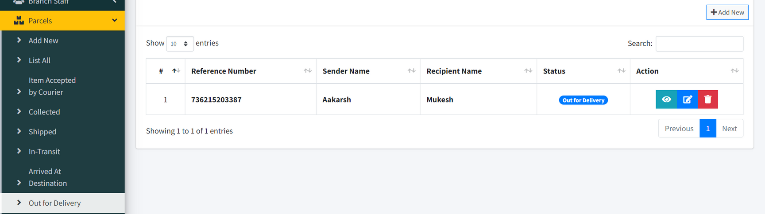

Slide 12
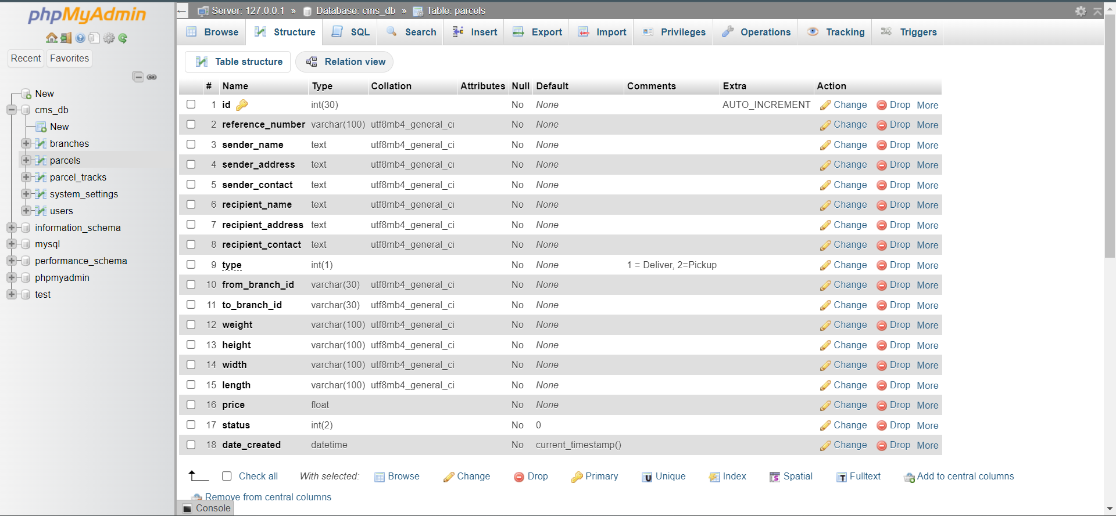

Slide 13
FUTURE WORK
Future enhancements for courier management involve AI-driven route optimization, IoT-based tracking, and sustainability with electric vehicles. Integrating blockchain for security, customer-centric upgrades, global compliance, and AR/VR for training are vital. Innovations in these areas ensure efficient and sustainable logistics.

Slide 14
CONCLUSION
The Courier Management System simplifies courier placement and tracking with a user-friendly interface. Tailored for specific business needs, it manages employees, tracks couriers, and streamlines related tasks. Its goal is efficiency through simplicity, ensuring accessibility with comprehensive features.

Slide 15
REFERENCE
Book used:
Henry F Korth, Abraham Silber Schatz, ''Database system concepts'', McGraw-Hill International editions, Computer Science Series (1991). Second Edition.
Sites Referred:
https://chat.openai.com/
https://optimoroute.com/courier-management/

Slide 16
Thank You

