Slide 1
Cricket Score Sheet
Presented by :
Aakarsh Vyas

Slide 2
AIM:
The Aim of this project was to have a score sheet of batsmen & bowlers as output.

Slide 3
Header Files Used:
include<iostream>
- include<cstring>
- include<stdio.h>

Slide 4
Concepts Used :
Structure
Array
Switch Case
Functions

Slide 5
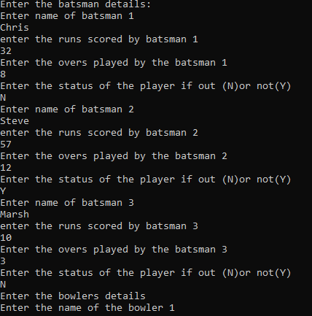
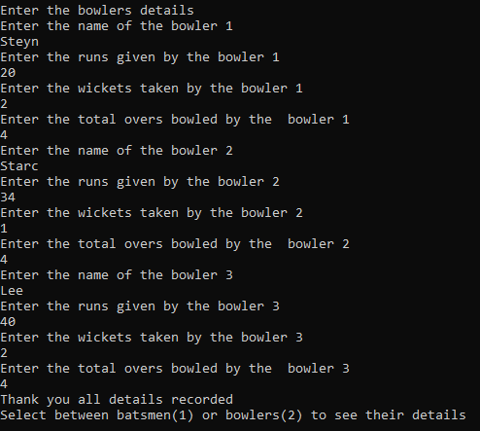
Output :
01.
.
.

Slide 6
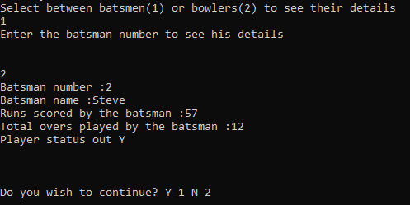
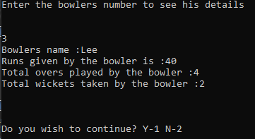
Output :

Slide 7

THANKS!
You can delete this slide when you’re done editing the presentation

