Slide 1
NAME:-AAKARSHAN BHARDWAJ SECTION:-SE ROLL NO:-2015041[1]
MINI PROJECT 2021

Slide 2
TOPIC
Fire detection alarm system

Slide 3
COMPONENTS
DEVICES | QUANTITY
Arduino UNO R3 | 1
Gas Sensor MQ-2 | 1
Piezo buzzer | 1
LED Bulbs | 2
220-ohm Resistor | 1
Servo motor | 1

Slide 4


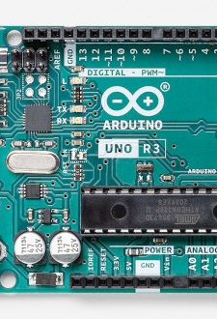
COMPONENT DESCRIPTION
ARDUINO UNO R3
The Arduino UNO is the best board to get started with electronics and coding. Arduino Uno is a microcontroller board based on the ATmega328P . It has 14 digital input/output pins (of which 6 can be used as PWM outputs), 6 analog inputs, a 16 MHz ceramic resonator (CSTCE16M0V53-R0), a USB connection, a power jack, an ICSP header and a reset button. It contains everything needed to support the microcontroller; simply connect it to a computer with a USB cable or power it with a AC-to-DC adapter or battery to get started..

Slide 5
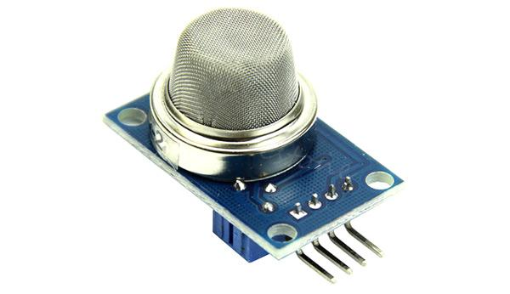
COMPONENT DESCRIPTION
GAS SENSOR
A gas sensor is a device which detects the presence or concentration of gases in the atmosphere. Based on the concentration of the gas the sensor produces a corresponding potential difference by changing the resistance of the material inside the sensor, which can be measured as output voltage. Based on this voltage value the type and concentration of the gas can be estimated.

Slide 6
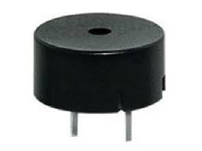
COMPONENT DESCRIPTION
PIEZO BUZZER
Piezo buzzers are simple devices that can generate basic beeps and tones. They work by using a piezo crystal, a special material that changes shape when voltage is applied to it. If the crystal pushes against a diaphragm, like a tiny speaker cone, it can generate a pressure wave which the human ear picks up as sound. Simple change the frequency of the voltage sent to the piezo and it will start generating sounds by changing shape very quickly!

Slide 7
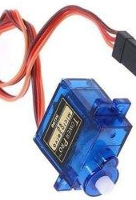
COMPONENT DESCRIPTION
SERVO MOTOR
A servo motor is a type of motor that can rotate with great precision. Normally this type of motor consists of a control circuit that provides feedback on the current position of the motor shaft, this feedback allows the servo motors to rotate with great precision. If you want to rotate an object at some specific angles or distance, then you use a servo motor. It is just made up of a simple motor which runs through a servo mechanism.

Slide 8

SOFTWARE USED
Arduino IDE where IDE stands for Integrated Development Environment - An official software introduced by Arduino.cc, that is mainly used for writing, compiling and uploading the code in the Arduino Device. Almost all Arduino modules are compatible with this software that is an open source and is readily available to install and start compiling the code on the go.

Slide 9
PROJECT DESCRIPTION
This project is purely created by Aakarshan Bhardwaj,The central target of this project was to study, analyse and design a fire detection and alarm system. This topic was suitable because it covered a basic and important aspect in our modern life. I have gained the valuable experience in the field of arduino board and alarm system from studying and conducting this project. The objectives of the project were to provide information on fire alarm system in India.

Slide 10
Secondly, in the practical part, the objective was to build a demo system to demonstrate how to tackle fire caused by an LPG or any other means.the system is expected to operate satisfactorily not only under fire conditions, but also when faced any conditions to be met in practice the condition about which we are talking here are burning of food, cloth catching fire,wire catching fire and other conditon from which fire can cause or formation of fumes occur.

Slide 11

HOW THIS PROJECT GETS ACTIVATED?
This project works on many principles like electronics circuitry , potential difference created by dense fumes. When the gas sensor installed on our breadboard comes in contact of fumes formed by any activity this leads to the detection upon change of resistance of the sensing material when the Gas comes in contact with the material. Using a simple voltage divider network, concentrations of gas can be detected now the signal is send to board which leads to the activation of piezo buzzer and servo motor.

Slide 12
Now the question arises what is the need of the servo motor. We are using servo motor for switching of mcb of all kitchen appliances. This servo motor is installed at main mcb board when piezo buzzer start ringing the servo motor do a 180-degree phase shift and hit the mcb. Which turn it off till it gets switch on back manually.

Slide 13
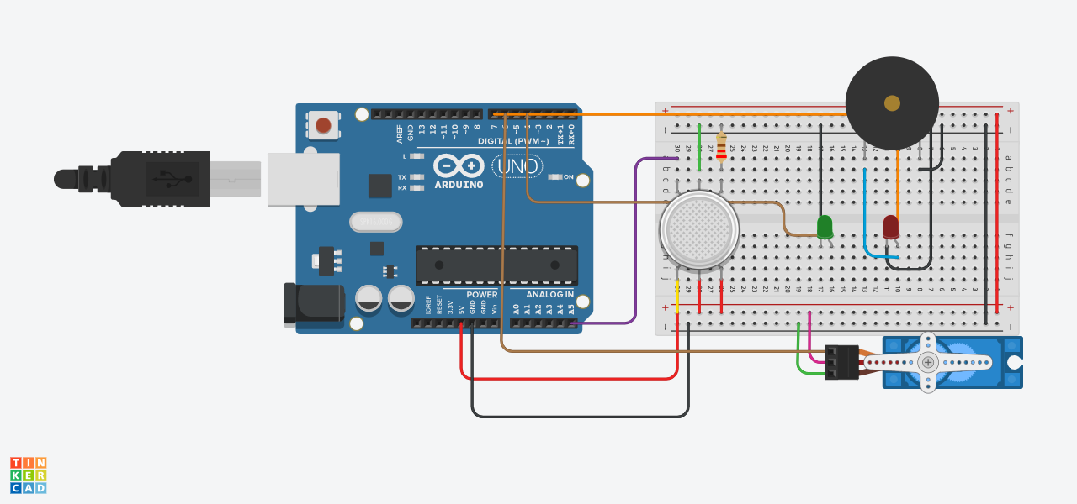
CIRCUIT DIAGRAM

Slide 14
PROJECT UPGRADATION
Any project with no future upgradation leads to degradation of that topic. We can upgrade it using GSM board, it will take a sim card for its working if any fire problem occur it will directly send maximum of 100 messages on your phone even if you are not at home, the only condition that can occur is that it need proper network and device need to be on during this process.

Slide 15
BIBLOGRAPHY
https://www.arduino.cc
https://lastminuteengineers.com
https://www.tinkercad.com
https://www.youtube.com

Slide 16
THANK YOU

