Slide 1
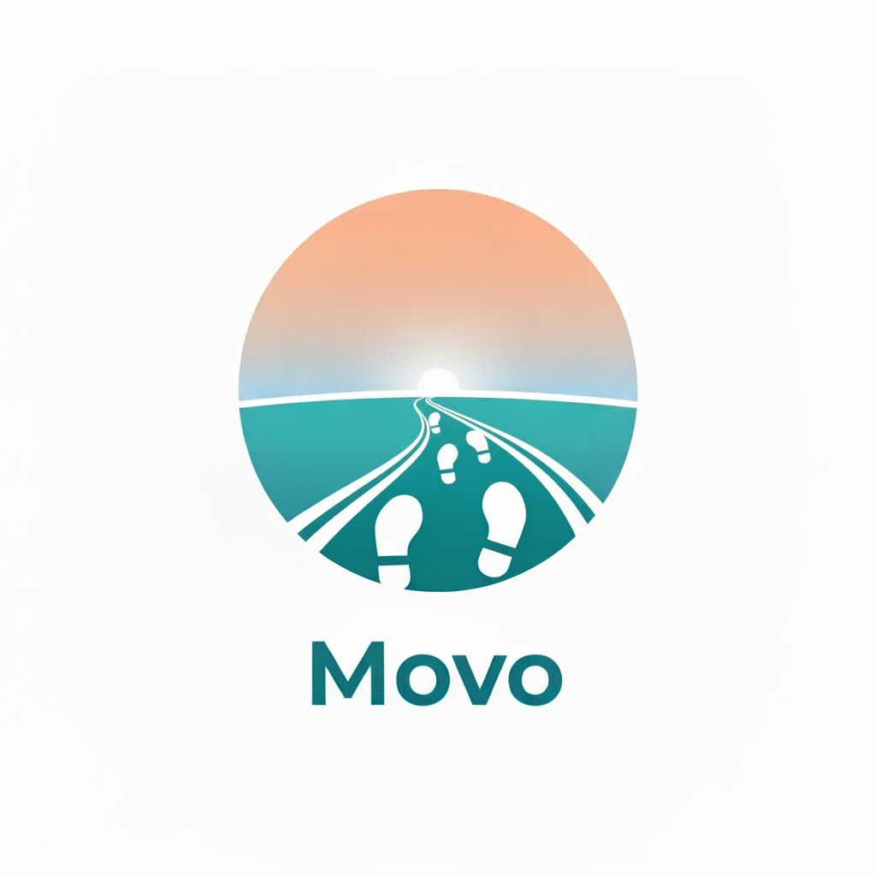

Team Overload 404
Our Team:
Manya Chourasiya
Aakarshan Indori
Hemangi Mourya
Because wellness begins with togetherness

Slide 2
The Problem
People walk miles chasing wellness, but somewhere along the way, the journey became solitary.
Data replaced dialogue, and fitness became another lonely routine.
It’s time to bring connection back into every step.
OUR MOTIVE??
Bridges fitness and connection by bringing people together through shared walks.
With part of our revenue supporting community initiatives, every step becomes an act of good.

Slide 3

Solution
Key Features
ENGAGING AND REWARDING WALKS FOR EVERYONE
Google Maps Security – Real-time route tracking for safe walks.
Rewards System – Earn coins and redeem exciting rewards.
SOS Button – Quick emergency alert with one tap.
Easy Layout – Clean and user-friendly interface.
Secure Payments – Encrypted and safe transactions.
Live Location – Share real-time walking location.
User Profile – Track progress and achievements.
Instant & Scheduled Walks – Walk now or plan ahead.
Minimal Steps – Requires fewer actions, making it more efficient and easy to use.
People walk miles chasing wellness, but somewhere along the way, the journey became solitary. Our app bridges fitness and connection through shared walks, supporting community initiatives.

Slide 4
User Flow
Wanderer
Create account
Home page
Request a walk
Walk confirmation
Review walk
End walk
Start walking
Walker
Create account
Home page
Check available walks
Walk history
Start walking
Confirm requests

Slide 5
Technology Stack
🧩 Frontend:
Flutter – For building a responsive, cross-platform mobile interface
Dart – Core programming language ensuring fast performance and smooth UI
🖥️ Backend:
Firebase – Used for authentication, database (Firestore), and cloud storage
Firebase Cloud Functions – To handle backend logic, automation, and notifications
🛠 Development & Collaboration:
Cursor IDE – For AI-assisted coding, debugging, and real-time collaboration
GitHub – For version control and project management
🗺 APIs & Integrations:
Google Maps API – For real-time location tracking and route mapping
Firebase Cloud Messaging (FCM) – For push notifications and updates
🔒 Security:
Firebase Authentication – For secure login using Email/Google
Firestore Rules – To protect user data and privacy

Slide 6
Future Scope
Enhanced Reward System – Introduce streaks, lucky cards, and special challenges to boost engagement.
Community & Leaderboard – Foster healthy competition and motivate users through rankings.
User Verification & Authentication – Strengthen user identity for a secure experience.
Chat Feature – Enable direct communication between users and wanderers.
Personalized Themes – Let users customize the app interface to match their style.
Referral Program – Encourage user growth through invite-and-earn rewards.
Wellness Programs – Integrate guided walks, meditation, and fitness goals.
Health Analytics Dashboard – Track steps, distance, and overall wellness during walks.
AI Activity Insights – Suggest routes, timing, and challenges based on user behavior.

Slide 7
Challenges Faced
Faced issues integrating Firebase Authentication and database smoothly during testing.
Ensuring accurate real-time location tracking with Google Maps API required multiple debugging rounds.
Designing a balanced and glitch-free reward system to keep users motivated was challenging.
Maintaining UI/UX consistency across various screen sizes took repeated refinements.
Managing team collaboration in Cursor and resolving version conflicts was a learning experience.

