Slide 1
CloudPilot
Cloud cost decisions
with evidence and approval
Utho SmartCloud Optimizer hackathon project
200 synthetic resources. A working review and execution workflow.
01
Notes:
Opening, 20 seconds. CloudPilot helps engineers review cloud costs with evidence and explicit approval. This deck describes the implemented prototype in README.md and docs/TRD.md, inspected 25 October 2026.

Slide 2
The cloud cost decision problem
Visibility
Engineers need resource-level usage, ownership and cost context.
Trust
Low average CPU can hide memory pressure and short usage peaks.
Control
A recommendation needs a reviewable change, approval and an audit trail.
02
Notes:
30 seconds. Product motivation from README.md and docs/PRODUCT_DEFINITION.md. These are the product problems addressed, not a quantified market study.

Slide 3
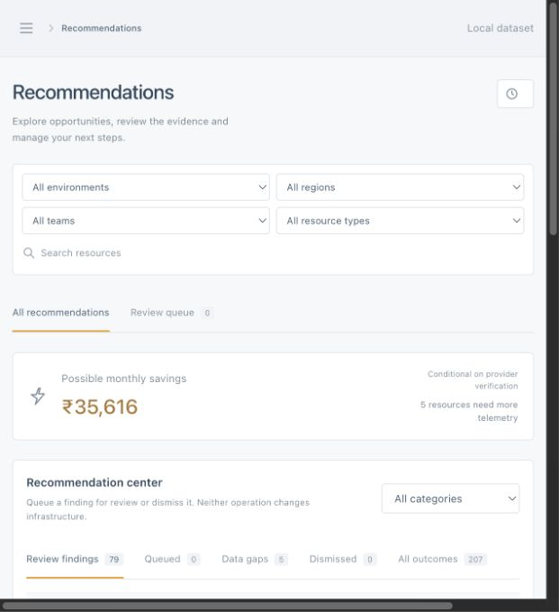
The engineer review workflow
Review each finding
1. Inspect history and usage peaks.
2. Compare candidate checks and blockers.
3. Queue the finding for review.
03
Notes:
35 seconds. Show Resources, then Recommendations. Inspect peaks, stress replay and blocked alternatives. Queue a finding for review. Queuing does not execute it or create verified savings. Source: README.md, docs/TRD.md. Screenshot: docs/verification/recommendations-ui.png, recorded project evidence, not a live view.

Slide 4
A reproducible synthetic benchmark
200
30 days at 15-minute intervals
resources
432,000 VM telemetry rows
28,800 GPU telemetry rows
2,880 VM rows mark missing observations
150 VMs
20 block volumes
20 public IPs
10 GPUs
Observed window: 1–30 August 2026
Naive timestamps use an unverified UTC assumption
04
Notes:
35 seconds. CSVs inspected directly on 25 October 2026. test-data/resources.csv: 200 rows. metrics.csv: 432000 rows, including 2880 missing observations. gpu_metrics.csv: 28800 rows. Window is Aug 1 through Aug 30 2026, end exclusive Aug 31. No production telemetry or measured cost savings.

Slide 5
Peak demand and stress replay guide sizing
Validate data quality. Enumerate plans. Retain every failed or unknown gate.
Policy
Illustrative candidate
80% CPU / memory limit
95% complete coverage
1.2× CPU / memory stress
2.8 used cores ÷ 4 target cores = 70%
Stress: 70% × 1.2 = 84%
Result: target fails the 80% stress limit
05
Notes:
45 seconds. Policy is conservative-demo-v1 in backend/app/engine/policy.py. CPU and memory peak <=80%, disk occupancy <=80%, coverage >=95%, >=7 days history and latest sample <=3600s from historical cutoff. All peaks participate. Example is illustrative arithmetic, not a recommendation for an actual resource. Synthetic evidence and unknown capabilities still block production eligibility.

Slide 6
Cost comparisons preserve billing limits
INR 10,28,550
Known-charge monthly equivalent in the supplied snapshot
Comparison basis
Quarterly compute price ÷ 3. Separate storage remains billable.
Material limits
30 resources have unknown tariffs. Stopping committed VMs saves INR 0 cash.
06
Notes:
40 seconds. Derived directly from pricing.csv: sum of monthly_equivalent_inr=1028550 INR across 170 known-price resources. 20 public IP and 10 GPU costs are unknown. Quarterly /3 is a comparison basis, not a monthly tariff or guaranteed cash saving. Source: test-data/pricing.csv, assumptions.json, README.md.

Slide 7
Architecture and responsibility boundaries
React + FastAPI + SQLite
One web client, one API and persistent evidence, decisions and audit.
Deterministic engine
CSV validation, peak analysis, candidate checks and cost arithmetic.
LLM text interface
Explains findings and fills scenario inputs. Server validation controls calculation.
Execution integrations
LocalStack through MCP and GitHub Terraform PRs after exact approval.
07
Notes:
35 seconds. Sources: docs/TRD.md and README.md. React/Vite frontend calls FastAPI. SQLite stores imported data, evidence, decisions and audit. Deterministic Python engine owns arithmetic. Shared LLM client handles explanation and scenario interpretation without tools. Execution service owns approved LocalStack MCP changes and Terraform PRs.

Slide 8
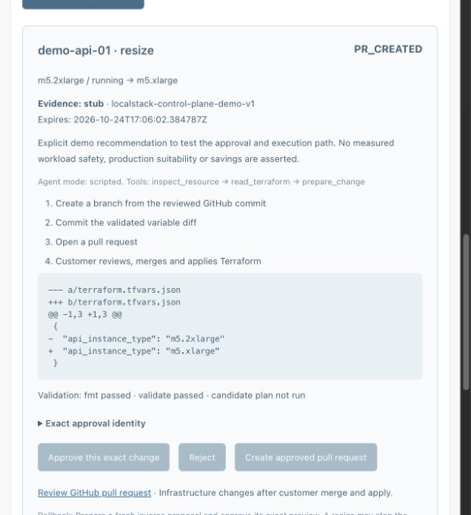
Approved execution in the demo environment
Explicit approval
1. Preview the exact change.
2. Approve and recheck evidence.
3. Verify the result and audit.
Terraform creates a reviewable PR. LocalStack tests control-plane state.
08
Notes:
40 seconds. Explain exact preview, approval, stale-evidence recheck, execution, verified state and audit. Manual inverse change needs fresh approval. LocalStack validates control-plane behavior, not VM performance. Terraform integration creates a PR for the audited module, with no merge or apply. Source: README.md, docs/TRD.md. Recorded screenshot: docs/terraform-pr-demo.png.

Slide 9
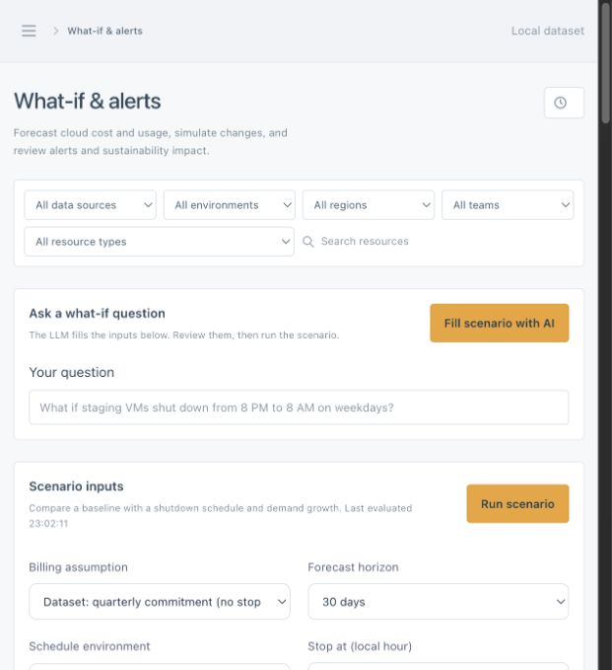
What-if analysis makes assumptions visible
Visible scenario inputs
Ask a plain-language question.
Review the interpreted schedule and billing mode.
Run the server-calculated scenario.
09
Notes:
30 seconds. Natural-language what-if interpretation uses the configured LLM. Users review visible inputs before running. Commitment mode produces zero shutdown cash savings. Hourly billing is a labeled hypothetical mode. Energy/carbon depend on editable assumptions. Historical extrapolation is not a calibrated ML forecast. Source: README.md, docs/TRD.md. Recorded screenshot: docs/verification/scenario-ui.png.

Slide 10
Recorded verification covers the complete workflow
153 backend tests
Recorded passing suite includes 15 dataset-to-execution journeys with simulated adapters.
15 live MCP journeys
Recorded API runs through approval, execution, state checks and repeat handling.
Real integration records
Frontend build, LLM checks and Terraform PR #3. No Terraform merge or apply.
Recorded results from 24 October 2026. They do not establish production savings.
10
Notes:
35 seconds. Historical verification as recorded in docs/verification/README.md dated 24 October 2026, not rerun while preparing this deck. 153 backend tests, 15 simulated-adapter API journeys, 15 additional real LocalStack MCP API journeys, frontend build, Qwen interpretation and real Terraform demo PR #3. Later focused checks are separate runs and must not be added to the 153 as a unique-test total.

Slide 11
Production adoption requires new evidence
Provider validation
Confirm current tariffs, regional availability and resize constraints with Utho.
Workload validation
Use real telemetry, configuration history and application performance tests.
Deployment readiness
Add tenant identity and isolation, production controls and invoice reconciliation.
11
Notes:
25 seconds. Sources: README.md, docs/TRD.md and docs/assumptions.md. Roadmap items are future work. No production Utho integration, tenant isolation, automatic deletion or unattended notifications.

Slide 12
Dataset assumptions and judge Q&A
Why synthetic data?
It enables repeatable edge cases and testing without tenant infrastructure access.
How is it justified?
The companion workbook ties each assumption to its purpose, source and validation gap.
What can we claim?
A functional evidence and approval workflow. Cost opportunities remain conditional estimates.
12
Notes:
Appendix. Companion workbook includes assumptions, policy constants, dataset checks, 200-resource price inventory and source hashes. Direct CSV audit found Aug 1–30 metrics and Mar–Aug billing. docs/assumptions.md names a different telemetry window and Apr–Sep billing. data_quality_summary.json references absent oracle and label files. These discrepancies remain visible in the workbook. Core engine consumes neither labels nor oracle.

