Slide 1
Title:
Memory Leak Visual Demo – Garbage Collection Simulation
Problem Statement:
To visualize how unreachable objects accumulate and cause memory pressure in managed runtimes, by simulating garbage collection using dynamic data structures in C.
Team Details – O log(3) Trio:
Aakash Desai:PES1UG24CS006
Aarush Muralidhara:PES1UG24CS010
Abhay Balakrishna Doddaballapur:PES1UG24CS012
Introduction
Built entirely in C using dynamic memory allocation.
Uses singly linked list to simulate heap memory.
Uses directed graph to represent object references.
Employs mark-and-sweep GC algorithm to free unreachable objects.
Generates Graphviz output showing reachable (green) vs unreachable (red) objects.

Slide 2
Data Structures Used and Reason for Choosing
Overview
To simulate object references and memory allocation realistically, the project uses dynamic pointer-based data structures.
These allow flexible memory usage, easy expansion, and direct modelling of how memory is linked in real runtime systems.
Data Structure | Purpose | Reason for Choice
Singly Linked List | Represents the heap — each node corresponds to an allocated object | Provides efficient insertion and traversal; minimal overhead compared to doubly or circular lists.
Directed Graph (Adjacency List) | Models one-way object references (A → B). | Realistic representation of memory references — reachability analysis works only on directed edges.
Recursive Stack (implicit) | Used internally in the mark phase (DFS traversal). | Recursion naturally uses the call stack, avoiding manual stack management and keeping code clean.

Slide 3
ADT Definition (ObjectGraph)
ADT Name: ObjectGraph
Definition:
ObjectGraph is an Abstract Data Type that models the heap memory of a program as a directed graph,
where nodes represent dynamically allocated objects and edges represent references between them.
It is used to simulate memory management and garbage collection (mark and sweep).
Data Description:
Component | Type | Description
Object | Struct | Represents a memory block with a name, ID, mark flag, and reference list.
RefNode | Struct | Represents a directed reference from one object to another.
heap_head | Object pointer | Head of the linked list storing all objects (heap simulation).
roots[] | Array of Object pointers | Stores global roots for the mark phase.
marked | Integer | Marks reachability during garbage collection (1 = reachable, 0 = unreachable).

Slide 4
ADT Operations & Algorithm
Core Operations of ObjectGraph:
Operation | Purpose
create_object() | Allocates a new object in the heap (linked list node).
add_reference(from, to) | Adds a directed reference between two objects
gc_mark_all() | Traverses all roots and marks reachable objects recursively.
gc_sweep() | Frees all unmarked (unreachable) objects from memory.
write_dot() | Generates a DOT file to visualize the object graph (Graphviz).
final_cleanup() | Frees all remaining allocated memory at program termination.
force_leak_scenario() | To Simulate and run pre-defined scenarios
reset_simulator_state() | Clears the data/memory values from previous simulations
export_snapshot() | Creates a .txt file with current heap status

Slide 5
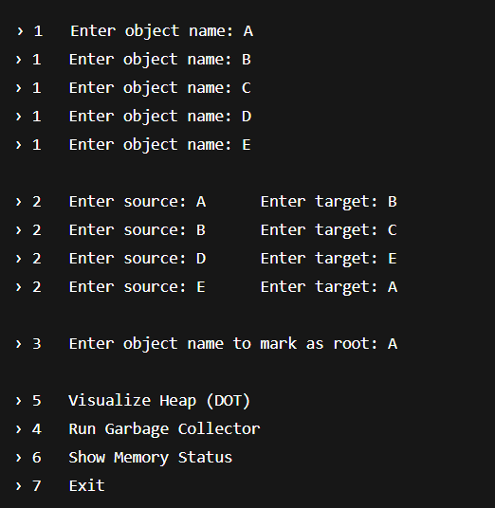
Sample Input (Functional Demonstration)
C
Action: Created 5 objects (A–E), formed references A→B→C D→E
E->A and marked A as the root for garbage collection
D
B
A
E
START
🟦 Root Object (A): Blue circle
🟩 Reachable Object (B,C): Green nodes
⚫ Unreachable Object (D,E): Black nodes

Slide 6
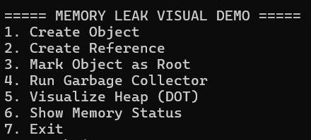

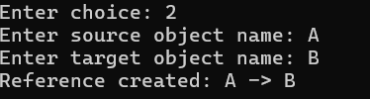

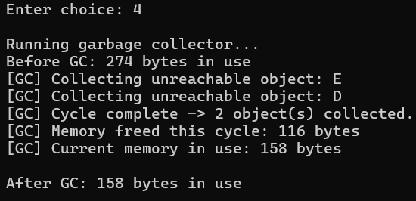

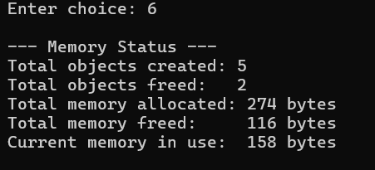
Output (Memory Status + Visualization)

Slide 7
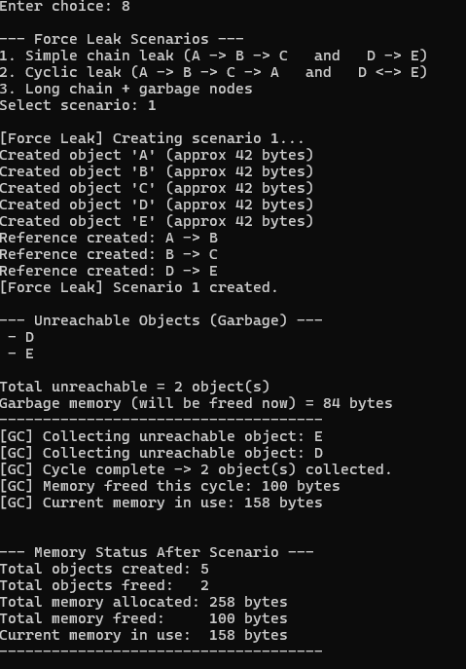
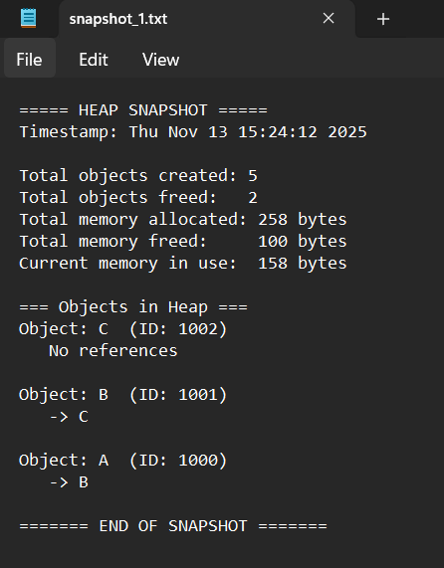
Additional Implementations

Slide 8
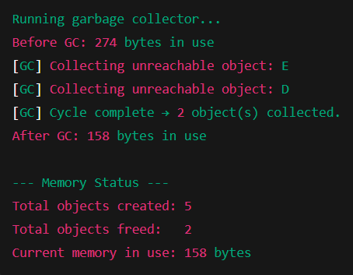
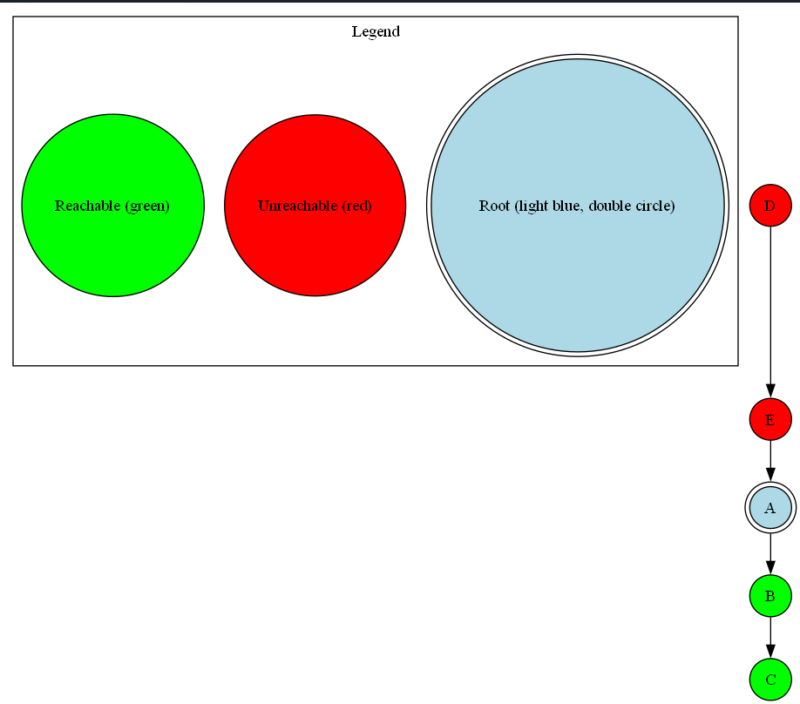
Output (Memory Status + Visualization)
🟦 Root Object (A): Double circle
🟩 Reachable (B,C): Green nodes
🟥 Unreachable (E,D): Red nodes — collected by GC

Slide 9
Concluding Remarks & Division of Work
Concluding Remarks
The project successfully simulates a Mark-and-Sweep Garbage Collector using user-defined data structures.
It demonstrates how unreachable objects lead to memory leaks and how garbage collection reclaims them.
The visualization clearly shows reachable (green) and unreachable (red) objects, improving conceptual understanding.
The implementation follows modular programming principles with multi-file structure (.h, .c, main.c).
Proper dynamic memory handling ensures no memory leaks at program exit.
Division of Work
Team Member | Contribution
Aakash Desai | Core C implementation, garbage collection logic, memory tracking
Abhay Balakrishna Doddaballapur | Visualization (Graphviz DOT generation), debugging, document preparation
Aarush Muralidhara | PPT design, testing, and final validation

