Slide 1
A day away, in Khoste
The ideal relaxation and unwinding destination

Slide 2
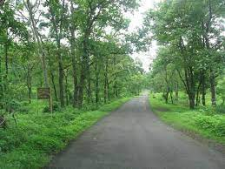
The journey
On the journey from Thane to Nashik (or back), along Highway 160, taking a diversion at Atgaon will bring you to a beautiful road towards Tansa lake, and Tansa wildlife sanctuary. On this road also lies a diversion to a small village, Khoste.
We offer to arrange transport for families or large groups. Refreshments would be served, during these trips.

Slide 3
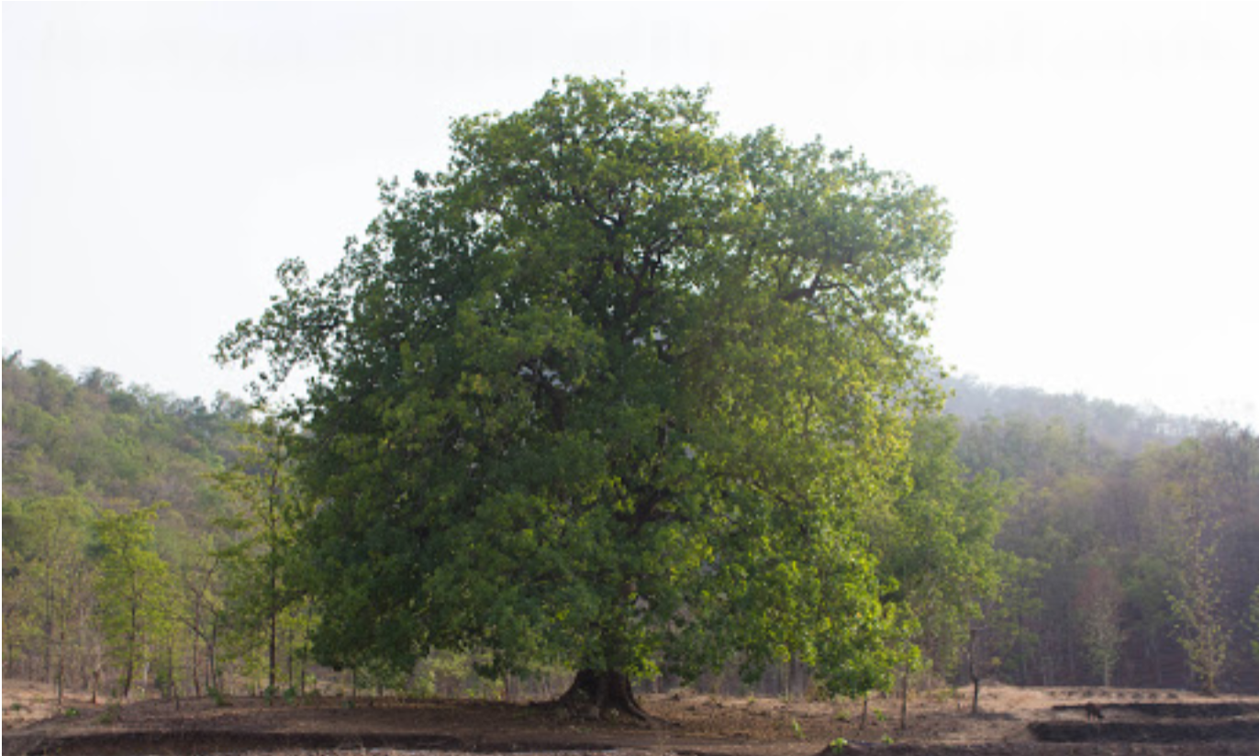
The destination
Khoste is surrounded by hills, giving it almost the feel of being in a valley.
The hills are pleasing to look at, with multiple waterfalls, small and big, making it an ideal destination for trekking.
Tansa river is close by, and is home to multiple coral formations and freshwater fishes.

Slide 4
Activities Offered
The hills: Trekking, Nature Walks
Tansa river: fishing, boating, snorkelling
Farm activities: Patrons can try sowing, harvesting, tilling etc. of small pieces of land. Bullock cart rides can be made available
Camping spots are available in this region, and mud houses can also be constructed for overnight stays.
Adventure sports: ziplining, rafting and rock climbing

Slide 5
Some issues:
Low starting capital :Large investment activities will need to be put off for a while.
Current sanitation conditions of the village might push our customers away, especially in the wake of the pandemic. Basic facilities like washrooms will need to be constructed.
Regular power shortages: Most of our starter activities do not require electricity, but we will suggest customers to bring power banks for their mobiles.
Internet connectivity is not available, which for some might be a deal breaker.
Avenues for publicity are hard to find.

Slide 6
Some other necessary investments/points:
Avoid the core of the village, farming activities at the outskirts
Jeep for traversal of area, to go from one activity to the other.
First aid, especially for sporting activities
Recommend power banks
//Compress all this text. This is more of an overview of what we’ve thought //of

Slide 7
Investments, in order of priority
Sanitation facilities for our customers, first aid kits
Any marketing costs
Costs for arranging customer travel
Setting up activities like the zip-line, snorkeling, camping
Vehicles for traversal of the area

Slide 8
Our major Customer groups, and how we will appeal to them:
People who simply want a day for themselves:
We offer a quiet getaway destination, without internet, with the day full of relaxing activities if our patrons want.
Groups who want to get together:
We offer a range of activities to be enjoyed amongst both friends and family. Discounts and travel facilities can also be arranged for larger groups.

Slide 9
Adverts
No 4G, enjoy watching children getting grumpy without it, nice pictures within the adverts
Feeling of community, meeting a new people with slightly diff. culture
Xtreme sports
Pure environment, away from city pollution
Many fun activities to be done
Restaurant mein billboard
Website + Social Media pages, promotion will be a problem.

Slide 10
Actual trip plans and prices

