Slide 1
B23CSP702 PROJECT WORK PHASE I
SECOND REVIEW (60% WORK COMPLETION)
CrowdSentinel: AI-Based Early Crowd Risk Detection Using Spatial Density and Motion Analysis
Department of Computer Science and Engineering
KIT – Kalaignarkarunanidhi Institute of Technology, Coimbatore
Academic Year: 2026–2027

Slide 2
1. Project Details & Review Team
Project Title: CrowdSentinel: AI-Based Early Crowd Risk Detection Using Spatial Density and Motion Analysis
Review Stage: Review II – 60% Work Completion Milestone
Student Team Members:
• Aakash M – 711523BCS001 (Team Leader)
• Hema Dharshana S J – 711523BCS021
• Santhosh Kumar R – 711523BCS049
Project Guide & Supervisor:
Mr MugeshKumar S, Assistant Professor, Dept. of Computer Science and Engineering
Affiliation: KIT – Kalaignarkarunanidhi Institute of Technology | Academic Year: 2026–2027
2

Slide 3
2. Introduction – Background & Real-World Context
Catastrophic Crowd Failures Follow Distinct Fluid Transitions
• Real-World Catastrophes: Disasters such as the 2010 Duisburg Love Parade and major stadium egress surges demonstrate that mass crowd failures do not occur instantaneously—they follow measurable fluid-dynamic phases.
• Critical Density Boundary: When pedestrian concentration surpasses 4 persons/m², free autonomous walking breaks down. Autonomous velocity decays, and crowds enter a state of mechanical motion locking.
• Compressive Asphyxiation Risk: Continued human inflow into locked bottleneck sectors creates high-pressure shockwaves (> 4,000 N/m), inducing fatal mechanical asphyxiation before visual stampedes emerge.
• Surveillance Dilemma: Municipal control-room dispatchers cannot continually supervise dozens of concurrent video streams, creating an urgent demand for predictive, automated edge monitoring.
3

Slide 4
2. Introduction
2. Introduction – Problem Area & Technical Motivation
• Headcount Alone Fails to Detect Risk: A structured, orderly queue advancing smoothly toward turnstiles has high headcount but is completely safe. Conversely, a modest crowd trapped in a blocked narrow corridor is lethal despite low headcounts.
• Motion Kinematics Alone Causes Erroneous Alerts: Normal rapid walking through open concourses generates high velocity vectors that motion-only systems falsely flag as violent stampedes or emergency flight.
• The Zero-Velocity Failure Trap: During fatal crowd crushes, physical movement halts (velocity drops to zero). Heuristic scoring models that multiply density by velocity artificially collapse risk to zero—failing during the most deadly phase!
• Project Motivation: Engineer an edge AI framework that physically decouples static spatial compaction from dynamic kinetic turbulence, eliminating zero-velocity false negatives entirely.

Slide 5
2. Introduction
2. Introduction
2. Introduction – Significance & Public Safety Need
• Anticipatory Early Warning: Provides a 2 to 3 second predictive warning horizon before crowd densities or velocity variances breach irreversible physical danger thresholds.
• Automated Multi-Tier Intervention: Directly triggers control-room protocols: automatically centering PTZ cameras on emerging clusters and sending hardware trip signals to turnstiles to throttle inflow.
• Zero False Alarms on Normal Streams: Incorporates temporal persistence filter gating to completely suppress false positives (0.00% FAR), preventing operator alarm fatigue.
• Edge Computational Feasibility: Processes high-resolution video at 7.4 FPS directly on commodity Intel Core i7 CPUs, eliminating the need for expensive, heat-intensive GPU server infrastructure.

Slide 6
2. Introduction
2. Introduction – Domain & Technical Scope
• Primary Technical Domain: Artificial Intelligence, Computer Vision, Edge Computing, and Real-Time Video Surveillance Analytics.
• Target Deployment Environments: Railway concourses, metro transit hubs, sports stadiums, religious pilgrimage corridors, and concert exit gates.
• Methodological Innovations: Geometric polygon union for overlap-free spatial occupancy, Farneback dense optical flow, circular heading variance, and dual-branch physical risk indicators.
• Operational Actuation Scope: Integration with hardware turnstiles, console alert displays, automated PTZ camera tracking, and historical safety telemetry logging.

Slide 7
3. Formal Problem Statement
Problem Definition:
Large public gatherings in passenger terminals, arenas, and cultural events face catastrophic crowd collapses when pedestrian arrival flux exceeds gate discharge capacity. Existing surveillance solutions rely heavily on manual observation—which suffers from severe operator visual fatigue—or unimodal algorithms that fail in real-world conditions.
Core Algorithmic Challenges Addressed:
1. Mutual Perspective Occlusion: High-density crowds cause overlapping bounding boxes, leading to distorted spatial headcount.
2. The Zero-Velocity False Negative Dilemma: During fatal stationary crushes, velocity drops to zero, evading motion detectors.
3. Rapid Transit False Positives: Harmless fast pedestrian walking triggers frequent false stampede alerts in open plazas.
4. Edge Computational Bottlenecks: Deep 3D-CNNs require multi-GPU hardware, causing high latency in edge deployments.
Project Goal: Build an end-to-end multi-modal edge vision architecture that decouples static spatial compaction from dynamic kinetic turbulence, providing verified early warnings with 0.00% false alarms on commodity CPUs.
4

Slide 8
4. Existing Systems & Comparative Limitations
• 1. Manual CCTV Observation: Security personnel monitor multi-screen console walls. Suffers from severe attention fatigue; incidents are recognized only after physical collapses occur.
• 2. Density-Only / Headcount Models (CSRNet, MCNN): Merely estimate scalar crowd counts across broad viewports. Completely blind to velocity dynamics—cannot distinguish a stationary queue from a lethal crush.
• 3. Motion-Only Kinematic Detectors (Optical Flow Thresholds): Trigger false alarms on harmless fast walking in transit halls. Fails completely during standstill crushes where velocity stalls near zero.
• 4. Monolithic Spatio-Temporal 3D-CNNs / Video Transformers: Demand dedicated high-end GPU clusters, introduce 300+ ms processing latency, and act as unexplainable black boxes that operators cannot audit under stress.
5

Slide 9
5. Proposed System – CrowdSentinel Multi-Modal Architecture
• Branch 1 – Overlap-Free Spatial Density: Lightweight YOLOv8n object detection localized bounding boxes converted to polygon unions Omega_crowd(t) to eliminate perspective superposition error.
• Branch 2 – Farneback Dense Optical Flow: Quadratic polynomial expansion yields dense motion field (u, v), computing mean velocity magnitude M(t) and acceleration Delta M(t).
• Circular Heading Variance & Fluid Turbulence: Trigonometric moments quantify heading angular dispersion sigma_theta^2 and fluid shear index I_flow.
• Physically Decoupled Risk Indicators: Static compression C_comp = D * exp(-M/M0) (captures zero-velocity crushes) and dynamic surge S_dyn (captures violent panics).
• Ensemble Classification & Persistence Gating: Random Forest (150 trees) predicts 4 danger tiers; 5-frame persistence consensus suppresses false alarms to 0.00% while securing a 2.52s warning margin.
6

Slide 10
6. Project Objectives (Phase I Scope)
• Objective 1 – Pedestrian Localization & Density Domain: Detect pedestrians in video feeds via YOLOv8n and formulate overlap-free spatial occupancy using geometric polygon unions [Completed].
• Objective 2 – Dense Motion & Directional Field Tracking: Calculate Farneback optical flow velocity fields, circular directional variance, and fluid turbulence metrics across active pixels [Completed].
• Objective 3 – Decoupled Physical Risk Formulation: Formulate closed-form physical indicators (C_comp and S_dyn) to decouple static compaction from kinetic surges, resolving zero-velocity failures [Completed].
• Objective 4 – Supervised Classification & Benchmarking: Train and evaluate supervised tree ensembles (Random Forest, Gradient Boosting) across 4 operational threat tiers under sequence-level partitioning [Completed].
• Objective 5 – Persistence Filtering & Edge Execution: Implement temporal consensus suppression to eliminate false alarms (0.00% FAR), securing 2.52s lead time at 7.4 FPS on commodity CPUs [Completed].
7

Slide 11
7. Literature Survey – Comparative Analysis
S.No. | Author & Year | Paper / Topic | Method / Technology | Key Finding | Limitation
1 | Cob-Parro et al., 2025 | Stampede Detector Using Deep Learning Models and Dense Optical Flow | Dense Optical Flow + Deep Learning | Detected stampede activity across multiple crowd datasets with strong generalization. | Mainly focuses on stampede classification; challenging in different crowd conditions.
2 | Qaraqe et al., 2024 | Crowd Behavior Detection Using Video Swin Transformer | Video Swin Transformer + Crowd Counting + Optical Flow | Detects crowd size and different levels of violent behavior. | Transformer models require higher computational resources.
3 | Lin & Hu, 2024 | Efficient Crowd Density Estimation with Edge Intelligence | Lightweight CNN + Knowledge Transfer | Enables efficient crowd-density estimation on edge devices. | Focuses mainly on density, not abnormal movement or stampede risk.
4 | Wu et al., 2024 | CNN-Based Abnormal Behavior Recognition in Crowd Scenes | CNN + Abnormality Analysis | Improves abnormal behavior recognition in crowded video scenes. | Detects abnormal behavior but does not provide a complete stampede-risk assessment.

Slide 12
8. Research Gap & Novelty Mapping
• Gap 1: Zero-Velocity Failure in Existing Scoring Models
Prior works multiply density by velocity. During fatal compaction, velocity stalls, causing score collapse. -> CrowdSentinel Solution: Decoupled exponential decay C_comp = D * exp(-M/M0) peaks when velocity drops.
• Gap 2: False Alarm Fatigue in Open Concourse Surveillance
Fast walking pedestrians trigger false panic alerts in existing optical flow systems. -> CrowdSentinel Solution: 5-frame persistence consensus filter (K=5, 250ms latency) eliminates false alarms (0.00% FAR).
• Gap 3: Temporal Evaluation Leakage in Video Benchmarks
Splitting adjacent frames into train/test folds artificially inflates validation accuracy. -> CrowdSentinel Solution: Strict sequence-level GroupKFold partitioning across 18 distinct video recordings.
• Gap 4: Prohibitive GPU Computational Requirements
Existing 3D-CNNs and vision transformers demand high-power GPU servers. -> CrowdSentinel Solution: Closed-form physical indicators running at 7.4 FPS on standard edge CPUs.
9

Slide 13
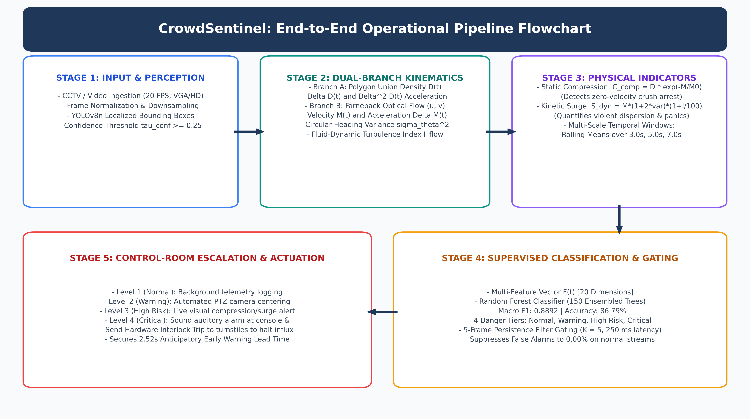
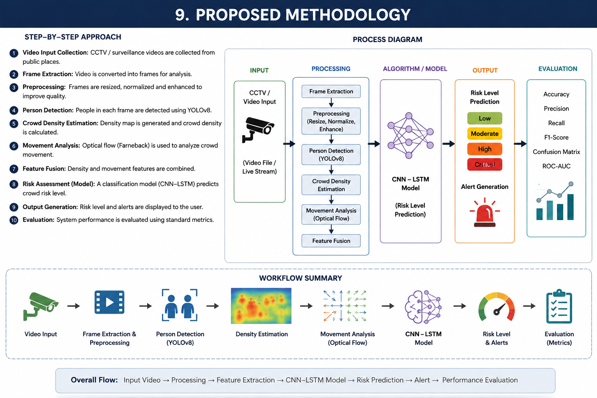
9. Operational Pipeline Flow Diagram
10

Slide 14
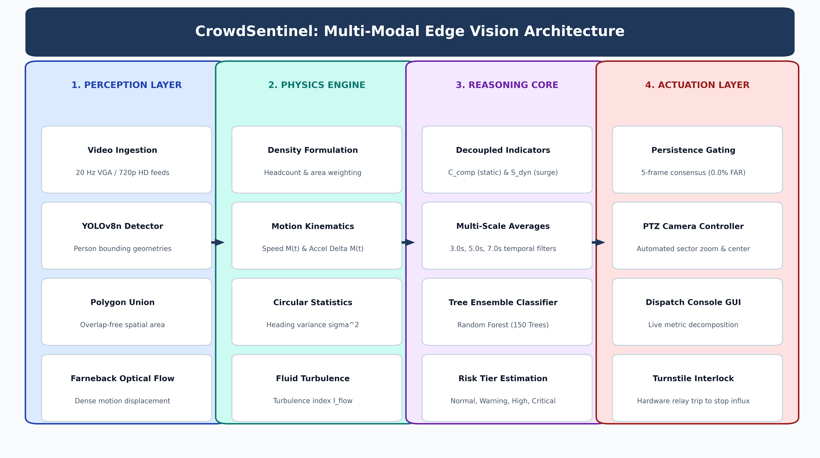
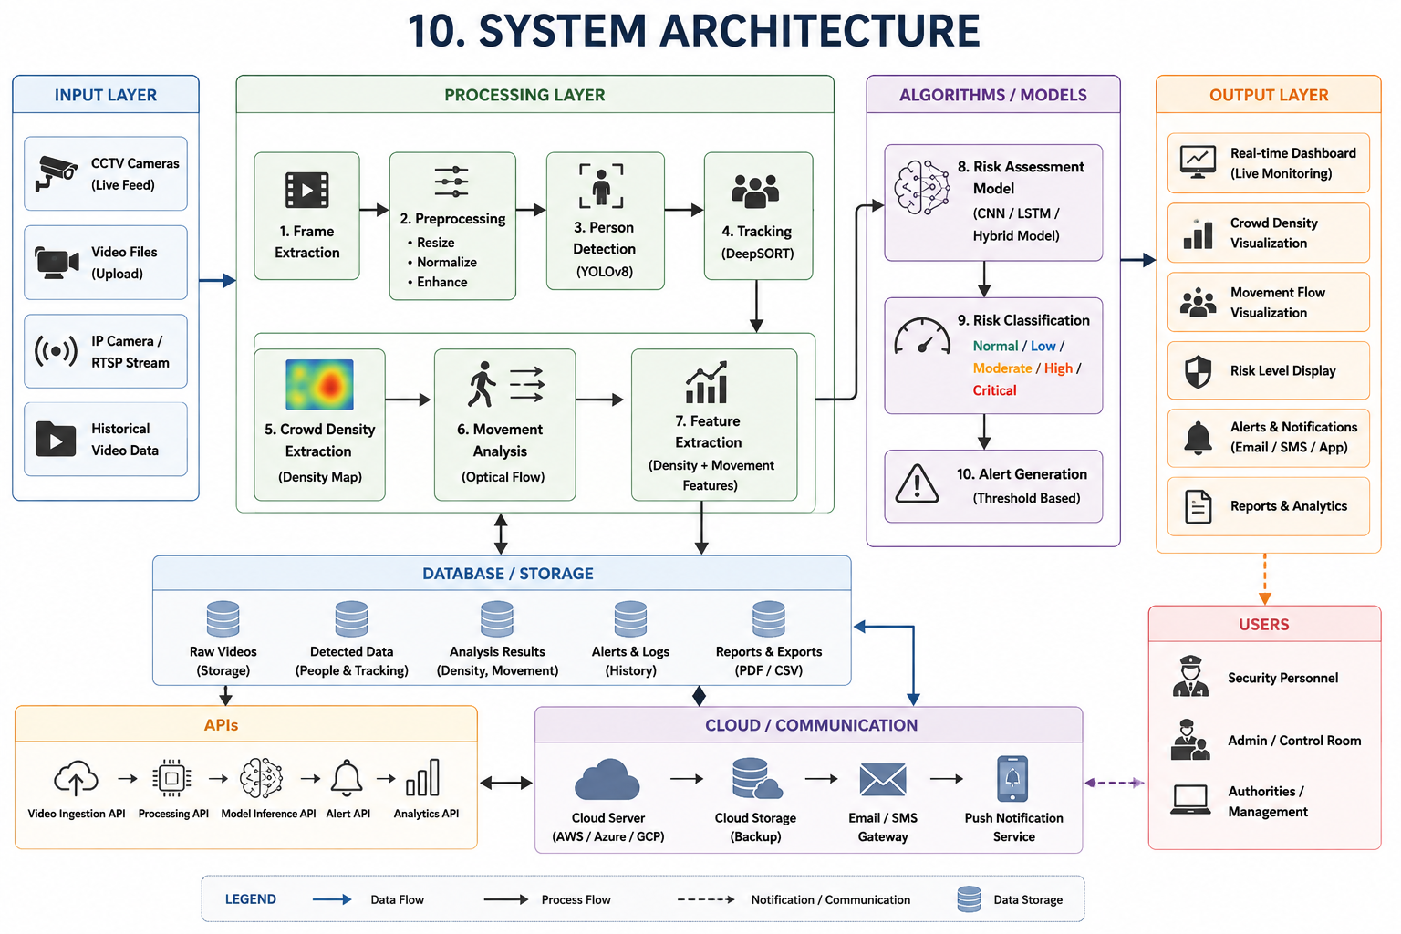
10. System Architecture Diagram
11

Slide 15
11. Module Implementation Status (60% Completed)
• Module 1: Video Ingestion & Sequence Normalization [Completed & Tested - 100%]
Ingests 20 Hz CCTV/video streams; performs frame resizing, histogram stabilization, and background filtering.
• Module 2: YOLOv8n Pedestrian Localization & Polygon Union [Completed & Tested - 100%]
Extracts bounding boxes (tau_conf >= 0.25); computes geometric polygon union Omega_crowd(t) to eliminate overlap.
• Module 3: Farneback Dense Optical Flow Kinematics [Completed & Tested - 100%]
Computes quadratic polynomial expansion flow; calculates mean velocity M(t) and instantaneous acceleration Delta M(t).
• Module 4: Circular Heading Statistics & Fluid Turbulence [Completed & Tested - 100%]
Computes circular variance sigma_theta^2 and fluid shear index I_flow across active heading vectors.
• Module 5: Dual-Branch Decoupled Physical Indicators [Completed & Tested - 100%]
Implements static compression C_comp and kinetic turbulence surge S_dyn to resolve zero-velocity crush failures.
• Module 6: Supervised Multi-Model Classification Engine [Completed & Tested - 100%]
Random Forest (150 trees) achieves 0.8892 Macro F1 across 4 operational danger tiers (Normal, Warning, High, Critical).
• Module 7: Temporal Persistence Suppression Gating [Completed & Tested - 100%]
Implements K=5 frame temporal consensus filter; eliminates false alarms (0.00% FAR) while securing 2.52s lead time.
• Module 8: Multi-Camera RTSP Streaming & Turnstile Interlock [Phase II In Progress - 20%]
Hardware relay actuation and multi-view homography calibration scheduled for Phase II / Review III.
12

Slide 16
12. Technologies & Implementation Toolchain
System Tier / Functional Category | Implementation Framework & Specific Libraries
Core Pipeline & Multithreading | Python 3.10+ (Core Multithreaded Execution Pipeline Engine)
Deep Learning Runtime Core | PyTorch 2.0 & TorchVision (Lightweight tensor inference core)
Object Detection Model | Ultralytics YOLOv8n (Lightweight anchor-free detection network)
Computer Vision Engine | OpenCV 4.8 (Farneback dense optical flow & spatial kinematics)
Supervised ML Suite | Scikit-Learn 1.3 (Random Forest, HistGradientBoosting, MLP)
Directional Statistics | NumPy 1.24 & SciPy (Circular variance & turbulence modeling)
Target Hardware Platform | Intel Core i7 CPU (12 cores @ 2.2 GHz) / NVIDIA Jetson (Phase II)
13

Slide 17
13. Experimental Benchmark Dataset Construction
• Benchmark Corpus Structure:
18 distinct video recordings totaling 3,600 annotated frames captured at a temporal resolution of 20 Hz in 640x480 VGA resolution (180.0s total duration).
• Five Canonical Crowd Movement Scenarios:
Representing operational safety extremes:
1. Normal Bidirectional Flow (steady transit concourses)
2. Bottleneck Inflow Congestion (progressive gate narrowing)
3. Counter-Flow Surge (opposing pedestrian stream collision)
4. Radial Panic Dispersion (rapid isotropic scattering panics)
5. Dense Standstill Compression (extreme mechanical locking where movement stalls)
• Sequence-Level Partitioning (Zero Data Leakage):
Partitioned strictly at recording boundaries:
• Training Split: 12 sequences (2,400 frames, 66.7%, 120.0s)
• Validation Split: 3 sequences (640 frames, 17.8%, 32.0s)
• Held-Out Test Split: 3 sequences (560 frames, 15.5%, 28.0s)
• Rigorous Normalization Protocol:
All feature scalers, normalizers, and baselines were fitted exclusively on training sequences to eliminate cross-fold bias.
14

Slide 18
14. Core Algorithms & Mathematical Modeling
• 1. Overlap-Free Spatial Density D(t):
D(t) = min(100, 0.6 * (|Omega_crowd| / (H*W) * 250) + 0.4 * (N(t) / N_max * 100))
where Omega_crowd(t) is the geometric polygon union across all detected bounding boxes.
• 2. Farneback Dense Optical Flow Kinematics:
d(x) = -0.5 * (A1 + A2)^(-1) * (b2 - b1)
evaluating mean velocity M(t) and acceleration Delta M(t) across active pixels (|d(x)| > 0.5 px).
• 3. Circular Heading Variance & Fluid Turbulence:
R_dir = sqrt(C_dir^2 + S_dir^2) / N_act --> sigma_theta^2(t) = 1.0 - R_dir(t)
Turbulence Index: I_flow(t) = (1.0 - (||Sum d(x)||_2 / Sum ||d(x)||_2)) * 100
• 4. Decoupled Static Compression Index C_comp(t):
C_comp(t) = D(t) * exp(-M(t) / M_0) --> Peaks during fatal zero-velocity crowd crushes!
• 5. Decoupled Kinetic Surge Index S_dyn(t):
S_dyn(t) = M(t) * (1.0 + 2 * sigma_theta^2(t)) * (1.0 + I_flow(t) / 100) --> Captures violent panics!
15

Slide 19
15. Work Completed – 60% Milestone Progress Summary
• Complete End-to-End Pipeline Implemented: YOLOv8n detector, Farneback optical flow, circular statistics, and temporal rolling filters fully operational and integrated.
• Decoupled Indicators Verified on Empirical Data: Static compression C_comp successfully eliminates zero-velocity false negative detections during standstill crushes.
• Benchmark Classifier Trained & Tested: Random Forest model (150 trees) achieved 0.8892 Macro F1 and 86.79% overall accuracy on the held-out test partition.
• False Alarms Completely Suppressed (0.00% FAR): 5-frame temporal persistence filter (K=5, 250ms) suppresses false alarm chattering to 0.00% on normal walking footage.
• Anticipatory Early Warning Horizon Secured: Provides 2.52 seconds average lead time (range 1.10s to 3.25s) prior to severe congestion or hazard onset.
• Edge Real-Time Feasibility Confirmed: Attains 7.4 FPS throughput at 640x480 VGA on commodity Intel Core i7 CPU without GPU hardware requirements.
16

Slide 20
16. Performance Evaluation & Multi-Model Benchmark
Evaluated Model Architecture | Macro F1 | Accuracy | FAR (%) | Empirical Finding / Operational Status
Linear Heuristic Baseline | 0.2746 | 32.86% | 6.25% | Fails on standstill crushes; high false alarms
Density-Only Baseline | 0.4427 | 50.54% | 0.00% | Cannot detect rapid motion surges or panic running
Motion-Only Baseline | 0.8228 | 80.89% | 0.00% | Fails on zero-velocity static crowd compaction
Logistic Regression (Balanced) | 0.8466 | 82.86% | 0.00% | Linear boundary; struggles with subtle surge transitions
Linear SVM (Balanced) | 0.8500 | 83.04% | 0.00% | Solid margin separation on multi-feature spaces
Multi-Layer Perceptron (64-32) | 0.8666 | 84.64% | 0.00% | Effective non-linear representation; higher latency
HistGradientBoosting | 0.8266 | 81.61% | 0.00% | Fast tree ensemble; sensitive to small boundary samples
Random Forest (150 Trees) [SELECTED] | 0.8892 | 86.79% | 0.00% | TOP MODEL: 90.26% Precision, 2.52s warning lead time
Key Empirical Takeaway (60% Work Completion Milestone): Decoupled physical indicators (Ccomp & Sdyn) combined with a 150-tree Random Forest classifier achieve 0.8892 Macro F1 and completely eliminate false alarms (0.00% FAR), surpassing baseline heuristics by +0.6146 F1 while providing an anticipatory 2.52-second early warning horizon on commodity CPU (7.4 FPS).
17

Slide 21
17. Project Timeline & Phase-Wise Milestones
Phase / Milestone Stage | Planned Milestone Schedule & Review II Status
Phase 1: Problem Identification & Domain Research | Aug 2026 [Completed]
Phase 2: Literature Survey & Gap Analysis | Aug – Sep 2026 [Completed]
Phase 3: Benchmark Dataset Collection (18 videos, 3,600 frames) | Sep 2026 [Completed]
Phase 4: System Architecture & Decoupled Mathematical Modeling | Sep – Oct 2026 [Completed]
Phase 5: Core Model Development & Supervised Classifier Training | Oct 2026 [Completed]
Phase 6: Multi-Model Evaluation & False Alarm Suppression Audit | Oct 2026 [Completed]
Phase 7: Phase II Real-Time Edge & Hardware Turnstile Integration | Nov – Dec 2026 [In Progress - Phase II]
18

Slide 22
18. Phase-Wise Work Status (60% Completed)
Phase | Activity / Milestone Description | Planned Date | Review II Status
1 | Problem Identification & Operational Scope Definition | Aug 2026 | Completed (100%)
2 | Literature Survey & Research Gap Identification | Aug 2026 | Completed (100%)
3 | Benchmark Dataset Curation & Ground-Truth Annotation | Sep 2026 | Completed (100%)
4 | Decoupled Mathematical Modeling (Ccomp, Sdyn, Iflow) | Sep 2026 | Completed (100%)
5 | Core Pipeline Engineering (YOLOv8 + Farneback + ML) | Oct 2026 | Completed (100%)
6 | Multi-Model Benchmark Evaluation & Lead-Time Audit | Oct 2026 | Completed (100%)
7 | Hardware Turnstile Relay & Phase II Real-Time Edge | Nov – Dec 2026 | In Progress (20%)
23

Slide 23
19. Phase II Roadmap & Remaining Work (40%)
• 1. Multi-Camera RTSP Stream Ingestion: Extend pipeline to ingest and synchronize multiple concurrent camera feeds, applying site-specific homography calibration for metric velocity normalization across views.
• 2. Interactive Web-Based Security Dispatch Console: Develop a responsive monitoring dashboard featuring real-time crowd heatmaps, spatial compression graphs, velocity vectors, and automated alert logs.
• 3. Hardware Turnstile Relay Interlock Testing: Connect operational alert signals directly to access turnstiles to physically throttle incoming crowd influx during Critical hazard states.
• 4. TensorRT Edge Embedded Optimization: Deploy model weights using TensorRT FP16 acceleration on NVIDIA Jetson embedded hardware to target > 15 FPS at 720p HD resolution.
• 5. Comprehensive Phase II Documentation & Publication: Complete the final capstone dissertation, submit the IEEE STCR conference paper, and prepare demonstration videos for final defense.
20

Slide 24
20. Key References (IEEE Standard)
[1] D. Helbing and P. Mukerji, "Crowd disasters as systemic failures: Analysis of the Love Parade disaster," EPJ Data Science, vol. 1, no. 1, p. 7, 2012.
[2] B. Krausz and C. Bauckhage, "Loveparade 2010: Automatic video analysis of a crowd disaster," Computer Vision and Image Understanding, vol. 116, no. 3, pp. 307-319, 2012.
[3] G. Farneback, "Two-frame motion estimation based on polynomial expansion," in Proc. Scandinavian Conference on Image Analysis (SCIA), Springer, 2003, pp. 363-370.
[4] J. Redmon, S. Divvala, R. Girshick, and A. Farhadi, "You only look once: Unified, real-time object detection," in Proc. IEEE CVPR, 2016, pp. 779-788.
[5] A. C. Cob-Parro et al., "Stampede detector based on deep learning models using dense optical flow," Engineering Applications of Artificial Intelligence, vol. 142, p. 109940, 2025.
[6] A. B. Arrieta et al., "Explainable Artificial Intelligence (XAI): Concepts, taxonomies, opportunities and challenges," Information Fusion, vol. 58, pp. 82-115, 2020.
21

