Slide 1

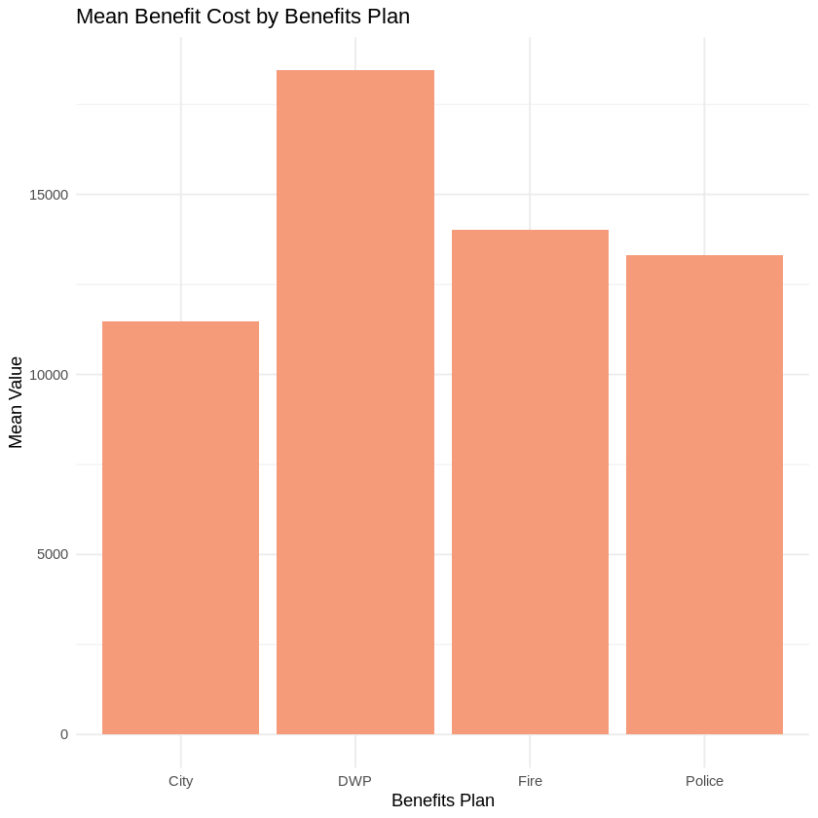
Predicting Salary Benefits in Los Angeles City Departments
Introduction
Employee benefits are forms of perks or compensation that are provided to employees in addition to their base salaries and wages. Salary Benefits for employees is a crucial aspect of compensation, reflecting the commitment of organizations to the well-being of their workforce.
In this data, salary benefits is subdivided into Health Cost, Dental Cost & Life Cost. And in the end the total Benefit Costs which is the sum of previous ones. Additionally, the employees are categorized based on the 4 available Benefit Plans.
Intended Audience
The intended audience for the presentation on LA City Payroll Data would likely include stakeholders involved in compensation management within organizations, human resources professionals, and decision-makers responsible for financial planning.
From the plot on the left, it is seen that on average the total benefits for Water & Power (DWP) employees is higher than the rest of the benefit plans.

Slide 2
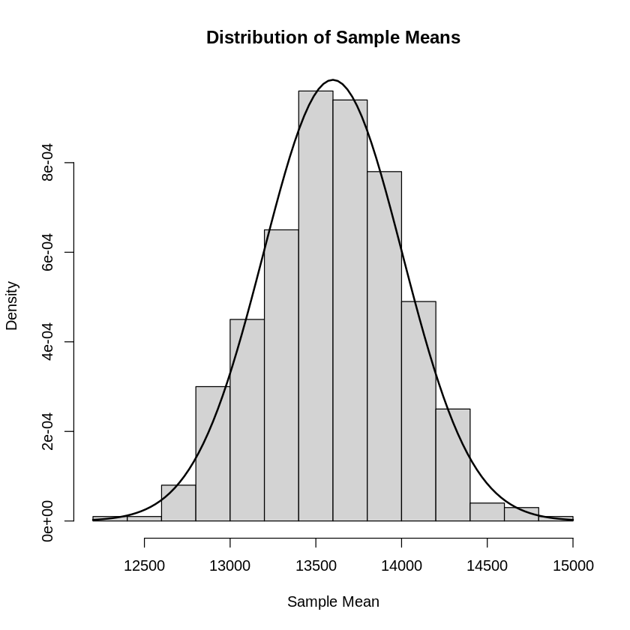


Hypothesis Testing
The plot on the left is the distribution of sample means to check the assumption of normality.
Any other assumptions pertaining to the tests have also been checked.
Do employment benefits vary significantly between Benefit Plans?
Tests Used
One way ANOVA
Tukey’s Significance Test
Is there a significant difference in the total employee benefits cost between the two most employed departments (Police & Fire)?
Tests Used
Shapiro Wilk’s test
Variance Test
T -test
In both the hypothesis tests that I conducted, a statistically significant difference in means was observed, highlighting distinctions between benefit plans in the first test and benefit costs among the samples in the second.
This shows that predicting anything related to Employee Benefits Cost will be useful due to the variation in those variables.

Slide 3
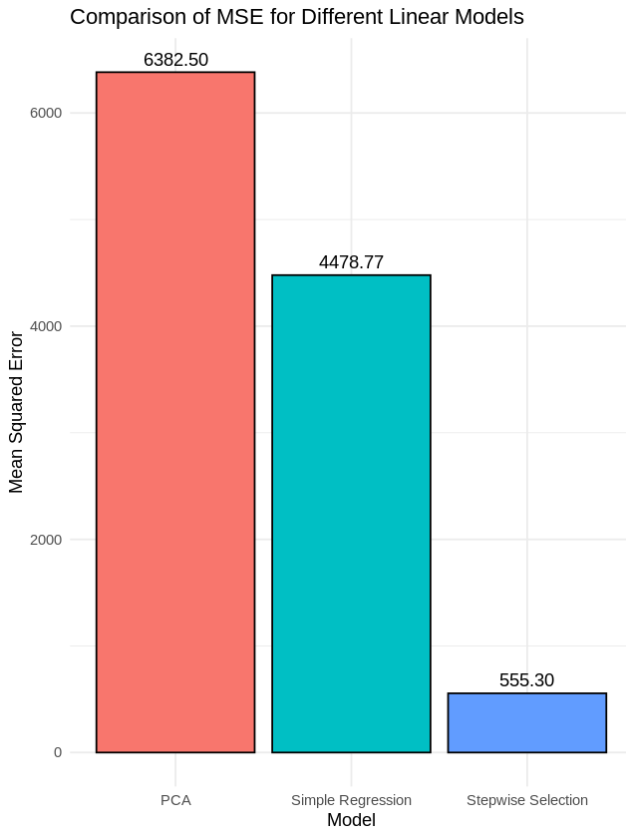
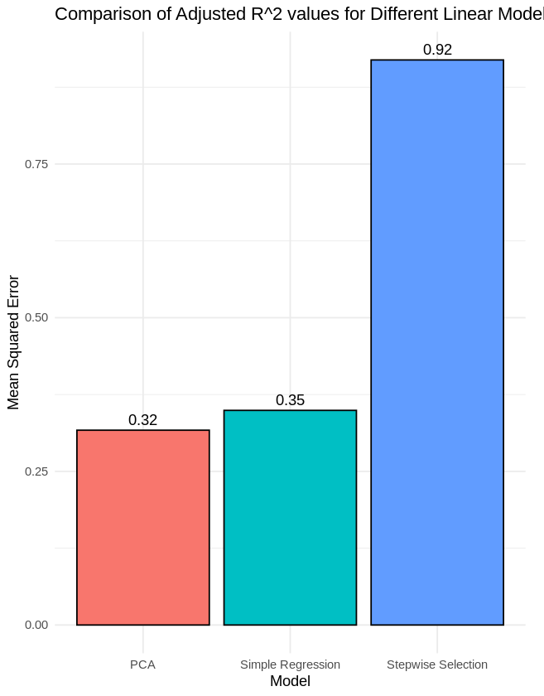
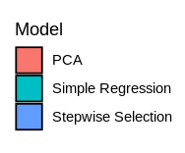
Model Evaluation
I decided to do predictions on Basic Life Cost which is part of the total benefit costs for employees.
For the 3 models I had created, I calculated the Mean Squared Error for each one and observed the Adjusted R^2 value to choose the best model.
The comparison of Mean Squared Errors (MSE) and accuracy indicates that the stepwise selection model performed the best among the three, showcasing its potential for accurate predictions and reduced complexity.
Key Predictors Identified
(More on this in the next slide)
Dental cost
Permanent bonus pay
Q1 Payment

Slide 4
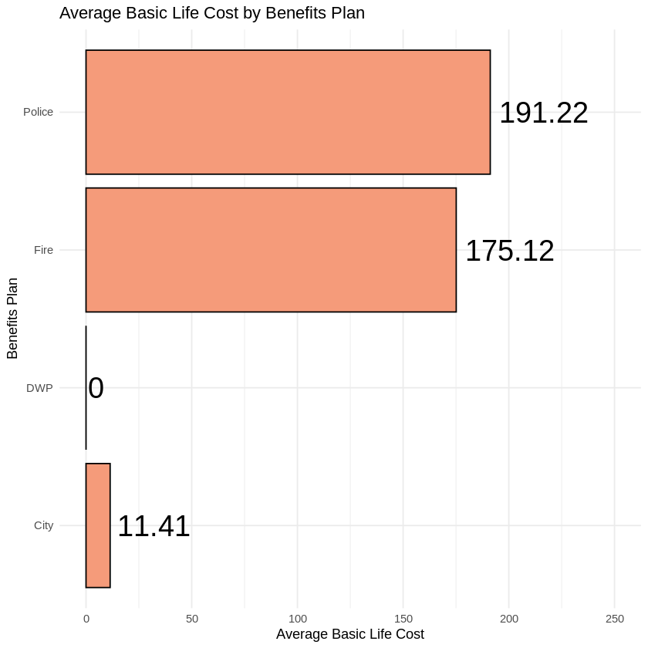
Key Observations & Takeaways
Predicting Basic Life Cost, a component of total benefits for employees, is valuable because it often goes overlooked in comparison to more emphasized benefits like health coverage. Despite its subtlety, accurately forecasting Basic Life Cost contributes to a comprehensive understanding of compensation structures, aiding in strategic decision-making and resource allocation within organizations.
Notably, employees of the Water & Power (DWP) department lack basic life coverage in the dataset (Seen in the figure to the left). This raises intriguing possibilities: either the department doesn't offer this benefit, or employees opted out, possibly due to the ability to purchase benefits through payroll deductions, a choice they might not have preferred.
Key predictors such as Permanent Bonus Pay & Q1 Payments caught me by surprise. A strong positive correlation with Permanent Bonus Pay emphasizes the impact of bonuses on Basic Life Cost. Organizations considering bonus structures should be aware of the associated implications for life insurance expenses. On the other hand, a negative correlation suggests a relationship where higher Q1 Payments are associated with lower Basic Life Costs. This could be linked to seasonal variations or specific compensation structures.

