Slide 1



Slide 2
Table Of Content
Engagement Objectives
1
Data Scope & Quality
2
AGENDA
Tools & Technology used
3
Approach, Architecture , Analysis & Pipeline
4
Future Scope
5

Slide 3
Engagement Objective
1
To help Indego business improve the performance of their services to the customers.
To perform exploratory analysis to derive insights and recommendations that can eventually lead to deeper analytics of the data to drive actionable business decisions
Establish and demonstrate a working framework for “Analytics-as-a-service” by performing a pilot project to come up with advanced machine learning use cases
2
3
4
Predicting Duration ( Time required to reach destination station) using different Input KPI and supervise algorithm.

Slide 4
Data Scope
Trip ID
Data Summary
Bike Type
Duration
Size/Format: 332MB/CSV
Data Summary: Data has total 13 features and approximate 3 million of raw data.
Timeframe of Data: 3 Years (2015 - 2019)
Market: Philadelphia
Start & end time
DATA
Trip Route
Start & end latitude-longitude
Pass holder Type
Start & end Station / Station ID

Slide 5
Data Quality and Type
0%
Trip ID is id generated for each trip and have unique value.
Data Type - String
0%
Trip Route is route type basically either a one way trip or round trip.
Data Type - String
90%
Bike Type is type of bike ( electric or standard) and have value for only 1 quarter 2019.
Data Type - String
0%
Pass holder Type is type pass a customer holds. Basically ( day, monthly or yearly )
Data Type - String
0%
Start & End Time is date time value when it is started and ended. End-time is dependent variable
Data Type – Date Time
0%
Start & End Station-Station ID is start and end station id where it has started and ended.
Data Type - Number
0.01%
Start & End Latitude, Longitude represents start and end latitude and longitude value
Data Type - Decimal
0%
Duration is time required to reach end station. This is Target column for this use case
Data Type - Number
**Note : value in hexagon represents either missing or junk value or both in particular column . Ex: bike type has 90% values are either null or junk

Slide 6







Tools and Technology
Data Consolidation
Explanatory Data Analysis
Statistical Analysis
Pipeline and Notebook
Dashboard
Deployment

Slide 7
Data Science Execution Approach
Activities
01
02
03
04
05
06
07
Data Exploration
Evaluate the Model
Use Case
Plot data, identify anomalies & detect patterns, finalize attribute(s) with higher influence on output
Evaluate and Validate the model with data & evaluate accuracy.
Scale & operationalize
Audience Segmentation
Deploy the Model to Production and Generate Output
Build Prediction/ Business Analysis Model
Analytical Model creation
Develop statistical &
machine-learning algorithms to generate insight(s)
Data sets
Data Visualization
Client websites
Test and Learn
Build Visualization for the generated Insight to make it actionable.
Key tasks for activities in scope for this engagement
DATA EXPLORATION
Analyze the data to validate or reject each segmentation hypothesis
Derive KPIs based on the input data sets available
Use visual representations to understand the frequency counts, missing values, outliers
Perform correlation analysis to identify association between data variables
BUILD THE MODEL
Apply Unsupervised, Supervised Machine learning algorithms to arrive at clusters
Follow an iterative procedure to arrive at a “Good fit” model
EVALUATE THE MODEL
Compare different segmentation schemes to arrive at an appropriate scheme
Synthesize Validated Segmentation Hypotheses to Form Distinct, Homogeneous Segments of High-value partners
Evaluate Segment Value, Target ability, and Size to Prioritize Your Best Segment(s)

Slide 8
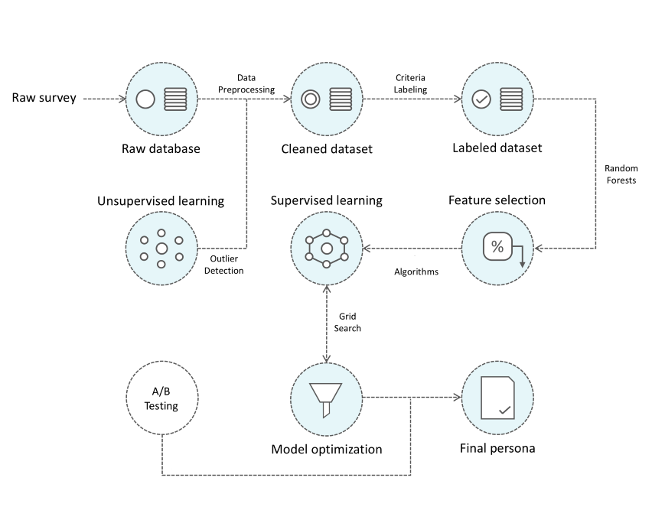
Working architecture of ML model
Labelling data in numerical format
or
Decision
Tree
Regression
Prediction on Test Data set.

Slide 9
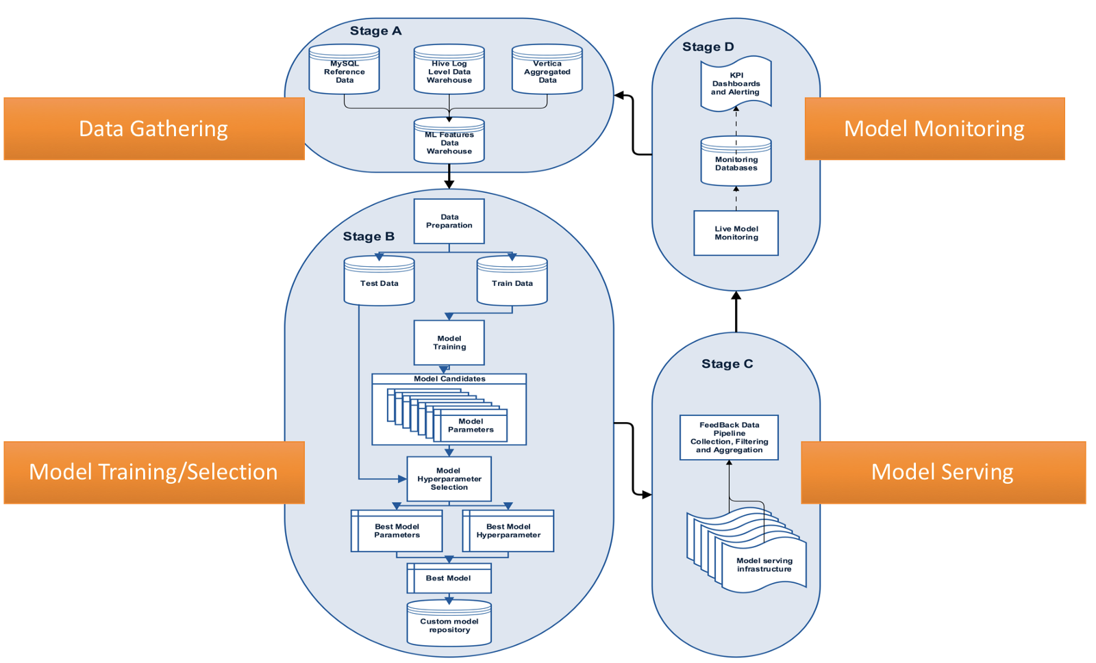
Pipeline structure

Slide 10
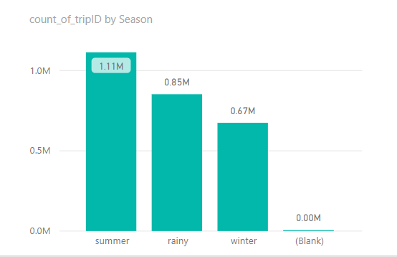
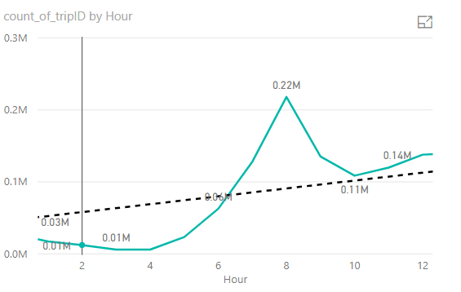
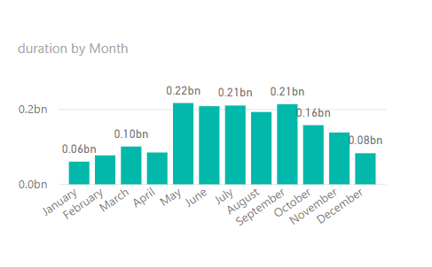
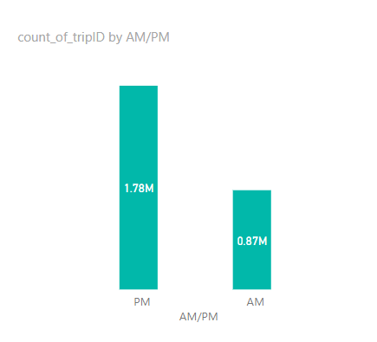
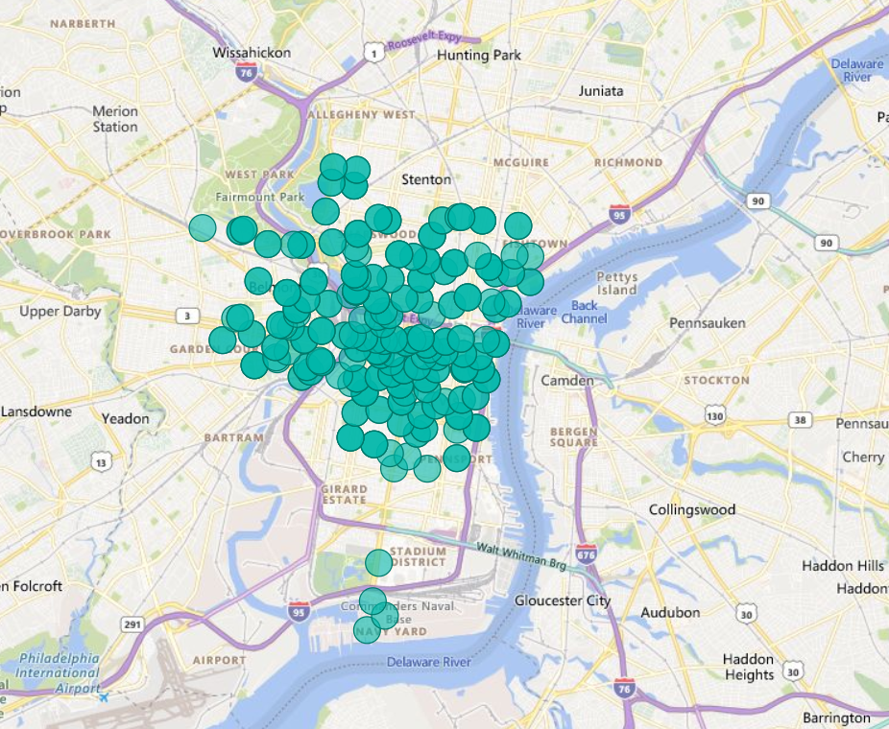
Dashboard snapshots

Slide 11
Future Scope
Clear Understanding of Business, process & operation. Campaign & strategy information.
Feature extraction like temp, near city, user sentiment, famous places, park, working/holiday, festive season detail etc.
ML model optimization through hyper parameter tuning, feature selection, Deployment CI/CD pipeline etc.

