Slide 1

DATA ANALYTICS PROJECT HIGH CLOUD AIRLINE
Presented By: AKASH AMBADAS SHINDE

Slide 2

Content
INTRODUCTION
KPI WISE LOAD FACTOR OVERVIEW
TOP COMPETITOR ANALYSIS
DASHBOARD OVERVIEW
SUGGESTIONS AND RECOMMENDATIONS

Slide 3
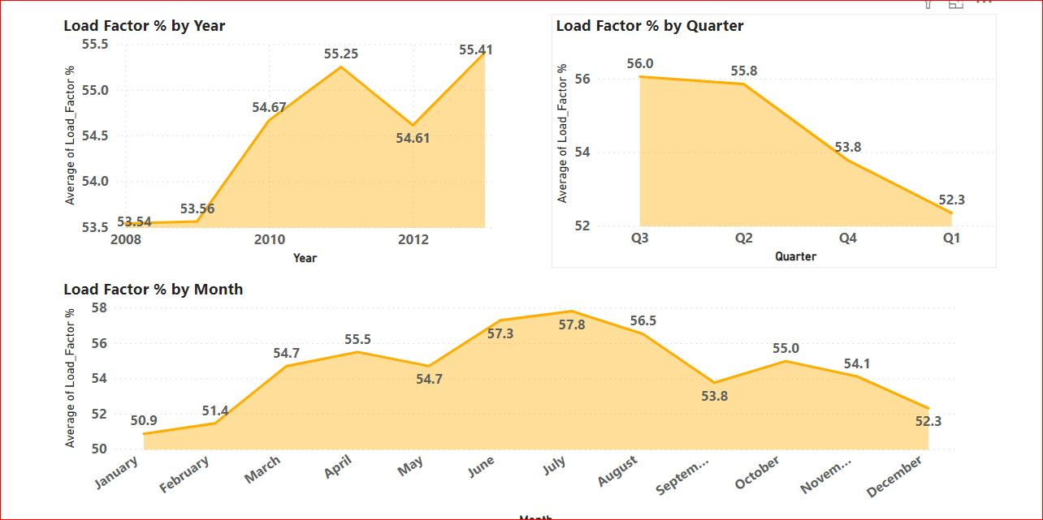
Load Factor % Based On Year, Quarter And Monthly
Upward Trend:
The Load Factor increased from 53.54% in 2008 to 55.41% in 2013, indicating better seat utilization.
Insights:
Improved Utilization:
Increasing Load Factor suggests effective capacity management
and higher revenue potential.
Consistency Needed:
The dip in 2012 should be investigated to avoid future declines.
Recommendations:
Enhance Marketing: Continue successful marketing strategies to maintain high Load Factors.
Focus marketing and promotional efforts to improve load factor in Q1.
Need to improve Load Factor from Jan-March and Oct-Dec
Optimize Operations: Adjust flight schedules and routes to sustain efficiency.
Monitor Customer Experience: Ensure high service quality to avoid dissatisfaction from fuller flights.

Slide 4
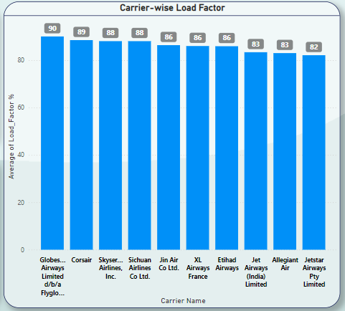
Load Factor % Based On Carrier Name Basis
Insights:
Highest Load Factor: Globes Airways Limited with an 90% load factor, indicating high seat occupancy and efficient use of capacity.
Strong Performers: Corsair Air Lines and Skyser Airways both have a load factor of 89%, reflecting strong operational efficiency.
Solid Efficiency: Sichuan Air Lines has a load factor of 80%, showing effective capacity management.
Recommendations:
Maximize Capacity: Globes Airways Limited should continue leveraging its high load factor by maintaining or improving its current strategies.
Enhance Utilization: Carriers with 89% load factors should explore ways to increase occupancy, such as route adjustments or targeted marketing.
Optimize Routes: Other Lines should aim to improve its already strong load factor through route optimization and better demand forecasting.

Slide 5
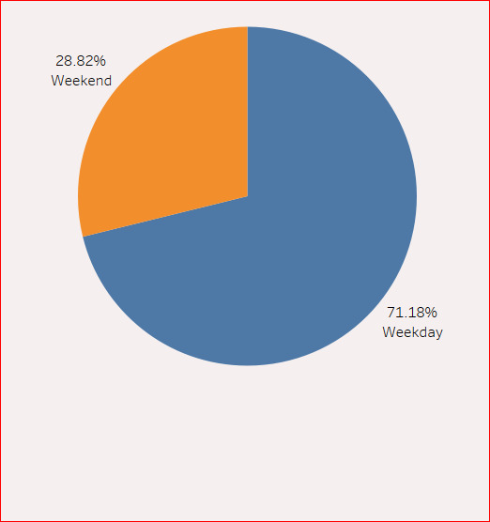
Load Factor occupied on Weekend vs Weekdays
Recommendations:
Optimize Flight Schedules:
Increase weekday flights.
Reduce or use smaller aircraft for weekend flights.
Adjust Pricing:
Higher fares on weekdays.
Discounts and promotions on weekends.
Targeted Marketing:
Business traveler campaigns for weekdays.
Weekend getaway packages for leisure travelers.
Enhance Loyalty Programs:
Extra points and upgrades for weekend flights.
Fleet Utilization:
Larger aircraft on busy weekday routes.
Smaller aircraft on quieter weekend routes.
Special Services:
Family-friendly and themed flights on weekends.
Business-centric services on weekdays.
Weekdays are the peak periods with a load factor of 71.18%.
Weekends are the off-peak periods with a load factor of 28.82%.

Slide 6
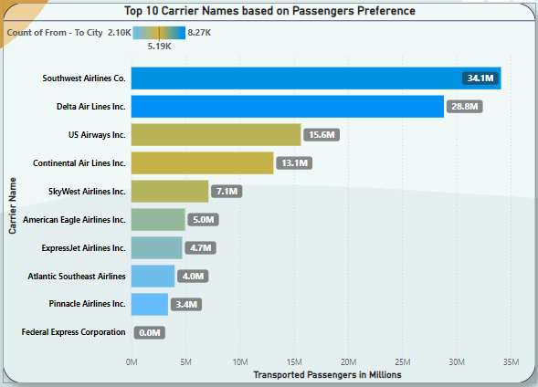
Top 10 Carrier Names Based On Passengers Preference
Insights:
Leading Carrier: Southwest Airlines has the highest number of flights (34.11M), dominating the market. Strong Competitors: Delta Air Lines follows with 28.84M flights, indicating significant competition. Smaller Carriers: American Airlines, American Eagle, and Alaska Airlines have lower flight counts, from 4.88M to 5.90M.
Recommendations:
Leverage Market Leadership: Southwest Airlines should capitalize on its leading position by enhancing service and expanding routes.
Enhance Competitive Edge: Delta Air Lines should focus on differentiating services to maintain competitiveness.
Optimize Fleet and Routes: Mid-tier carriers like US Airways and JetBlue should optimize their fleets and routes to improve efficiency and capture more market share.
Strategic Partnerships: Smaller carriers like American Airlines and Alaska Airlines should explore strategic partnerships or alliances to boost their flight volumes and market presence.

Slide 7
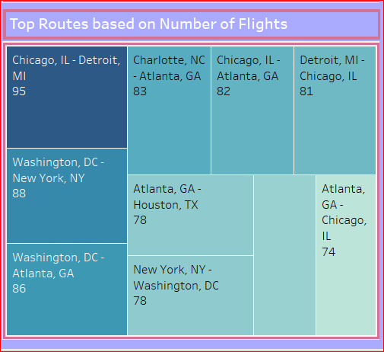
Top 10 Carrier Names Based On Passengers Preference
RECOMMENDATIONS:
Optimize Schedules: - Increase flights or use larger aircraft for high-demand routes like Chicago-Detroit and Washington, DC-New York. - Adjust frequency on lower-demand routes like Atlanta-Chicago.
Enhance Services: - Focus on business-class services for major business hubs. - Strengthen loyalty programs for frequent flyers on these routes.
Pricing Strategy: - Implement dynamic pricing for peak times. - Offer promotions on less frequent routes.
Marketing : - Launch targeted campaigns to promote these top routes. - Form partnerships with local businesses and tourism boards.
Continuous Improvement: - Monitor route performance regularly. - Gather and act on customer feedback

Slide 8
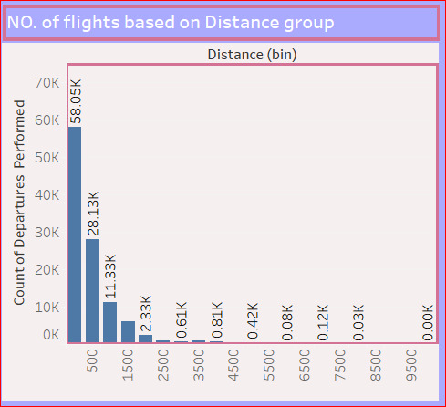
Number Of Flights Based On Distance Group
INSIGHTS:
Short-Haul Dominance: Most flights (58,050) are in the 0 - 500 miles range, indicating high demand for short-haul routes.
Decreased Long-Haul Demand: Flight numbers drop significantly with distance, especially beyond 1000 miles.
RECOMMENDATIONS:
Optimize Short-Haul Routes: Adjust schedules and capacity for the high volume of short-haul flights.2. Assess Long-Haul Routes: Evaluate the profitability and demand for long-haul flights; consider focusing on high-yield routes.
Fleet Adjustments: Align aircraft types with route distances—use smaller planes for short-haul and larger ones for long-haul.
Expand and Enhance: Grow short-haul network and improve customer experience to capture more market share.
Adjust Pricing:Use dynamic pricing to optimize revenue based on demand trends.

Slide 9
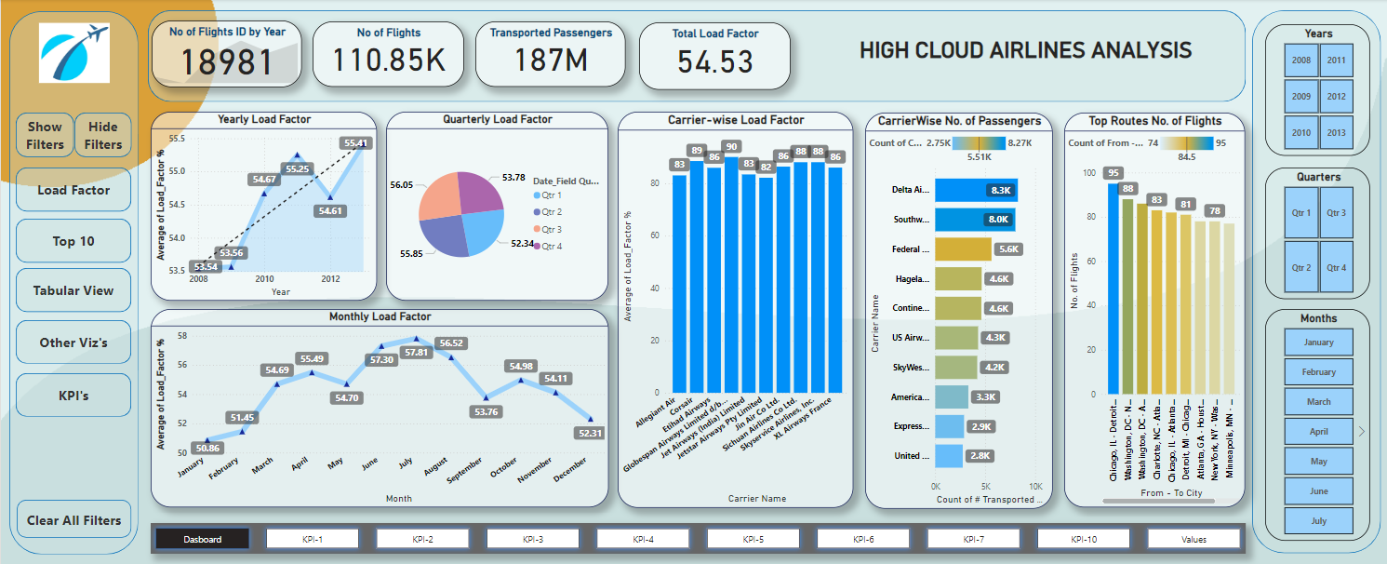
Power-BI Dashboard showing Analysis on HCA data

Slide 10
Suggestions and Recommendations for Airline Companies :
Customer Experience : Comfort Improve seating, legroom, and in-flight entertainment.
Technology Integration: Mobile App
Loyalty Programs : Rewards, Enhance frequent flyer and Offer personalized promotions
Safety and Cleanliness
Environmental Sustainability : Eco-Friendly, Invest in fuel-efficient aircraft.
Flexibility : Pricing and cancellation policies.
On-Time Performance
Assistive Services: Offer comprehensive services for passengers with disabilities.
Feedback Mechanism
Partnerships and Alliances- Form strategic partnerships and Marketing Collaboration
Implementing these strategies can help optimize capacity, improve customer satisfaction, and maximize revenue.

Slide 11
Thank You

