Slide 1
Online Taxi
Booking
System
Group Member:
186496:Sooraj
187148:Manisha
186502:William
187057:Akash
186879:Yogita
186494:Praveenkumar
178113:Parag
186613:Himanshu
Mentor: Vaishali Kasture
Notes:
Add instructor notes here.

Slide 2
Objectives
Project Understanding
Approach used
Project Execution
Modules
Learning
Best Practices
Opportunity for improvement
Demo and Code Walkthrough
Q&A
Notes:
Add instructor notes here.

Slide 3
Project Understanding
Online Taxi Booking System allows customers to book taxi for their daily transport.
In the current system customer contacts with us for getting transport service.
The company then books the vehicle for customer on the requested date and time and then sends the vehicle to the customer place on time.
The Online taxi booking system is the online service which will automate the process of booking a taxi and will facilitate both the customer and the company with reduced time and efforts.
Notes:
Add instructor notes here.

Slide 4
Project Understanding (Continued)
Then the customer will request for booking a vehicle on his required date and time, providing all necessary information.
The fare will be calculated and the customer should confirm it. Then the employee will serve the customer on the specific date and time.
Finally the customer will have an opportunity to give a feedback for the service he got. The company can check it and take appropriate action for the future improvements.
Approach used :
Database First Approach
Notes:
Add instructor notes here.

Slide 5
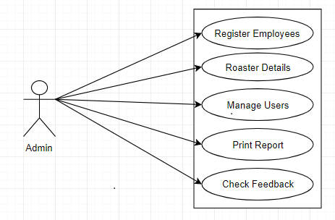
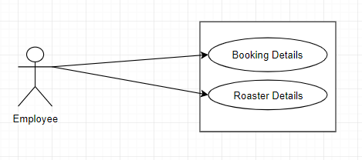
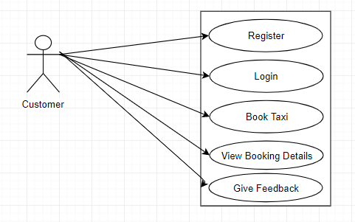
Use Case Diagram
Notes:
Add the notes here.
Add instructor notes here.

Slide 6
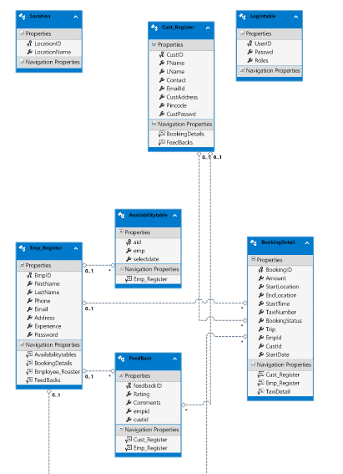
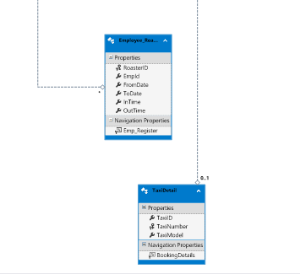
Class Diagram
Notes:
Add the notes here.
Add instructor notes here.

Slide 7
Modules
Admin
Admin is the only person who can make changes in the system.
Here Authorized Person i.e. Admin can Perform various tasks like add employees, view booking details, add taxi details, perform weekly roaster, check feedback.
View the past roaster details of particular employee
Notes:
Add the notes here.
Add instructor notes here.

Slide 8
Modules
Employee
Employees can login to the system using their authenticated credentials & able to view their roasters, Booking details.
And according to their roaster they will go for trip, on particular date & time

Slide 9
Modules
Customer
Customer can able to register themselves & can used their username ,Password for the next time when they want to login.
Customer can able to Book taxi according to their required date & time before 2 hours of the trip. After the completion of the trip customer can also give ratings & comments, so that admin will able to know the feedback of the system.

Slide 10
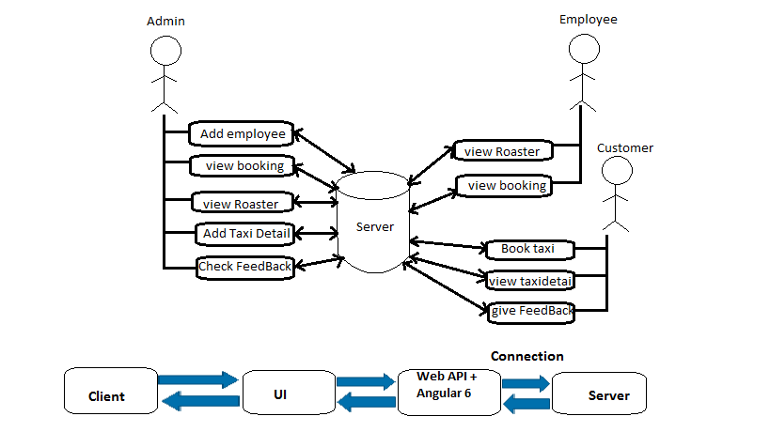
Architecture Of System
Notes:
Add the notes here.
Add instructor notes here.

Slide 11
Employee: this contains employee details
EmployeeRoster: this contains roaster details like roster id, employee id, from date, to date, in time, out time etc.
Customer: this contains customer details
Users: this contains user details like user id, password, employee id, customer id, role etc.
Taxi : this contains taxi details
Booking: this contains booking details

Slide 12
Learning
Data Access Components to perform any CRUD operations using DBFirst Approach ,creating web API, angular as a UI.
Bootstarp designing.
Notes:
Add the notes here.
Add instructor notes here.

Slide 13
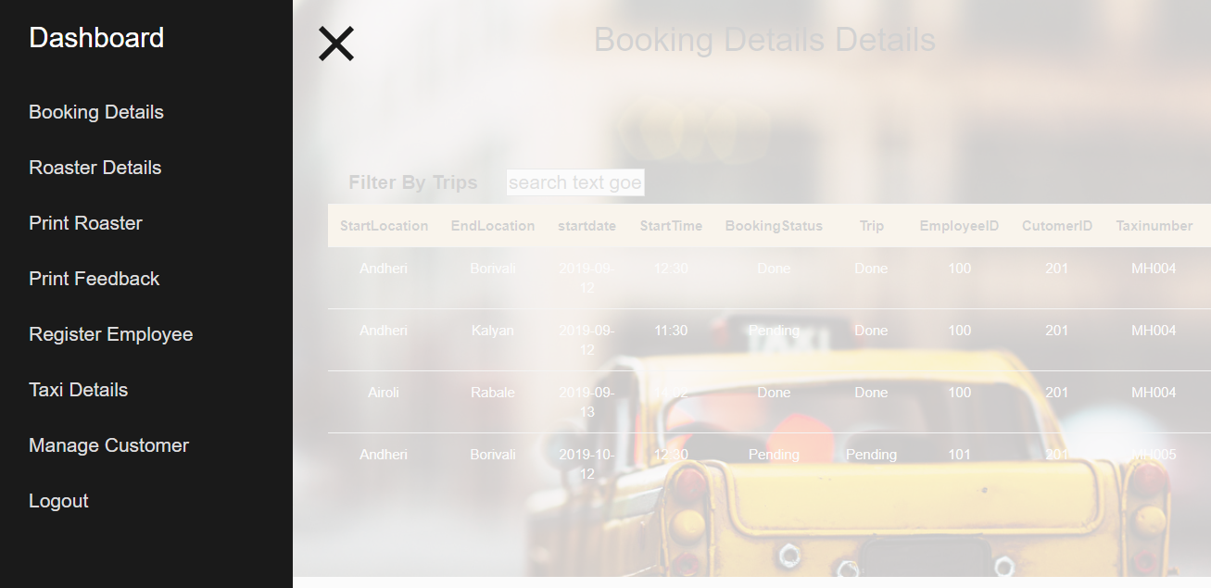
Admin page
Notes:
Add the notes here.
Add instructor notes here.

Slide 14
Opportunity for improvement
User Interface will be enhanced.
Working on validations.
User will able to track the taxi details.
Notes:
Add the notes here.
Add instructor notes here.

Slide 15
Q & A
Notes:
Add the notes here.
Add instructor notes here.

Slide 16
Thank You
Notes:
Add the notes here.
Add instructor notes here.

