Slide 1
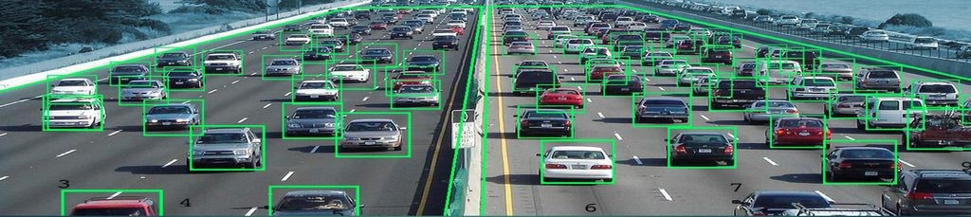


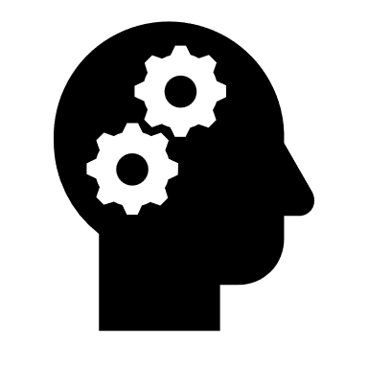
TRAFFIC MANAGEMENT SYTEM
The purpose of Traffic Management System is to improve transport operations and transport services profitability, reduce traffic jams and fatalities, provide sufficient driving training, maintain road infrastructure, and maintain traffic law enforcement.
The purpose of Traffic Management System is to improve transport operations and transport services profitability, reduce traffic jams and fatalities, provide sufficient driving training, maintain road infrastructure, and maintain traffic law enforcement
USING DRONE SCIENCE AND ML ALGORITHM

