Slide 1

Big Data Processing in a Containerized Environment
Aakash Pahwa
170905136
7C, 23

Slide 2
Base Paper
Docker Container-Based Big Data
Processing System in Multiple Clouds for Everyone
Nitin Naik
Defence School of Communications and Information Systems
Ministry of Defence, United Kingdom
2017 IEEE International Systems Engineering Symposium (ISSE)

Slide 3
List of Figures
Figure-1: The V’s of Big Data
Figure-2: Docker Architecture
Figure-3: Swarm Architecture
Figure-4: Proposed Design and Sequence
Figure-5: Prototype using VMs
Figure-6: Setup Hadoop Components
Figure-7: Hadoop vs Pachyderm Stack
Figure-8: Input Data
Figure-9: Dispatcher, Mapper and Reducer Containers
Figure-10: Word Count Result

Slide 4
Contents
Introduction
Motivation
Big Data
Containerization & Orchestration
Architectural Design & Simulation Modelling
Containerization + Existing Technologies
Hadoop Cluster using Apache Ambari
Pachyderm
Next Steps
Prototype
Conclusion
References

Slide 5
Introduction
Objective – A new approach to big data processing
What does big data processing exactly encompass?
The five Vs of Big Data
Computational challenges posed by Big Data
Traditional approach using Hadoop
Potential in the field of big data processing using containerization
Orchestration of containers in a distributed system environment

Slide 6
Motivation
Distributed systems before emergence of cloud computing services
Widespread adoption of containers owing to huge benefits
Provision of containers as a service with the emergence of cloud services
Automation in the DevOps process
Provision of orchestration services in the cloud

Slide 7
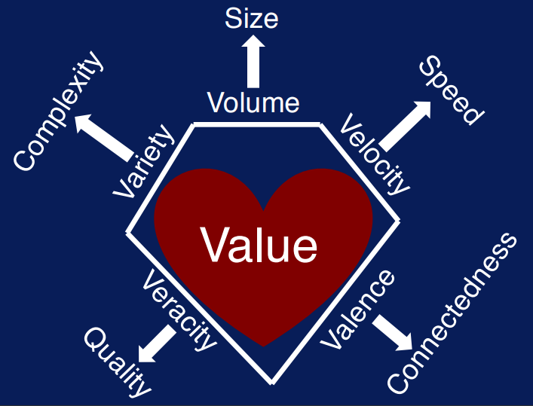
Big Data
What is Big Data?
Characterization of Big Data – 5Vs of Big Data [1]
Purpose of Big Data Analysis
Methods for Big Data Analysis
Infrastructure requirement for Big Data Processing
Figure-1: The V’s of Big Data

Slide 8
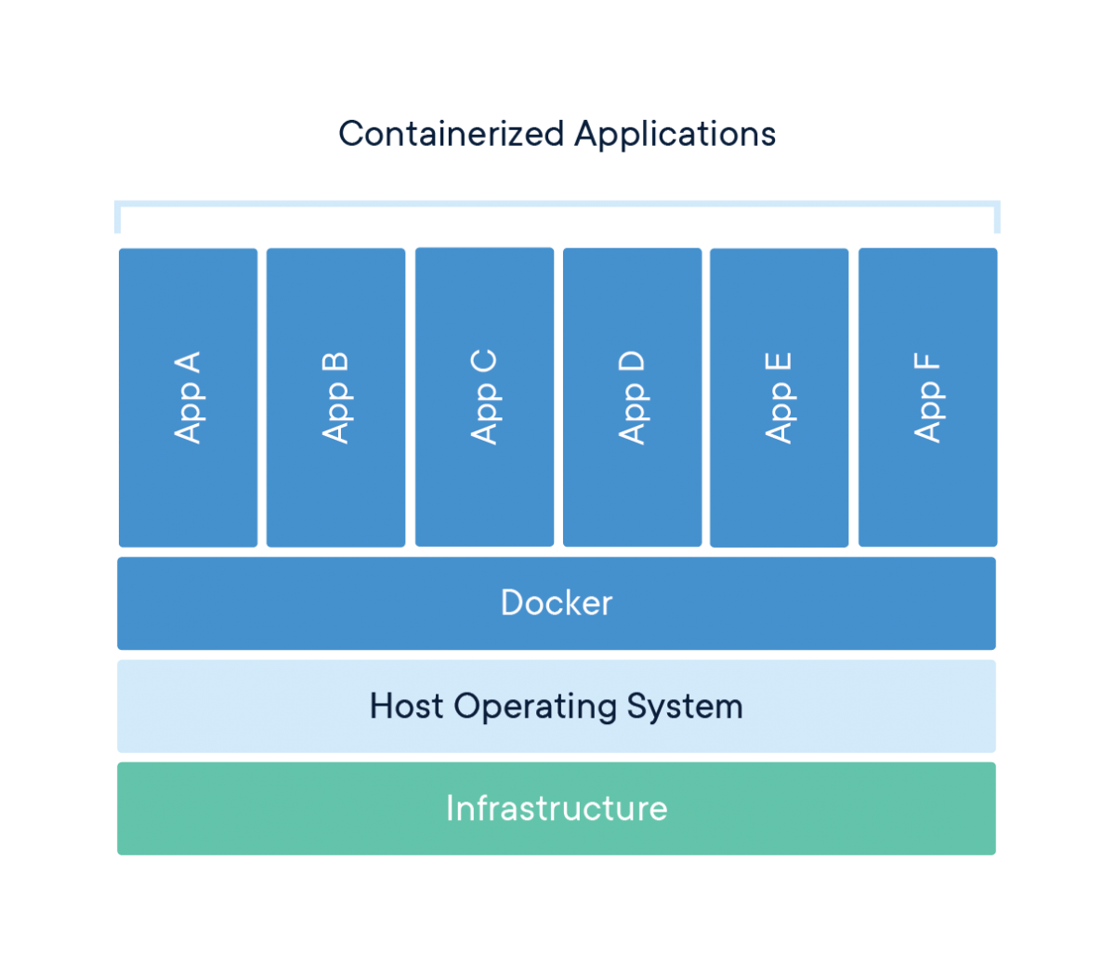
Containerization
Packaging all aspects of a software application
Containerization using Docker
Images, Containers & Container Image Repositories [2]
Docker vs Virtual Machines
Figure-2: Docker Architecture

Slide 9
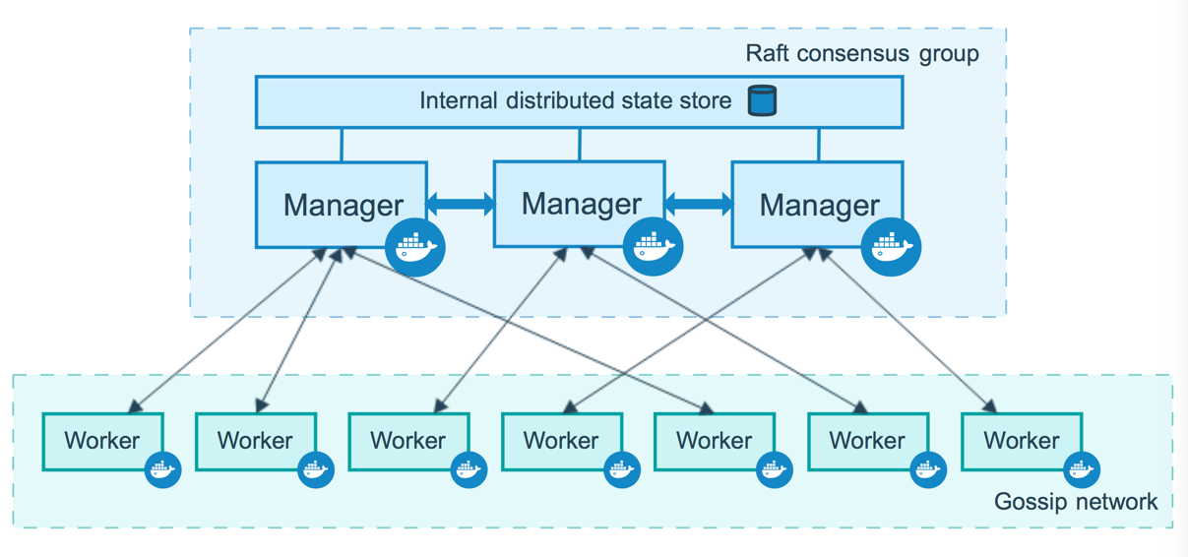
Orchestration
Need for co-ordination in a container-based environment
Clustering together groups of hosts using Docker Swarm [3]
Types of nodes in swarm – Manager and Worker node
Roles of a Manager and a Worker Node
Features provided by an orchestration engine
A reliable and available container-based infrastructure
Figure-3: Swarm Architecture

Slide 10
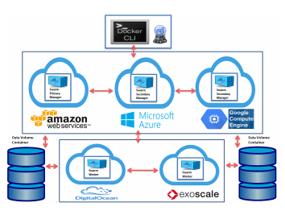
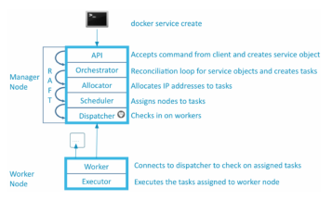
Architectural Design
Proposing a simple design for a containerized big data processing system [4]
Components and tools required for development – Manager nodes, Worker nodes, Data Volumes, Cluster Access
Breakdown of sequence of events and workflow
Figure-4: Proposed Design and Sequence

Slide 11
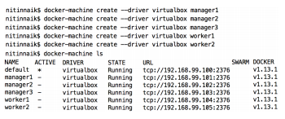
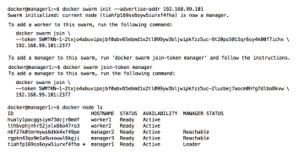
Simulation Modelling
Creating a quick prototype of the proposed design
Creating virtual machines to act as Docker nodes [4]
Creation of data volumes to manage data inside and between containers
Independence of data volumes with respect to containers’ lifecycle
Figure-5: Prototype using VMs

Slide 12
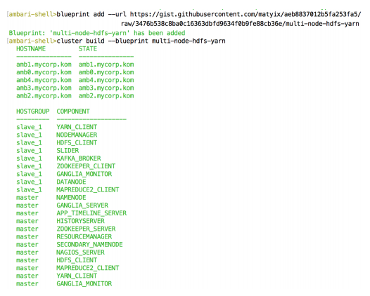
Hadoop Cluster using Apache Ambari
Simpler Hadoop management using Apache Ambari
Creating an Ambari cluster [5]
Setting up Hadoop components using Blueprint [6]
Master and slave node assignment
User-friendly interface for cluster management on the browser using Hue [7]
Figure-6: Setup Hadoop Components

Slide 13
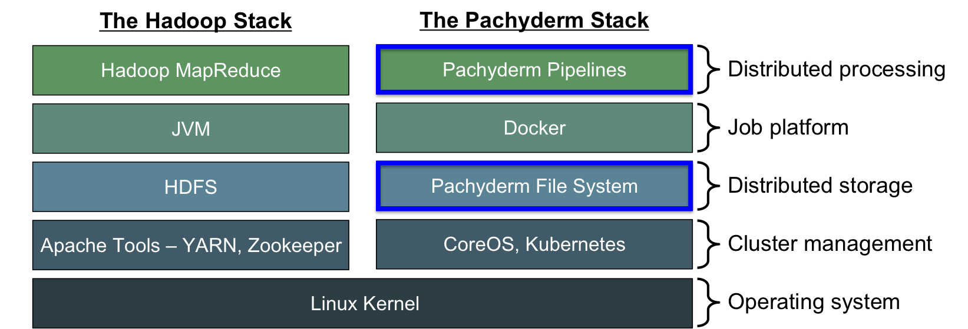
Pachyderm
Working on the weaknesses of Hadoop
Pachyderm – tools for production data pipelines [8]
Features provided by Pachyderm
Comparing tech stacks of Hadoop and Pachyderm
Tool built with containerization and orchestration in mind
Figure-7: Hadoop vs Pachyderm Stack

Slide 14
Next Steps
Hadoop features – Scalable, Fault Tolerant, High Availability
Stateless aspect of Docker Containers – Advent of Data Volumes, Replica Sets, Sharding
Orchestration of Containers – Features Docker Swarm lacks, and Hadoop natively supports
Kubernetes – Abstraction and Storage Orchestration, Scaling, Self-Healing, Availability, Automated Tasks, Networking, Load Balancing [9]
Features of Hadoop abstracted by the Kubernetes’ features
Need for idempotency adds another operation: Dispatch – Map – Reduce

Slide 15


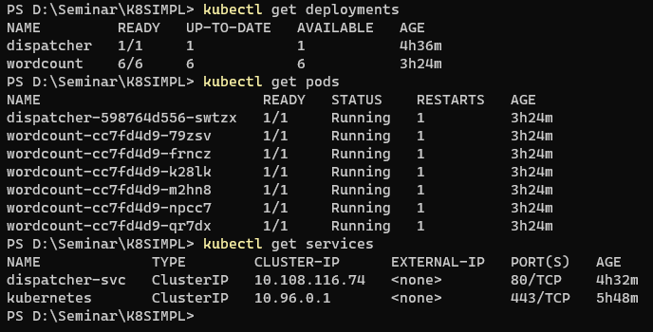
Prototype
Figure-8: Input Data
Decoupled distribution API and Dispatch-Map-Reduce image creation
MapReduce Java classes replaced by coding images compatible with distribution API
Scaling, Availability, Networking and other features provided by Kubernetes by abstraction using objects
Figure-9: Dispatcher, Mapper and Reducer Containers
Figure-10: Word Count Result

Slide 16
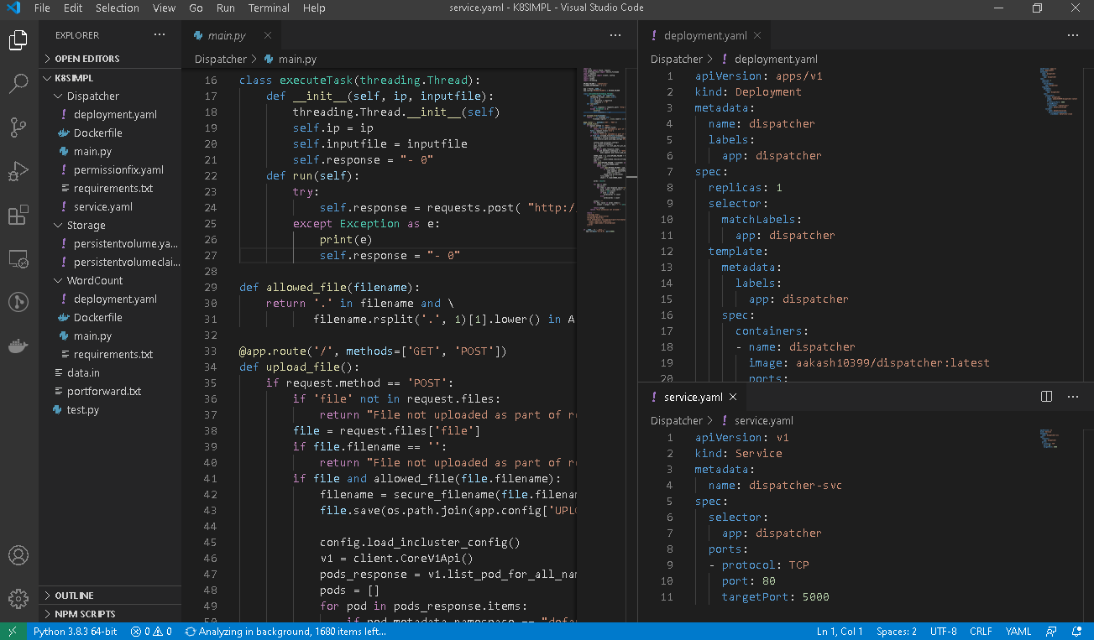
Conclusion
A new dimension to Big Data processing with containerization and Docker at its core
Proposing a system and creating a prototype - https://github.com/Aakash10399/dispatch-map-reduce-k8s
Provisioning of popular Big Data analytics platform
Virtues of a containerized distributed system beneficial to Big Data processing
Emergence of cloud computing services and how it affects this field
Need for refinement and maturity in design before adoption by cloud computing services
Applications – Streaming data processing apps like gaming, ingesting weather data, energy data, education, banking etc.

Slide 17
References
[1] UC San Diego. Big Data Specialization [Online]. Available: https://www.coursera.org/specializations/big-data
[2] Docker (2013). Docker Documentation [Online]. Available: https://docs.docker.com/
[3] Docker (2013). Swarm Documentation [Online]. Available: https://docs.docker.com/engine/swarm/
[4] N. Naik, "Docker container-based big data processing system in multiple clouds for everyone," 2017 IEEE International Systems Engineering Symposium (ISSE), Vienna, 2017, pp. 1-7, doi: 10.1109/SysEng.2017.8088294.
[5] Apache Software Foundation. Apache Ambari [Online]. Available: https://ambari.apache.org/
[6] Apache Software Foundation (2006, April 1). Hadoop [Online]. Available: https://hadoop.apache.org/
[7] Cloudera. Hue [Online]. Available: https://gethue.com/
[8] Pachyderm. Pachyderm Documentation [Online]. Available: https://docs.pachyderm.com/latest/getting_started/
[9] Google. (2014, June. 7). Kubernetes Documentation [Online]. Available: https://kubernetes.io/docs

Slide 18
Thank you for your time

