Slide 1
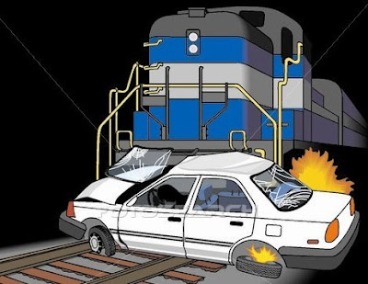
US Highway RailRoad Crossing Accident
DATS 6103 PROJECT
Team 3 Members:
Aakash Hariharan
Abhilasha Singh
Trisha Singh
Vishal Fulsundar

Slide 2
Overview
Purpose
Smart questions
Data Overview
Exploratory Data Analysis
Addressing SMART Questions Using Data Visualizations and Predictive Models
Conclusion

Slide 3
Purpose
Summarize important background research and EDA
Answer the SMART questions by building plots & models

Slide 4

Smart Questions

Slide 5

Dataset Details
US Highway Railroad Crossing Accident dataset sourced from Kaggle
Dataset contains,
120365 observations
46 variables
Railroad Information, Incident Details, Location Information, Highway and Crossing Details, Vehicle Information, Train Information, Environmental Conditions

Slide 6
Exploratory Data Analysis (EDA)
Preprocessing Overview
No missing values
No unique values
Data Type Conversion

Slide 7
Conclusion

Slide 8

Any thoughts or questions?

