Slide 1
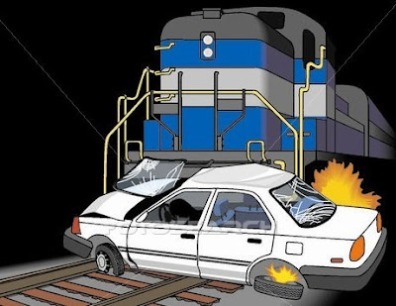
Rail Accident Prediction
DATS 6103 PROJECT
Team 3 Members:
Aakash Hariharan
Abhilasha Singh
Trisha Singh
Vishal Fulsundar

Slide 2
Overview

Slide 3
Purpose
Summarize important background research and EDA
Answer the SMART questions by building plots & models

Slide 4

Smart Questions

Slide 5

Dataset Details

Slide 6
Exploratory Data Analysis (EDA)

Slide 7
Conclusion

Slide 8

Any thoughts or questions?

