Slide 1

AI26501
MODERN AI · ASSIGNMENT 17
Feature Selection for Classification
Evaluating Dimensionality Reduction, Predictive Performance
and Computational Efficiency
PRESENTED BY
Instructor
Aakash Arya (MT\AI\10035\26)
Tinku Raj (MT\AI\10014\26)
Dr. Shruti Garg
Group 14

Slide 2
Real-world Problem and Motivation
Can we classify accurately with fewer features?
Not all input features are equally useful for prediction.
ALL FEATURES
SELECTED FEATURES
Use all 30 input features
Retain a smaller subset
Research motivation: reduce dimensionality while evaluating predictive performance and computational efficiency.

Slide 3
Research Question and Hypotheses
Research question: Can ANOVA F-test-based feature selection reduce input dimensionality and computational cost while maintaining classification performance?
H1 — EFFICIENCY
H2 — PREDICTIVE PERFORMANCE
Using fewer features may reduce Logistic Regression training and inference time.
A smaller subset may preserve Accuracy and Macro-F1 close to the baseline.
Both are hypotheses to test; neither outcome is assumed in advance.

Slide 4
Dataset Description
Breast Cancer Wisconsin (Diagnostic)
WHY THIS DATASET?
• 30 numeric input features
• Binary classification: malignant vs benign
• Cell-nuclei measurement features
• Loaded using scikit-learn load_breast_cancer
• Manageable binary task
• 30 features allow several subset sizes
• Suitable for full vs reduced comparison
Dataset documentation: scikit-learn load_breast_cancer
https://scikit-learn.org/stable/modules/generated/sklearn.datasets.load_breast_cancer.html

Slide 5
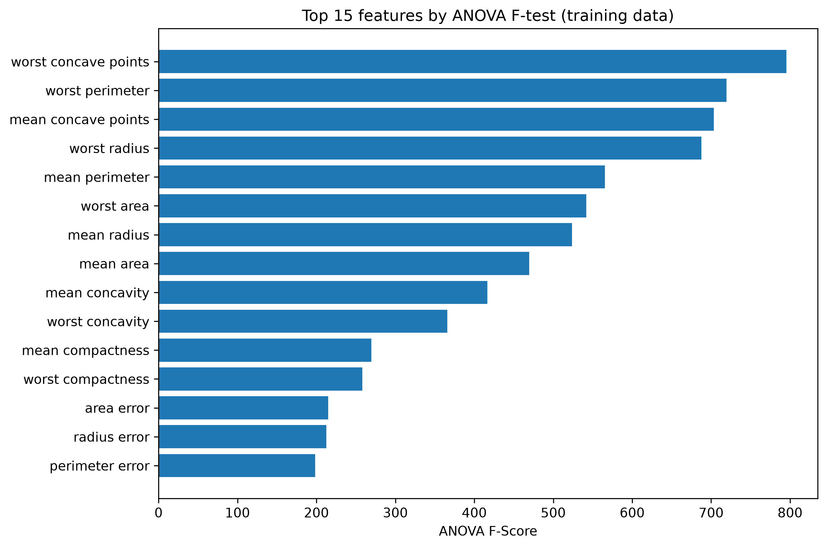
Methodology and Feature Selection
1
Load data
Separate feature matrix X and target y
2
Split data
80% training / 20% testing
3
Scale
Fit scaler on training data only
4
SelectKBest
ANOVA F-test fitted on training data only
5
Train and evaluate
Logistic Regression on each configuration
Configurations: All 30 features | Top 20 | Top 15 | Top 10 | Top 5

Slide 6
Experimental Setup and Evaluation Metrics
EXPERIMENTAL SETUP
REQUIRED METRICS
• Dataset: Breast Cancer Wisconsin
• Classifier: Logistic Regression
• SelectKBest with ANOVA F-test
• 80:20 train/test split
• Scaling and selection fitted on training data
• Same train/test split across configurations
• Repeated Stratified 5-Fold Cross- Validation (10 repeats; 50 fold evaluations per configuration)
• Number of features
• Accuracy
• Macro-F1
• Training time
• Inference time

Slide 7
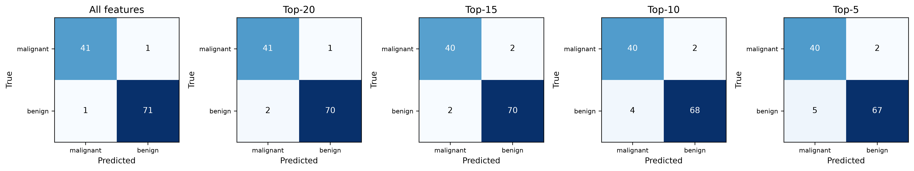
Results and Comparative Analysis
Configuration
# Features
Accuracy
Macro-F1
Training (s)
Inference (s)
All features
30
0.9825
0.9812
0.010991
0.000199
Top-20
20
0.9737
0.9719
0.009217
0.000476
Top-15
15
0.9649
0.9623
0.010073
0.000390
Top-10
10
0.9474
0.9440
0.010555
0.000414
Top-5
5
0.9386
0.9349
0.009188
0.000359
Training and inference times are median measurements over 200 repetitions after warm-up. Inference time excludes the feature-selection transformation.

Slide 8
Conclusion, Limitations
CONCLUSION FROM THIS RUN
LIMITATIONS
All 30 features achieved the highest test Accuracy and Macro-F1.
Top-5 reduced the input feature count by 83.3%.
Reduced-feature models showed lower predictive performance in the test split.
The efficiency benefit depends on whether feature-selection overhead is included.
Only one dataset and one classifier were evaluated.
ANOVA F-test ranks features individually and does not eliminate redundant features.
Timing measurements are hardware- and system-dependent.
Reduced dimensionality does not guarantee faster end-to-end inference.
Results may vary across datasets and train/test splits.

Slide 9
References and Questions
REFERENCES
• 1. scikit-learn: Breast Cancer Wisconsin (Diagnostic) dataset
• scikit-learn.org/stable/modules/generated/sklearn.datasets.load_breast_cancer.html
• 2. scikit-learn: SelectKBest feature selection
• scikit-learn.org/stable/modules/generated/sklearn.feature_selection.SelectKBest.html
• 3. scikit-learn: ANOVA F-value (f_classif)
• scikit-learn.org/stable/modules/generated/sklearn.feature_selection.f_classif.html
• 4. scikit-learn: LogisticRegression
• scikit-learn.org/stable/modules/generated/sklearn.linear_model.LogisticRegression.html
QUESTIONS?

