Slide 1
Feature Selection for Efficient Text Classification
39,115
features with all TF-IDF terms
Can fewer input features make models faster without losing accuracy?
9,779
AI26501 Modern AI | Assignment 17 | MTech I Sem
features (25%) with the same performance
Group 14
Aakash Arya (MT\AI\10035\26)
Tinku Raj (MT\AI\10014\26)
Instructor: Dr. Shruti Garg

Slide 2
High-dimensional text makes models slow and costly
Text becomes tens of thousands of TF-IDF features, most of them rare or uninformative
More features mean more memory, slower training and slower predictions
Feature selection keeps only the useful ones, but may cost accuracy
39,115
TF-IDF features per document
0.16%
of the values are non-zero (sparse text)

Slide 3
Research question and hypothesis
Research question
Hypothesis
Can we reduce input dimensionality and improve efficiency without sacrificing predictive performance?
A much smaller feature set keeps Accuracy and Macro-F1 within 1 point and makes training faster.
Tested by keeping 75%, 50%, 25%, 10%, 5%, 2% and 1% of the features

Slide 4
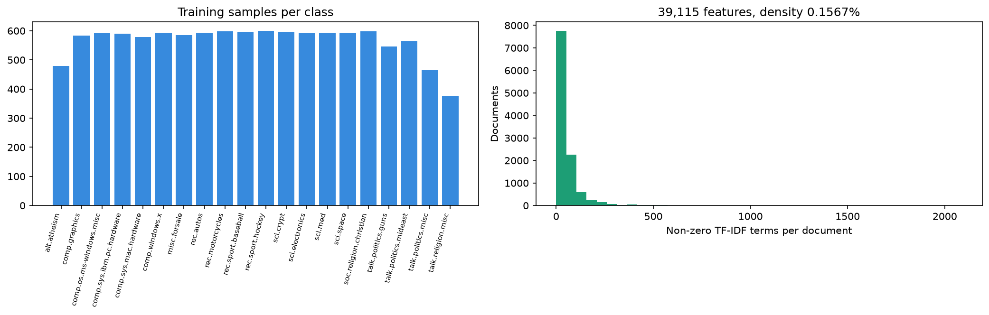
Dataset: 20 Newsgroups, 20 topics
11,314 train posts | 7,532 test posts | 39,115 TF-IDF features | 69.8% baseline accuracy
Headers, footers and quoted replies removed; TF-IDF fitted on the training set only

Slide 5
Methodology: one pipeline, same split and seed
TF-IDF
39,115 features
Select features
6 methods
Train
4 models
Compare
5 metrics
Methods: Variance, Chi-square, ANOVA F, Mutual Information, L1-SVM, Random Forest importance
Models: LinearSVC (primary), Logistic Regression, Naive Bayes, Random Forest
Selectors fitted on training data only; timings are medians of repeated runs
Verdict Yes: Accuracy and Macro-F1 drop 1 point or less, and training is 1.1x faster or better

Slide 6
All features vs. selected features at k = 3,000
LinearSVC on the 7,532-post test set; timings are medians of repeated runs
Setup | Features | Accuracy | Macro-F1 | F1 change | Train (s) | Infer (ms/1k)
All features | 39,115 | 69.8% | 68.6% | - | 1.23 | 1.67
Variance Threshold | 17,094 | 69.6% | 68.3% | -0.3 | 1.10 | 1.69
Chi-square (k=3000) | 3,000 | 67.8% | 66.7% | -1.9 | 1.01 | 0.70
ANOVA F (k=3000) | 3,000 | 66.4% | 65.2% | -3.4 | 1.20 | 0.85
Mutual Info (k=3000) | 3,000 | 65.5% | 64.3% | -4.3 | 1.54 | 1.07
L1-SVM (non-zero) | 400 | 57.7% | 57.2% | -11.4 | 0.69 | 0.52
Random Forest (k=3000) | 3,000 | 65.2% | 63.9% | -4.7 | 1.50 | 1.47
At a fixed k = 3,000 (8% of the features) only Variance Threshold stays within 1 point. The next slide reduces features gradually to show where the limit really is.

Slide 7
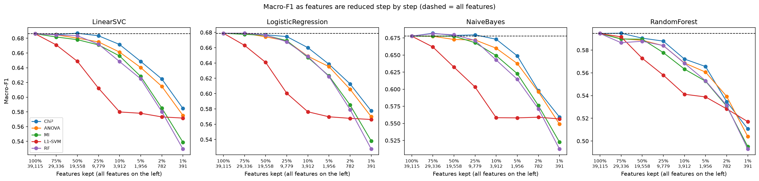
Performance holds down to 25% of the features
25%
3.6x
10%
Chi-square stays within 1 point for all 4 models
Logistic Regression trains faster at 25%
is where Macro-F1 starts to drop (up to 2.2 points)

Slide 8
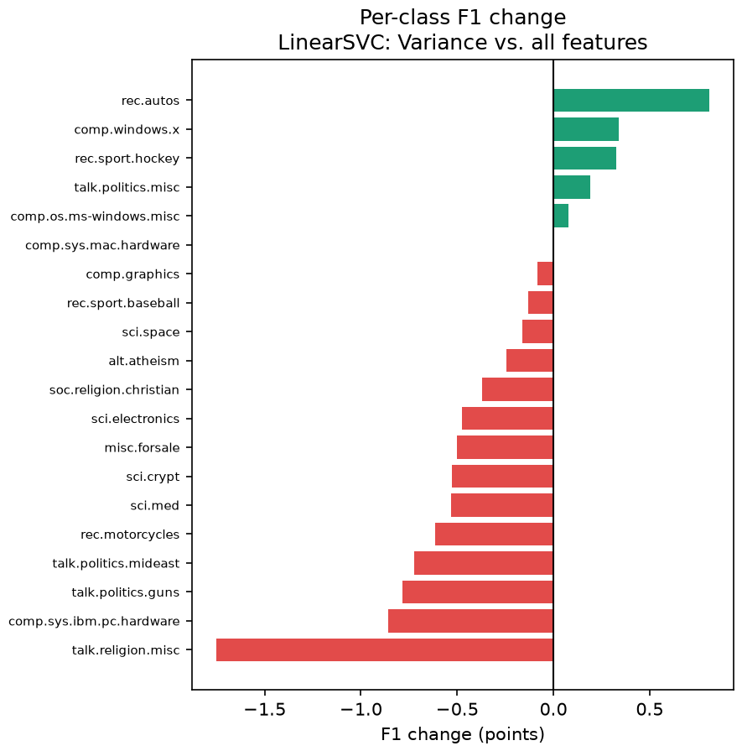
Failure cases: which topics lose accuracy?
-1.8
talk.religion.misc: the biggest loss, in F1 points
+0.8
rec.autos: the biggest gain
19 of 20
topics change by less than 1 point, so the damage is small
Change in F1 per topic, Variance Threshold vs. all features. Green = better, red = worse

Slide 9
Conclusion, limitations and next steps
What we found
Limitations and next steps
Chi-square keeps performance within 1 point down to 25% of the features, for all 4 models
Training is 3.6x faster for Logistic Regression, 2.1x for Naive Bayes, 1.9x for Random Forest
At 1% of the features, Macro-F1 drops 8 to 12 points
Mutual Information and RF importance cost more to run than they save
One dataset, TF-IDF only, one seed
Timings are noisy; LinearSVC training barely depends on feature count
Next: embeddings, RFE, several seeds, more datasets

