Slide 1

User Interface Design Guidelines

Slide 2
Rules of UI
Nielsen and Molich's 10 User Interface Design Guidelines:
Visibility of system status. Users should always be informed of system operations with easy to understand and highly visible status displayed on the screen within a reasonable amount of time.
User control and freedom. Offer users a digital space where backward steps are possible, including undoing and redoing previous actions.
.
Consistency and standards. Interface designers should ensure that both the graphic elements and terminology are maintained across similar platforms. For example, an icon that represents one category or concept should not represent a different concept when used on a different screen.
Help users recognize, diagnose and recover from errors. Designers should assume users are unable to understand technical terminology, therefore, error messages should almost always be expressed in plain language to ensure nothing gets lost in translation.

Slide 3

Rules of UX design
9 rules and guidelines for UX

Slide 4
Tools and tips:
1. Involve Your Users
Users naturally gravitate to websites they like. To best determine what people want in a website, just ask them. When you involve your users in the design process, you organically create a better UX. Though intuition is often a useful tool in a design project, what is intuitive to a site designer might not be intuitive to your customer base. Reaching out to users will give you design ideas that you can count on.

Slide 5
Tools and tips:
Aesthetically usable effect:
Users often perceive aesthetically pleasing design as design that’s more usable.
Doherty Threshold:
Productivity soars when a computer and its users interact at a pace (<400ms) that ensures that neither has to wait on the other.

Slide 6
Tools and tips:
Fitts’s Law
The time to acquire a target is a function of the distance to and size of the target.
Goal-Gradient Effect
The tendency to approach a goal increases with proximity to the goal.

Slide 7
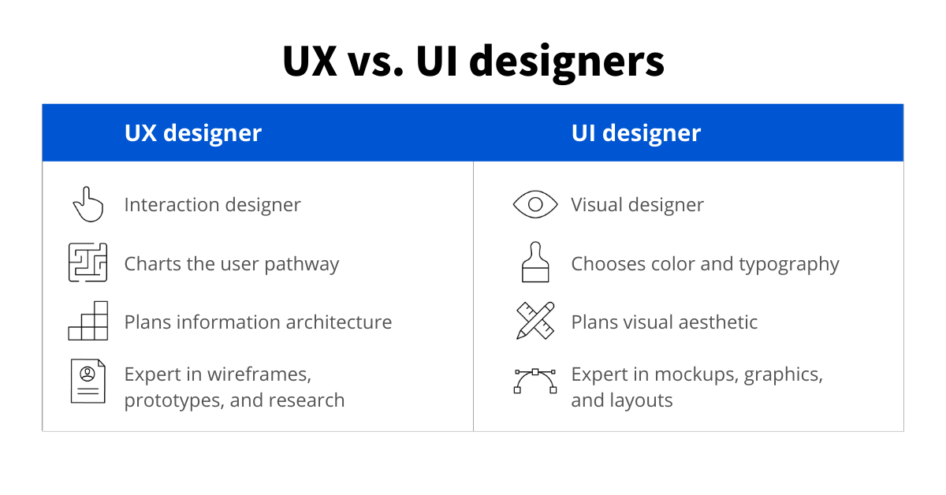
Difference between UI & UX

