Slide 1

CMR INSTITUTE OF TECHNOLOGY
Bengaluru, Karnataka-560037
Submitted By: Submitted To: Aakash Ku Jaiswal Prof. Ann Mathews
1CR24CS003 Prof. Shilpa
CSE Dept. of CSE

Slide 2

CSE Study Vault
One Place for All Your Study Needs
“Empowering every mind, one click at a time.”

Slide 3
Description
CSE Study Vault is a web-based platform designed to provide organized and easy access to academic resources for Computer Science students. The system allows users to navigate through semesters and subjects to access study materials such as notes, previous year question papers, lab programs, and important questions. It simplifies the learning process by offering all resources in one centralized location.

Slide 4
Problem Statement
Materials scattered across platforms.
Hard to locate resources.
No semester-wise organization.
Retrieval takes too long.
Important files get buried.
Need centralized access.

Slide 5
Objectives
Build centralized CSE platform.
Organize resources by semester.
Enable quick material access.
Minimize search time and effort.
Enhance usability with simplicity.

Slide 6
Social Benefits
Supports student learning efficiency.
Reduces academic stress.
Promotes equal resources access.
Encourage organized study habits.
Improves overall academic performance.

Slide 7
Tools and Technologies to be Use
Frontend: HTML(for structuring web pages), CSS(for designing and styling), JavaScript(for basic interactivity and dynamic content).
Backend: Python “Flask Framework”(to handle server logic, routing, and data processing).
Database: SQLite/MySQL(to store data like subjects, semesters, and study materials).
Other tools: VS code(for development), Browser “Chrome”(for testing), Git(version control).

Slide 8
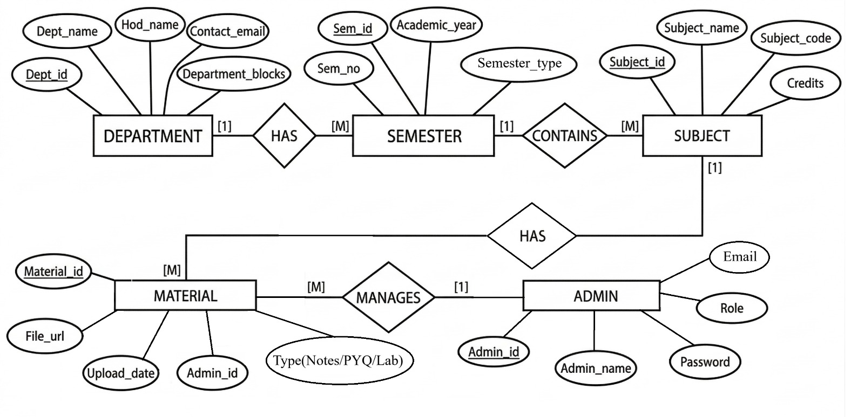
ER Diagram

Slide 9
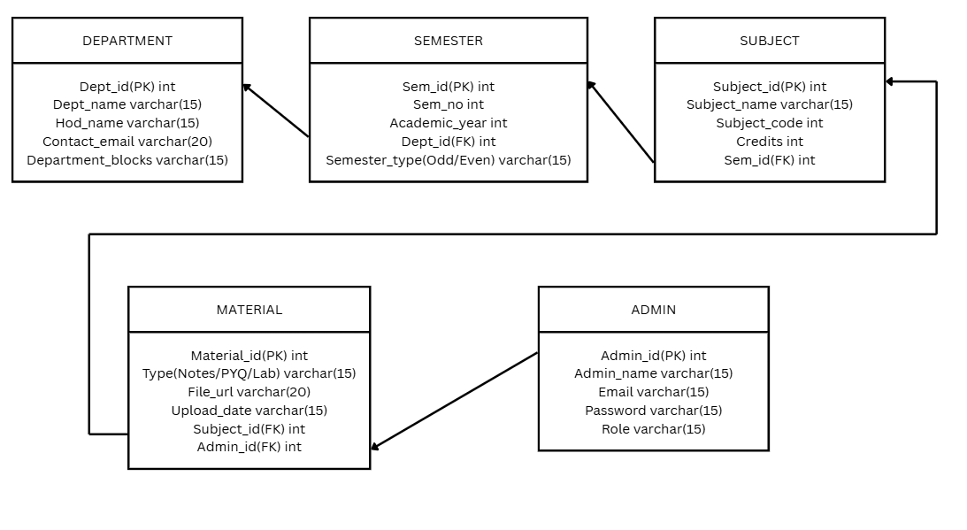
Schema Diagram

Slide 10


