Slide 1

Titanic Survival Prediction
Machine Learning Project Group – 59
Aakash Sagar Sreerala - A20547846
Vaishnavi Bhaskara - A20546861
Pavani Reddy Podduturi - A20545675

Slide 2
— Problem Statement —
Accurately predict Titanic passenger survival using machine learning amidst historical data complexities.
Develop a robust predictive model to differentiate survivors from non-survivors based on all the data that we about the passengers.
Explore machine learning's utility in understanding historical events like the Titanic disaster.

Slide 3
— Methodology —
1. Data Collection: Acquire the Titanic dataset containing passenger attributes like age, gender, class, and ticket details.
2. Data Preprocessing: Cleanse and prepare the dataset by handling missing values, encoding categorical variables, and scaling numerical features.
3. Model Selection: Explore and select appropriate classification algorithms such as Logistic Regression, Decision Trees, Random Forest, and Support Vector Machines.
4. Model Training and Evaluation: Train each selected model on a subset of the dataset and assess their performance using metrics like accuracy, precision, recall, and F1-score.
5. Model Optimization and Deployment: Fine-tune the hyperparameters of the chosen model(s) and deploy the optimized model(s) to make predictions on new data for real-world application.

Slide 4
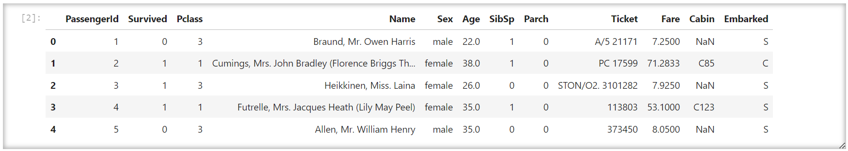
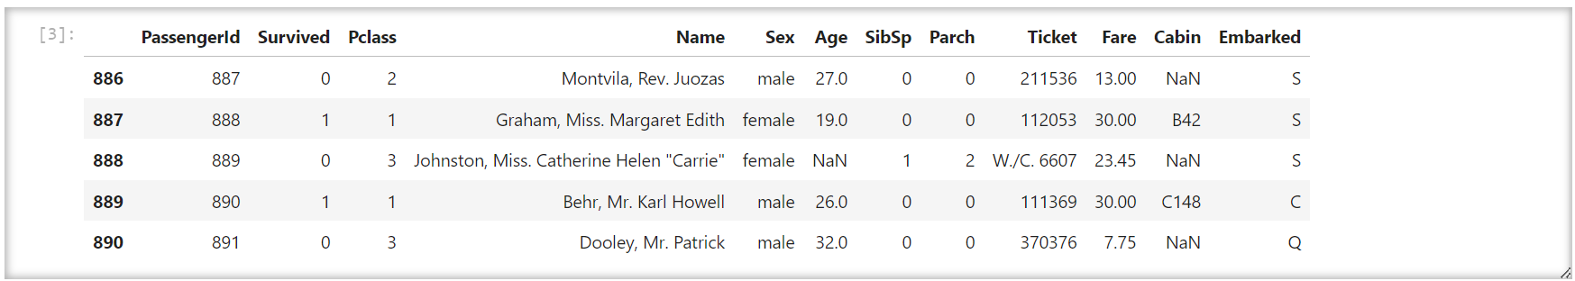
— Data Collection — We have collected the dataset from kaggle
1.

Slide 5
Exploratory Data Analysis
We take a dataframe of the training data
Initially, we looked for the presence of null values within the dataset. Subsequently, we imputed the null values.
We looked for the survival rate for various features in our dataset.
We have dropped the unnecessary features which are not related to survival prediction of people.
Using the correlation plot we have visualized the feature importance after handling the missing values by imputing the data.

Slide 6
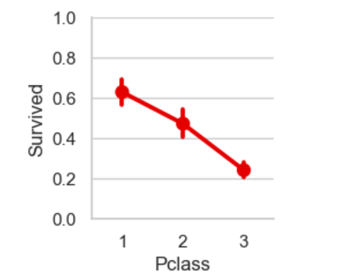
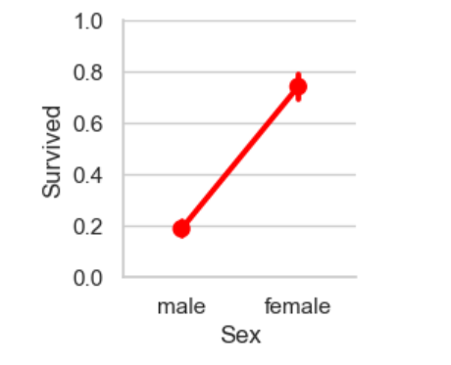
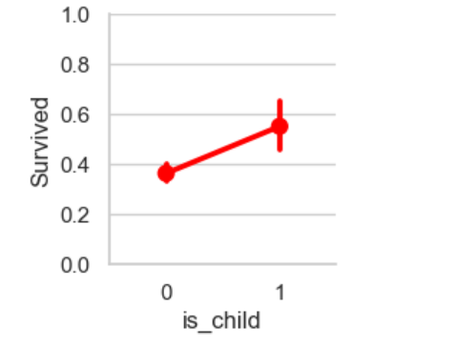
Pictorial Representation of Survival Rate
Passenger Class vs Survival Rate
Gender vs Survival Rate
Age vs Survival Rate

Slide 7
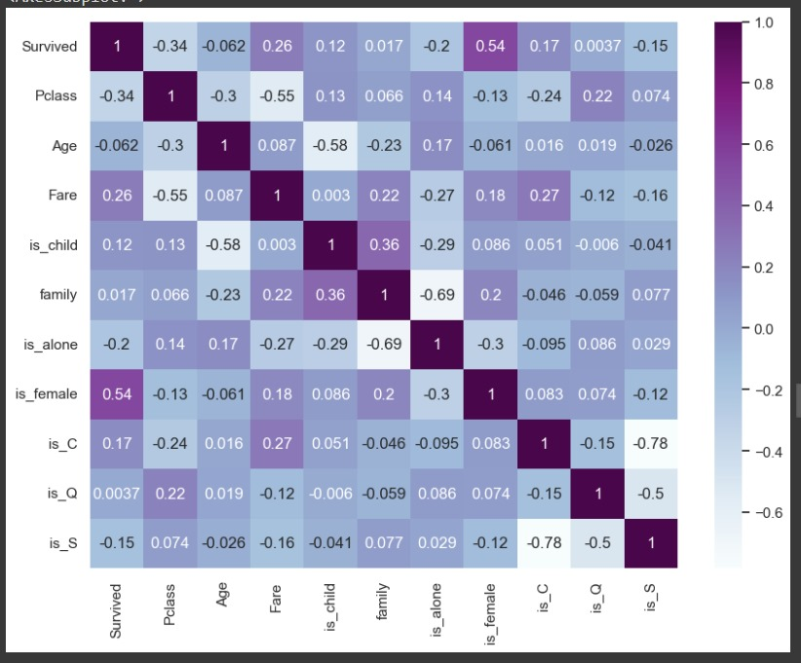
Correlation plot

Slide 8
—Model Training—
1.
2.
3.
We have used 80% of data for training and 20% of the data for testing.
We have checked the accuracies of different models like SGDClassifier, GradientBoostingClassifier, RandomForestClassifier, Logistic Regression, SVClassifier and Confusion Matrix
Then we have used Random Forest Classifier which gave us an accuracy of 81.01% on test data.

Slide 9
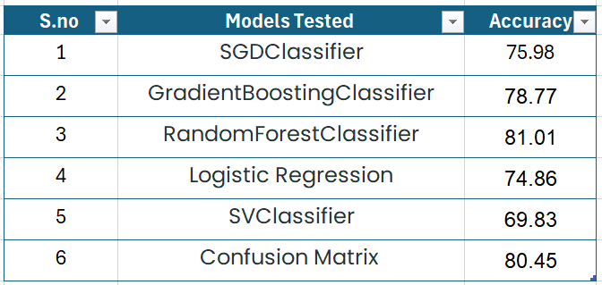
Results
Finally, we have used Random Forest Classifier which gave us an accuracy of 81.01% on test data.

Slide 10
THANK YOU

