Slide 1

Rajkiya Engineering College Mainpuri
In the partial fulfillment for the award of the degree of
BACHLOR IN TECHNOLOGY
DEPARTMENT AT
ELETRICAL ENGINEERING
PRESENTATION ON
FACE MASK DETECTION SYSTEM
SUBMMITED TO
Asst. Prof. Smriti Singh
SUBMITTED BY
AKASH VERMA
ROLL NO-1908400200004

Slide 2
About The Project
Introduction
Overview
Hardware & Software Requirement
Basics Of Neural Network
Working
Code Explanation
Reference

Slide 3
Introduction:
Face Mask Detection System
to prevent the spreading of Corona
Virus.

Slide 4
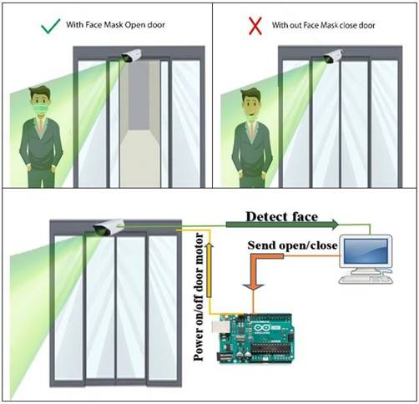
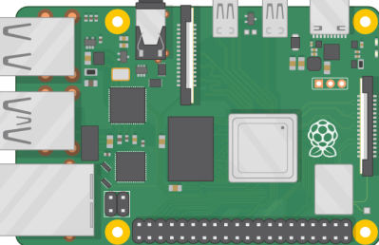
OVERVIEW :

Slide 5
Hardware & Software Requirement
Hardware | Software
Raspberry Pi | Python
Power Supply | Tensor flow
Camera module | ScikitLearn
Monitor | Matplotlib
Sliding Gate | Pillow
Jumper wire | Numpy
Motor driver | Open cv

Slide 6
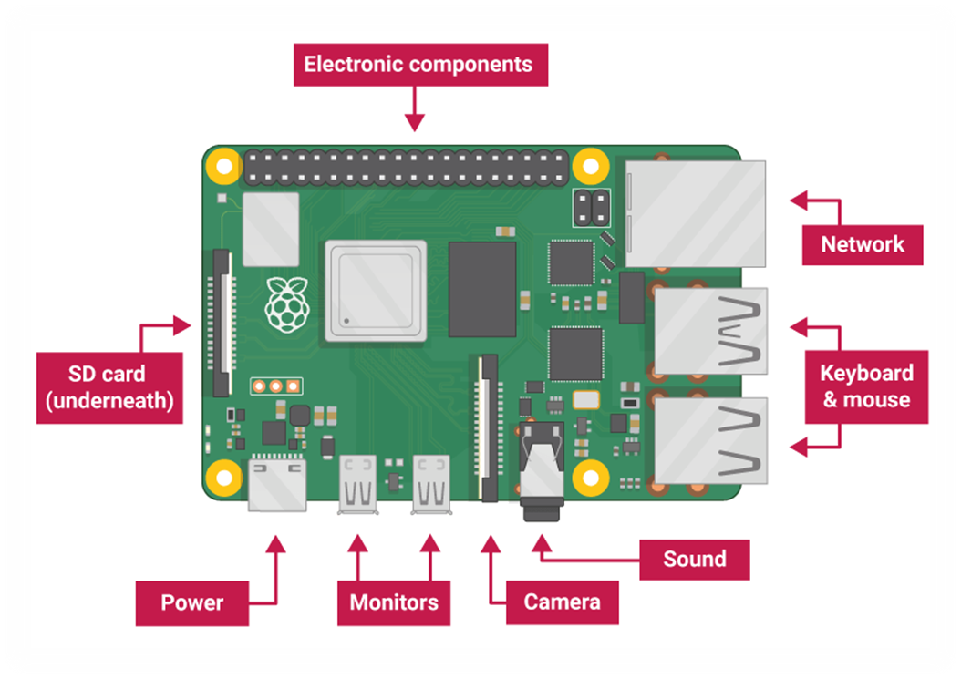
Raspberry Pi

Slide 7
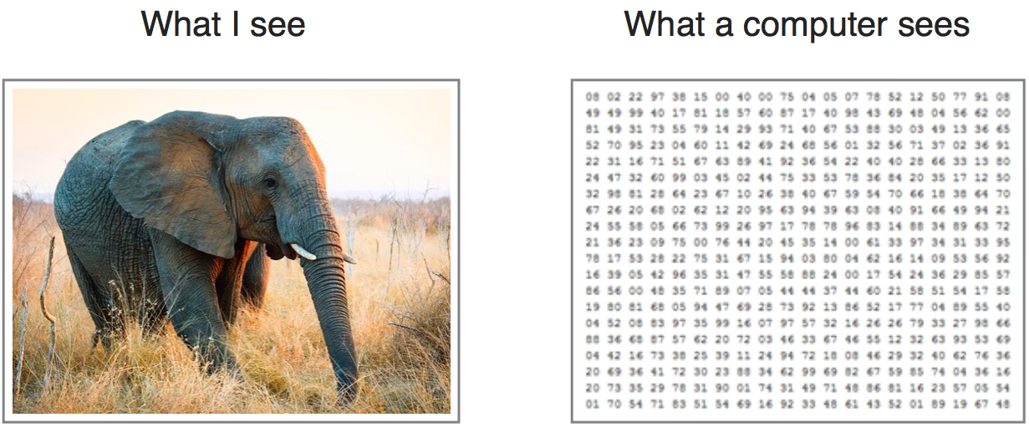

Slide 8
Basic of Neural Network
Biological Neural Network
Artificial Neural Network
.Comparison between ANN & Biological Neural network
Types of Neural Network
Components of CNN

Slide 9
Biological Neural Network
Specialized cell for receiving , processing and transmitting information.
Human Brain - aprox. 10 Billion Neuron interconnected with 10 Trillion synapses.
Processing is carried out by neurons.
Dendrites receive signals from other neurons.
Soma sums all the incoming signals
Axon transmits the signals to other cells.

Slide 10
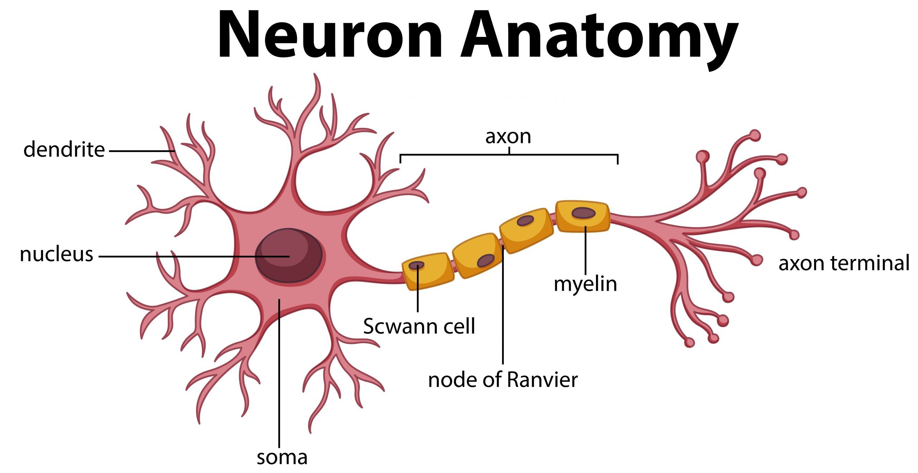
Model of a Biological Neuron

Slide 11
Artificial Neural Network
Artificial system inspired by Biological Neural Network.
Computational model & Threshold logic (Algo. &Mathematics)
Study of Brain or on the application of N.N to artificial intelligence
ANN is made up of 3 components - input , output ,& hidden layer.
Input layer – used to take input
Output layer – gives the output
Hidden layer – used for processing..

Slide 12
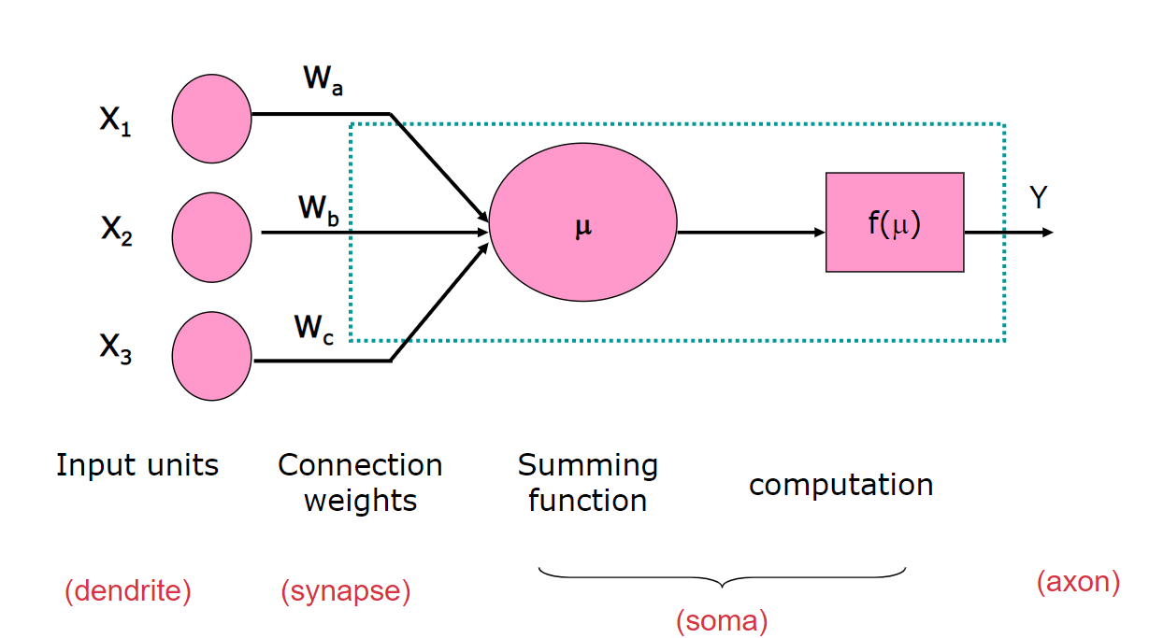
Model of Artificial Neuron

Slide 13
. Comparison between ANN & BNN
S.No. | Artificial neural network | Biological neural network
1 | Fast Processing speed. | Slow in processing information.
2 | Processes operate in sequential mode. | The process can operate in massive parallel operations.
3 | Corrupted information in the memory it cannot be retrieved | It can be retrieved bcz Information is distributed into the network throughout into sub-nodes
4 | The activities are continuously monitored by a control unit. | There is no control unit to monitor the information being processed into the network

Slide 14
Types of Neural Network -
Artificial Neural Network
Recurrent Neural Network
Convolution Neural Network

Slide 15
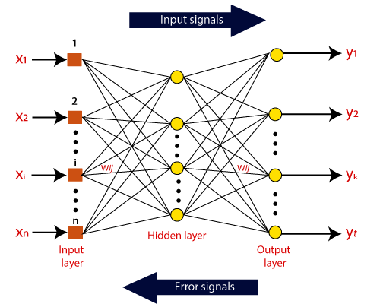
Artificial Neural Network

Slide 16
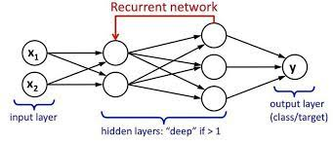
Recurrent Neural Network

Slide 17
Convolution Neural Network
Powerful tool because of its ability to handle large amounts of data.
One of the most popular deep neural network.
In CNN, the hidden layers include layers that perform convolutions.
Includes a layer that performs the dot product of the convolution kernel with the layer's input matrix.
Kernel slides along the input to get feature map.
Consists - input layer, hidden layer and an output layer.

Slide 18
Components of CNN
Kernel = Filter –
It’s a matrix that move over the input data.
Perform Dot product with the sub-region of input data.
Extract Feature from input image.
iv. Dim.(o/p) = Size (i/p) – Size(kernel) + 1
Stride

Slide 19
2. Padding -
Fix Border Effect Problem.
Help to preserve some lost information.
Size (i/p) – Size(kernel) +2Size(P) + 1
iii. Dim.(o/p) =
Stride

Slide 20
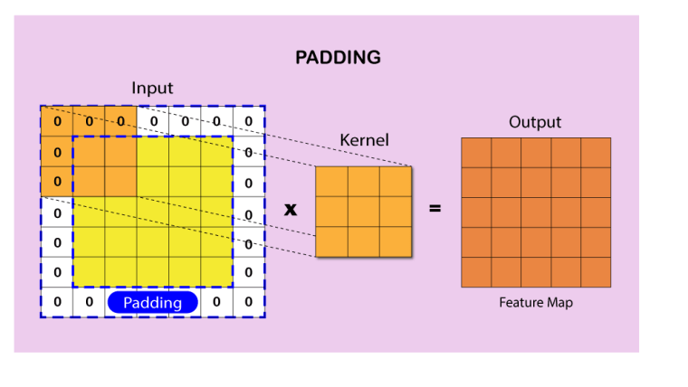

Slide 21
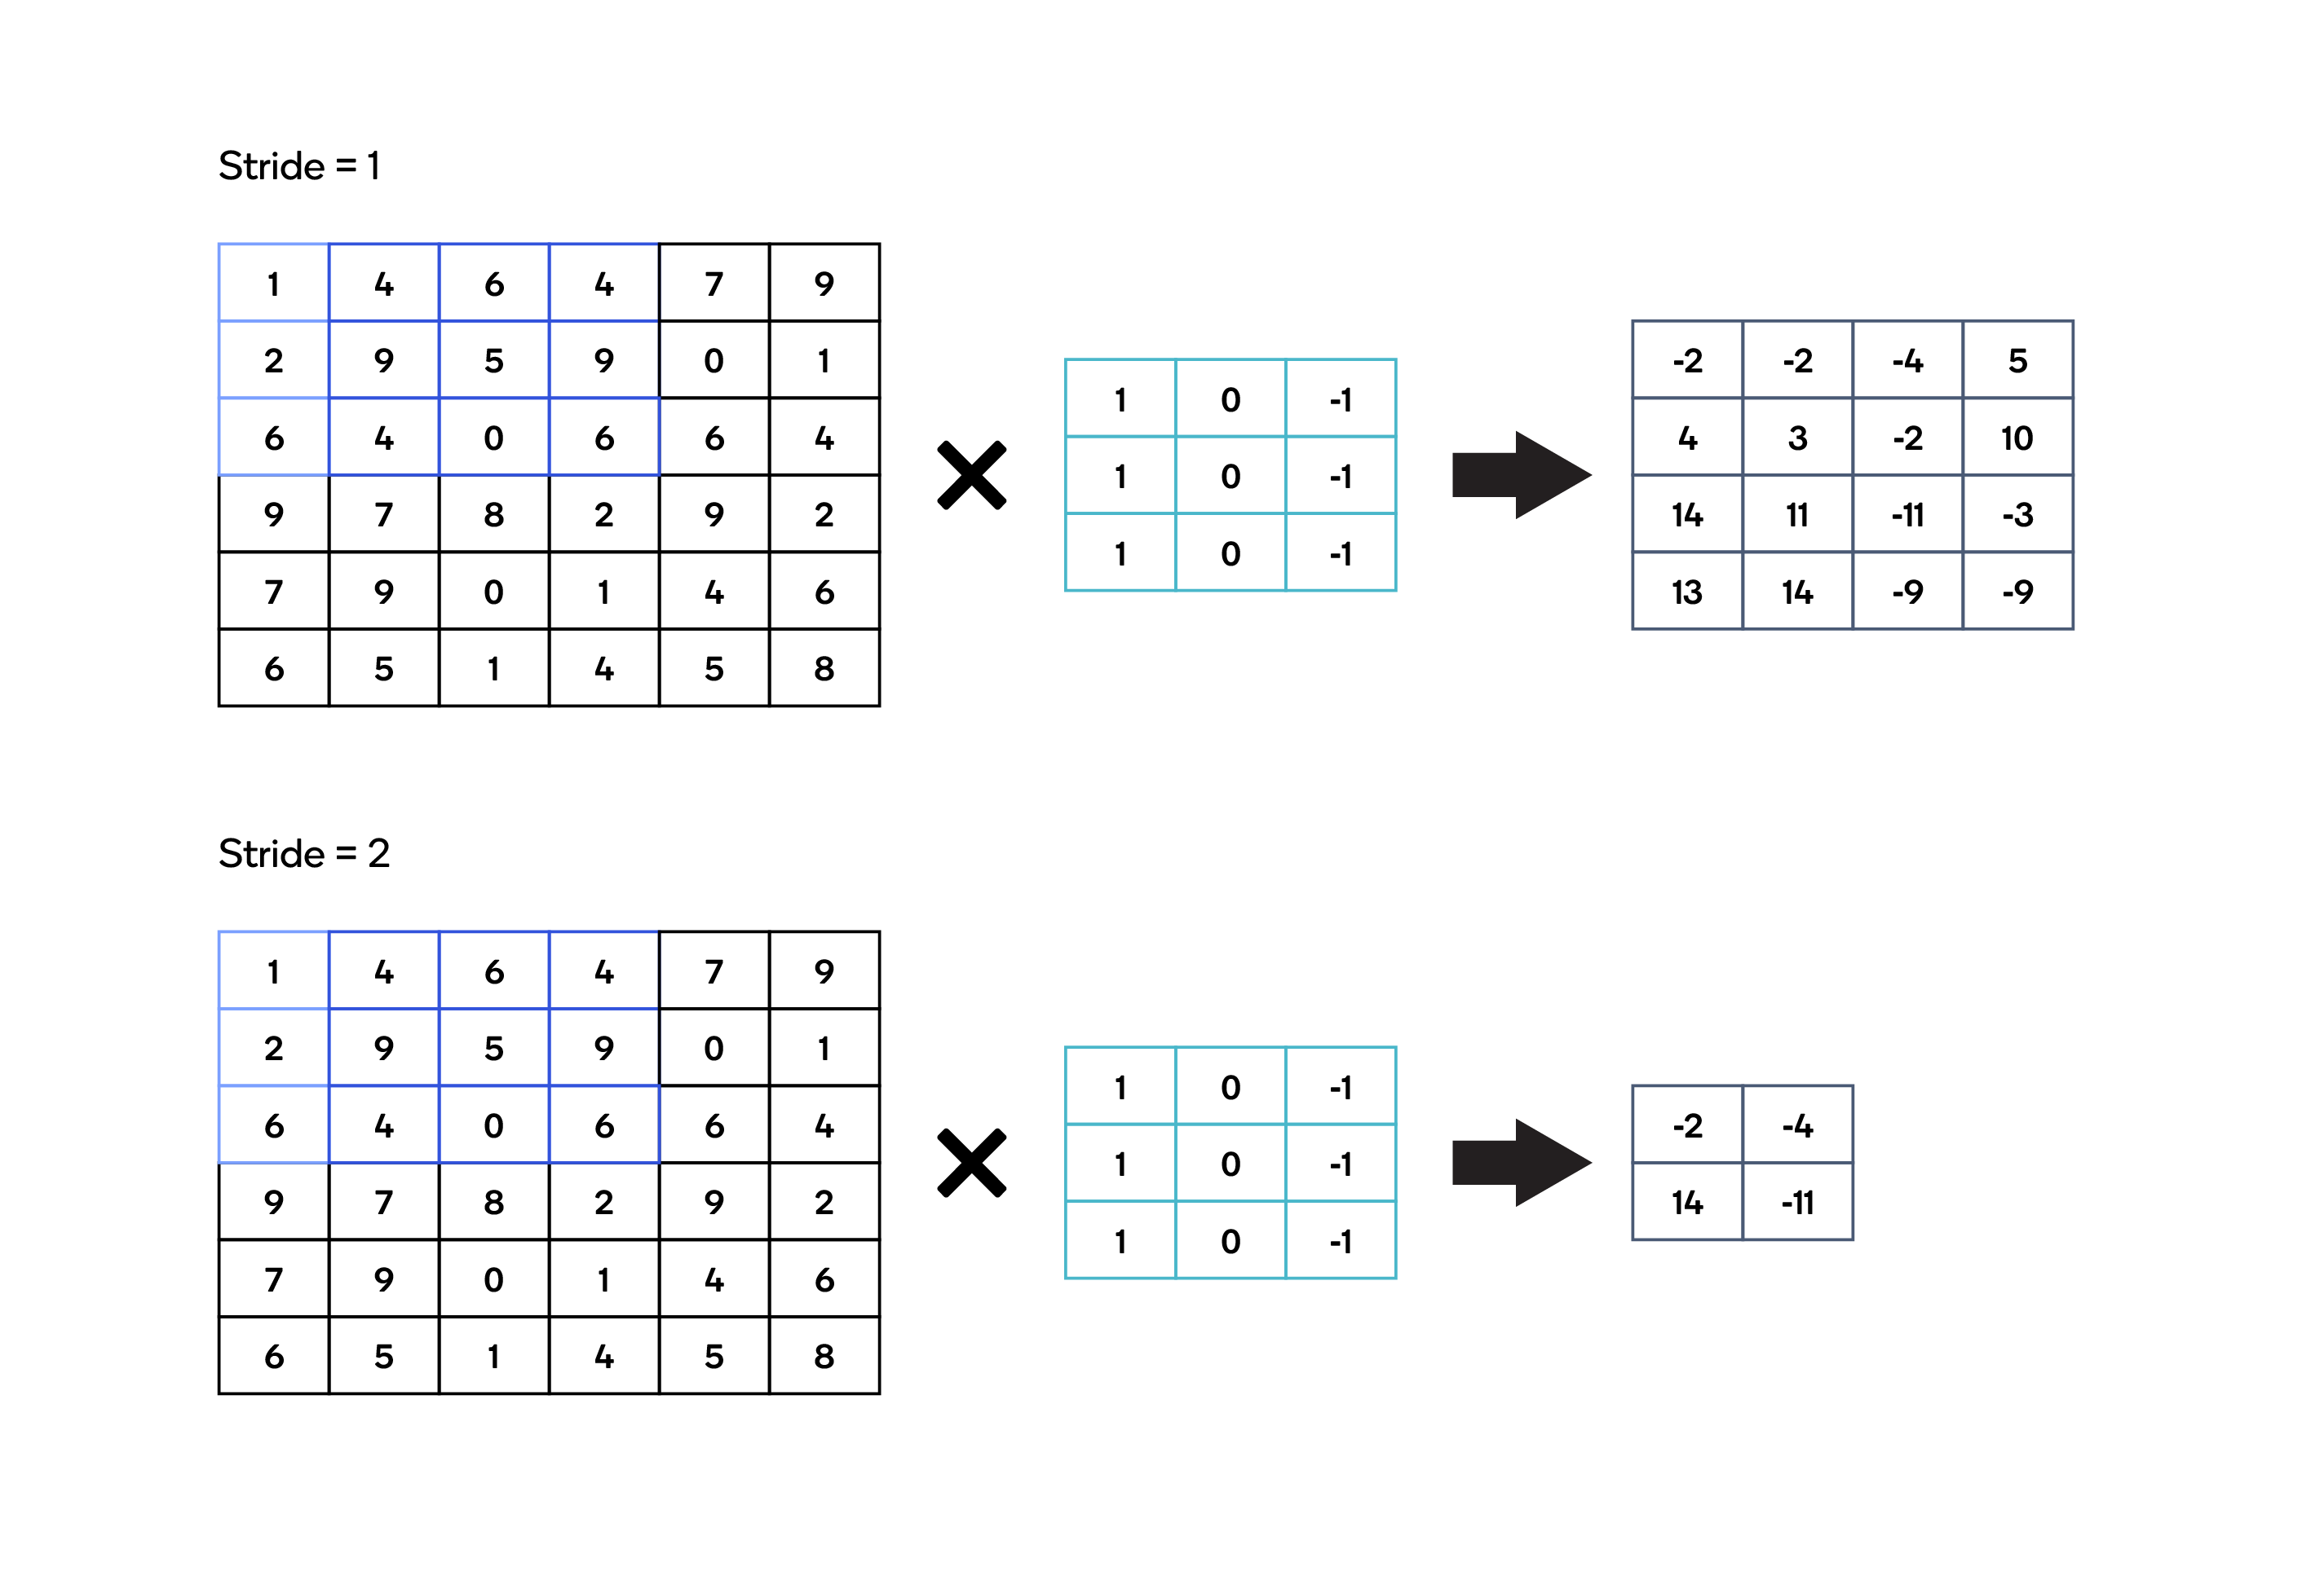
Kernel (3*3)
Input img (6 * 6)
Feature Map (4*4)
Kernel (3*3)
Feature Map (2*2)
Input img (6 * 6)

Slide 22
3. Pooling -
Used for Dimensionality Reduction.
Reduces the amount of Parameters and Computational power required.
Types of pooling-
a) Average pooling –
Returns the average of all the values from the portion of the image
covered by the Kernel.
b) Max Pooling-
Find the maximum value of a pixel from a portion of the image covered
by the kernel.
iv. Dim(o/p) = int Size(Feature Map)
2

Slide 23
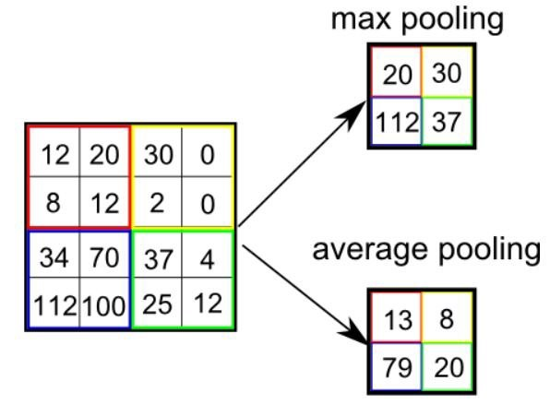

Slide 24
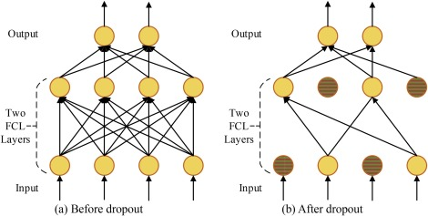
Dropout –
Used to prevent the network from overfitting .
Some fraction of units in the network is dropped in training

Slide 25
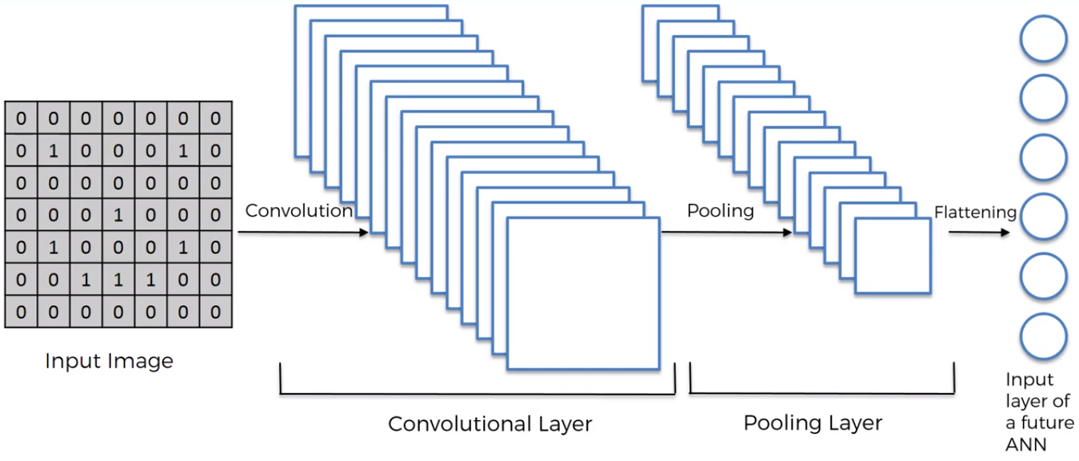
5. Flattening -
Involve transforming the entire feature map matrix into single column.
This is fed to Neural Network for processing.
Simply it convert pooled feature map into 1D array.

Slide 26
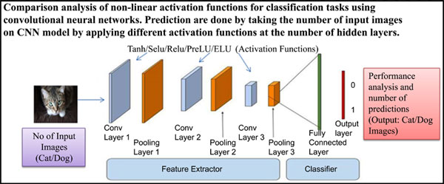
6. Activation function-
i. Determine the output of neural network like yes or no.
ii. It maps the resulting values in between 0 to 1 or -1 to 1 etc.

Slide 27
7. One Hot Encoding –
Used to convert the label into binary format (0 or 1).
label Binarizer()
8. Data Augmentation –
Recreating image or data with the help of input data.
Avoid the overfitting problem, we need expand the dataset.
More the data, the better our models would perform.
Image Data Generator()

Slide 28
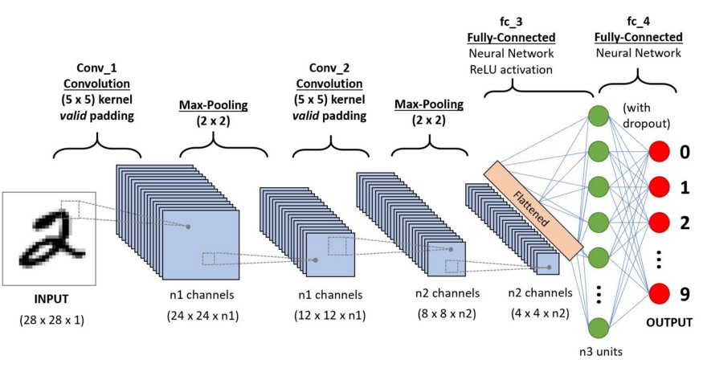
Implementation of CNN Model

Slide 29
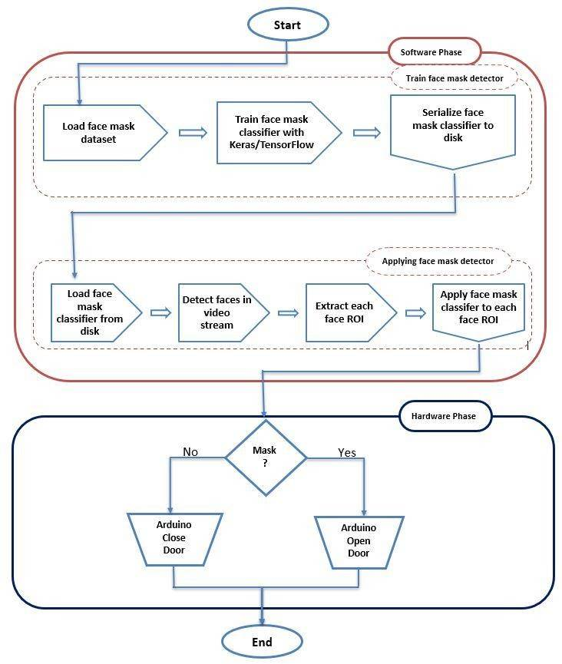


P
HASE
1
WORKING
PHAS
E
2
Raspberry pi
Open door
Raspberry pi
Close door

Slide 30
Reference –
https://ieeexplore.ieee.org/document/9350556
https://www.kaggle.com/andrewmvd/face-mask-detection
https://www.raspberrypi.org/

Slide 31
PRINT (“THANKS EVERYONE ”)

