Slide 1


JSPM’S RAJARSHI SHAHU COLLEGE OF ENGINEERING (An Autonomous Institute, Affiliated to SPPU) TATHWADE, Pune-33 Department of Computer Applications
Project Viva-voce 24-25

Slide 2
MCA-SEM IV
Name: Aakash Bendale
PRN No: RMC23MC005
Project Title: Cricket Data Analytics
Company Name: Pentagon Space Pvt. Ltd.

Slide 3
Cricket Data Analytics of
ICC Men's T20 World Cup 2022

Slide 4
Introduction of the project
In this project we have analyze the data of the ICC Men’s T20 World Cup 2022.
Aiming to uncover the valuable insights about the players.
Utilize them to optimize operations within your establishment.
Using this project we will be able to see the players performance in the ICC Men’s T20 World Cup 2022 using which we will be able to make the team of best 11 players from the world.

Slide 5
Why this project?
This project can be used to know the performance of the players played in ICC Men’s T20 World Cup 2022.
Using this project we can easily classify who will be in our best 11 team.
This project can be used in IPL auction to select the team.
We can also use our project to make the team on fantasy sport platform like Dream11.

Slide 6
What’s the process to make the project?
Data Collection
Data Integration & Cleaning
Data Transformation
Data Analysis & Reporting
Visualization & Communication

Slide 7
Tools Used
ESPNcricinfo:- Link
Bright data:-Link
Jupyter Notebook
Power Bi

Slide 8
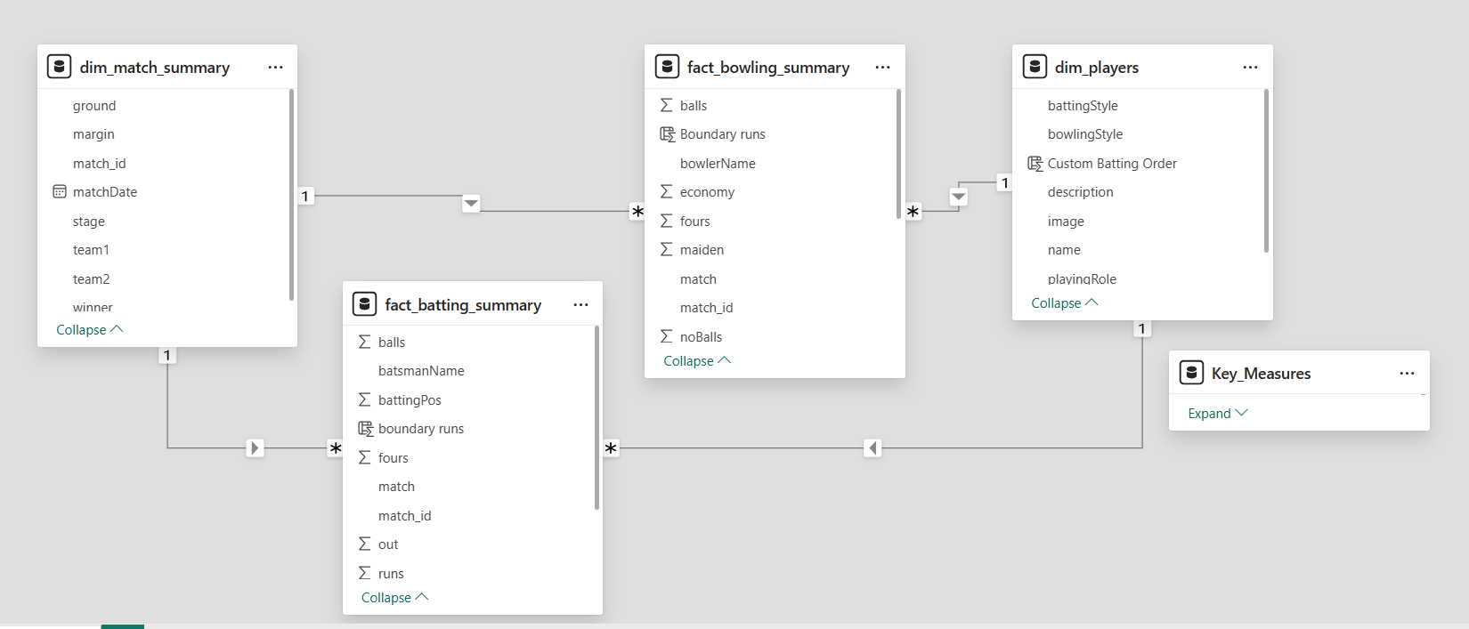
Class Diagram

Slide 9
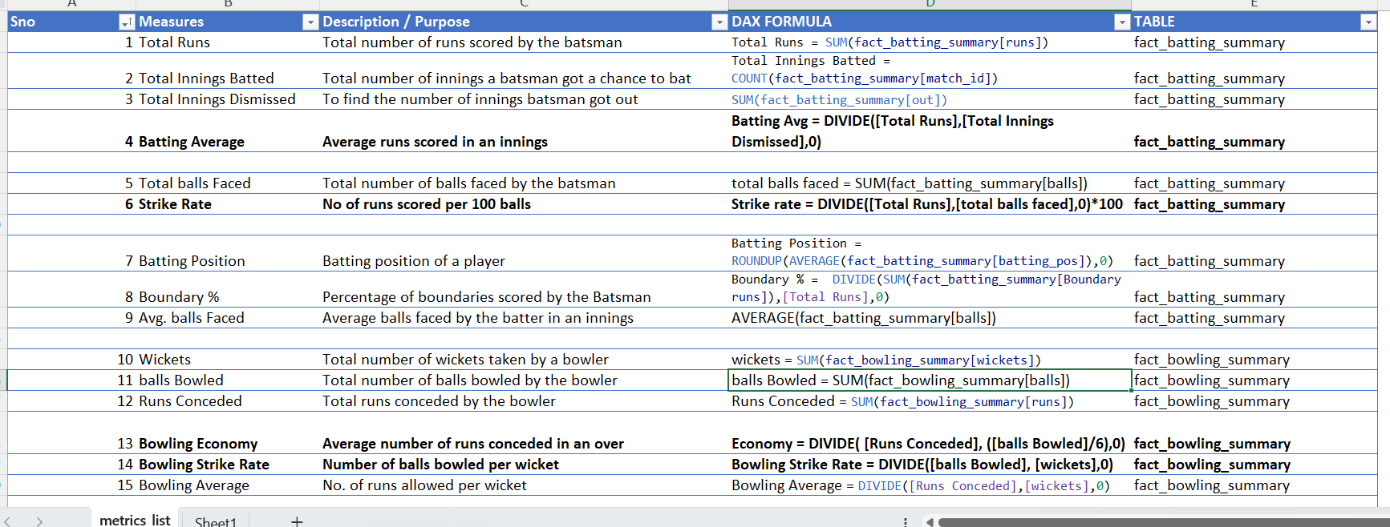
Additional Attribute

Slide 10
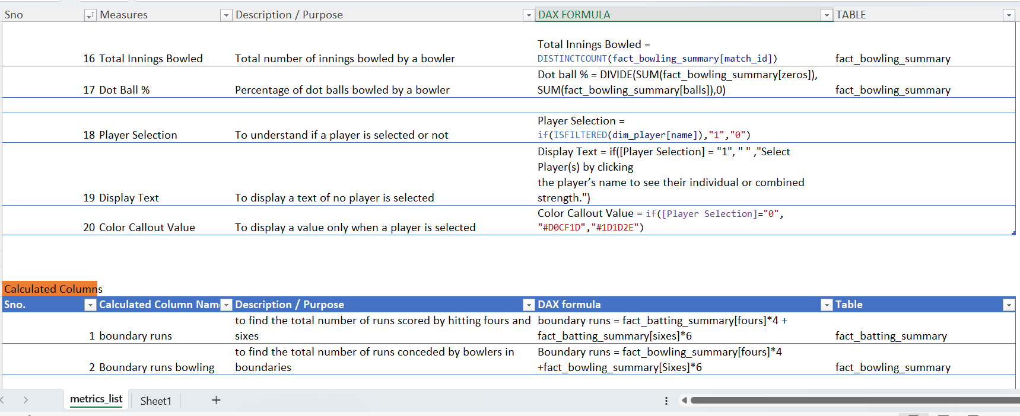

Slide 11
Divided into five categories
Team
Openers
MIDDLE ORDER
FINISHER
ALL-ROUNDERS
SPECIALIST FAST BOWLERS
2
Players
1
Players
3
Players
2
Players
3
Players

Slide 12
Openers
PARAMETERS | DESCRIPTION | CRITERIA
Batting Average | Average runs scored in an innings | >30
Strike Rate | No of runs scored per 100 balls | >140
Innings Batted | Total Innings batted | >3
Boundary % | % of runs scored in boundaries | >50
Batting Position | Order in which the batter played | <4

Slide 13
Middle Order
PARAMETERS | DESCRIPTION | CRITERIA
Batting Average | Average runs scored in an innings | >40
Strike Rate | No of runs scored per 100 balls | >125
Innings Batted | Total Innings batted | >3
Avg. Balls Faced | Average balls faced by the batter inn an innings | >20
Batting Position | Order in which the batter played | >2

Slide 14
Finisher
PARAMETERS | DESCRIPTION | CRITERIA
Batting Average | Average runs scored in an innings | >25
Strike Rate | No of runs scored per 100 balls | >130
Innings Batted | Total Innings batted | >3
Avg. Balls Faced | Average balls faced by the batter inn an innings | >12
Batting Position | Order in which the batter played | >4
Innings Bowled | Total Innings Bowled by the bowler | >1

Slide 15
All-Rounders
PARAMETERS | DESCRIPTION | CRITERIA
Batting Average | Average runs scored in an innings | >15
Strike Rate | No of runs scored per 100 balls | >140
Innings Batted | Total Innings batted | >2
Batting Position | Order in which the batter played | >4
Innings Bowled | Total innings bowled | >2
Bowling Economy | Average runs allowed per over | >7
Bowling Strike Rate | Average no. of balls required to take a wicket | <20

Slide 16
SPECIALIST FAST BOWLERS
PARAMETERS | DESCRIPTION | CRITERIA
Innings Bowled | Total Innings Bowled | >4
Bowling Economy | Average runs allowed per over | >7
Bowling Strike Rate | Average no. of balls required to take a wicket | <16
Bowling Style | Bowling style of the player | =“%Fast%”
Bowling Average | No. of runs allowed per wicket | <20
Dot Ball % | % of dot balls bowled | >40

Slide 17
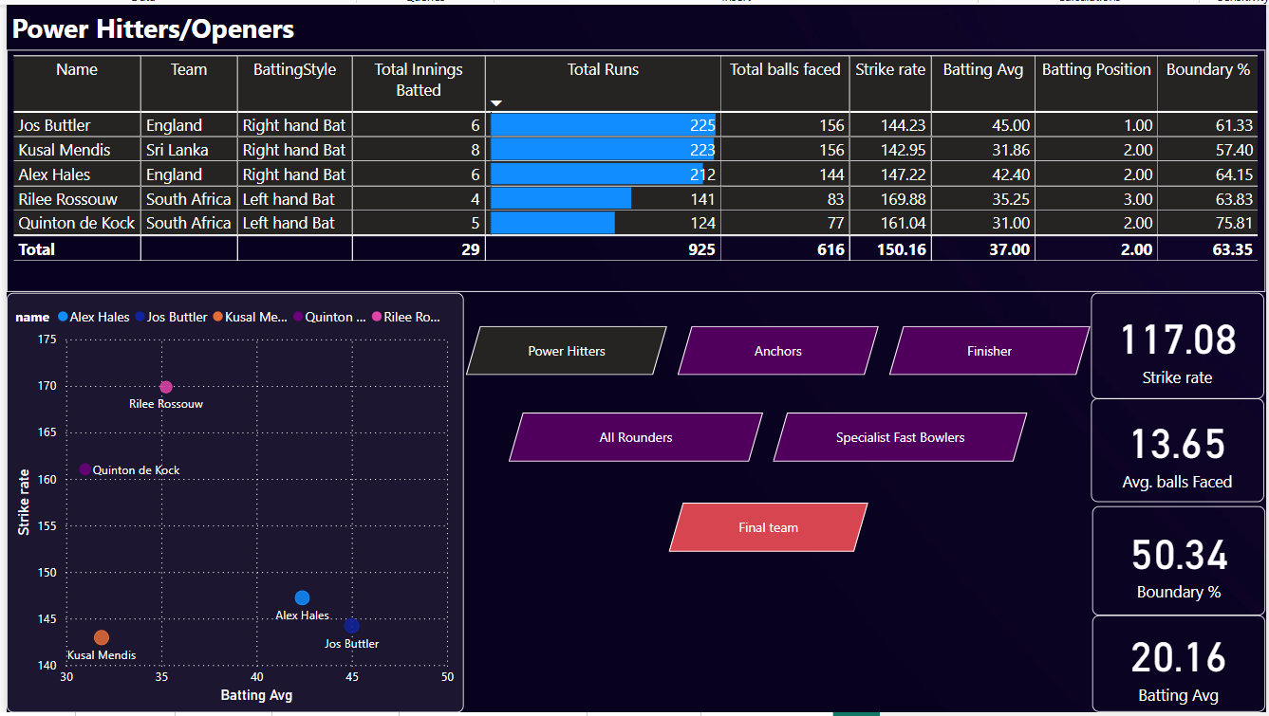
Final Output

Slide 18
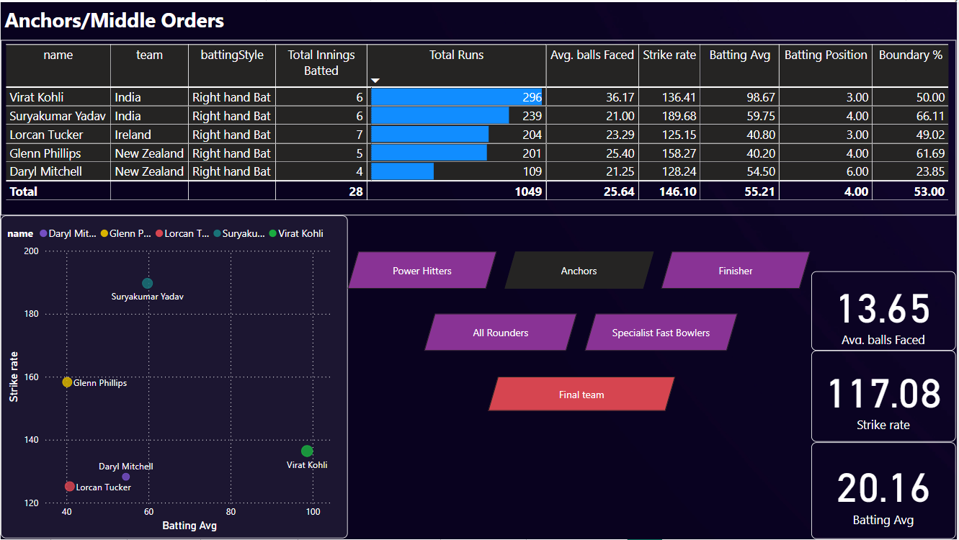

Slide 19
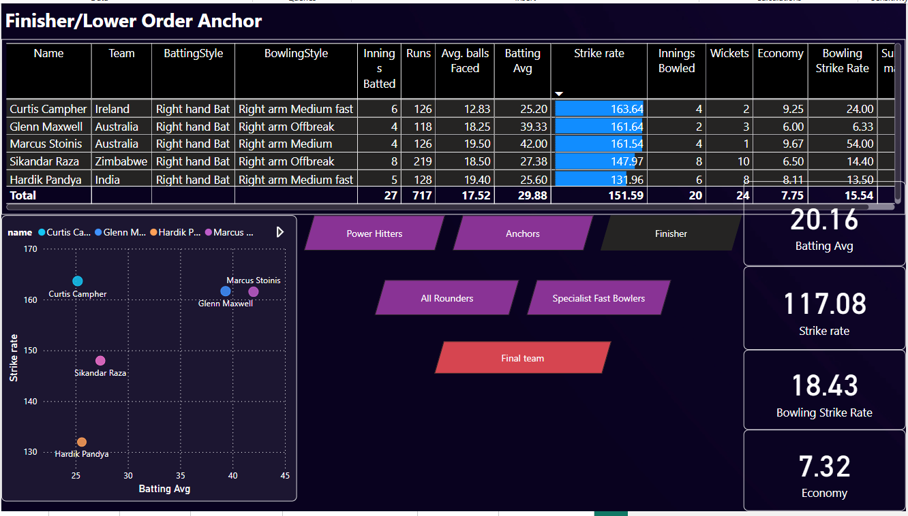

Slide 20
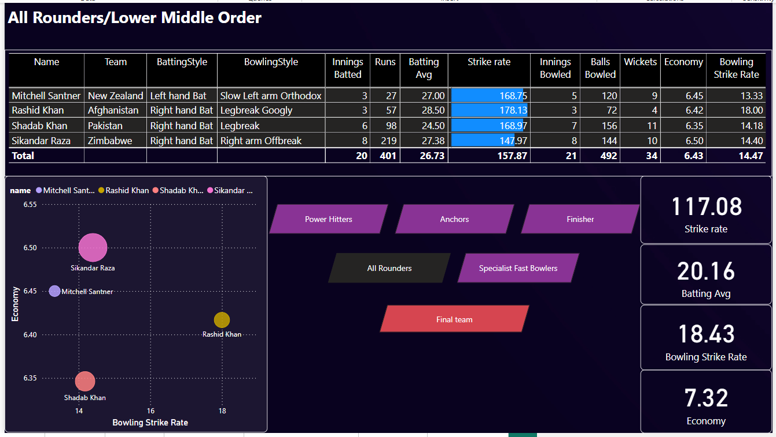

Slide 21
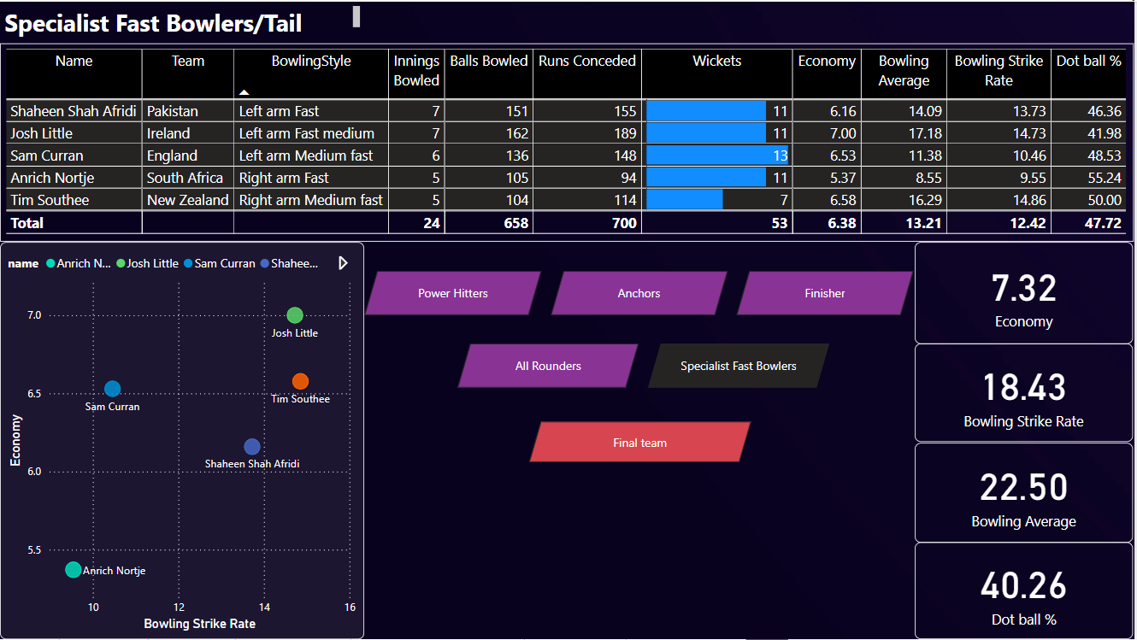

Slide 22
