Slide 1

INFORMATION TECHNOLOGY CPU Scheduling Algorithm Simulator
Submitted By:
Aakash Birla BTIT24O1001
Atharv Chaturvedi BTIT24O1037
Guided By:
Dr. Sanjiv Sharma
Submitted to:
Prof. Neha Bhardwaj
Prof. Vikram Rajpoot
Session: January- June 2026 , IT Second Year, Fourth Semester

Slide 2
Introduction to CPU Scheduling
CPU scheduling decides which process gets the CPU at any given time. It is crucial for maximising CPU utilisation and system responsiveness, and is a fundamental concept in Operating Systems education.
⚙️ Decision Making
📈 Optimisation
🎓 Education
Decides which process gets the CPU at any given time
Crucial for maximising CPU utilisation and system responsiveness
Fundamental concept in Operating Systems education

Slide 3
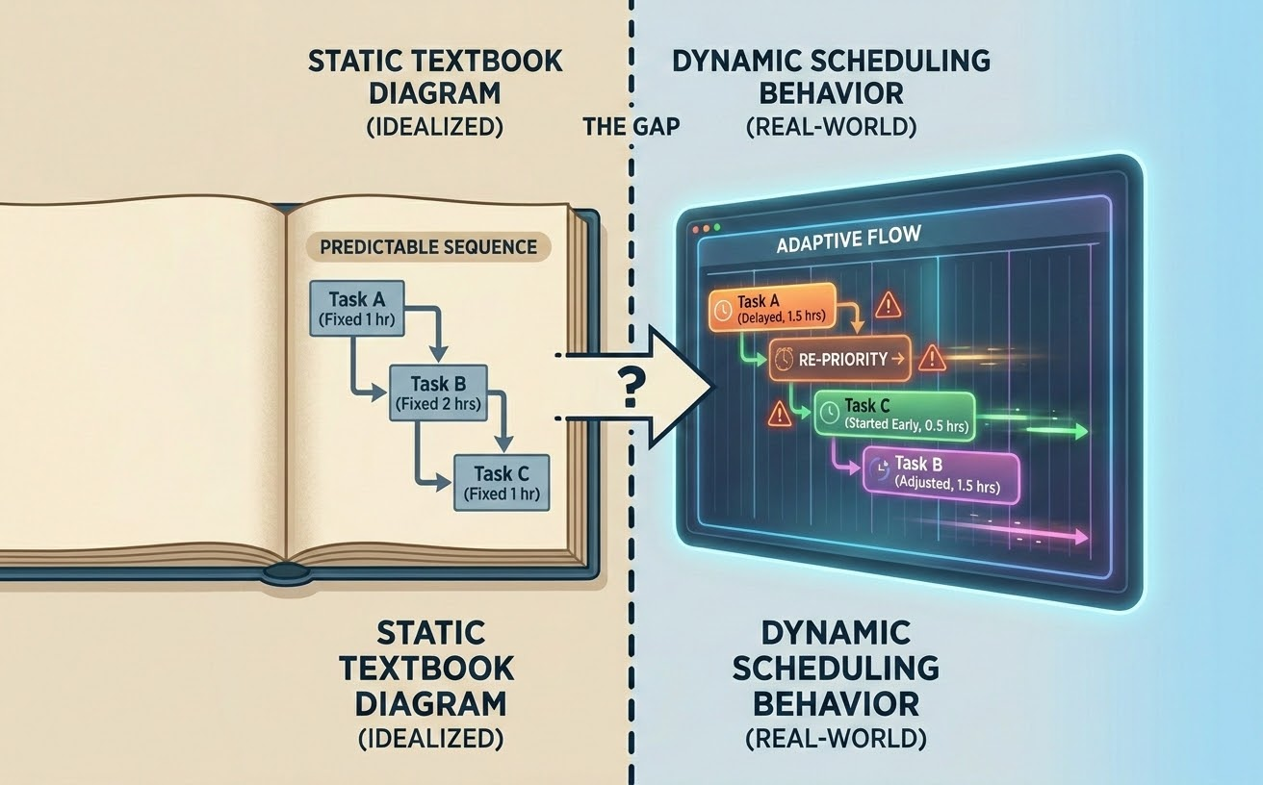
Problem Statement
Scheduling algorithms are highly dynamic and time-dependent. Traditional textbooks use static diagrams which fail to show real-time changes such as ready queue updates and preemption. Students struggle to visualise context switching and algorithm performance comparisons.
Dynamic Nature
Static Limitations
Visualisation Gap
Scheduling algorithms are highly dynamic and time-dependent
Textbooks use static diagrams which fail to show real-time changes (e.g., ready queue updates, preemption)
Students struggle to visualise context switching and algorithm performance comparisons

Slide 4

Solution
We propose a fully interactive, client-side web application that brings scheduling algorithms to life with real-time animated Gantt charts and provides step-by-step plain-English explanations for every tick of the CPU.
Interactive Web App
Animated Gantt Charts
Plain-English Explanations
A fully interactive, client-side web application
Brings algorithms to life with real-time animated Gantt charts
Provides step-by-step plain-English explanations for every tick of the CPU

Slide 5
Core Algorithms Simulated
The simulator implements five classic CPU scheduling algorithms, covering both preemptive and non-preemptive strategies.
FCFS
SJF
SRTF
First Come, First Served
Shortest Job First (Non-Preemptive)
Shortest Remaining Time First (Preemptive)
Priority
RR
Priority Scheduling (Non-Preemptive)
Round Robin (Preemptive with Time Quantum)

Slide 6
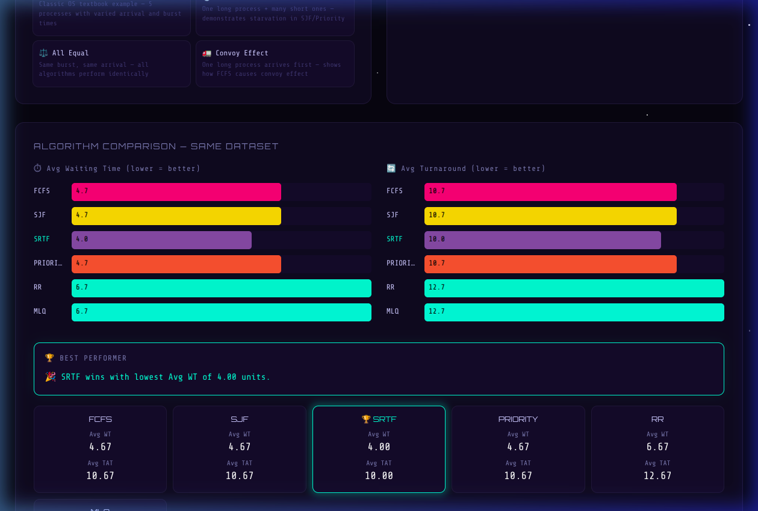
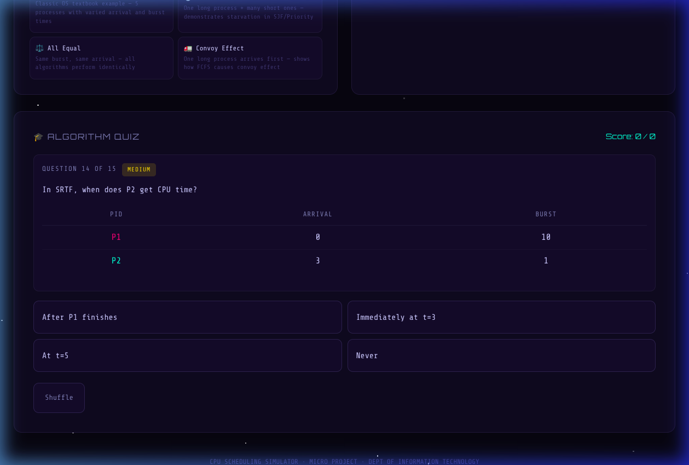
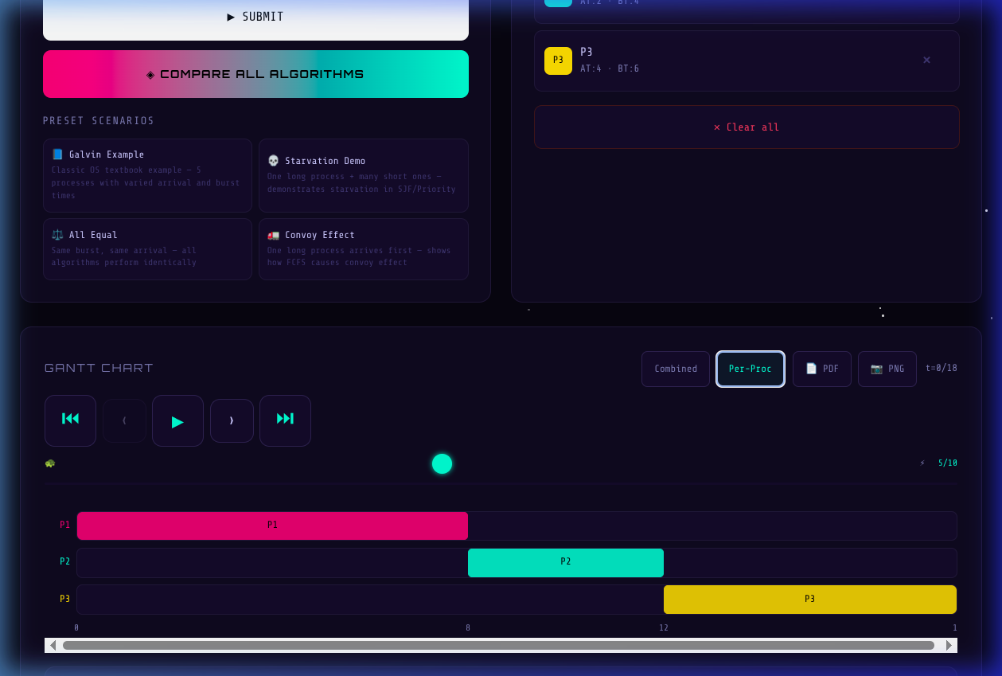
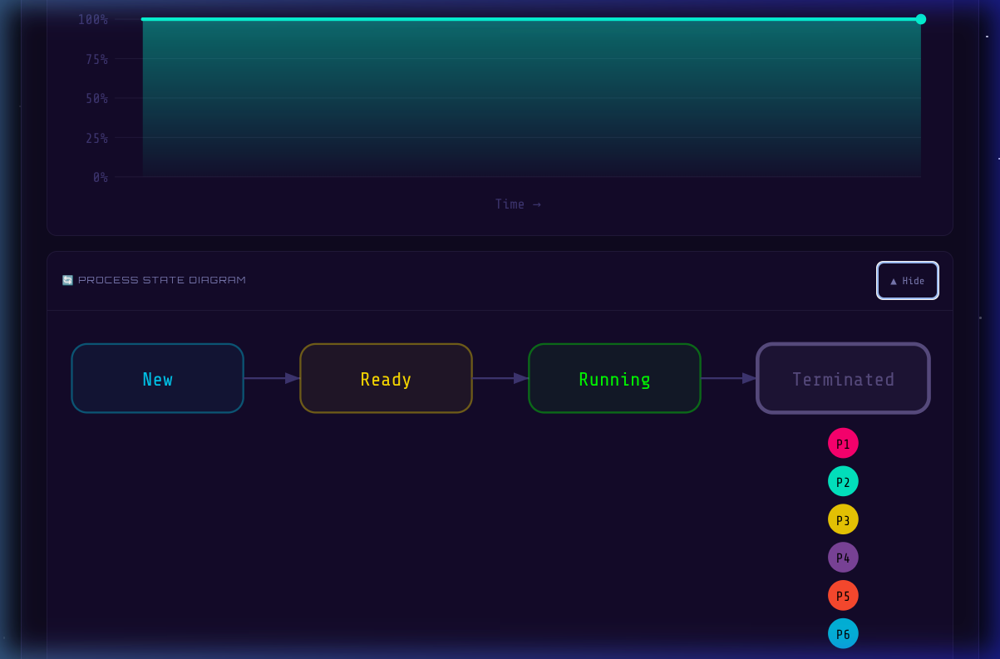
Key Features of the Simulator
Animated Gantt Charts
Combined & Per-Process Views
Performance Dashboard
WT, TAT, CPU Utilisation, Throughput
Tick-by-Tick Explanation Engine
"Compare All Algorithms" Analytics
Interactive Built-in Quiz Module

Slide 7
System Architecture & Tech Stack
The simulator is built with a modern, lightweight technology stack ensuring fast performance and a smooth user experience with zero server latency.
Frontend
Build Tool
React.js (v18+)
Vite (for fast HMR and optimised builds)
Styling
Architecture
Custom Vanilla CSS (with CSS variables for theming)
100% Client-side (No backend = zero latency)

Slide 8
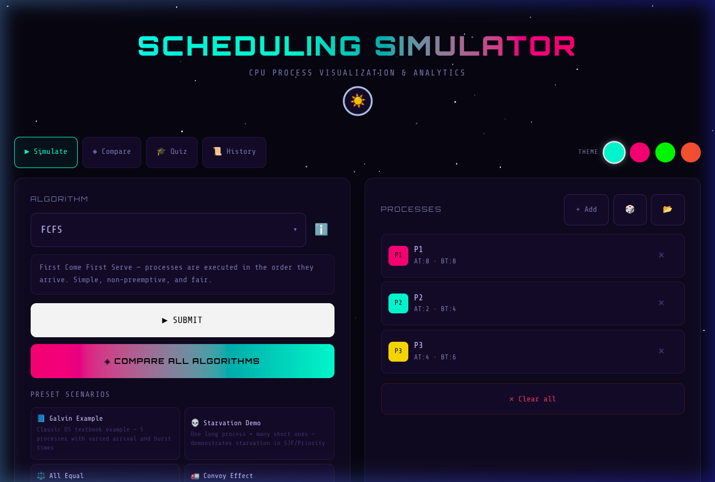
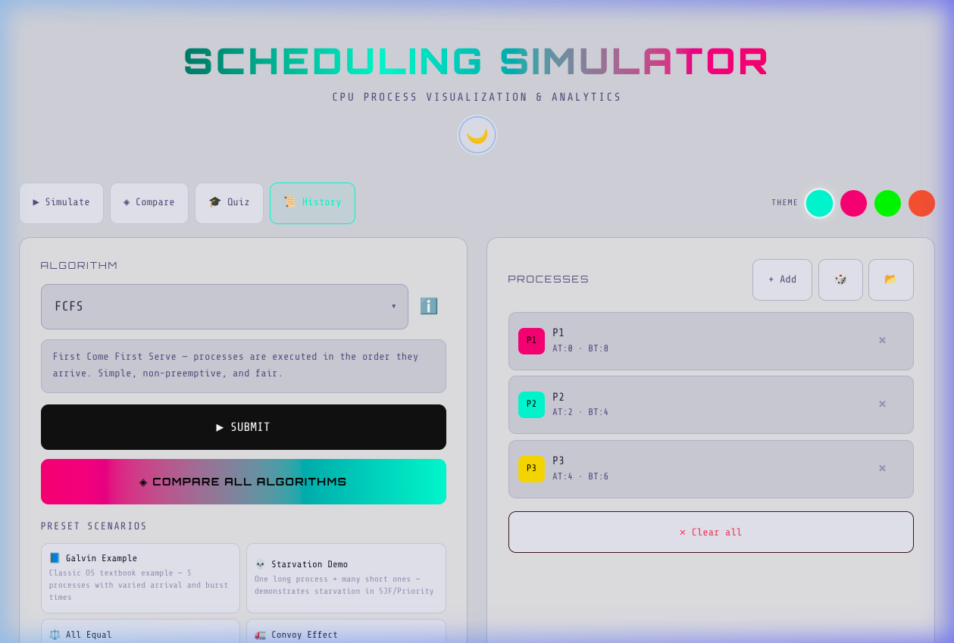
User Interface & Dark/Light Mode
The simulator features a modern, responsive UI with full Dark and Light mode support, allowing users to choose their preferred viewing experience.
📸 Light Mode Screenshot
Insert screenshot: screenshots/10_light_mode.png here.

Slide 9
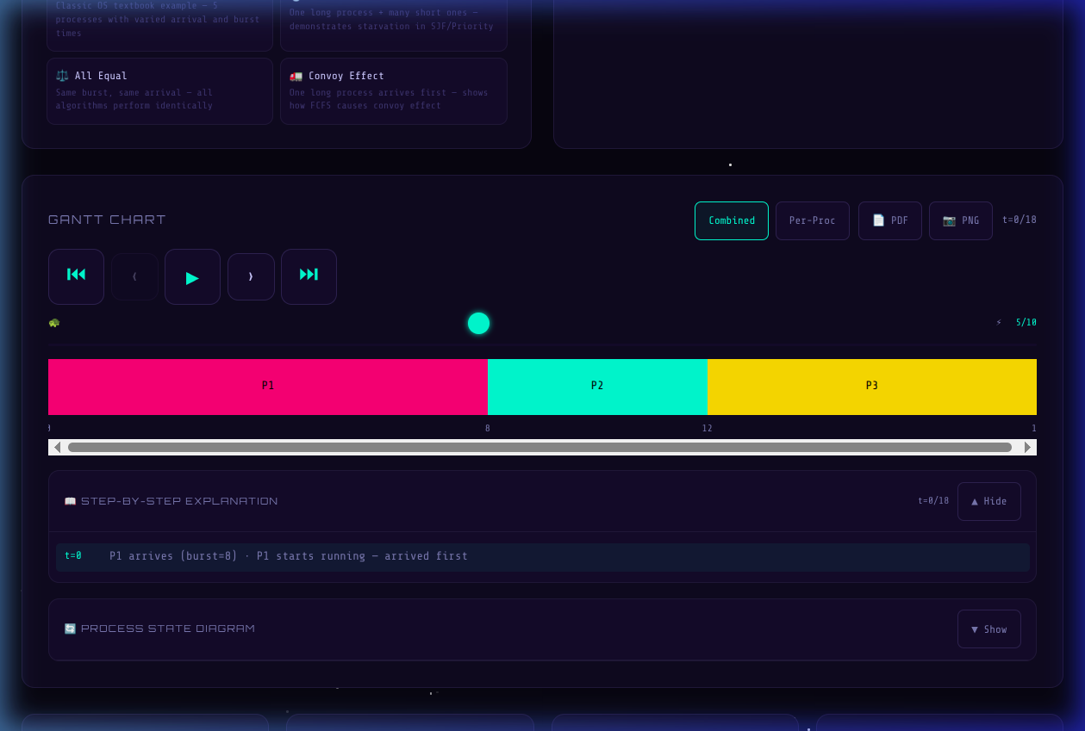
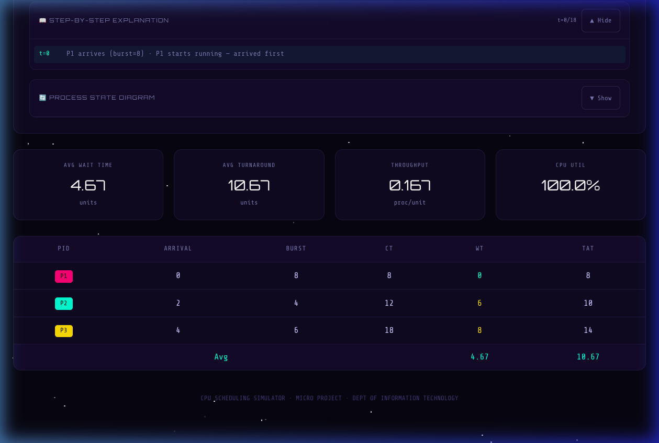
Real-time Visualisation
The animated Gantt chart updates in real time, showing exactly which process is running at each CPU tick, alongside a detailed performance statistics table.
📸 Gantt Chart Screenshot
📸 Stats Table Screenshot
Insert screenshot: screenshots/03_gantt_chart_dark.png here.
Insert screenshot: screenshots/04_stats_table.png here.

Slide 10
Comparative Analytics
The "Compare All Algorithms" feature allows students to instantly see how different scheduling strategies perform on the same set of processes, making it easy to understand trade-offs in Waiting Time, Turnaround Time, and CPU Utilisation.

Slide 11
Conclusion
This project successfully bridges the gap between theoretical textbook concepts and practical understanding of CPU scheduling through an engaging, interactive web application.
✅ Accurate Tool
🔗 Bridged the Gap
🎨 Modern UI
Successfully created a mathematically accurate OS educational tool
Bridged the gap between theoretical textbook concepts and practical understanding
Delivered a modern, engaging UI to enhance technical learning

Slide 12
Future Enhancements
The following features are planned to extend the simulator's capabilities and make it a more comprehensive tool for studying CPU scheduling algorithms.
1
2
Multilevel Feedback Queue (MLFQ)
Preemptive Priority Scheduling
Implement MLFQ scheduling to dynamically adjust process priorities based on execution history.
Add support for preemptive priority-based scheduling where higher-priority processes interrupt lower-priority ones.
3
4
Context Switch Time Penalties
Export Results to PDF/CSV
Include context switch overhead (Δt) to simulate real-world CPU behaviour more accurately.
Enable users to export scheduling results and performance metrics for assignments and reports.

Slide 13
Thank You!

