Slide 1

SUICIDE BOMBER
AAKASH CHAUHAN
B. Tech
Branch - (CSE) with specialization in Internet of Things & Cyber Security including Blockchain Technology

Slide 2
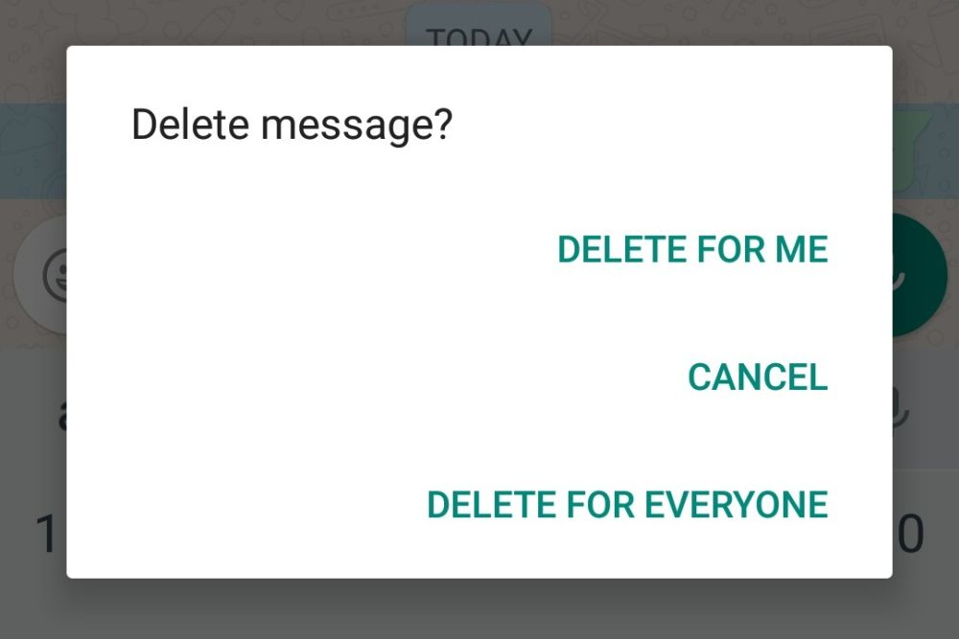



Slide 3




WHAT IS SUICIDE BOMBER ??
z
In Simple Words
It is a python program.
It delete files and folders of local directory.
Python is a general-purpose programming language

Slide 4

z
DEMO
This Photo by Unknown author is licensed under CC BY-SA-NC.

Slide 5
What I Learned
Different Commands like del(delete) and rm(remove).
How to get path of any file.

Slide 6
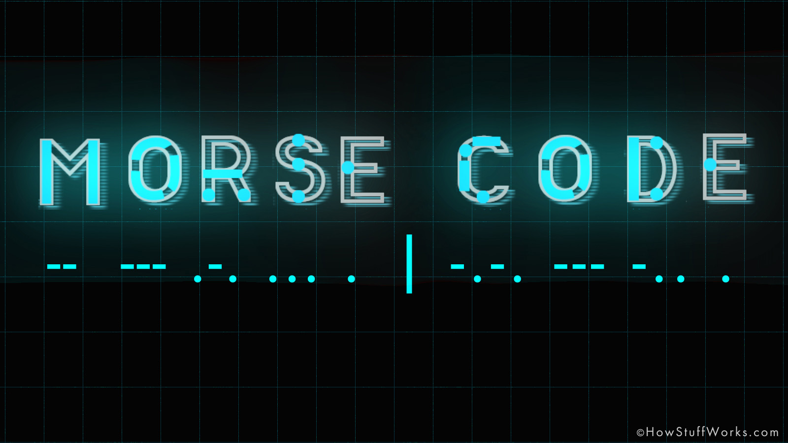
DEMONSTRATION ON MORSE CODE
z

Slide 7

What Is Morse Code ??
z
An alphabet or code in which letters are represented by combinations of long and short light or sound signals.
Nowadays, Morse code is used to a limited extent by amateur radio operators, landline telegraphers, and military radio operators.

Slide 8

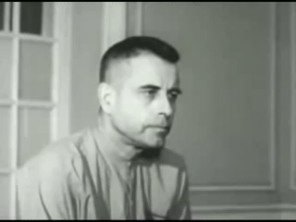
Admiral Jeremiah Denton Jr.
z

Slide 9
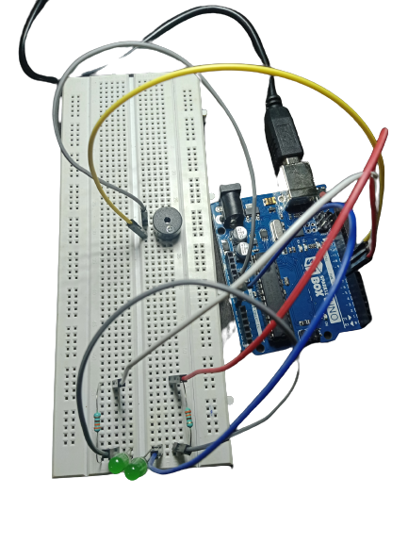

Slide 10
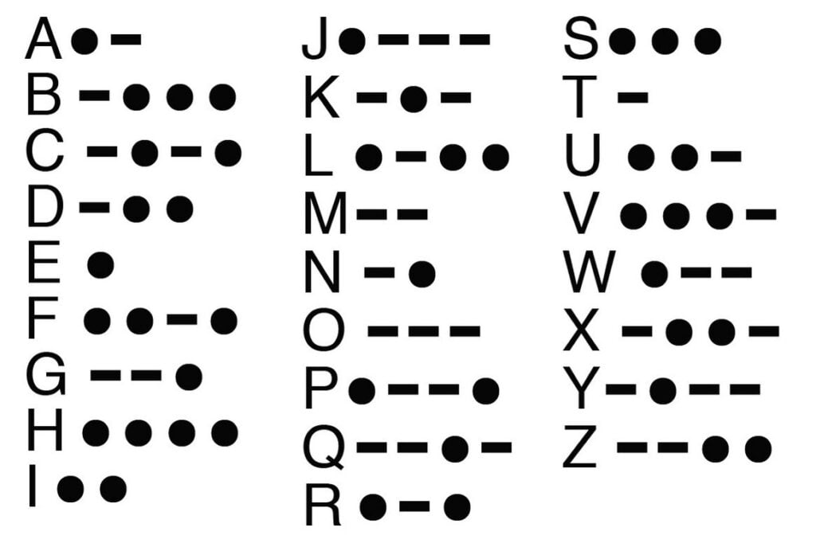

Slide 11
What I Learned
z
Morse Code.
Input strings in Arduino.
Tone in buzzer.
Troubleshooting.

