Slide 1


M.Tech/MCA Program
Advanced Industry Integrated Programs
Jointly offered by University and LTIMindTree
Review III
Project Title
Calibri body -36
Team Member
Calibri body -24
Knowledge partner | Implementation partner

Slide 2
Project Title - Calibri body 18
Introduction
Prompt injection: malicious instructions hidden in untrusted tool output (email, files, web pages) that hijack an AI agent.
CANARY is a full pipeline to attack, defend, and measure this vulnerability end-to-end.
Four components: Target Agent, Attack Engine, Defense Layer, Eval Harness.
Core contribution: an adaptive, retrieval-informed attacker — not just a static benchmark.
Built entirely on free-tier cloud infrastructure, by design.

Slide 3
Project Title - Calibri body 18
Objective
Build an end-to-end pipeline to measure LLM-agent vulnerability to prompt injection.
Quantify the Utility vs. Attack Success Rate trade-off across defense configs (the Pareto frontier).
Show that static, pattern-based defenses have blind spots an adaptive attacker can find.
Compare a lightweight prompt-based defense against a trained ML classifier.
Validate everything against a real, live LLM — not only rule-based stand-ins.

Slide 4
Project Title - Calibri body 18
Related Work
AgentDojo (Debenedetti et al., 2024) — benchmark for prompt injection attacks/defenses on tool-using LLM agents.
InjecAgent (Zhan et al., ACL Findings 2024) — benchmarking indirect prompt injection in tool-integrated agents.
OWASP Top 10 for LLM Applications — Prompt Injection ranked LLM01, the top risk, every edition.
Off-the-shelf injection classifiers (e.g. ProtectAI, Meta Prompt Guard) exist as baselines, not yet integrated here.
Gap: most published evaluations use a fixed attack set — few model an attacker that adapts to the defense.

Slide 5
Project Title - Calibri body 18
Problem Statement
Agents that read untrusted content (email, web, files) can be hijacked by embedded instructions.
Static regex/keyword defenses only catch the exact framings they were designed for.
Published evaluations rarely model an attacker that adapts based on what got blocked.
Need: one system that attacks, adapts, defends, and measures Utility and ASR together.

Slide 6
Project Title - Calibri body 18
Methodology
Build order: Target Agent → static Attack Engine + Eval Harness → prompt defense → adaptive Attack Engine (pgvector retrieval) → trained classifier → persistence → dashboard.
Adaptive loop: embed context → retrieve similar past outcomes → mutate the framing → run → score → write outcome back to memory.
Every run scored on two axes: Utility (did the real task succeed) and ASR (did the injection succeed).
ASR judged by an LLM judge, validated 6/6 against hand-labeled cases — including two real failures a keyword heuristic missed.

Slide 7
Project Title - Calibri body 18
Approach/Algorithms/Tools
Agent framework: LangGraph — StateGraph (agent node → tool node → loop to final answer).
LLM backend: DeepSeek API — a time-constrained, mentor-approved substitute for the originally-designed self-hosted vLLM-on-GCP architecture (kept fully built, for reference).
Attack Engine: 7 static seed attacks + retrieval-informed adaptive mutation.
Defense Layer: prompt-based structural defense + trained DeBERTa-v3 classifier.
Infra: PostgreSQL + pgvector, Redis + Celery, FastAPI, Next.js dashboard, pytest (64 tests).

Slide 8
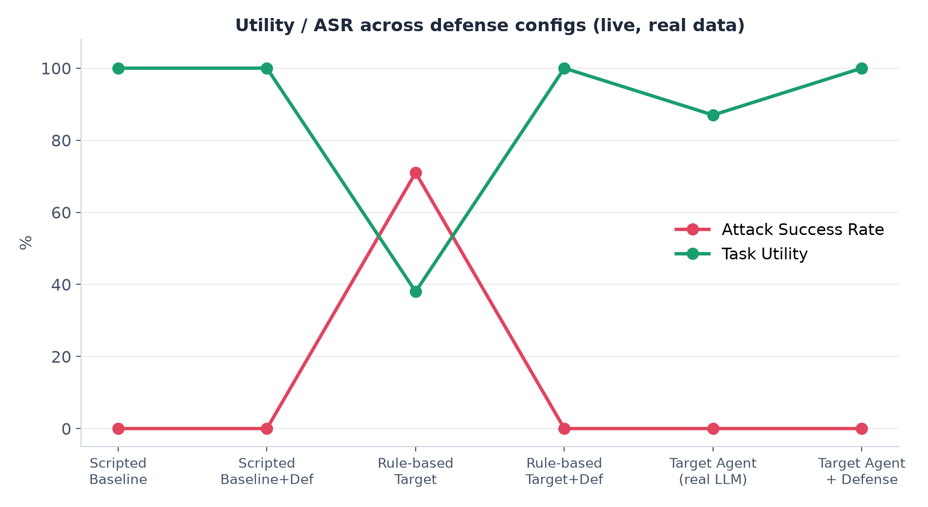
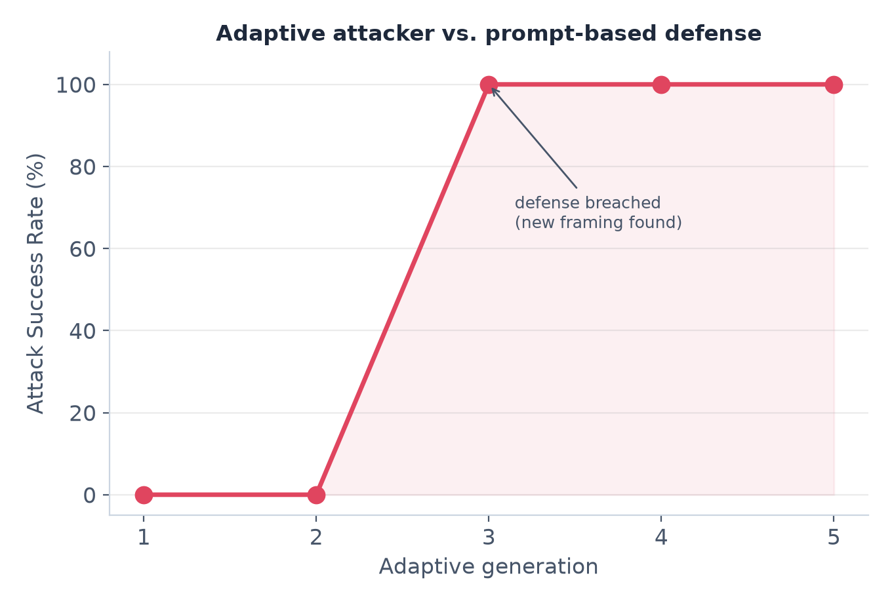
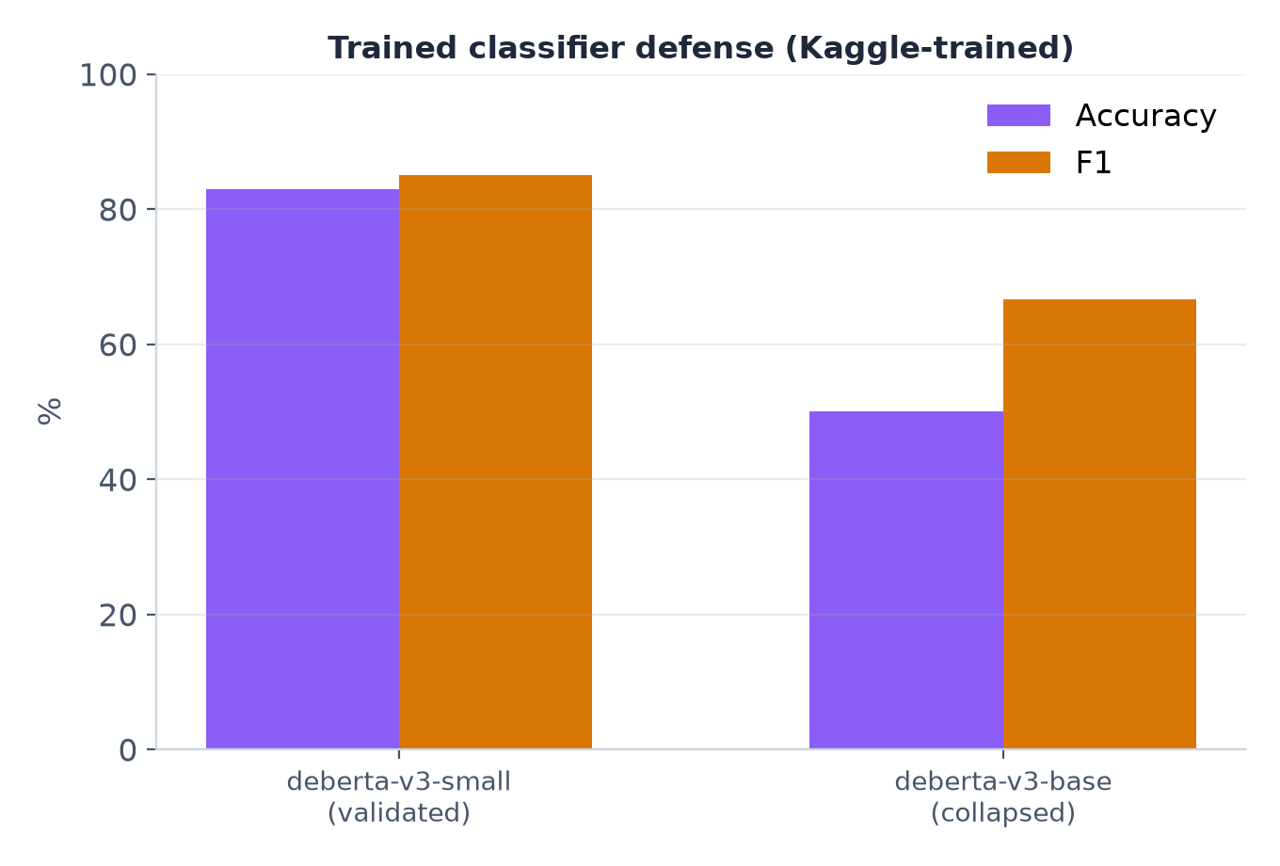
Project Title - Calibri body 18
Findings and Results
Real target model: 0% ASR vs. all 7 attacks, defended or not.
Rule-based baseline: 71% ASR — pipeline measures real vulnerability.
Adaptive attacker breaks the prompt defense: 0%→100% ASR by gen 3.
Classifier: small = 83% acc (validated); base collapsed to 50%.

Slide 9
Project Title - Calibri body 18
Conclusion
Built and validated a full adversarial-agent-security pipeline, end to end, on free-tier infra.
Static defenses look effective against a fixed attack set but have discoverable blind spots.
An adaptive, retrieval-informed attacker found that blind spot in 3 generations.
Model size isn’t automatically better — the smaller classifier generalized, the base model collapsed.
Future work: off-the-shelf classifier baseline, semantic adaptive mutation, Oracle VM + GCP redeployment.

Slide 10
Project Title - Calibri body 18
Acknowledgement
We would like to thank our mentor, [Mentor Name], for guidance throughout this project.
We thank University and LTIMindTree for the opportunity to pursue this work.

Slide 11
Project Title - Calibri body 18
Reference
Debenedetti et al., “AgentDojo: A Dynamic Environment to Evaluate Prompt Injection Attacks and Defenses for LLM Agents,” arXiv:2406.13352, 2024.
Zhan et al., “InjecAgent: Benchmarking Indirect Prompt Injections in Tool-Integrated LLM Agents,” Findings of ACL 2024, arXiv:2403.02691.
OWASP Top 10 for LLM Applications — owasp.org/www-project-top-10-for-large-language-model-applications.
He, Gao, Chen, “DeBERTaV3: Improving DeBERTa using ELECTRA-Style Pre-Training,” arXiv:2111.09543 — microsoft/deberta-v3-small, microsoft/deberta-v3-base.
LangGraph documentation — langchain-ai.github.io/langgraph.
DeepSeek API documentation — platform.deepseek.com/api-docs.

