Slide 1


Pose detection using Yolov8 :
A Custom Deep learning model
2025

Slide 2
Objective
1) To train a pose detection model using the YOLOv8 framework on a custom dataset annotated with human body keypoints.
2) To accurately detect and estimate human poses in images, videos, and real-time streams.
3) To enable practical applications such as fitness tracking, motion analysis, and gesture recognition.

Slide 3
Literature review
Model/Study | Key Contributions | Dataset(s) Used | Performance Highlights
Ultralytics YOLOv8 | Versatile framework for detection, segmentation | COCO | Real-time performance with varying model sizes
YOLO-Pose | Heatmap-free , end-to-end multi-person pose estimation | COCO | Achieved 90.3% AP50 without test-time augmentation
KSL-POSE | Integration of KANs and SOEP for small object detection | MS COCO 2017 | 1.5% increase in average detection accuracy
HP-YOLO | Lightweight model with high accuracy | COCO validation set | Outperformed other lightweight models in accuracy and efficiency
Modified YOLOv8 | Incorporation of CCAM and SACS for enhanced feature extraction | COCO | Improved accuracy in complex environments

Slide 4
Methodology on how pose detection works:
[Live Webcam / image Input/Video input]
↓
Backbone CNN
(Feature Extraction)
↓
YOLOv8 Pose model
↓
Detects Keypoints + Skeleton Visualization(17 Keypoints)
↓
Analysis/Angle Calculation (e.g., T-pose Detection)]

Slide 5
What Happens in YOLOv8’s CNN
Convolution layers extract features like edges, shapes, and body parts from input images.
Backbone CNN downsamples image size while keeping important pose-related features.
Neck and Head layers detect keypoints and output coordinates with confidence scores

Slide 6
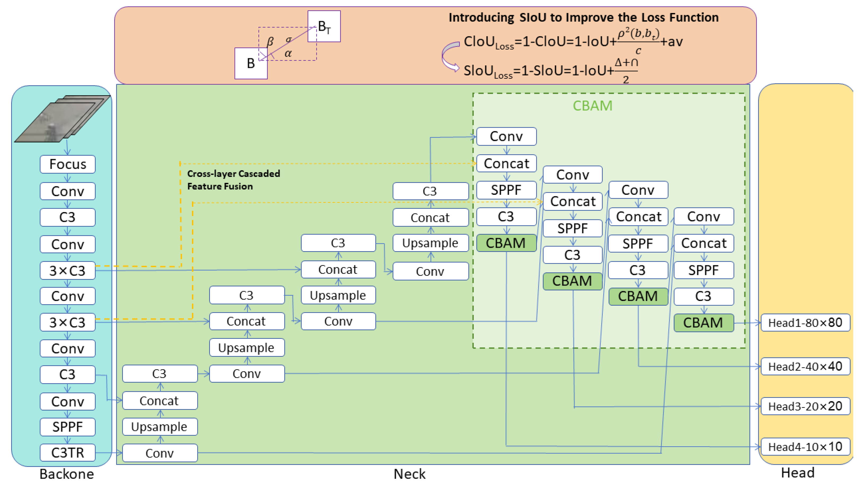
YOLOv8 Architecture – The 3 Main Blocks
YOLOv8-Pose has three core components:
1. Backbone
2. Neck
3. Head

Slide 7
1.Backbone — Feature Extractor
Goal: Extract low-level and high-level visual features from the input image.
Input: Image (e.g., 640x640 pixels)
Output: Feature maps (encoded visual information)
Layer | Purpose
Focus | Splits the image into patches and increases channel depth, making processing more efficient.
Conv (Convolution) | Extracts basic features like edges, colors, and textures from the input.
C3 / C3TR | Stacked convolutional layers with residual connections (C3) and optional transformer attention (C3TR) for deep feature learning.
Downsampling | Reduces the spatial size of feature maps to focus on high-level, meaningful features and reduce computation.
SPPF (Spatial Pyramid Pooling - Fast) | Merges features at different scales to improve detection of objects (or keypoints) of varying sizes.

Slide 8
2. Neck — Feature Fusion Layer
Goal: Merge features from different layers to improve detection at multiple scales (small, medium, large people).
Based on: PANet (Path Aggregation Network)
Layer | Purpose
Upsample | Enlarges small feature maps to match the size of larger ones
Concat | Combines multiple feature maps into one
C3 | Performs convolutional operations to extract hierarchical features
CBAM (Attention) | Enhances feature representation by applying attention mechanisms
SPPF (Pooling) | Pools feature maps to capture multi-scale spatial information

Slide 9
Head — Prediction Layer
Goal: Predict bounding boxes, class labels, and keypoints (x, y, confidence) for each person detected.
Output of Head: at each head prediction keypoint at various scales.
Prediction | Description
Bounding Box | [x1, y1, x2, y2] — corners of person
Confidence Score | Probability that it’s actually a person
Keypoints | 17 keypoints (x, y, and confidence) for body joints
Layer Name | Output Size | Description
Head1 | 80×80 | High-resolution head for detecting small-scale or fine-grained features.
Head2 | 40×40 | Medium-resolution head for mid-sized objects or details.
Head3 | 20×20 | Low-resolution head suited for larger structures or coarse features.
Head4 | 10×10 | Lowest-resolution head, best for capturing overall context or very large objects.

Slide 10
:
implementation:
This Project Uses Coco Dataset with a massive amount of images of people for training keypoint detection
First we took 900 images and annotated images for human with 17 keypoints supported by yolov8 format. And added it to training set, and took 100 for testing set from coco Dataset
As we took yoloV8 a pre-built CNN model and Modified the architecture of YOLOV8 to work with custom datasets
It consist of thirteen convolution blocks designed to extract image features at multiple levels (backbone + neck + head).
Backbone Stage : Extract low-level and high-level features,Stabilize the weight distributions, SPPF block aggregates multi-scale context.
Conv layers with reduce resolution progressively.(.ie from 640x640 → 320x320 → 160x160 → 80x80 → 40x40 → 20x20).

Slide 11
:
implementation:
The model was trained with 100 epochs with early stopping enabled to avoid overfitting.
The training was monitored by tracking accuracy and loss for both training and validation sets during each epoch.
Final result: The model detects with 84% Accurately. And 37ms/image with our computation – real time friendly
Now the system is ready to detect Keypoint detection ,now we and directly upload image/video and get result of a skeletal image over the body.
This does corrections for exercise form by accurately tracking keypoints and analyzing body alignment.
And it use is in variable forms and Can be extended to count exercise repetitions (e.g., squats, push-ups)

Slide 12
Mapping at Training:
CNN layers extract features
Predict key points
Training Image
↓
↓
↓
Compare with labels
↓
Calculate loss
Adjust weights
↓

Slide 13
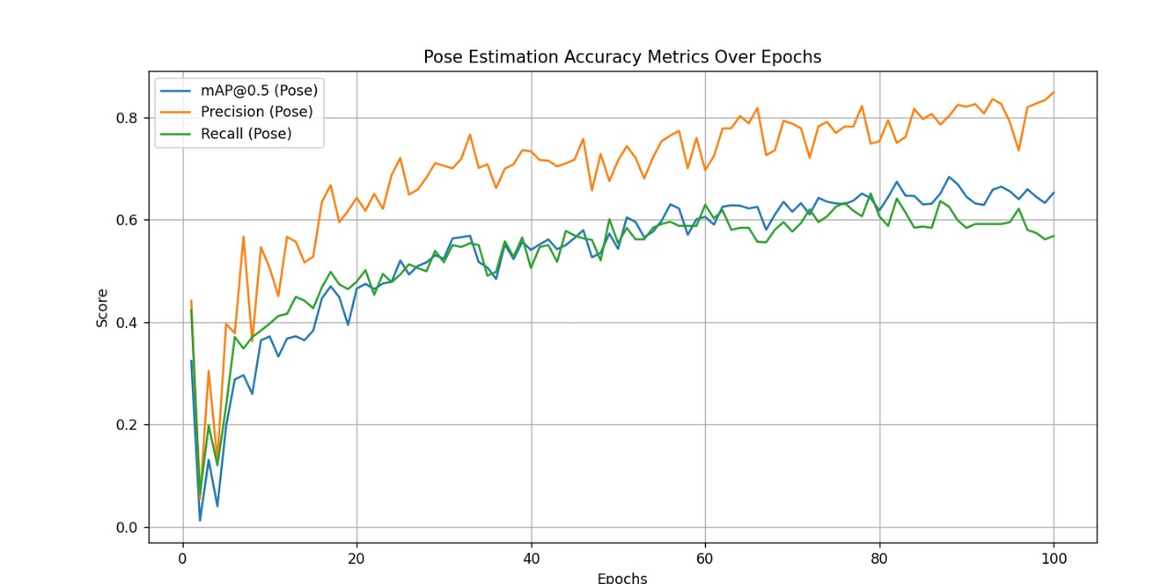
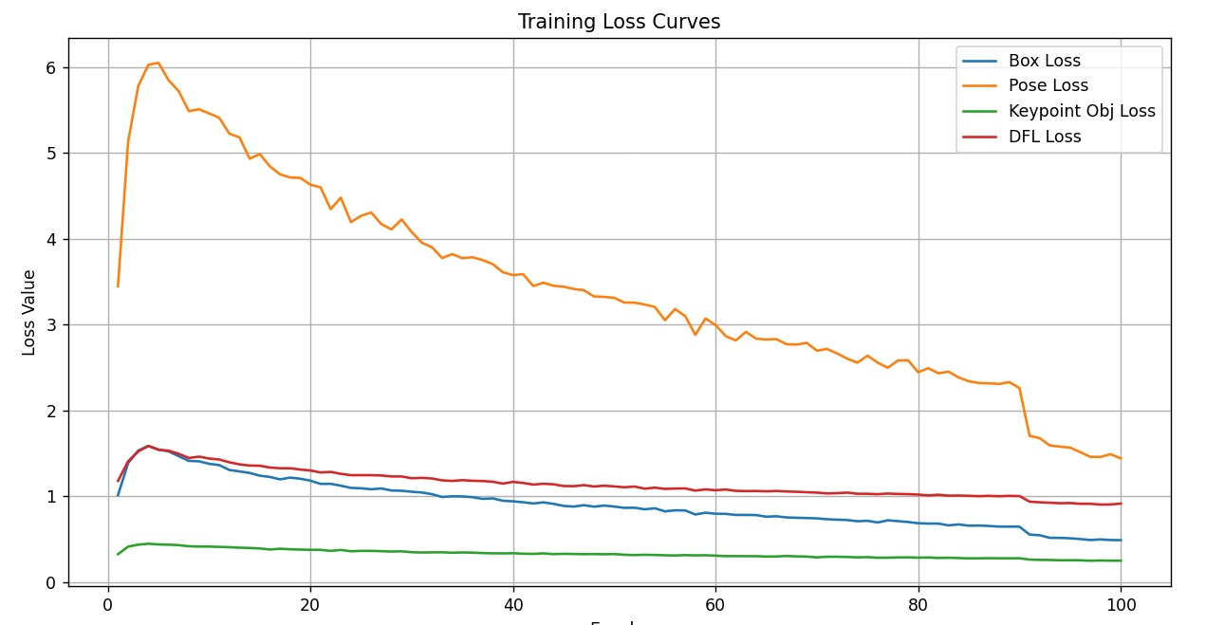
Results and analysis:
=> accuracy is of 84%
Is high enough to return key points
=> loss is of 0.2510, The prediction are near the ground truth. The loss is less.

Slide 14
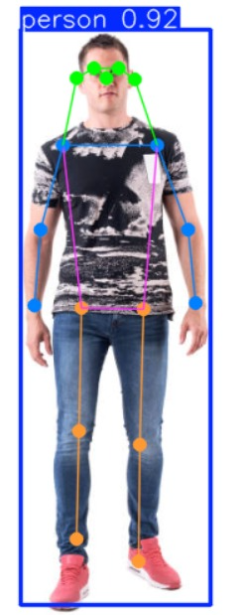
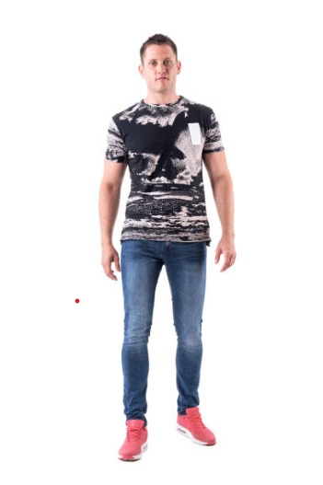
Results of key point detection
→
Identifying a region of interest (ROI).
Cutting the image into a bounding box.
Detecting key points and overlaying them on the subject.

Slide 15
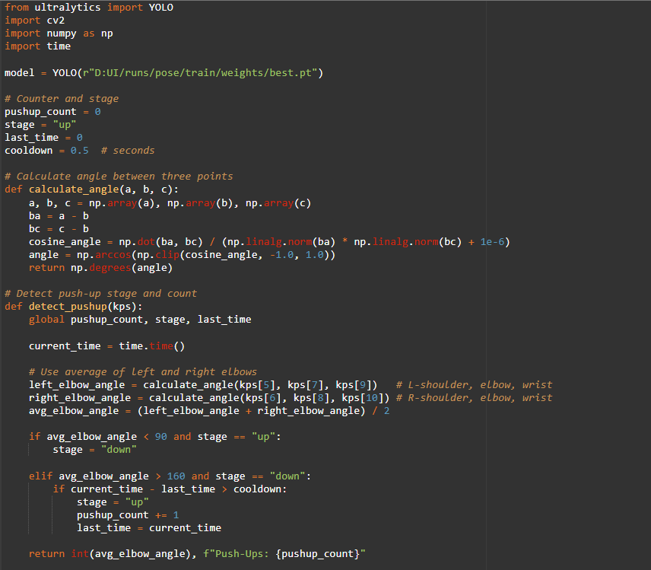
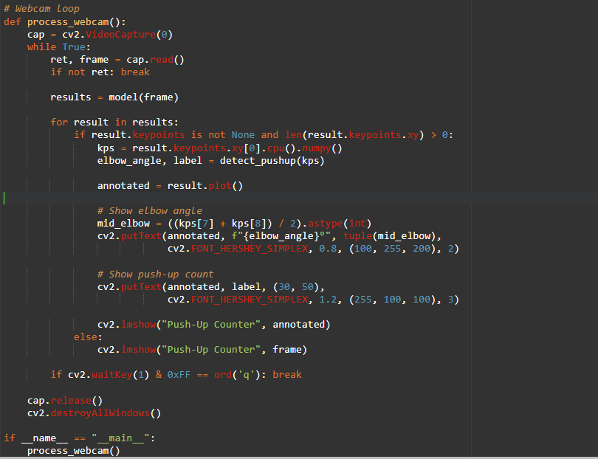
Pose detection : Pushups counter
Code to Count pushups form the recognised skeletal structure (key points)

Slide 16
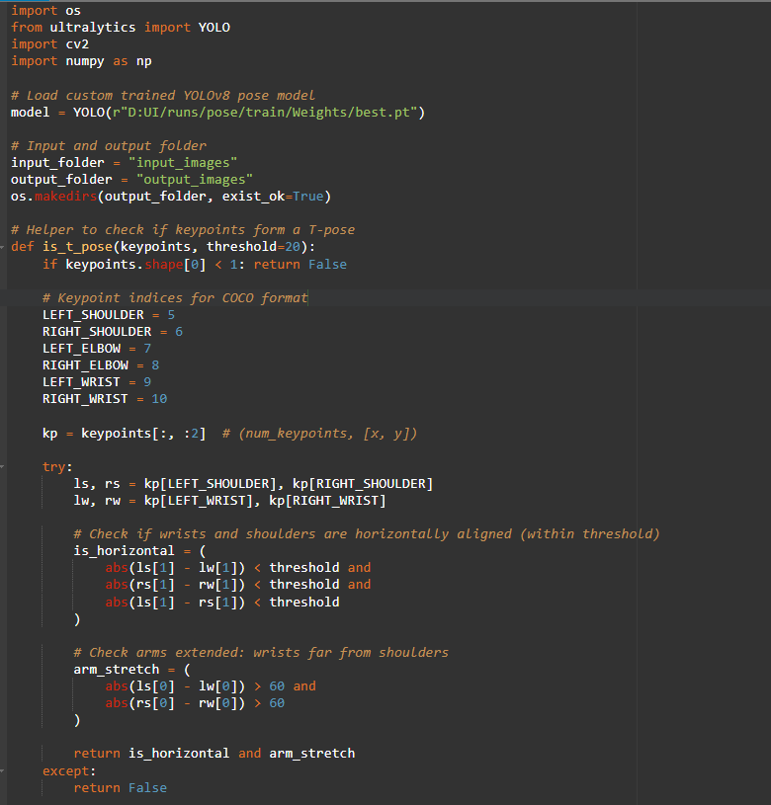
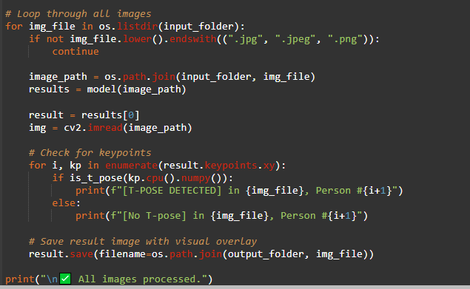
Pose detection : T-pose
Code to determine t-pose form the recognised skeletal structure (key points)

Slide 17
Future work :
Fitness Tracking: Accurate pose detection for real-time workout feedback in gyms.
Gaming: Seamless motion tracking for immersive AR/VR gaming.
Sports Analysis: High-precision pose estimation to enhance athletic performance.

Slide 18
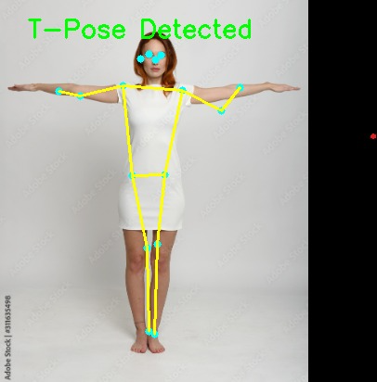
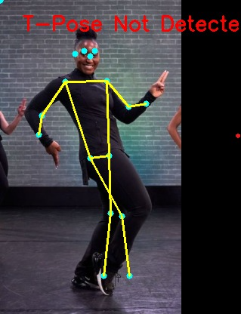
Output and result of pose detection:
After correctly mapping the skeletal structure it gave accurate results of pose detection.

Slide 19
Conclusion:
Our pose detection system successfully tracks human keypoints and demonstrates effective performance in recognizing body posture. However, to ensure reliable deployment in real-world applications, the model requires further improvement in accuracy and robustness across diverse conditions. Continued training with a larger and more varied dataset, along with fine-tuning the model, will be essential for achieving deployment-ready precision.

