Slide 1
Pose Detection using
Deep Learning
3D-image and video Pose detection
Team members
cb.sc.uaie24101 - G.S Aakash
cb.sc.uaie24141 - Neeraj
cb.sc.uaie24142 - K.Nithin
cb.sc.uaie24146 - Puneeth

Slide 2
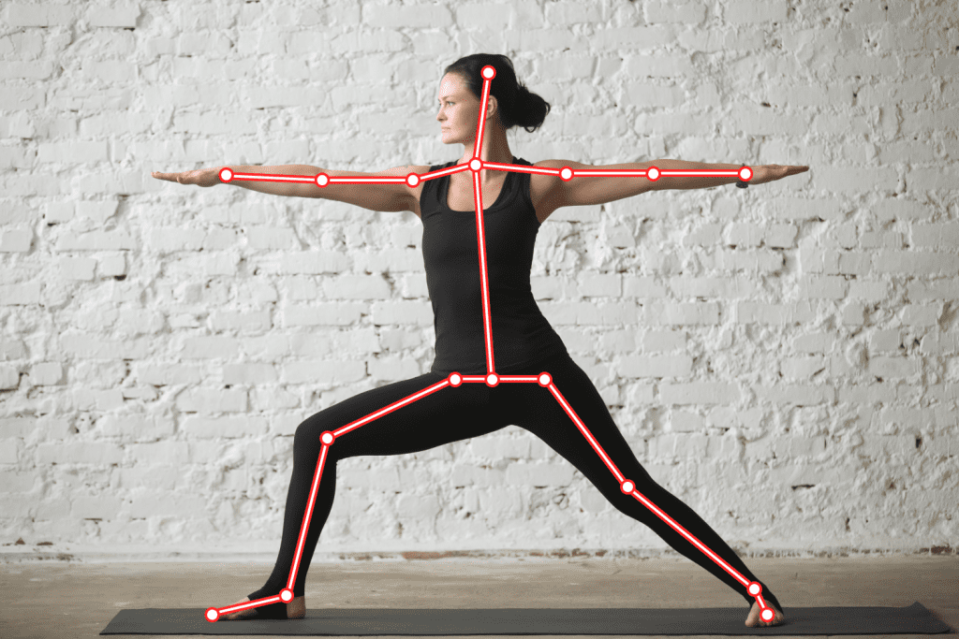
Introduction
This Project focuses on recognizing and analyzing human body movements and postures using computer vision techniques. By identifying the positions of key points, such as joints (e.g., wrists, elbows, knees), pose detection enables machines to interpret human actions, gestures, and poses in real time or from still
images.

Slide 3
Literature Review
S. No | Paper Name | Methodology | Contribution | Year
1 | Deep Pose: Human Pose Estimation via Deep Neural Networks | Utilized deep neural networks to treat pose estimation as a regression problem. | First method to apply CNNs for pose estimation, achieving better accuracy than traditional methods. | 2014
2 | Open Pose: Real time Multi-Person 2D Pose Estimation Using Part Affinity Fields | Used Part Affinity Fields to associate body parts across multiple people in images. | Enabled real-time multi-person pose detection in crowded environments. | 2018
3 | High-Resolution Representations for Human Pose Estimation | Maintained high-resolution feature maps throughout the network for precise keypoint detection. | Improved accuracy for occluded body parts and complex poses. | 2019

Slide 4
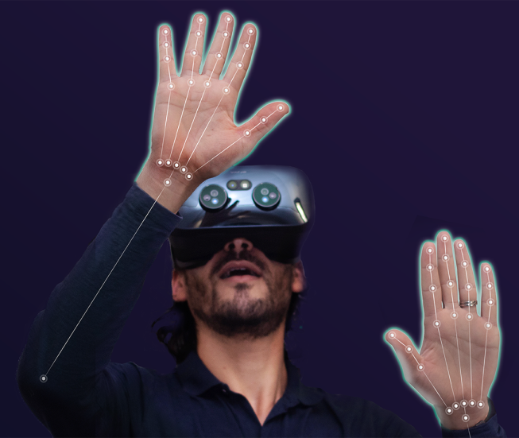
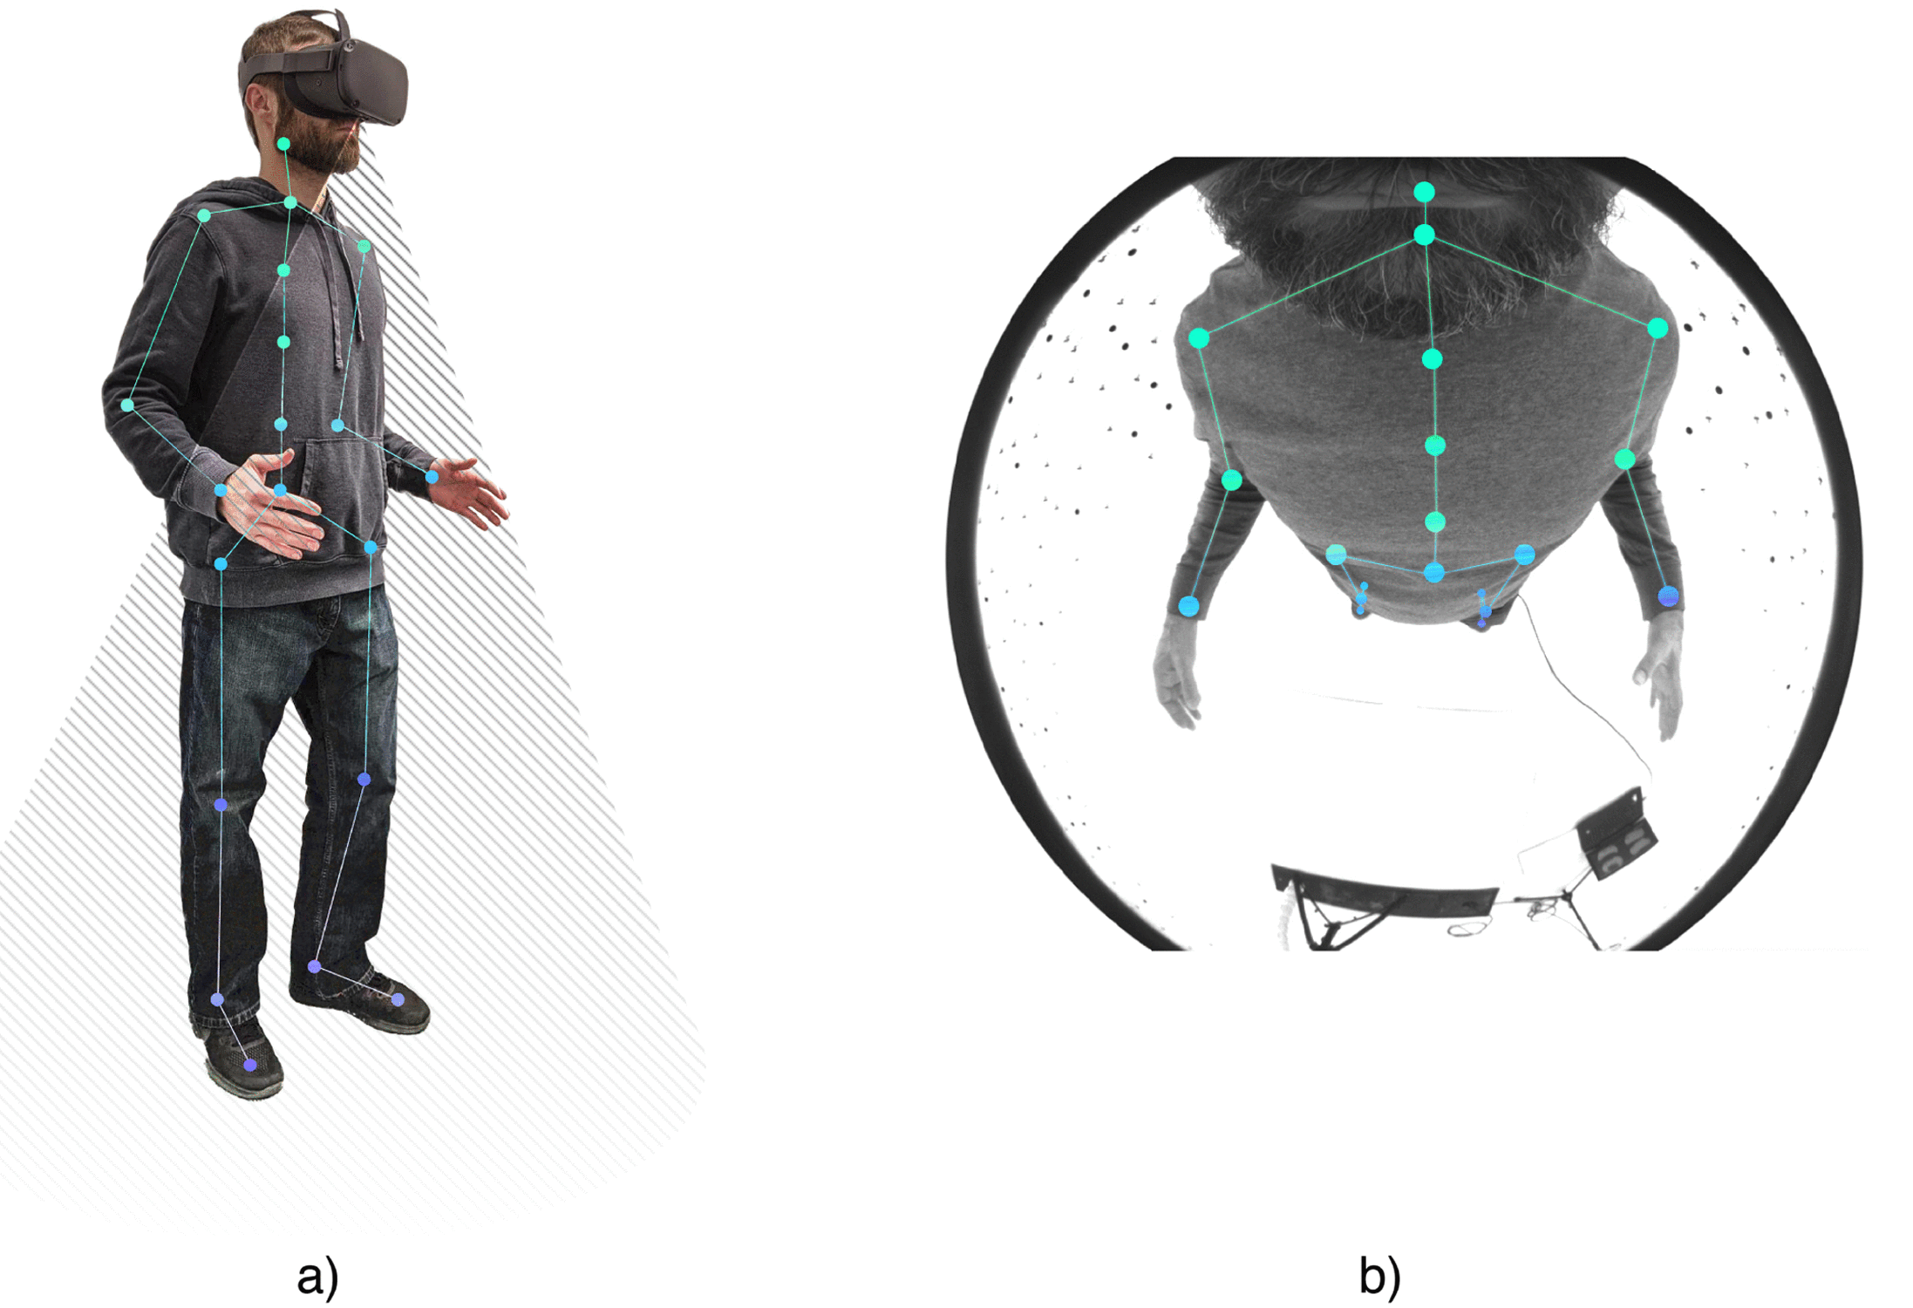
Application :
➢ Applications of Pose Detection:
◉ Fitness and Sports: Providing feedback on posture and movement for workouts or sports training.
◉ Healthcare: Assisting in physical therapy and rehabilitation by monitoring body movements.
◉ Gaming and VR: Enhancing immersive experiences by tracking player movements.
◉ Sign Language Recognition: Translating gestures into meaningful commands or text.
◉ Security and Surveillance: Detecting suspicious or unusual activities.

Slide 5
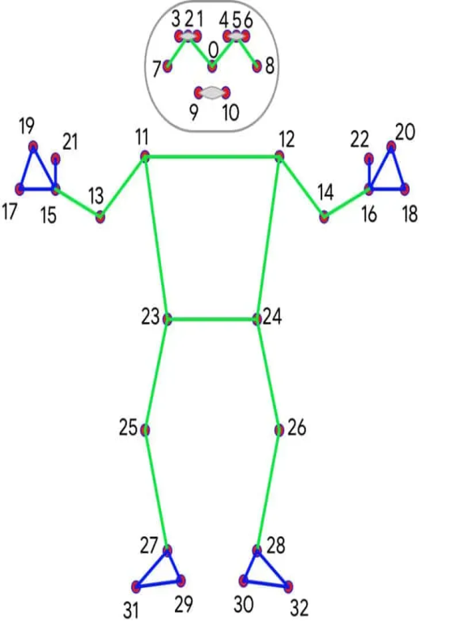
Methodology :
Pose Detection Workflow:
➢ Input Image:
Accepts static images or video frames in RGB format.
Images are resized for better speed and accuracy.
➢ Pre-Processing:
Converts the image to the required format (e.g., normalization, resizing).
Ensures proper scaling and color format (RGB).
➢ Pose Detection:
Uses a lightweight model to locate the human body.
Identifies a rough skeleton within a bounding box (Region of Interest).
➢ Landmark Detection:
Refines the pose by detecting 33 specific Key points (e.g., shoulders, elbows, knees).
Focuses on joints, face, and torso.
➢ Post-Processing:
Normalizes Key point coordinates and smooth's transitions for videos.
Confidence scores are added for accuracy.
➢ Output:
Provides Key point data as (x, y, z) coordinates with confidence scores.
Can overlay results on images for applications like fitness, gestures, or motion analysis.

Slide 6
Maths for computing :
• Linear Algebra in Pose Detection:
➢ Matrix Representation of Images:
Images are stored as 2D matrices where each entry represents pixel intensity.
Operations like scaling, rotation, and translation are applied using matrix transformations.
➢ Dot Product:
Measures the angle between vectors, which is useful for determining limb orientations:
A ⋅ B = |A| |B| cos⁡(θ)
➢ Cross Product:
Computes perpendicular vectors, helping determine the depth or relative 3D orientation:
A x B = |A| |B| sin⁡(θ) n̂

Slide 7

Maths for computing :
• 3D Posing from 2D Images
➢ Homogeneous Coordinates:
Add a third dimension (z-coordinate) to 2D points for projections:
Used to convert 2D Key points into 3D space.
➢ Depth Estimation:
Predicts the z-coordinate (depth) of each Key point using neural networks or stereo vision.

Slide 8
Advantages :
➢ Fosters Innovation
Acts as a foundation for developing advanced systems that integrate AI and machine learning, driving innovation in robotics, autonomous vehicles, and more.
➢ Reduction in Costs
Eliminates the need for expensive hardware (like motion-capture suits) in fields like sports analytics and filmmaking.
.
➢ Improved Efficiency and Accuracy
Real-Time Feedback: Offers instant insights into human movements, enabling quicker decision-making and actions in areas like healthcare, sports, and safety.

Slide 9
• Mediapipe: A cross-platform framework by Google, designed for real-time machine learning applications. It offers pre-trained models for pose detection that are optimized for efficiency and speed. Mediapipe’s Pose module can detect 33 Keypoints in the human body. (Other frameworks: OpenPose, TensorFlow pose estimation models). ➢ Languages used • Python: It used with Mediapipe for prototyping and real-time applications. Python bindings make it easy to integrate with libraries like OpenCV(for camera). ➢ Dataset’s and ITs Limitations : .
Technology and Tools Used:
• COCO (Common Objects in Context): designed of multi purpose pose estimation
-Accuracy may decrease in cases of complex interactions or occlusions (e.g., overlapping people).
• MPII (Max Planck Institute for Informatics: Specializes in single-person pose estimation with high accuracy.
- Focuses only on single-person detection, making it less effective for multi-person scenarios

Slide 10
Timeline :
First Review : (February 1st Week)
Define the problem statement and project objectives.
Conduct a literature review on pose detection techniques.
Analyze existing methods (e.g,OpenPose, Mediapipe).
Select the methodology (Keypoint R-CNN, Mediapipe Pose, or other CNN-based methods).
Second Review: (March)
Implement the pose detection pipeline (pre-processing, ROI extraction, skeleton mapping).
Develop the pose detection model using a chosen framework (e.g., Mediapipe or Keypoint R-CNN).
Test the model on sample datasets (e.g., COCO, MPII).
Third Review: (April 2nd Week)
Fine-tune the model to improve accuracy for challenging conditions (e.g., occlusions, unusual poses).
Implement real-time video processing with pose overlays for applications (e.g., fitness, gesture control).
Evaluate the model's performance on diverse datasets (multi-person detection, sports activities, etc.).

Slide 11
References used:
➢ 3D Human Pose Estimation = 2D Pose Estimation + Matching :
https://openaccess.thecvf.com/content_cvpr_2017/papers/Chen_3D_Human_Pose_CVPR_2017_paper.pdf
➢ OpenPose: Realtime Multi-Person 2D Pose Estimation with OpenCV:
https://arxiv.org/abs/1812.08008
➢ A Review on 3D Human Pose Estimation: Datasets, Methods, and Challenges“ https://link.springer.com/article/10.1007/s10462-024-11019-3

Slide 12
Conclusion:
Pose detection plays a crucial role in analyzing human movements using deep learning and computer vision techniques. By detecting key points of the body, it enables applications in sports, healthcare, gaming, and security. Using frameworks like Mediapipe, it efficiently processes images and videos to provide real-time insights. With mathematical foundations like linear algebra and projection matrices, pose detection enhances accuracy and usability across various domains, making human motion analysis more accessible and effective.

