Slide 1

64
integration tests
against real Postgres and Redis
FLAGFORGE
2,000
teams load-tested
on a single API process, no failures
FORGE YOUR CTF. CHALLENGE YOUR HACKERS.
A platform for creating and hosting Capture The Flag events
4 ms
scoreboard read
from Redis — Postgres never touched
Organizers build events and challenges in the browser. Players form teams and submit flags. The scoreboard rewrites itself on every solve and reaches every spectator over a socket — no polling, no refresh.
Node.js
TypeScript
React 19
Express 5
PostgreSQL
Redis
1
compose file
to self-host the whole stack
Socket.io
Docker
RELEASE 1.0 · 2026
Notes:
FlagForge: a full-stack Capture The Flag platform. Organizers author events and challenges in a browser dashboard; players compete in real time against a scoreboard that is pushed, not polled.

Slide 2
FLAGFORGE
A Platform for Creating and Hosting
Capture The Flag Events
RELEASE 1.0 · 2026
FORGE YOUR CTF.
CHALLENGE YOUR HACKERS.
FlagForge is a full-stack Capture The Flag platform where organizers build events and challenges in the browser and players compete in real time. It keeps the scoreboard honest with dynamic scoring, pushes every change over a socket, and serves the standings from a Redis snapshot that never touches Postgres.
Organizer Dashboard
(events · challenges · files)
Platform Capabilities:
[1] Event authoring – organizer dashboard for events, Markdown challenges, attachments and publish control.
[2] Team play – invite-code teams, shared solves, one team per player per event.
[3] Dynamic scoring – a challenge the whole field clears is worth less; first blood is never devalued.
[4] Live scoreboard – Socket.io push, rank-over-time graph, public to spectators with no account.
Scoring Curve
Auth & Teams
(JWT HS256 · Argon2id)
First blood · solve 1
500 pts, never devalued
Tier 0 · solves 2–6
499 → 484 pts
Flag Check
(HMAC-SHA256 · rate limit)
Tier 1 · solves 7–16
477 → 356 pts
Our Implementation includes:
• Redis sorted-set leaderboard rebuilt by a single Lua script per solve and read with one ZREVRANGE plus one HMGET — 4 ms instead of a full SQL recompute.
• Database-enforced game rules: composite foreign keys and a partial unique index make a duplicate or cross-event solve impossible, even under concurrent submits.
• HMAC-SHA256 flags compared in constant time behind a Redis sliding-window rate limiter — a leaked database alone cracks nothing.
• 64 integration tests run against real Postgres and Redis, plus a measured 2,000-team load test and a one-command Docker deployment.
Scoring & Leaderboard
(Redis sorted set · Lua)
Tier 2 · solves 17–26
336 → 100 pts
Live Scoreboard
(Socket.io · React 19)
Tier 3 · solves 27+
100 pts floor
FlagForge · Forge your CTF. Challenge your hackers.
2

Slide 3
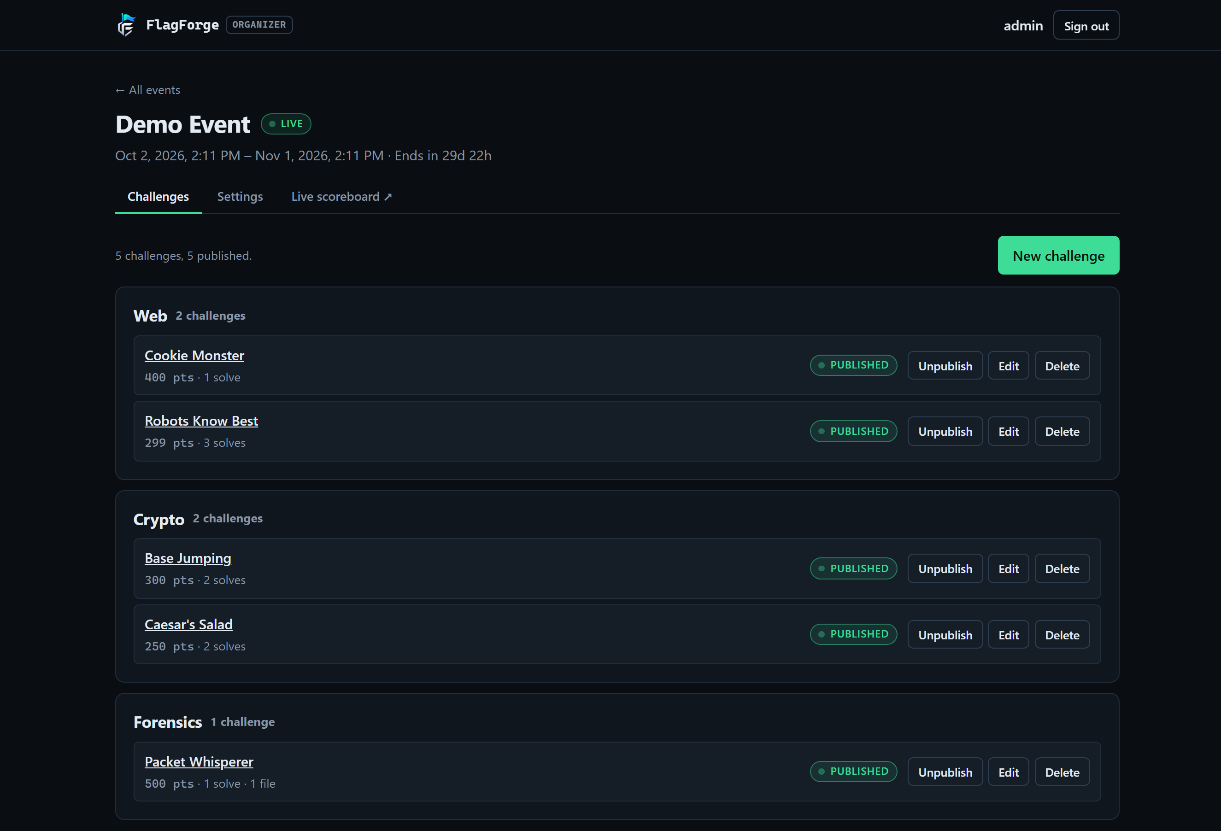
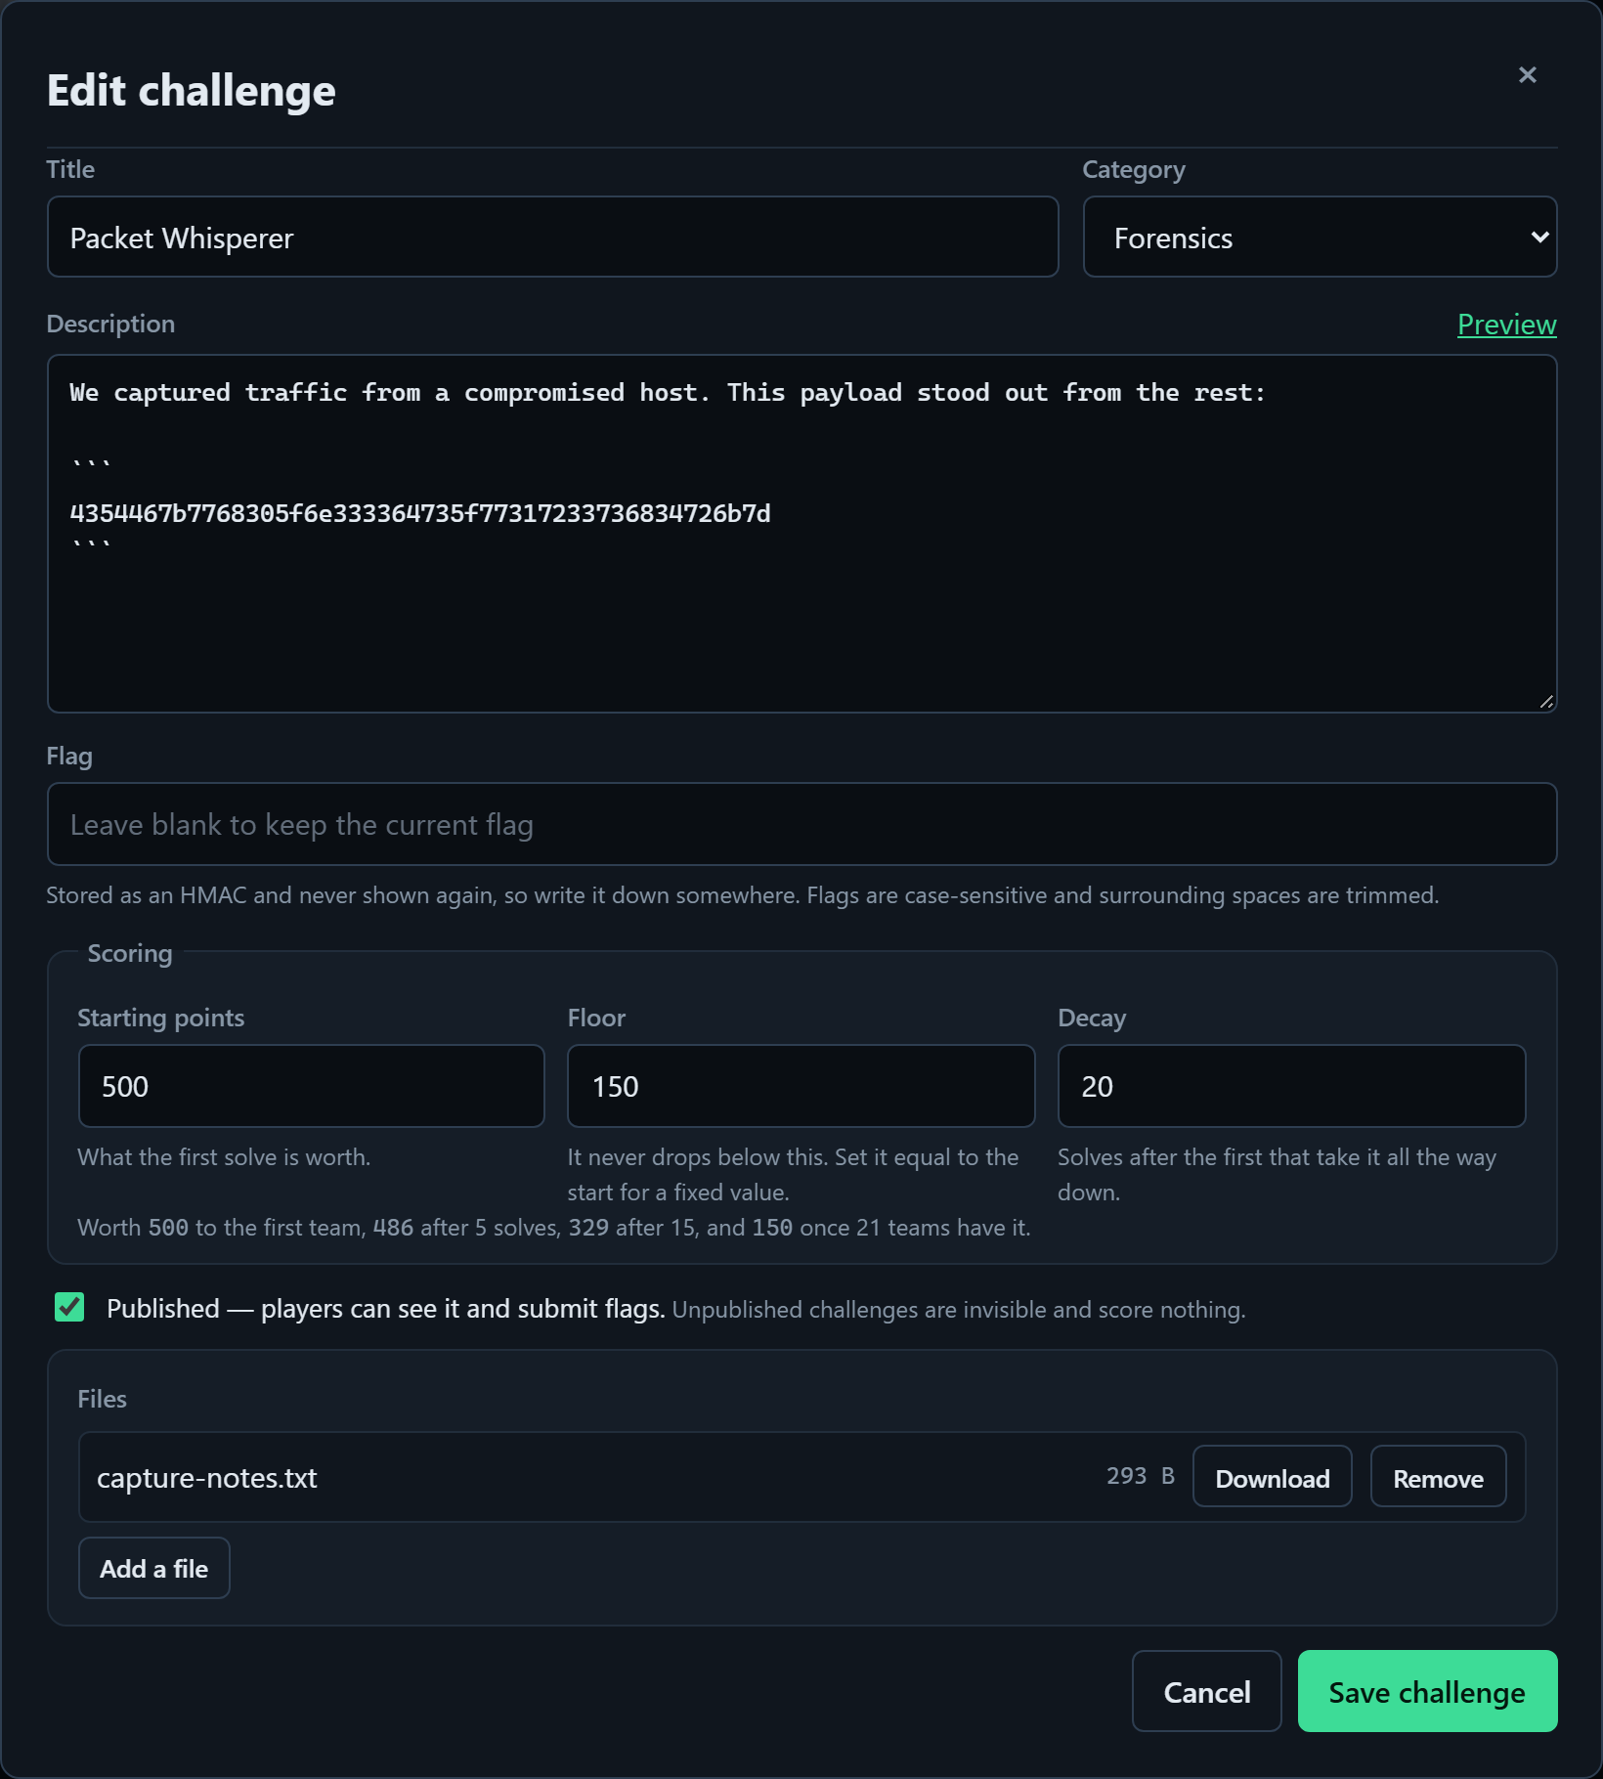
ORGANIZER DASHBOARD
RELEASE 1.0 · 2026
FLAGFORGE
FORGE YOUR CTF.
CHALLENGE YOUR HACKERS.
Events, Markdown challenges, dynamic scoring and file attachments — authored entirely in the browser.
Challenges grouped by category — live point value, solve count and publish state at a glance
The editor: Markdown, write-only flag, scoring curve and attachments
FlagForge · Forge your CTF. Challenge your hackers.
3
Notes:
Drafts are dimmed and dashed so one look says what players can actually see. The flag field opens blank on an existing challenge: the API never returns a flag, not even to its author.

Slide 4
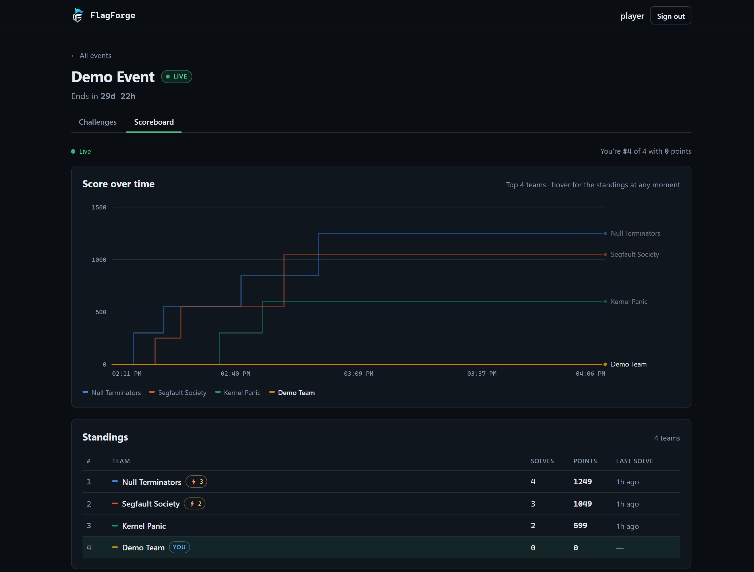
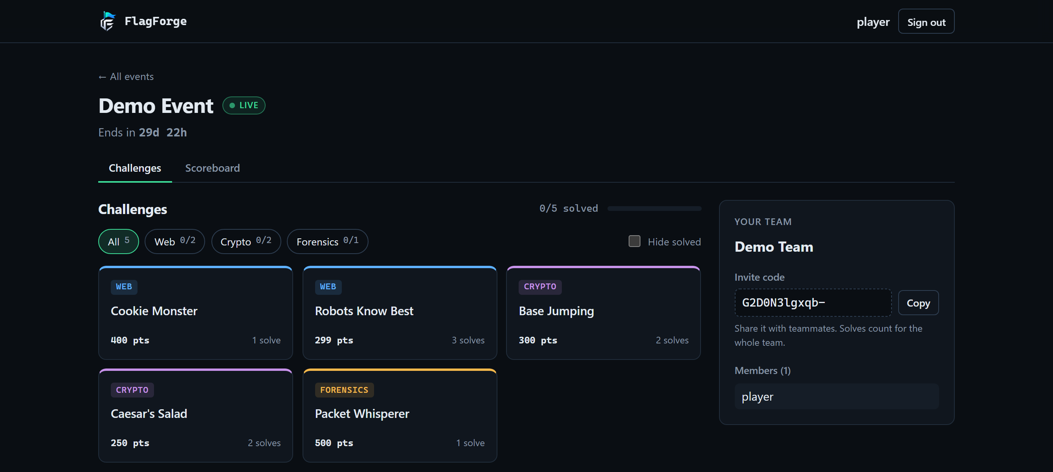
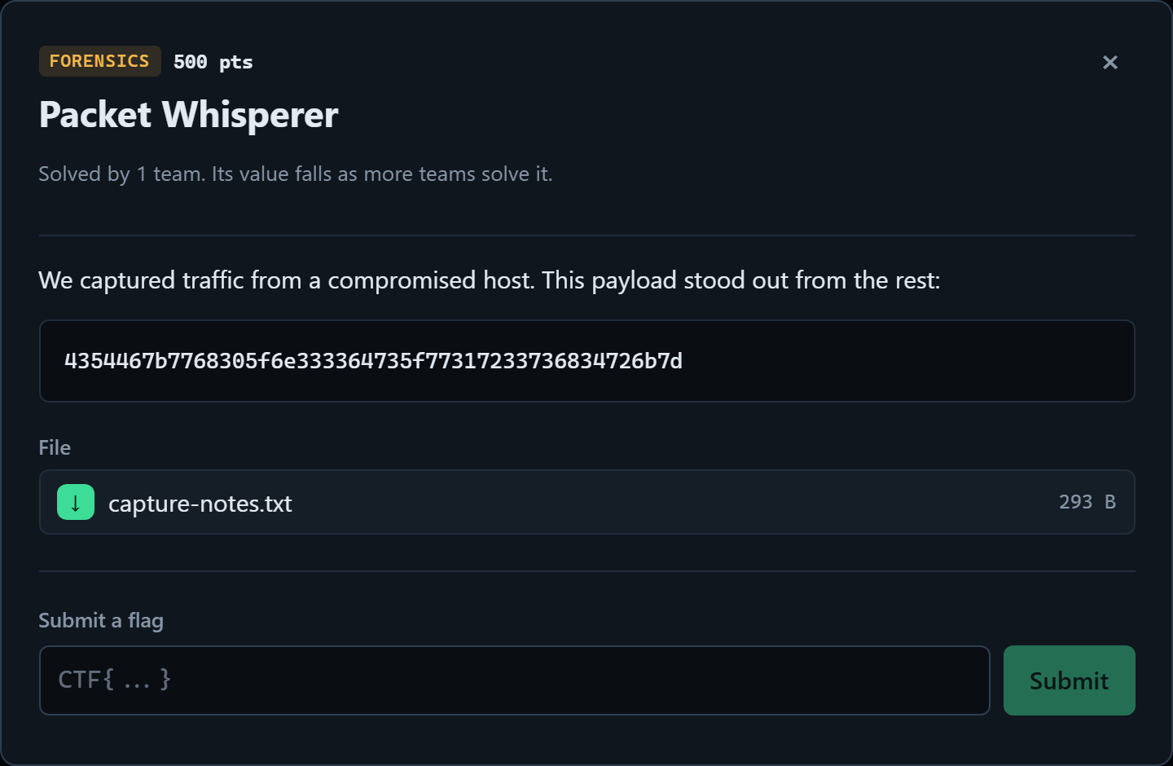
PLAYER EXPERIENCE
RELEASE 1.0 · 2026
FLAGFORGE
FORGE YOUR CTF.
CHALLENGE YOUR HACKERS.
Teams, a filtered challenge board, instant flag feedback, and a scoreboard that moves on its own.
Challenge board with category filters, live points and the team panel
Public scoreboard — rank over time, pushed over Socket.io, no account needed to watch
Challenge dialog: brief, handout, flag input
FlagForge · Forge your CTF. Challenge your hackers.
4
Notes:
Every number on these pages follows the live scoreboard feed: a challenge devalues as other teams solve it, without a refresh.

Slide 5
FLAGFORGE
TECHNICAL APPROACH
RELEASE 1.0 · 2026
FORGE YOUR CTF.
CHALLENGE YOUR HACKERS.
WORKFLOW ARCHITECTURE
TOOLS and TECHNOLOGIES
CLIENTS
✔
Automated tests
64
TESTS
Core Platform:
● Node.js 22 + TypeScript 5.9: API, game core and scripts
● Express 5 + Zod 4: routing, validation and typed errors
Organizer dashboard
React 19 · Vite · wizard
Player web app
board · team · submit
Public scoreboard
no account needed
Data & Cache:
● PostgreSQL 17 + Drizzle ORM: schema and generated migrations
● Redis 7 (ioredis): leaderboard snapshot and rate limits
API LAYER (Express 5 · TypeScript)
Auth & roles
JWT HS256 · fresh user load
Request validation
Zod 4 schemas
Rate limiter
Redis sliding window
Real-time & Clients:
● Socket.io 4.8: UPDATE_SCOREBOARD on the API's HTTP server
● React 19 + Vite 8 + React Router 8: player and organizer UIs
GAME CORE
Evaluation
vitest + supertest
real Postgres + Redis
typecheck on both
workspaces
load test · 2,000 teams
Flag check
HMAC-SHA256 · constant time
Dynamic scoring
value(n) curve · per challenge
Leaderboard rebuild
one Lua script · revision guard
Security & Testing:
● Argon2id, JWT, Helmet, HMAC flags: auth and flag storage
● Vitest + Supertest: 64 integration tests against real services
DATA LAYER
Infrastructure:
● Docker Compose: Postgres 17 + Redis 7 with health checks
● Free-tier deploy: static client, container API, managed data stores
PostgreSQL 17
7 tables · FK + index enforced
Redis 7
rank · teams · meta · 5 min TTL
Attachment store
multer · token-checked downloads
REAL-TIME & OUTPUTS
☺
Organizer
watches the run live
Socket.io channel
UPDATE_SCOREBOARD
Rank-over-time graph
inline SVG · top 8
REST fallback
works without a socket
◆
Node.js
◆
TypeScript
◆
React
◆
Vite
◆
Express
DEPLOYMENT
Docker Compose for local and production · nginx in front of both clients · containerised API · persistent upload volume
◆
PostgreSQL
◆
Redis
◆
Socket.io
◆
Docker
◆
Vitest
FlagForge · Forge your CTF. Challenge your hackers.
5

Slide 6
FLAGFORGE
TECHNICAL APPROACH
RELEASE 1.0 · 2026
FORGE YOUR CTF.
CHALLENGE YOUR HACKERS.
WORKFLOW ARCHITECTURE
END-TO-END REQUEST FLOW
01 · INPUT LAYER
02 · AUTH, VALIDATION & RATE LIMIT
03 · EVENT & CHALLENGE MANAGEMENT
08 · EVALUATION
Organizer input
event + challenge forms
Argon2id verify
login
JWT HS256
issue + decode
Role / ownership
player vs organizer
Zod 4 schema
typed 400s
Redis limiter
429 + Retry-After
Event CRUD
window · phase
Challenge CRUD
Markdown · category
64 integration tests
real Postgres + Redis
Player input
flag submission
Rejected early — no database work is done for an unauthenticated, invalid or rate-limited request
Attachment upload
multer · size cap
Publish gate
hidden until ready
Typecheck
server + both clients
Seed / demo data
db:seed script
Scoreboard read
4 ms from the snapshot
04 · SUBMISSION CORE
05 · SCORING ENGINE
Trim & normalise
case-sensitive
HMAC-SHA256
server secret
Constant-time compare
no timing leak
Partial unique index
one solve per team
Result
correct / incorrect / already
Solve count n
after first blood
value(n) curve
500 → 100
Packed rank key
pts×2²² − secs
Flag submit p95
659 ms at 2,000 teams
Load test
2,000 teams · one instance
06 · LEADERBOARD CACHE (REDIS)
07 · DELIVERY LAYER
scoreboard:<id>:rank
sorted set · teamId → packed score
Socket.io push
one message per solve
ZREVRANGE + HMGET
page of ranks
REST fallback
HTTP read, same shape
Concurrency
no duplicate solves
scoreboard:<id>:teams
hash · teamId → row
Standings table
rank · solves · last solve
Rank-over-time graph
stepped SVG, top 8
Challenge values
live points · first blood
Rate limiter
per player, all challenges
scoreboard:<id>:meta
challenge values · revision
Atomic Lua rebuild
readers never see half a board
Revision guard + 5 min TTL
a stale rebuild is skipped
Public scoreboard — spectators watch without an account
Build
production bundles green
FlagForge · Forge your CTF. Challenge your hackers.
6

Slide 7
FLAGFORGE
TECHNICAL APPROACH
RELEASE 1.0 · 2026
FORGE YOUR CTF.
CHALLENGE YOUR HACKERS.
score over time · points · one stepped line per team
How Dynamic Scoring Works
3,200
Team A
Team B
500
points
499
points
477
points
336
points
100
points
2,400
Team C
Team D
1,600
First blood
Tier 0
Tier 1
Tier 2
Tier 3
800
solve 1
solves 2–6
solves 7–16
solves 17–26
solves 27+
First blood is never devalued
value(n) = 500 + (100−500)(n/25)²
0
0
25
50
75
100
minutes into the event · 4 teams · every step arrived over the socket, not a refresh
a late solve pulls down every team already holding it — the board reflects how hard it proved to be
Why the Scoreboard Stays Fast
Scoreboard read holds its shape under load — 2,000-team board, one API process
Rebuild from Postgres
cold cache, 2,000 teams
41 ms
Redis snapshot
one ZREVRANGE + one HMGET
4 ms
Socket push
the client is told, not asked
0 reads
1 reader
no contention
3.8 ms
25 readers
775 req/s
31 ms
100 readers
799 req/s
123 ms
11 × faster
no request at all
200 readers
784 req/s
250 ms
Same numbers, no polling
Postgres stays the source of truth
1
10
100
1,000
10,000
the cache expires after five minutes and any read can rebuild it from the database
time to serve one scoreboard request, 2,000 teams (ms, log scale)
MEASURED — 2,000 teams, 6,000 solves, zero failures · node load/run.mjs against a production build
FlagForge · Forge your CTF. Challenge your hackers.
7

Slide 8
FLAGFORGE
FEASIBILITY AND VIABILITY
RELEASE 1.0 · 2026
FORGE YOUR CTF.
CHALLENGE YOUR HACKERS.
Feasibility
Challenges
Solutions
Evidence
Technical:
• Full TypeScript stack, 64 integration tests green
• Scoreboard read never touches Postgres
• Socket.io shares the API's own HTTP server
⚙
Scoreboard read storm in the final minutes
Redis sorted-set snapshot, rebuilt once per solve
4 ms per read — ZREVRANGE + one HMGET, Postgres untouched
Flag brute-forcing
Sliding-window limiter before any database work
429 + Retry-After; the limit is per player across all challenges
Operational:
• An event is live in under five minutes
• Public scoreboard needs no account
• One docker compose up for the whole stack
Duplicate or cross-event solves
Invariants enforced by the database itself
partial unique index (team_id, challenge_id) WHERE is_correct
☺
A leaked database exposing flags
HMAC-SHA256 with a server-side secret
constant-time compare; no endpoint ever returns a flag
Concurrent rebuilds overwriting fresh scores
One Lua script plus a revision guard
a rebuild that finished late carries a lower revision and is skipped
Economic:
• Zero licensing cost, fully open source
• Runs on free-tier hosting end to end
• No ops team — migrate, seed, done
₹
Viability
₹
☁
⚑
ZERO LICENSING COST · FULLY OPEN SOURCE
RUNS END TO END ON FREE-TIER INFRASTRUCTURE
ONE COMPOSE FILE TO SELF-HOST ANYWHERE
FlagForge · Forge your CTF. Challenge your hackers.
8

