Slide 1

Alzheimer'sAI_Enhancing Disease Diagnosis and Interpretability with LRP
Department of Computer Science and Engineering
Netaji Subhas University of Technology (NSUT)
NAME OF THE STUDENT ROLL NUMBER
AAKASH KUMAR 2020UCA1865
Under the supervision Of Prof. Ritu Sibal

Slide 2
Introduction
Alzheimer's Disease is a severe neurodegenerative condition that affects millions of people worldwide. Early diagnosis and intervention are crucial to improving the quality of life for affected individuals.
The application of artificial intelligence (AI) and deep learning in medical image analysis has shown promise in automating disease diagnosis and classification
AI can help with early diagnosis, but its "black-box" nature is a concern. Our project combines AI and Layer-wise Relevance Propagation (LRP) to improve Alzheimer's classification and model transparency.

Slide 3
Motivation & Objective
01
Our project, "Alzheimer's Disease Classification and Interpretability Enhancement Using LRP," is driven by the urgent need to address Alzheimer's disease, a growing healthcare crisis. Leveraging Layer-wise Relevance Propagation (LRP), we aim to make a meaningful impact by improving diagnosis accuracy, transparency, and ultimately, patient care.
02
The primary objective of our project is to develop a deep learning model capable of classifying Alzheimer's disease stages from medical images. Furthermore, we aim to enhance the interpretability of our model's decisions using Explainanle AI methods.

Slide 4
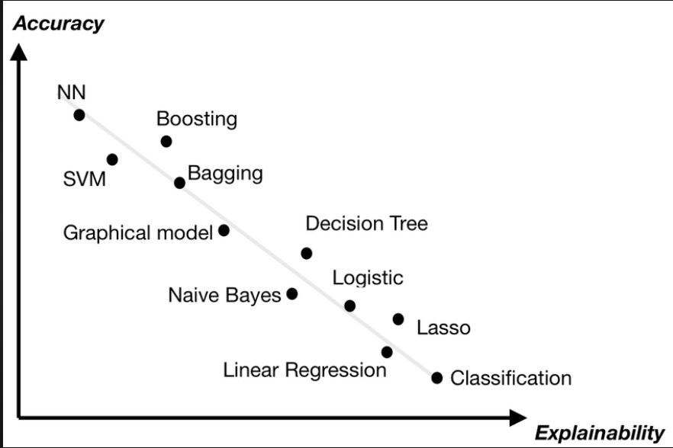
eXplainable AI
01
What is Explainable AI? Explainable AI (XAI) refers to the set of techniques and approaches in artificial intelligence that enable human users to understand, interpret, and trust the decisions and actions made by AI systems.
02
Key Concepts: Interpretability, feature importance , Local Interpretability vs. Global Interpretability , Fairness and Bias Assessment , Trust Scores and rule extraction are some of the key concepts in Explainable AI.

Slide 5

Why is eXplainable AI Important?
In traditional machine learning and deep learning models, such as neural networks, the decision-making process can often appear as a "black box," meaning that it's challenging to understand why a particular decision was made.
This lack of transparency can be a significant barrier, especially in critical applications like healthcare, finance, and autonomous systems. XAI aims to address this issue by providing insight into Model Behavior, Feature Importance, Bias and Fairness etc, and ensure Trust and Accountability, Regulatory Compliance, Ethical Considerations etc.

Slide 6
eXplainable AI Methods
Explainable AI (XAI) methods are techniques and approaches that enhance the transparency and interpretability of artificial intelligence models. Some of the key XAI methods are:
SHAP (SHapley Additive exPlanations):
It assigns a value to each feature to measure its contribution to the prediction.
01
LIME (Local Interpretable Model-agnostic Explanations):
LIME creates local, simplified models to explain the predictions of complex models for specific data points
02
LRP (Layer-wise Relevance Propagation):
This method calculates relevance scores for each feature to explain a model's output.
03

Slide 7
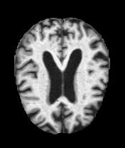
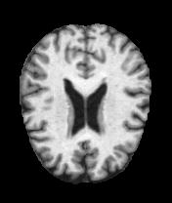
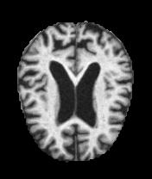
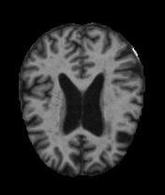
DATA COLLECTION
Mild Demented
Non Demented
Moderate Demented
Very Mild Demented
In our dataset we have four classes of MRI images mild demented, non-demented, moderate demented and very mild demented.

Slide 8
Data Preprocessing & Augmentation
01
02
Data Preprocessing
We resized our data into height and width of 255 pixels.
This is often done to ensure that all images have a consistent size before feeding them into a neural network.
Data Augmentation
After resizing our images we converted the resized images data into a Pytorch tensor. Neural networks typically operate on tensors, so this step is essential to use the images as input to the model.
.
After these transformations we created our data loaders of batch size 32.

Slide 9
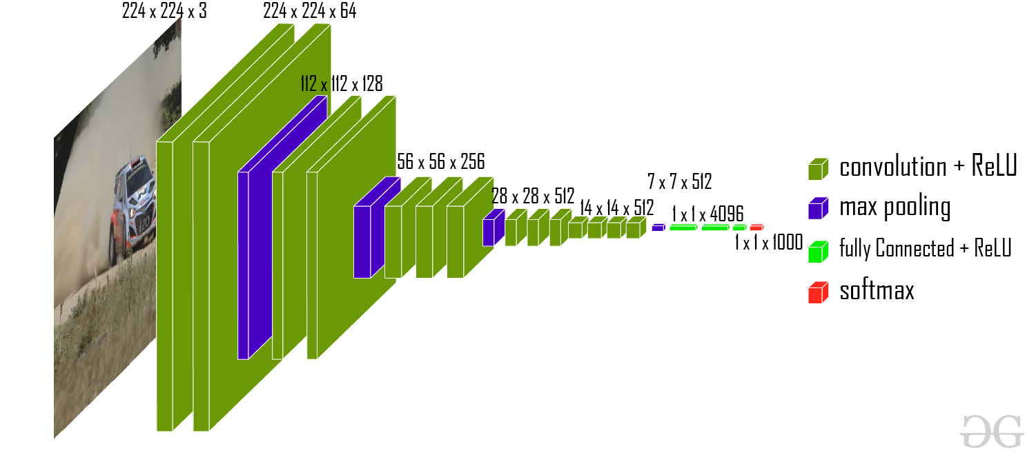
Model Architecture: VGG16
Machine learning
VGG16 model Architecture
Vel vestibulum libero pharetra vel Fringilla sollicitudin orci.
WHEN
WHY
VGG 16 was proposed by Karen Simonyan and Andrew Zisserman of the Visual Geometry Group Lab of Oxford University in 2014 in the paper “VERY DEEP CONVOLUTIONAL NETWORKS FOR LARGE-SCALE IMAGE RECOGNITION”.
We use VGG16 as we have only had to change the output layer according to our problem which is a multiclass classification.

Slide 10
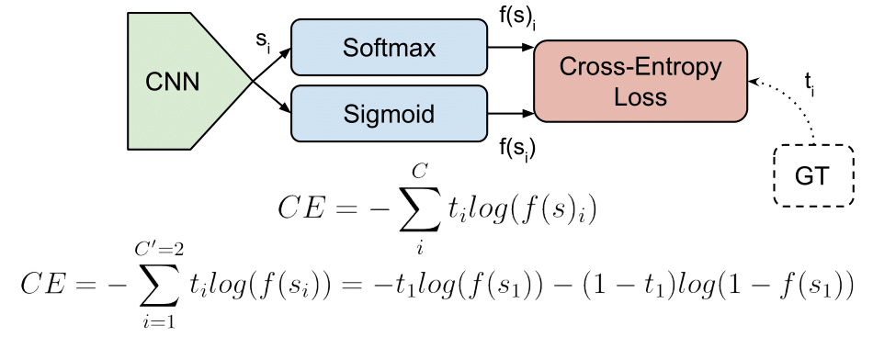
Model Training: Adam Optimizer and Cross-Entropy Loss
Training our model-
After some changes of our pretrained VGG16 model, we try to train our model. In our model we use Adam optimizer and Categorical Cross-Entropy loss function.
Adam optimizer-
parameter_t = parameter_{t-1} - α * m_t_hat / (sqrt(v_t_hat) + ε)
m_t = β1 * m_{t-1} + (1 - β1) * gradient
v_t = β2 * v_{t-1} + (1 - β2) * (gradient^2)
Correct for bias in the first and second moment estimates:
m_t_hat = m_t / (1 - β1^t)
v_t_hat = v_t / (1 - β2^t)
Loss Function-
To compute the loss for a batch of samples, you typically average the losses for individual samples in the batch. The formula for the average categorical cross-entropy loss for a batch of samples is:

Slide 11
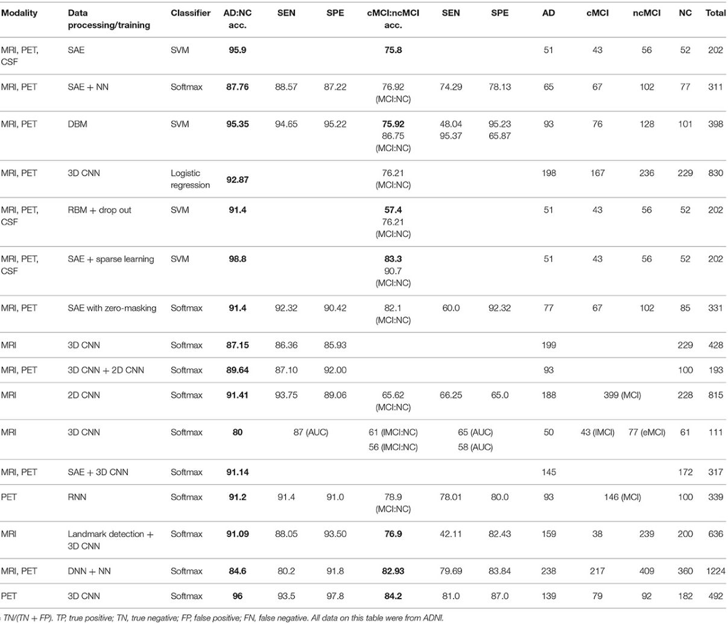
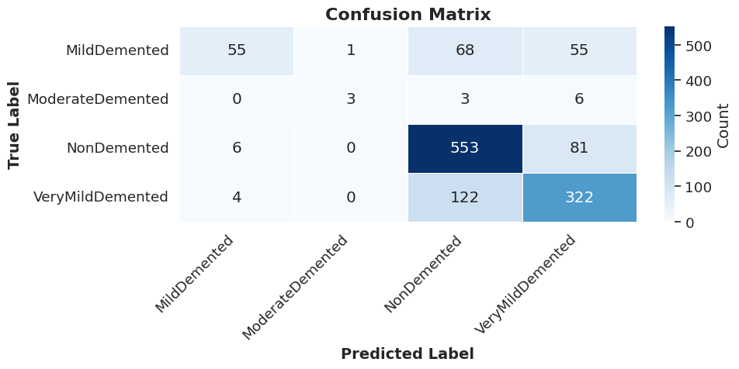

RESULT COMPARSION
OUR MODEL’S ANALYSIS
Data of Other Easier Interpretable Models

Slide 12
Interpretability Insights
Let's take a look at a batch accuracy to get a sense of our model's overall performance. In this case, the batch accuracy stands at an impressive 81.725%.
True Class | Model Prediction
NON-DEMENTED | NON-DEMENTED
MILD DEMENTED | MILD DEMENTED
MODERATE DEMENTED | MILD DEMENTED
VERY MILD DEMENTED | VERY MILD DEMENTED
MILD DEMENTED | NON-DEMENTED
MODERTE DEMENTED | MODERATE DEMENTED
Interpretability is a crucial aspect when dealing with AI models. It allows us to delve deeper into
understanding why
our model makes
specific predictions.

Slide 13
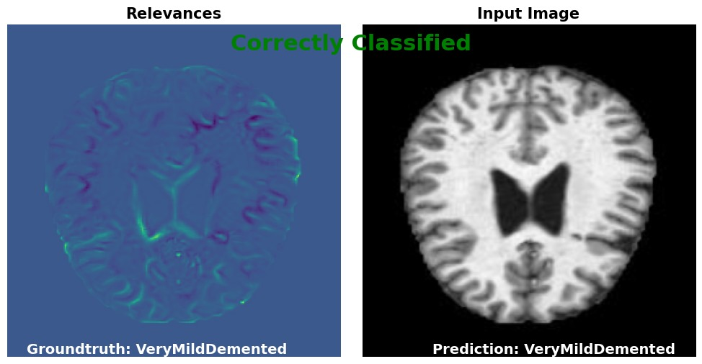
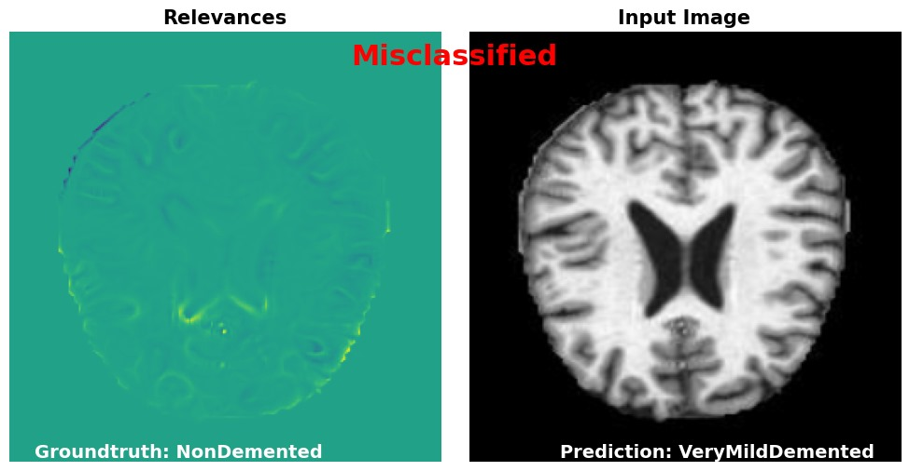
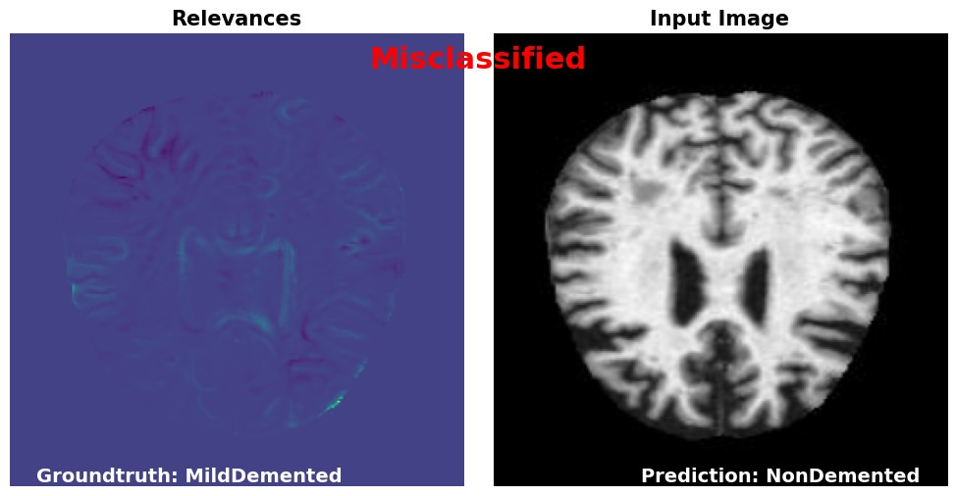
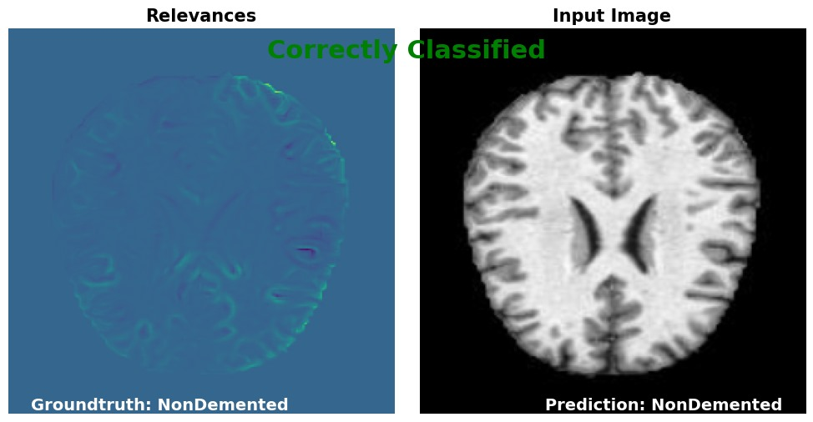
Results Showcase: Interpretability Visualizations
ACTUAL VALUES
POSITIVE
NEGATIVE
POSITIVE
?
1
TRUE POSITIVE
1
2
2
FALSE POSTIVE
PREDICTED VALUES
NEGATIVE
3
FALSE NEGATIVE
3
4
4
TRUE NEGATIVE
Confusion Matrix of Interpretability

Slide 14
SCOPE OF FUTURE WORK
Accuracy Enhancement
Balancing higher accuracy without compromising interpretability.
Striving for improved classification accuracy while maintaining interpretability.
Multi-GPU Training
Exploring multi-GPU usage for accelerated training.
Investigating the feasibility of using multiple GPUs to speed up training.
1
3
Optimization Analysis
Evaluating time consumption for optimization.
Analyzing time usage to identify optimization opportunities.
Model Expansion
Testing various architectures with added layers.
Experimenting with additional layers and architectures for model improvement.
2
4

Slide 15
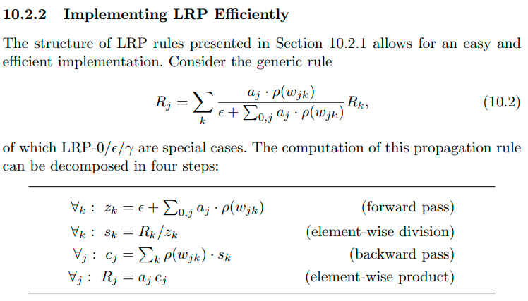
Our AI model, designed for Alzheimer's disease classification, demonstrates great potential for real-world applications. While our focus has been on enhancing interpretability, we acknowledge the need to further improve accuracy and optimize training time to make it even more practical in clinical settings. Our ongoing research and development aim to bridge these gaps and contribute to more effective disease diagnosis and treatment.
REFERENCES
Dataset Source: Alzheimer's Dataset - 4 Class of Images
LRP for Explainable Artificial Intelligence (XAI)
CONCLUSION

Slide 16
Thank You!
For your patience.
We respect your valuable time!

